Slide 1
CSC 2211 Algorithms
_{Introduction Class}
Kaniz Fatema
Assistant professor
Department of CS
Faculty of Science & Technology
American International University Bangladesh (AIUB)

Slide 2
Self Introduction
^{M.Sc.: Software} ^{Engineering,}
Tampere University of Technology (Finland).
B.Sc.: Computer Science and Engineering
Ahsanullah University of Science and Technology.
HSC & SSC : Mymensingh Girls Cadet College (94-00).
^{Lecturer at} ^{AUST 2006-2008}
^{Assistant Professor at} ^{AIUB 2017}

Slide 3
Conducted Courses:
Programming Language-1.
Data Structure.
Algorithms.
VLSI.
Operating Systems.
Software Requirement engineering.

Slide 4
Contact Information
TEAMS
Email: kaniz.fatema@aiub.edu
Phone: 01772416291 (for emergency)

Slide 5
STUDENT CONSULTATION & MY TEACHING SCHEDULE
Day |  | Time
Sunday |  | 3:30 to7:00
Monday |  | 3:30 to7:00
Tuesday |  | 3:30 to7:00
Wednesday |  | 3:30 to7:00
Thursday |  | 3:30 to 6:30

Slide 6
 | Evaluation Policy
 | Midterm | Quiz (Best one out of two) | 20%
 |  | Attendance & Spot Quiz | 10%
 |  | Lab performance | 20%
 |  | Midterm Exam | 50%
 |  | Total | 100%
 | Final term | Quiz (Best one out of two) | 20%
 |  | Attendance & Spot Quiz | 10%
 |  | Lab performance | 20%
 |  | End term Exam | 50%
 |  | Total | 100%
 | Grand Total | 40% of Mid-Term + 60% of Final Term

Slide 7
 | MidTerm Evaluation Policy
 | Midterm | Theory MCQ | 20%
 |  | Lab MCQ | 20%
 |  | Viva | 40%
 |  | Assignment | 20%
 |  | Total | 100%
 | Final term | Theory MCQ | 20%
 |  | Lab MCQ | 20%
 |  | Viva | 40%
 |  | Assignment | 20%
 |  | Total | 100%

Slide 8
Policies for Quizzes:
There will be no Makeup quiz.
There will be no Make up for sudden spot quiz.

Slide 9
Mid-Term Policy
Mid term grade will never be changed after it has been locked once.
Decide whether you want to drop the course after getting mid term exam so that I can provide UW. If you continue the course with grade F in mid, then there will be no way to drop the course after the final exam. The only way left will be to retake the course again in next semester.
Sorry! No Exceptions

Slide 10
Drop Policy
Student can not drop this course:
If student is in probation.
If student has grade F/I in (mid/ final/ grand final)
If student does any copy, cheat or any kind of unfair means in any event through out the course.
Any student with grade I will not be able to register any course in next semester.
Sorry! No Exceptions

Slide 11
Course Contents
RAM model, Basic notation
Recurrences & Master Method
Greedy strategy
Dynamic Programming
Graphs Algorithms
Greedy Graph Algorithm
Shortest Path Algorithms

Slide 12
Course Objectives
The objective of this course is to teach how we can compare algorithms, the complexity analysis of time and space, effective data structure for solving difficult problems and implementation of different algorithms with the practical examples.
The purpose of the course is
  a) to raise your level of sophistication in thinking about the design and analysis of algorithms;
  b) learn some of the classic algorithms and recent improvements;
  c) exercise your creativity in designing algorithms.

Slide 13
Course Prerequisites
Programming
  Data types, operations
  Conditional statements
  Loops
  Procedures and functions
  C/ C++
Discrete Mathematics (proof theorems)
Data Structures (array, structure, pointer, file, etc...)
Computer lab (edit, compile, execute, debug)
If you lack of any of the above please refine yourselves.
Notes:
CSC2105
Shamsur Rahim

Slide 14
Importance of the course
This course is a continuation of the courses Programming Language 1 & 2, and Data Structure.
Algorithm is required for all areas of computer science – especially for developing problem solving ability.
This course will give the basic for the understanding of the courses –Theory of Computation, Artificial Intelligence, etc.

Slide 15
Resources & References
Introduction to Algorithms, Third Edition, Thomas H. Cormen, Charle E. Leiserson, Ronald L. Rivest, Clifford Stein (CLRS).
Fundamental of Computer Algorithms, Ellis Horowitz, Sartaj Sahni, Sanguthevar Rajasekaran (HSR)
Helpful link for Problem Solving : http://acm.uva.es/problemset/
Lectures and Laboratory works will be provided online at the course website weekly.

Slide 16
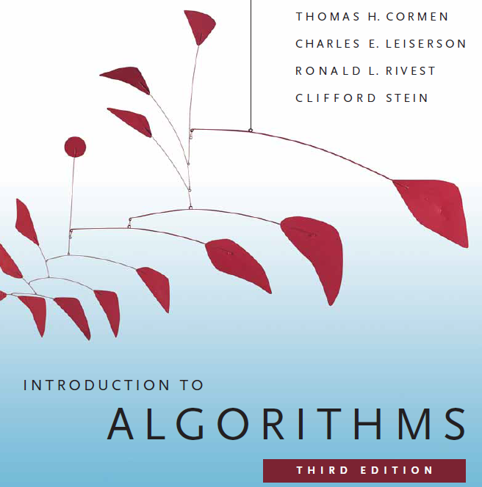

Slide 17
The Goals of this Course
To think algorithmically
To understand and learn the idea behind algorithm design techniques
To get to know a toolbox of classical algorithms.
To reason (in a precise and formal way) about the efficiency and the correctness of algorithms.
Notes:
CSC2105
Shamsur Rahim

Slide 18
I would request all of you to...
Be simple and precise in understanding the problem
Solve the problem first on the paper and then keyed in on the computer.
During lectures:
  Interaction is welcome; ask questions.
  Additional explanations and examples if desired.
  Speed up/slow down the progress.
Notes:
CSC2105
Shamsur Rahim

Slide 19
??????
What is Algorithm?

