Slide 1
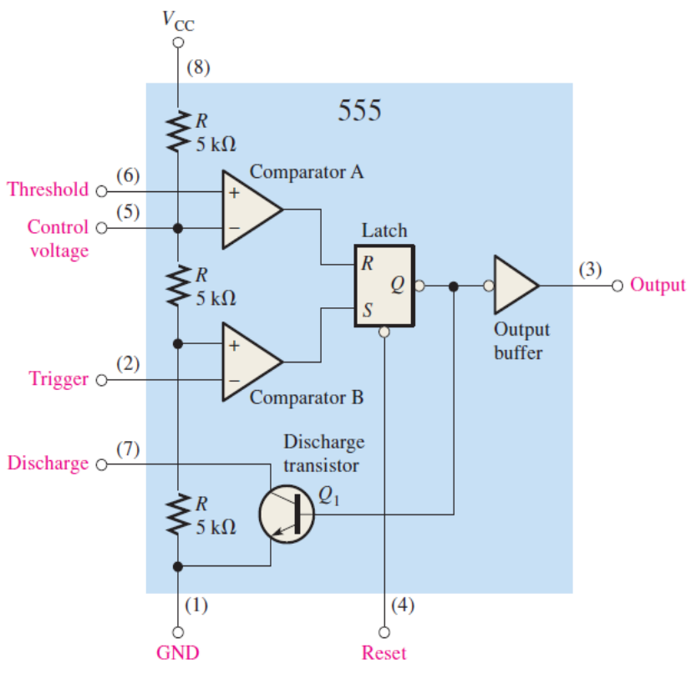
Basic operations
What if?
HIGH trigger input momentarily goes below 1/3 VCC
What if?
LOW threshold input goes above 2/3 VCC

Slide 2
Mode of Operation
Astable mode:
1. What is a Astable mode?
2.What are the components?
Mono stable mode:
1.What is mono stable mode?
2.What are the components?

Slide 3
Advantages
555 timer has various applications in different fields.
Produce accurate timing pulses.
Operate as a simple timer and can also produce time-delays.
Highly stable controller.
wide voltages ranges.
Easy and flexible
High precision.
Can be used in different devices
Work at a particular temperature range .

Slide 4
Disadvantages
555 timer is not very linear.
Not accurate with changes in the temperature.
555 does not us.e a current regulator for capacitor charging or discharging

Slide 5
Conclusion
555 timer can be used in:
1:Motion detection
2:PWM Audio Amplifier
3:Sequential Timer for DC Motor Control
4: Touch-Free Timer Switch
5:Infrared Remote Control Timer

