Slide 2
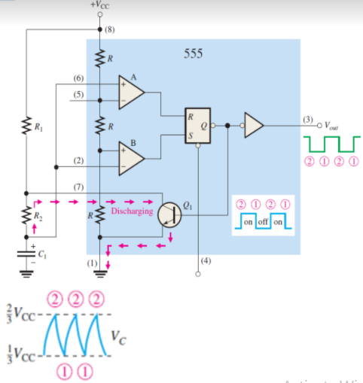
CHARGING AND DISCHARGING
when the power is just turned on,
the capacitor (C1) remain uncharged.
C1 begins charging through R1 and
R2, indicated in Figure.
Once the voltage of C1 is below 2/3 VCC,
the output of the comparator A becomes
0.
When the capacitor C1 discharges just
below 1/3 VCC, the output of the
comparator becomes 1 and the flip-flop is
again set.

