Slide 1
Shobhan Kumar Saha ID-19-40911-2
DIGITAL LOGIC AND CIRCUITS [E]

Slide 2
Design a Synchronous Binary Irregular Counter. With the help of Student id

Slide 3
ID: 19-40911-2
I have to generate a counter sequence with my id’s middle 5 digit.
ABCDEA corresponds to 40911
But the digit 1 is twice there.So I have added 1 to this.
A | B | C | D | E | 1
4 | 0 | 9 | 1 | 1
4 | 0 | 9 | 1 | 2 | 1+1
But the digit 1 is twice here so I added 1 to this and make it 2
4 0 9 1 2

Slide 4
Step 1: Binary of the Decimal Sequence
B
0000
A
0100
C
1001
A=4=0100
B=0=0000
C=9=1001
D=1=0001
E=2=0010
E
0010
D
0001

Slide 5
STEP-2 : Indentifying the number of flifflop required
Here the maximum decimal value is 9.when we convert 9 to binary we get 1001 which is a 4 bit output.so,we will require 4 flip-flops here to design our system
J₃
Q₃
J₀
Q₀
J₁
Q₁
J₂
Q₂
K₂
K₃
K₀
K₁
flifflop required = 4

Slide 6
STEP 3: COUNTER TABLE
(Filling the present state and next state values)
Present State
Next State
Q₃ | Q₂ | Q₁ | Q₀
0 | 1 | 0 | 0
0 | 0 | 0 | 0
1 | 0 | 0 | 1
0 | 0 | 0 | 1
0 | 0 | 1 | 0
Q₃ | Q₂ | Q₁ | Q₀
0 | 0 | 0 | 0
1 | 0 | 0 | 1
0 | 0 | 0 | 1
0 | 0 | 1 | 0
0 | 1 | 0 | 0

Slide 7
Step 4 : Creating Transition table
Output Transition | Flip flop input
Q_{N} | Q_{N+1} | J | K
0 ➔ | 0 | 0 | X
0 ➔ | 1 | 1 | X
1 ➔ | 0 | X | 1
1 ➔ | 1 | X | 0

Slide 8
STEP 5: Filling up the values of J_{0 ,} K_{0,} J_{1,} K_{1,} J_{2,} K_{2,} J_{3,} K₃
Q_{N} | Q_{N+1} | J | K
0 | 0 | 0 | X
0 | 1 | 1 | X
1 | 0 | X | 1
1 | 1 | X | 0
Input
J₃ | K₃ | J₂ | K₂ | J₁ | K₁ | J₀ | K₀
0 | X | X | 1 | 0 | X | 0 | X
1 | X | 0 | X | 0 | X | 1 | X
X | 1 | 0 | X | 0 | X | X | 0
0 | X | 0 | X | 1 | X | X | 1
0 | X | 1 | X | X | 1 | 0 | X

Slide 9
STEP 6: Use karnaugh-map to derive the logic requirement
Q₁ Q₀ Q₃ Q₂ | 00 | 01 | 11 | 10
00 | 1 | x | x | 0
01 | 0 | x | x | x
11 | x | x | x | x
10 | x | x | x | x
Q₁ Q₀ Q₃ Q₂ | 00 | 01 | 11 | 10
00 | 0 | 1 | X | x
01 | 0 | X | X | X
11 | x | X | X | X
10 | x | 0 | x | X
J₁
Jo
Q₁ Q₀ Q₃ Q₂ | 00 | 01 | 11 | 10
00 | 0 | 0 | x | 1
01 | x | x | x | X
11 | x | x | x | x
10 | x | 0 | x | x
Q₁ Q₀ Q₃ Q₂ | 00 | 01 | 11 | 10
00 | 1 | 0 | x | 0
01 | 0 | x | x | x
11 | x | x | x | x
10 | x | x | x | x
J₂
J₃

Slide 10
_{Q1 Q0} _{Q3 Q2} | 00 | 01 | 11 | 10
00 | x | 1 | X | X
01 | X | X | x | X
11 | X | X | X | X
10 | X | 0 | X | X
Q₁ Q₀ Q₃ Q₂ | 00 | 01 | 11 | 10
00 | X | X | X | 1
01 | X | X | x | x
11 | X | X | X | X
10 | X | X | X | X
K₁ =1
K₀
Q₁ Q₀ Q₃ Q₂ | 00 | 01 | 11 | 10
00 | X | X | X | X
01 | 1 | X | x | x
11 | X | X | X | X
10 | X | X | X | X
Q₁ Q₀ Q₃ Q₂ | 00 | 01 | 11 | 10
00 | X | X | X | X
01 | X | X | X | X
11 | X | X | X | X
10 | x | 1 | X | X
K₂ =1
K₃ =1

Slide 11
Connections:
J₀ = Q₁´Q₂´
J₁ = Q₀´Q₃´
J₂ = Q₁´
J₃= Q₀´ Q₁´Q₂´
K₀ = Q₃´
K₁ = 1
K₂ = 1
K₃ = 1

Slide 12
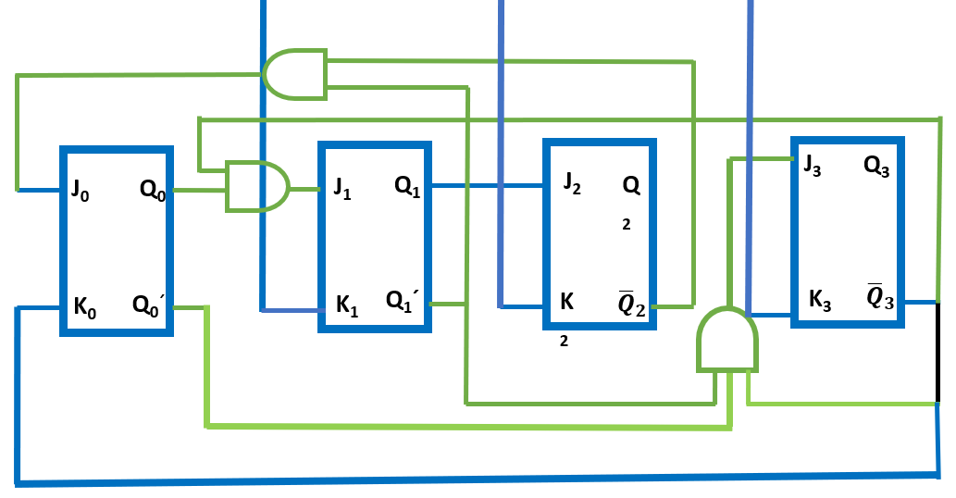
STEP 7: Connecting the output in diagram

Slide 13
Thanks For Watching!

