Slide 1
CSC 2105 Data Structures
_{Lecture 3: Pointer}

Slide 2
Pointers
  Powerful feature of the C++ language
  Essential for construction of interesting data structures
DataStructure:Pointer

Slide 3
Pointers
A pointer is a datatype.
Contains a memory address.
Points to a specific data type.
int *pointer1 = &x;
int x;
addr of x
0x2000
1
0x9060
DataStructure:Pointer

Slide 4
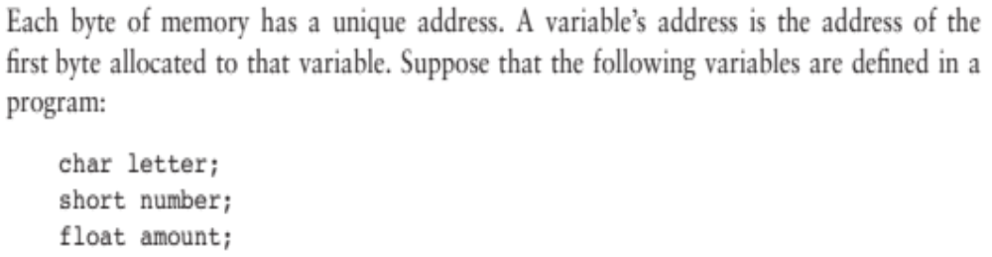
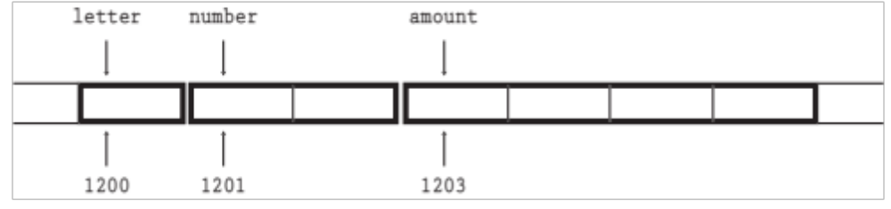
&
The address of a memory location is called a pointer.
Every variable is assigned a memory location whose address of this memory location can be retrieved using address operator & of C++.
Following figure shows their memory arrangement and addresses:
&letter is 1200 , &number is 1201, &amount is 1203
DataStructure:Pointer

Slide 5
Memory Size
Type | Storage size | Value range
char | 1 byte | -128 to 127 or 0 to 255
unsigned char | 1 byte | 0 to 255
signed char | 1 byte | -128 to 127
int | 2 or 4 bytes | -32,768 to 32,767 or -2,147,483,648 to 2,147,483,647
unsigned int | 2 or 4 bytes | 0 to 65,535 or 0 to 4,294,967,295
short | 2 bytes | -32,768 to 32,767
unsigned short | 2 bytes | 0 to 65,535
long | 8 bytes | -9223372036854775808 to 9223372036854775807
unsigned long | 8 bytes | 0 to 18446744073709551615
DataStructure:Pointer

Slide 6
Memory Size(Cont..)
Type | Storage size | Value range | Precision
float | 4 byte | 1.2E-38 to 3.4E+38 | 6 decimal places
double | 8 byte | 2.3E-308 to 1.7E+308 | 15 decimal places
long double | 10 byte | 3.4E-4932 to 1.1E+4932 | 19 decimal places
DataStructure:Pointer

Slide 7
Example
#include <iostream>
void main( )
{
int data = 100;
float value = 56.47;
cout << data << &data << endl;
cout << value << &value << endl;
}
Output:
100 FFF4
56.47 FFF0
FFF0
56.47
value
FFF1
FFF2
FFF3
data
FFF4
100
FFF5
FFF6
DataStructure:Pointer

Slide 8

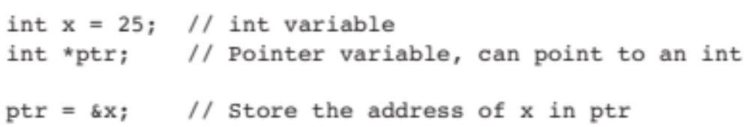
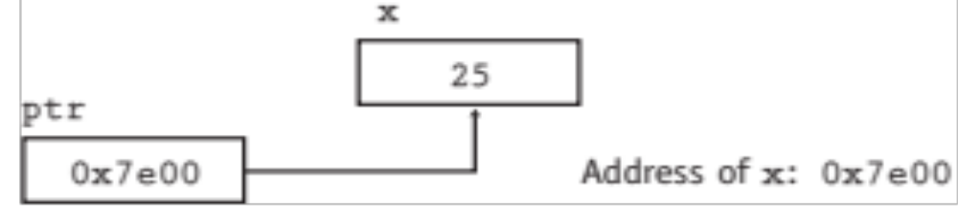
OR
Like any variable or constant, you must declare a pointer before you can use it to store any variable address.
DataStructure:Pointer

Slide 9
Declaration of Pointer Variables
  Type *pointerVarName;
  The * before the pointerVarName indicates that this is a pointer variable, not a regular variable
  The * is not a part of the pointer variable name
Some valid pointer declaration:
int *inp; // pointer to an integer
char *chp // pointer to a character
double *dp; // pointer to a double
float *flp; // pointer to a float
DataStructure:Pointer

Slide 10
The pointer data type
A data type for containing an address (hexadecimal number ) rather than a data value
Provides indirect access to values
The actual data type of the value of all pointers, (integer, float, character) is the same, a long hexadecimal number that represents a memory address.
The only difference between pointers of different data types is the data type of the variable that the pointer points to.
DataStructure:Pointer

Slide 11
Declaration of Pointer Variables (Cont ..)
Whitespace doesn‘t matter and
each of the following will declare
  ptr as a pointer (to a float) variable and
  data as a float variable
float *ptr, data;
float* ptr, data;
float (*ptr), data;
float data, *ptr;
DataStructure:Pointer

Slide 12
Assignment of Pointer Variables
A pointer variable has to be assigned a valid memory address before it can be used in the program
Example:
    float data = 50.8;
    float *ptr;
    ptr = &data;
  This will assign the address of the memory location allocated for the floating point variable data to the pointer variable ptr.
  This is valid, since the variable data has already been allocated some memory space having a valid address
DataStructure:Pointer

Slide 13
Assignment of Pointer Variables (Cont ..)
float data = 50.8;
float *ptr;
ptr = &data;
FFF0
FFF1
FFF2
FFF3
data
FFF4
50.8
FFF5
FFF6
DataStructure:Pointer

Slide 14
Assignment of Pointer Variables (Cont ..)
float data = 50.8;
float *ptr;
ptr = &data;
ptr
FFF0
FFF1
FFF2
FFF3
data
FFF4
50.8
FFF5
FFF6
DataStructure:Pointer

Slide 15
Assignment of Pointer Variables (Cont ..)
float data = 50.8;
float *ptr;
ptr = &data;
ptr
FFF0
FFF4
FFF1
FFF2
FFF3
data
FFF4
50.8
FFF5
FFF6
DataStructure:Pointer

Slide 16
Assignment of Pointer Variables (Cont ..)
Don’t try to assign a specific integer value to a pointer variable since it can be disastrous
  float *ptr;
  ptr = 120.5; //This is wrong.
h they are both integrals
float data = 50.0;
float *ptr;
ptr = &data; //This is valid
DataStructure:Pointer

Slide 17
Initializing pointers
A pointer can be initialized during declaration by assigning it the address of an existing variable
    float data = 50.8;
    float * ptr = &data;
If a pointer is not initialized during declaration, it is wise to give it a NULL (0) value
  float *fp = NULL;
DataStructure:Pointer

Slide 18
The NULL pointer
The NULL pointer is a valid address for any data type.
  But NULL is not memory address 0.
It is an error to dereference a pointer whose value is NULL.
  Such an error may cause your program to crash, or behave erratically.
  It is the programmer’s job to check for this.
DataStructure:Pointer

Slide 19
Dereferencing
Dereferencing – Using a pointer variable to access the value stored at the location pointed by the variable
      Provide indirect access to values and also called indirection
Done by using the dereferencing operator * in front of a pointer variable
      Unary operator
      Highest precedence
DataStructure:Pointer

Slide 20
Dereferencing (Cont ..)
Example:
  float data = 50.8;
  float *ptr;
  ptr = &data;
  cout << *ptr;
Once the pointer variable ptr has been declared, *ptr represents the value pointed to by ptr.
OUTPUT:
50.8
DataStructure:Pointer

Slide 21
Dereferencing (Cont ..)
The dereferencing operator * can also be used in assignments.
*ptr = 200;
  Make sure that ptr has been properly initialized
  float data;
  float *ptr;
  ptr = &data;
  *ptr = 200;
  cout << *ptr;
OUTPUT:
200
DataStructure:Pointer

Slide 22
Dereferencing Example
#include <iostream.h>
void main()
{
float data = 50.8;
float *ptr;
ptr = &data;
cout << ptr << *ptr << endl;
*ptr = 27.4;
cout << *ptr << endl;
cout << data << endl;
}
Output:
ptr
FFF0
FFF4
FFF1
FFF2
FFF3
data
FFF4
50.8
FFF5
FFF6
DataStructure:Pointer

Slide 23

#include <iostream.h>
void main()
{
float data = 50.8;
float *ptr;
ptr = &data;
cout << ptr <<“ ”<< *ptr << endl;
*ptr = 27.4;
cout << *ptr << endl;
cout << data << endl;
}
OUTPUT:
FFF4 50.8
ptr
FFF0
FFF4
FFF1
FFF2
FFF3
data
FFF4
50.8
FFF5
FFF6
DataStructure:Pointer

Slide 24
Dereferencing Example (Cont ..)
#include <iostream.h>
void main()
{
float data = 50.8;
float *ptr;
ptr = &data;
cout << ptr <<“ ”<< *ptr << endl;
*ptr = 27.4;
cout << *ptr << endl;
cout << data << endl;
}
OUTPUT:
FFF4 50.8
ptr
FFF0
FFF4
FFF1
FFF2
FFF3
data
FFF4
27.4
FFF5
FFF6
DataStructure:Pointer

Slide 25
Dereferencing Example (Cont ..)
#include <iostream.h>
void main()
{
float data = 50.8;
float *ptr;
ptr = &data;
cout << ptr << *ptr << endl;
*ptr = 27.4;
cout << *ptr << endl;
cout << data << endl;
}
OUTPUT:
27.4
ptr
FFF0
FFF4
FFF1
FFF2
FFF3
data
FFF4
27.4
FFF5
FFF6
DataStructure:Pointer

Slide 26
Dereferencing Example (Cont ..)
#include <iostream.h>
void main()
{
float data = 50.8;
float *ptr;
ptr = &data;
cout << ptr << *ptr << endl;
*ptr = 27.4;
cout << *ptr << endl;
cout << data << endl;
}
OUTPUT
???
ptr
FFF0
FFF4
FFF1
FFF2
FFF3
data
FFF4
27.4
FFF5
FFF6
DataStructure:Pointer

