Slide 1
Chapter Two
Array

Slide 2
Definition of an array
An array is a finite set of same type of data items.
In other words, it is a collection of homogeneous data items (elements).
The elements of an array are stored in successive memory locations.
Any element of an array is referred by array name and index number (subscript).
There may have many dimensional arrays. But usually two types of array are widely used; such as
  one dimensional (linear) array and
  two dimensional array.

Slide 3
Types of Array
One Dimensional Array

Slide 4
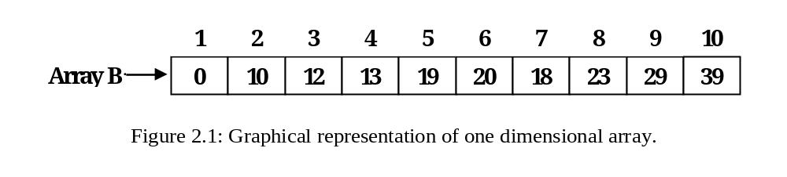
One Dimensional Array
An array that can be represented by only one dimension such as row or column and that holds finite number of same type of data items is called one dimensional (linear) array.
Here 1, 2, 3, … … …, 10 are index number, and 0, 10, 12, … … …, 39
are data items or elements of the array and B is the array name.

Slide 5
One Dimensional Array [contd. ]
Symbolically an element of the array is expressed as B_{i} or B[i], which denotes i^{th} element of the array, B.
Thus B[4], B[9] denotes respectively the 4th element and the 9th element of the array, B.
The name of the array usually is a name constituted by one or more characters.
Thus array name may be A, S, Stock, Array1 etc.
The element of an array may be number (integer or floating point number) or character.

Slide 6
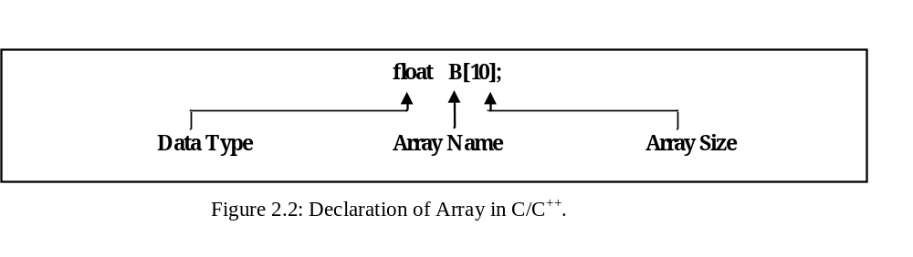
One Dimensional Array [contd. ]
Expression of one dimensional array in C/C⁺⁺:
  For integer array:
    int a[10];
  For character array:
    char b[30];
  For floating point array:
    float B[10];

Slide 7
Expression [Cont…]
Another Example:
int A[20];
Data type
Name of the array
Size of the array

Slide 8
One Dimensional Array [contd. ]
Store an element into an array
  B[4] = 19;
  it means 19 will be stored in the cell number 4 or 5 of the array of B.
  If there is any (previous) value that will be overwritten.
Read (retrieve) a value (element) from an array
  x = B[6];
  it means the value of x will be 20, if the cell
  number 6 or 7 of the array, B contains 20.

Slide 9
Storing data to the array
Code in C/C++ for storing data in an array
  int x[10];
  for (i = 0; i < 10; ++i)
  scanf (“%d”, &x[i]);
Since the size of the array is 10, so we should
enter data to the array 10 times. That is why we
use a loop of 10 times using a variable i. C/C++
language starts indexing from 0 (zero), so the
loop also starts from 0 (zero).

Slide 10
One Dimensional Array [contd. ]
Code in C/C++ for accessing data from an array and the data will be displayed on the monitor’s screen:
  int x[10];
  for (i =0; i < 10; ++i)
  printf (“%d”, x[i]);

Slide 11
Pointer and Dynamic Array
We can declare a pointer as follows:
int *a;
Here a is pointer variable that point inter type data.
Similarly we can declare pointer for other types of data.
Using pointer and keyword, new we can declare dynamic array.

Slide 12
Dynamic array
Dynamic array declaration:
int *a;
a= new int [5];
a

Slide 13
Dynamic Array
Variable can be used for size of the array. Such as:
int s, *a;
cin>>s;
a= new int [s];
Size can be increased also:
s= s+1;

Slide 14
Dynamic Array
Entering data to an array:
int s, i,*a;
cin>>s;
a= new int [s];
for( i =0;i<s;++i)
cin>>a[i];

Slide 15
To find out largest element
Problem 2.1:
  Given a list of elements, write an algorithm to store the list of elements (numbers) in an array and find out the largest element of the list.
Algorithm 2.1: Algorithm to search the largest element of a list
  1. Input: x[1 . . . n];
  2. for (i = 1; i ≤ n; ++i)
  store data to x[i];
  3. large = x[1];
  4. for (i = 2; i ≤ n; ++i)
  if (x[i] > large), large = x[i];
  5. Output: the largest number is, large

Slide 16
To find out largest element
  Code for algorithm 2.1 in C/C++
  int x[10],i, large;
  cout<< “Enter data to the array:”;
  for (i = 0; i < 10; ++i )
  {
  cin>>x[i];
  }
  large = x[0];
  for (i = 1; i < 10; ++i )
  if (x[i] > large), large = x[i];
  cout<<“the largest is:”<< large;

Slide 17
Find Out A Particular (Specific) Element
Problem 2.2
  Given a linear array with data, find out a particular (specific) element of x from the array. We do not know the index (cell) number where the element has been stored.
Algorithm 2.2: Algorithm to search a particular element from a list
  1. Input: a[1 . . . n], x;
  //A set of data in array a, and variable x i.e., the target element
  2. found = 0
  3. for (i = 1; i ≤ n; ++ i )
  {
  if (a[i] = = x);
  location = i, found = 1, break;
  }
  4. Output: if (found = = 1), print “FOUND” and location, i.
  else print “NOT FOUND”.

Slide 18
Find out the summations of even and odd numbers
Algorithm 2.3: Algorithm to find the summation of even and odd numbers
  Input: A[1...n], sum_odd = 0, sum_even = 0;
  //An array and variables to store the summation
  2. for (i = 1; i ≤ n; ++i)
  {
  if (A[i] % 2 = = 0), sum_even = sum_even + A[i];
  else sum_odd = sum_odd + A[i];
  }
  3. Output: Summation of odd numbers, sum_odd
  and summation of even numbers, sum_even)

Slide 19
Summation Of Numbers in Odd and even indices separately
Algorithm 2.4: Algorithm to find the summation of even and odd indexed numbers
  Input: A[1...n], sum_odd = 0, sum_even = 0;
  //An array and variables (to store the summation)
  2. for (i = 1; i ≤ n; ++i )
  {
  if (i % 2 = = 0), sum_even = sum_even + A[i];
  else sum_odd = sum_odd + A[i];
  }
  3. Output: Summation of numbers in odd indices, sum_odd and summation of numbers in even indices, sum_even.

Slide 20
Insert an Element into an Array at a Given Position
Problem 2.5:
  Given a list of sorted integers stored in a linear array and a data element, insert the element into the array at a given position.
Algorithm 2.5: Algorithm to insert an element into an array.
  1. Input: An array A[1...n], the position of insertion m and the data x.
  2. Increase the size of the array, A[1...n + 1]
  3. for (i = n; i>= m; -- i )
  A[i + 1] = A[i];
  4. A[m] = x;
  5. Output: The array, A with size n + 1.

Slide 21
Types of Array
Two Dimensional Array

Slide 22
Definition of two dimensional array
  Two dimensional array is an array that has two dimensions, such as row and column.
  Total number of elements in a two dimensional array can be calculated by multiplication of the number of rows and the number of columns.
  If there are m rows and n columns, then the total number of elements is m × n, and m × n is called the size of the array.
  Of course, the data elements of the array will be same type.
  In mathematics, the two dimensional array is called a matrix and in business it is called table.

Slide 23
Symbolic representation of
Two Dimensional Array
A two dimensional array can be represented using symbols as follows:
Where m is the number of rows and
n is the number of columns.
A[1 . . . . m, 1 . . . . n]
m rows n columns

Slide 24
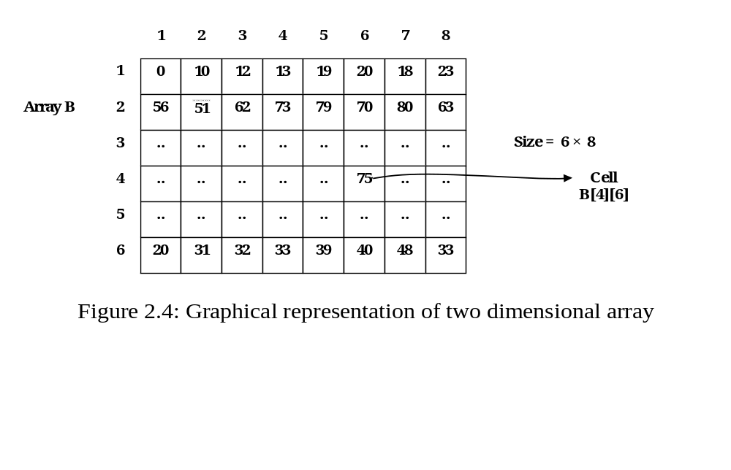
Two Dimensional Array
.

Slide 25
Expression of Two dimensional array
Two dimensional array can be expressed in C/C++
as follows:
int A[5][4];
Here int is the type of the array,
A is the name of the array,
5 is the number of rows and
4 is the number of columns.
The type of the array is integer means the data of the array are integers.

Slide 26
Graphical representation
int A[5][4];
0 1 2 3
0
1
2
3
4
45 | 15 | 10 | 12
5 | 45 | 33 | 42
17 | 49 | 31 | 24
85 | 92 | 22 | 37
48 | 18 | 28 | 30

Slide 27
Expression [Cont…]
Another Example of expression:
Float B[40][4];
Data Type
Number of rows
Name of the Array
Number of columns

Slide 28
To store and retrieve values in and from array
Data can be stored in a two dimensional array using loop or directly as shown below:
i) storing data taken from keyboard
int B[7][3];
for (int i = 0; i < 7; ++ i)
{
for (int j = 0; j < 3; ++ j)
scanf (“%d”, &B[i][j]);
}

Slide 29
ii) Direct insertion of data in two dimensional array
int B[7][3] = {
{ 1, 2, 3},
{ 9, 10, 11},
… …. ….,
… …. ….,
… …. ….,
… …. ….,
{22, 25, 40}
};

Slide 30
Two dimensional array representation in memory
The elements of a two dimensional array are stored in computer’s memory row by row or column by column.
If the array is stored as row by row, it is called row-major order.
If the array is stored as column by column, it is called column-major order.
Suppose there is a two-dimensional array of size 5 × 6. That means, there are 5 rows and 6 columns in the array.

Slide 31
Array representation in memory
In row-major order, elements of a two dimensional array are ordered as –
A₁₁, A₁₂, A₁₃, A₁₄, A₁₅, A₁₆, A₂₁, A₂₂, A₂₃, A₂₄, A₂₅, A₂₆, A₃₁, ............, A₄₆, A₅₁, A₅₂, .......,A_{56.}
and in column-major order, elements are ordered as –
A₁₁, A₂₁, A₃₁, A₄₁, A₅₁, A₁₂, A₂₂, A₃₂, A₄₂, A₅₂, A₁₃, ............, A₅₅, A₁₆, A₂₆, .......,A_{56.}

Slide 32
Location of an element
Location of an element of a two-dimensional array
  Row-major Order:
    If Loc (A[i, j]) denotes the location in the memory of the element A[i][j] or Aij, then in row-major order –
      Loc (A[i, j]) = Base (A) + (n (i - 1) + (j - 1)) * w;
    Here Base (A) is starting or base address of the array A, n is the number of columns and w is the width of each cell, i.e, number bytes per cell.

Slide 33
Location of an element
Column-major Order:
  In column-major order,
    Loc (A[i, j]) = Base (A) + (m (j - 1) + (i - 1)) * w;
  Here Base (A) is starting or base address of the array A, m is the number of rows and w is the cell width.

Slide 34
Location of an element
Example:
  Base address, Base (A) = 100, Size of the array = 5 × 6. If the type of array is integer then find Loc (A[4, 3]).
Solution:
  (2 bytes for each integer cell in C/C++)
  If the array is stored in row-major order:
    Loc (A[4, 3]) = Base (A) + (n (i - 1) + (j - 1))* 2
    = 100 + (6 × 3 + 2)* 2
    = 100 + 40
    = 140
  If the array is stored in memory in column-major order:
    Loc (A[4, 3]) = Base (A) + m (j - 1) + (i - 1)* 2
    = 100 + (5 × 2 + 3)* 2
    = 100 + 26
    =126

Slide 35
Two dimensional array
Operations on two dimensional array

Slide 36
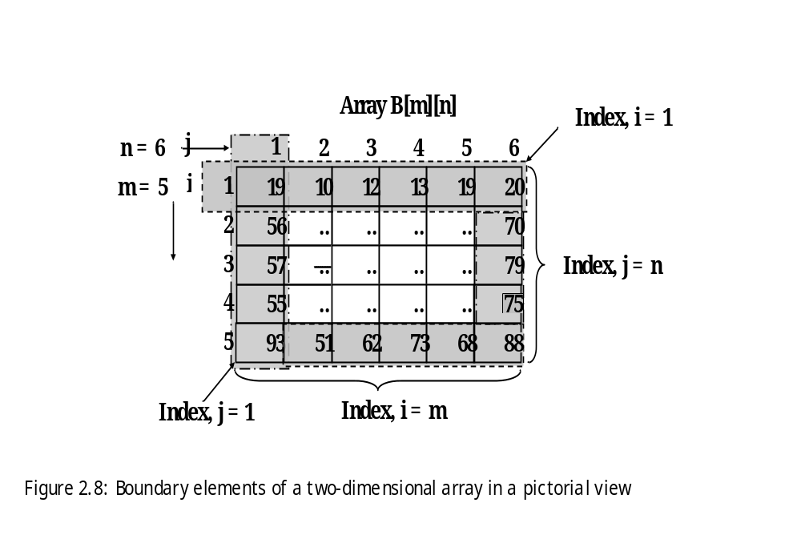
The Summation Of Boundary Elements
.

Slide 37
The Summation Of Boundary Elements
Algorithm 2.8: Algorithm to find the summation of boundary elements
  1. Input: A[1…m, 1…n], sum = 0;
  //a two-dimensional array and a variable for summation
  2. Find each boundary element
  for (i = 1; i ≤ m; ++i )
  for (j = 1; j ≤ n; ++j )
  if (i = 1 || j = 1 || i = m || j = n),
  sum = sum + A[i, j];
  3. Output: Print sum as the result of summation of boundary elements

Slide 38
The Summation Of The Diagonal Elements
Figure 2.9: Diagonal elements of a two-dimensional array.
Array B[n][n]
j
Rows = 5
1
2
3
4
5
Columns = 5
i
1
19
..
..
..
19
i + j = n +1
2
..
10
..
62
..
3
..
..
12
..
..
4
..
51
..
13
..
5
93
..
..
..
68
i = j

Slide 39
Algorithm to find out summation of diagonal elements
1. Input: B[1 . . . n, 1...n], sum = 0;
//a two dimensional array
2. Find each diagonal element and add them
for (i = 1; i ≤ n; ++i)
{for (j = i; j ≤ n; ++j )
if (i = j || i + j = n + 1), sum = sum + B[i, j]
}
3. Output: Print sum as the result of summation of diagonal elements.

Slide 40
Programming consideration
  For top-right to left-bottom diagonal in C/C++:
  i + j = n – 1
  1 sholud be deducted from row index and another 1 should be deducted from column index.
  So, n+1-2 = n-1.
Therefore:
i + j = n -1;

Slide 41
This is the end
of
Array

Slide 42
Sample questions of this chapter
1. Define linear array with example.
2. Declare a linear array of size 5, store data and show (print) them using code.
3. What is dynamic array? Give example.
4. Algorithms related to linear array.
5. What is two-dimensional array? Give example.
6. Write code to store (enter) data using a two-dimensional array of size 3x4 and print them.

Slide 43
Sample questions …..
7. How two-dimensional array can be represented into computer’s memory? Explain with example.
8. Algorithms related to two-dimensional array.

Slide 44
Thank You.

