Slide 1
Heap

Slide 2
An array implementation of a Complete Binary Tree:
Number the nodes (starting at 0) by levels, from top to bottom and left to right within level
0
1
2
3
4
5
6
Parent to children (index i to 2i+1, 2i+2)
0 1 2 3 4 5 6 ……
Root
Level 1 nodes
Level 2 nodes

Slide 3
Complete Binary Tree Representations
If a complete binary tree with n nodes is represented sequentially, then for any node with index i, 0<=i<=n-1, we have:
parent(i) is at ⎣(i-1)/2⎦ if i!=0.
If i=0, i is at the root and has no parent.
leftChild(i) is at 2i+1 if 2i+1<n.
If 2i+1>=n, then i has no left child.
rightChild(i) is at 2i+2 if 2i+2 <n.
If 2i +2>=n, then i has no right child.

Slide 4
Heap
Definition:
A heap is a binary tree with the following conditions:
it is essentially complete: all its levels are full, except last level where only some rightmost leaves may be missing
The key at each node is ≥ keys at its children

Slide 5
Example
a heap
not a heap
not a heap
Note: Heap’s elements are ordered top down (along any path down from its root), but they are not ordered from left to right

Slide 6
The Heap Data Structure
Def: A heap is a complete binary tree
with the following two properties:
Structural property: all levels are full, except possibly the last one, which is filled from left to right
Order (heap) property: for any node x
Parent(x) ≥ x
8
It doesn‘t matter that 4 in level 1 is smaller than 5 in level 2
7
4
5
2
Heap (top to bottom and left to right)

Slide 7
Heap Types
Max-heaps (largest element at root), have the max-heap property:
for all nodes, excluding the root:
PARENT ≥ child
Min-heaps (smallest element at root), have the min-heap property:
for all nodes , excluding the root:
PARENT ≤ child

Slide 8
7
1
5
5
2
5
4
2
4
3
4
5
6
7
Max-heaps
Min-heaps

Slide 9
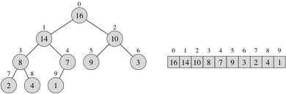
Heap as an array
Parent left Child right Child
index index index
i 2i+1 2i+2
⎣(i-1)/2⎦ i
Notes:
Heap Algorithms
Parent(A, i)
/ Input: A: an array representing a heap, i: an array index / Output: The index in A of the parent of i / Running Time: O(1)
1 if i == 1 return NULL
2 return ⌊i/2⌋
Left(A, i)
/ Input: A: an array representing a heap, i: an array index / Output: The index in A of the left child of i / Running Time: O(1)
if 2 ∗ i ≤ heap-size[A]
return 2 ∗ I
else return NULL
Right(A, i)
/ Input: A: an array representing a heap, i: an array index / Output: The index in A of the right child of i / Running Time: O(1)
if2∗i+1≤heap-size[A]
return 2∗i+1
else return NULL
Max-Heapify(A, i)
/ Input: A: an array where the left and right children of i root heaps (but i may not), i: an array index / Output: A modified so that i roots a heap / Running Time: O(log n) where n = heap-size[A] − I
l ← Left(i)
r ← Right(i)
if l ≤ heap-size[A] and A[l] > A[i]
largest ← l
else largest ← I
if r ≤ heap-size[A] and A[r] < A[largest]
largest ← r
if largest ̸= I
exchange A[i] and A[largest]
Max-Heapify(A, largest)
Build-Max-Heap(A)
/ Input: A: an (unsorted) array / Output: A modified to represent a heap. / Running Time: O(n) where n = length[A]
heap-size[A] ← length[A]
for i ← ⌊length[A]/2⌋ downto 1
Max-Heapify(A, i)

Slide 10
Array Representation of Max Heaps
A heap is a complete binary tree that is filled in order
When index i is from 0 to n-1 and
number of element = length of A[]= n = 10
Root of tree is A[0] = 16
Left child of A[i] = A[2i+1]
Right child of A[i] = A[2i + 2]
Parent of A[i] = A[ ⎣(i-1)/2⎦ ]
Heapsize[A] ≤ length[A]
The elements in A[(⎣n/2⎦] …..A[n-1] are leaves i.e. A[5] to A[9]
Parents are A[0]………..A[(⎣n/2⎦-1] i.e. A[0] to A[4]
The root have the maximum element of the heap
0
16
1
2
14
10
3
4
5
6
8
7
9
3
7
8
9
2
4
1

Slide 11
Operations on Heaps
Maintain the max-heap property
MAX-HEAPIFY
Create a max-heap from an unordered array
BUILD-MAX-HEAP
Sort an heap array
HEAPSORT

Slide 12
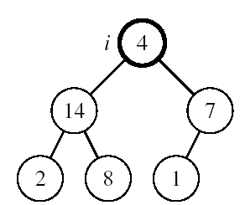
Maintaining the Heap Property
When:
Left and Right subtrees of i are max-heaps and
A[i] breaks the heap property.
A[i] may be smaller than its children
How to return on heap?
Compare i^{th} value with it’s left and right child key value to find the largest one.
If Largest value is in largest_index
And If the largest_index is not equal to i, i.e. largest value is not in i^{th} position then exchange the i^{th} value with largest value.
And repeat the recursive procedure for largest_index instead of i.

Slide 13
Building a Heap
Convert an array A[0 … n-1] into a max-heap
when, n = length of A[] = number of element
The elements in the sub-array A[⎣n/2⎦] …… A[n-1] are leaves
Apply MAX-HEAPIFY() on elements among A[(⎣n/2⎦-1)] to A[0]
0
4
Alg: BUILD-MAX-HEAP(A)
n = length of A[] i.e. no of element
for i = from ⎣n/2⎦-1 down to 0
do MAX-HEAPIFY(A, i, n)
1
2
1
3
3
4
5
6
2
16
9
10
7
8
9
14
8
7
A:
4 | 1 | 3 | 2 | 16 | 9 | 10 | 14 | 8 | 7

Slide 14
MAX-HEAPIFY(A, i, n)
LEFT_child = 2i+1
RIGHT_child =2i+2
If LEFT_child < n and A[LEFT_child] > A[i]
then largest_index = LEFT_child
else largest_index = i
If RIGHT_child < n and A[RIGHT_child] > A[largest_index]
then largest_index = RIGHT_child
if largest_index ≠ i
then exchange A[i] ↔ A[largest_index]
MAX-HEAPIFY(A, largest_index, n)

Slide 15
Building A Max Heap
1
2
3
4
5
6
7
8
9
7
11
7
8
10
input array = [1, 2, 3, 4, 5, 6, 7, 8, 9, 10, 11]

Slide 16
Initializing A Max Heap
1
2
3
4
5
6
7
8
9
7
11
7
8
10
Start at rightmost node that has a child i.e. last parent.
Index is (⎣n/2⎦-1) .

Slide 17
Initializing A Max Heap
1
2
3
4
11
6
7
8
9
7
5
7
8
10
Move to next lower array position. Repeat it up to root.

Slide 18
Initializing A Max Heap
1
2
3
4
11
6
7
8
9
7
5
7
8
10

Slide 19
Initializing A Max Heap
1
2
3
9
11
6
7
8
4
7
5
7
8
10

Slide 20
Initializing A Max Heap
1
2
3
9
11
6
7
8
4
7
5
7
8
10

Slide 21
Initializing A Max Heap
1
2
7
9
11
6
3
8
4
7
5
7
8
10

Slide 22
Initializing A Max Heap
1
2
7
9
11
6
3
8
4
7
5
7
8
10

Slide 23
Initializing A Max Heap
1
11
7
9
6
3
8
4
7
5
7
8
10
Find a home for 2.

Slide 24
Initializing A Max Heap
1
11
7
9
10
6
3
8
4
8
7
7
5
Find a home for 2.

Slide 25
Initializing A Max Heap
1
11
7
9
10
6
3
8
4
7
7
8
2
5
Done, move to next lower array position.

Slide 26
Initializing A Max Heap
1
11
7
9
10
6
3
8
4
2
7
7
8
5
Find home for 1.

Slide 27
Initializing A Max Heap
11
7
9
10
6
3
8
4
2
7
7
8
5
Find home for 1.

Slide 28
Initializing A Max Heap
11
10
7
9
6
3
8
4
2
7
7
8
5
Find home for 1.

Slide 29
Initializing A Max Heap
11
10
7
9
5
6
3
8
4
2
7
7
8
Find home for 1.

Slide 30
Initializing A Max Heap
11
10
7
9
5
6
3
8
4
2
7
7
8
1
Done.

Slide 31
Exercise: Arrange this array as a heap tree/Array?
Array
0
5
1
2
4
9
3
4
5
6
7
19
8
17
7
8
9
2
6
5
10
21
Heap array
21 19 17 7 5 8 9 2 6 5 4
0 1 2 3 4 5 6 7 8 9 10

Slide 32
Putting An Element Into A Max Heap
9
8
7
6
7
2
6
5
1
7
Complete binary tree with 10 nodes.

Slide 33
Putting An Element Into A Max Heap
9
8
7
6
7
2
6
5
1
7
5
New element is 5.

Slide 34
Putting An Element Into A Max Heap
9
8
7
6
7
2
6
5
1
7
7
If the new element is 20 rather than 5.

Slide 35
Putting An Element Into A Max Heap
9
8
7
6
2
6
5
1
7
7
7
New element is 20.

Slide 36
Putting An Element Into A Max Heap
9
7
6
8
2
6
5
1
7
7
7
New element is 20.

Slide 37
Putting An Element Into A Max Heap
20
9
7
6
8
2
6
5
1
7
7
7
New element is 20.

Slide 38
Putting An Element Into A Max Heap
20
9
7
6
8
2
6
5
1
7
7
7
Complete binary tree with 11 nodes.

Slide 39
Putting An Element Into A Max Heap
20
9
7
6
8
2
6
5
1
7
7
7
New element is 15.

Slide 40
Putting An Element Into A Max Heap
20
9
7
6
2
6
5
1
7
8
7
8
7
New element is 15.

Slide 41
Putting An Element Into A Max Heap
20
15
7
6
9
2
6
5
1
7
8
7
8
7
New element is 15.

Slide 42
Removing The Max Element
20
15
7
6
9
2
6
5
1
7
8
7
8
7
Max element is in the root.

Slide 43
Removing The Max Element
15
7
6
9
2
6
5
1
7
8
7
8
7
After max element is removed.

Slide 44
Removing The Max Element
15
7
6
9
2
6
5
1
7
8
7
8
7
Heap with 10 nodes.
Reinsert 8 into the heap.

Slide 45
Removing The Max Element
15
7
6
9
2
6
5
1
7
7
7
Reinsert 8 into the heap.

Slide 46
Removing The Max Element
15
7
6
9
2
6
5
1
7
7
7
Reinsert 8 into the heap.

Slide 47
Removing The Max Element
15
9
7
6
8
2
6
5
1
7
7
7
Reinsert 8 into the heap.

Slide 48
Removing The Max Element
15
9
7
6
8
2
6
5
1
7
7
7
Max element is 15.

Slide 49
Removing The Max Element
9
7
6
8
2
6
5
1
7
7
7
After max element is removed.

Slide 50
Removing The Max Element
9
7
6
8
2
6
5
1
7
7
7
Heap with 9 nodes.

Slide 51
Removing The Max Element
9
7
6
8
2
6
5
1
Reinsert 7.

Slide 52
Removing The Max Element
9
7
6
8
2
6
5
1
Reinsert 7.

Slide 53
Removing The Max Element
9
8
7
6
7
2
6
5
1
Reinsert 7.

Slide 54
Removal of root: The procedure for deleting the root from the heap (effectively extracting the max/min element in a max-heap or in a min-heap) and restoring the properties is called down-heap (also known as heapify-down, cascade-down and extract-min/max).
Delete
Replace/exchange the root of the heap with the last element on the last level.
Reduce the heap size by one and
Perform the MAX-HEAPIFY(A, 0, n-1 ) function for the root i=0.

Slide 55
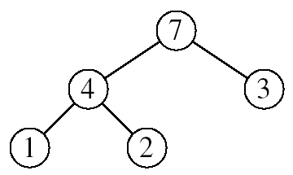
Heapsort
Goal:
Sort an array using heap representations
Idea:
Build a max-heap from the array
Swap the root (the maximum element) with the last element in the array
“Discard” this last node by decreasing the heap size
Call MAX-HEAPIFY on the new root
Repeat this process until only one node remains

Slide 56
Alg: HEAPSORT(A)
BUILD-MAX-HEAP(A) ……………….
for i ← from n-1 down to 1
do exchange A[0] ↔ A[i]
MAX-HEAPIFY(A, 0, i) ….
Running time: O(nlogn)
O(n)
n-1 times
O(logn)
Notes:
Heap-Sort(A)
/ Input: A: an (unsorted) array / Output: A modified to be sorted from smallest to largest
/ Running Time: O(n log n) where n = length[A]
Build-Max-Heap(A)
for i = length[A] downto 2
exchange A[1] and A[i]
heap-size[A] ← heap-size[A] − 1
Max-Heapify(A, 1)

Slide 57
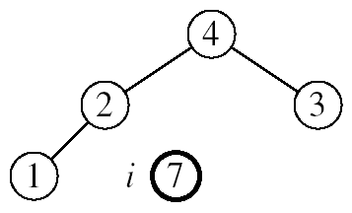
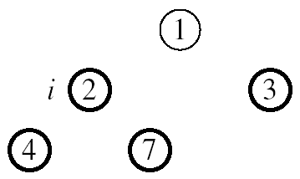
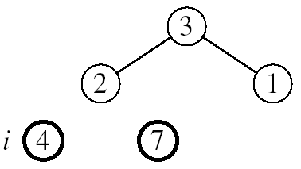
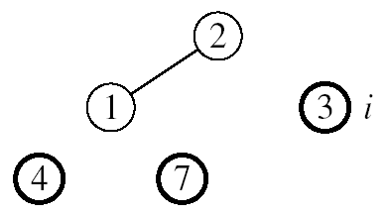

Example: A=[7, 4, 3, 1, 2]
MAX-HEAPIFY(A, 0, 3)
MAX-HEAPIFY(A, 0, 2)
MAX-HEAPIFY(A, 0, 1)

Slide 58
Uses of Heaps
There are two main uses of heaps.
The first is as a way of implementing a special kind of queue, called a priority queue.
The second application is sorting.

Slide 59
To sort an array, or list, containing N values there are two steps:
insert each value into a heap (initially empty)
remove each value form the heap in ascending order (this is done by N successive calls to get_smallest).
What is the complexity of the HeapSort algorithm?
(N insert operations) + (N delete operations)
Each insert and delete operation is O(logN) at the very worst - the heap does not always have all N values in it. So, the complexity is certainly no greater than O(NlogN).

Slide 60
Some Important Properties of a Heap
Given n, there exists a unique binary tree with n nodes that
is essentially complete, with h = ⎣log₂ n⎦
The root contains the largest key
The subtree rooted at any node of a heap is also a heap
A heap can be represented as an array

Slide 61
A Heap is a data structure used to efficiently find the smallest (or largest) element in a set.
Min-heaps make it easy to find the smallest element. Max-heaps make it easy to find the largest element.
Heaps are based upon trees. These trees maintain the heap property.
The Heap invariant. The value of Every Child is greater than the value of the parent. We are describing Min-heaps here (Use less than for Max-heaps).
The trees must be mostly balanced for the costs listed below to hold.
Access to elements of a heap usually have the following costs.
The cost to find the smallest (largest) element takes constant time.
The cost to delete the smallest (largest) element takes time proportional to the log of the number of elements in the set.
The cost to add a new element takes time proportional to the log of the number of elements in the set.

Slide 62
Heaps can be implemented using arrays (using the tree embedding described above) or by using balanced binary trees
Trees with the leftist property have the following invariant.
The leftist invariant. The rank of every left-child is equal to or greater than the rank of the cooresponding right-child. The rank of a tree is the length of the right-most path.
Heaps form the basis for an efficient sort called heap sort that has cost proportional to n*log(n) where n is the number of elements to be sorted.
Heaps are the data structure most often used to implement priority queues.

