Slide 1
Introduction to Database Lecture 07: Entity-Relationship Model(Part 2)

Slide 2
Learning Objectives
To know about:
Alternative ER Notation
Total and Partial Participation
Keys
Weak Entity Set
Generalization
Specialization
Aggregation
Summary of Symbols

Slide 3
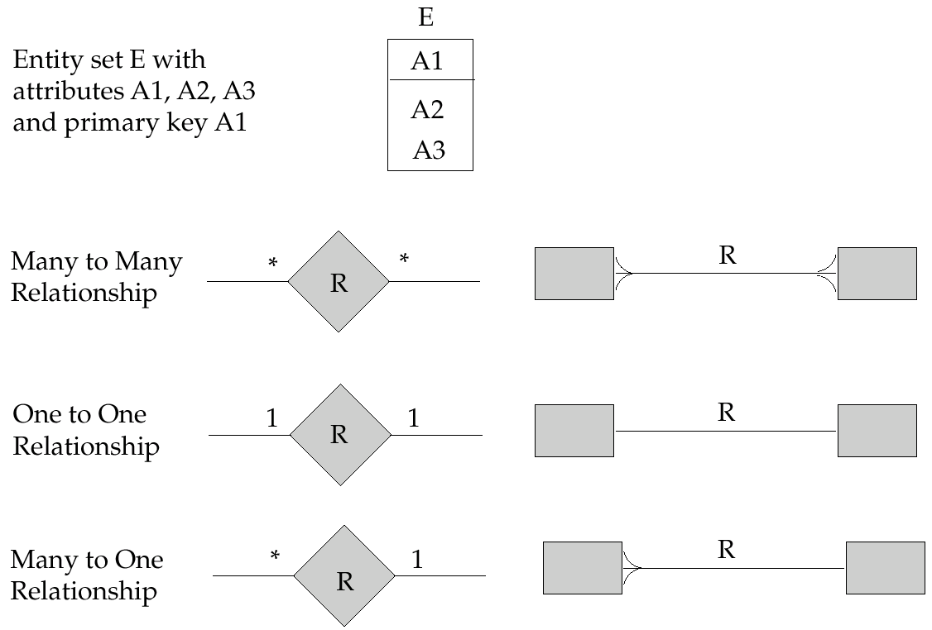
Alternative E-R Notations

Slide 4
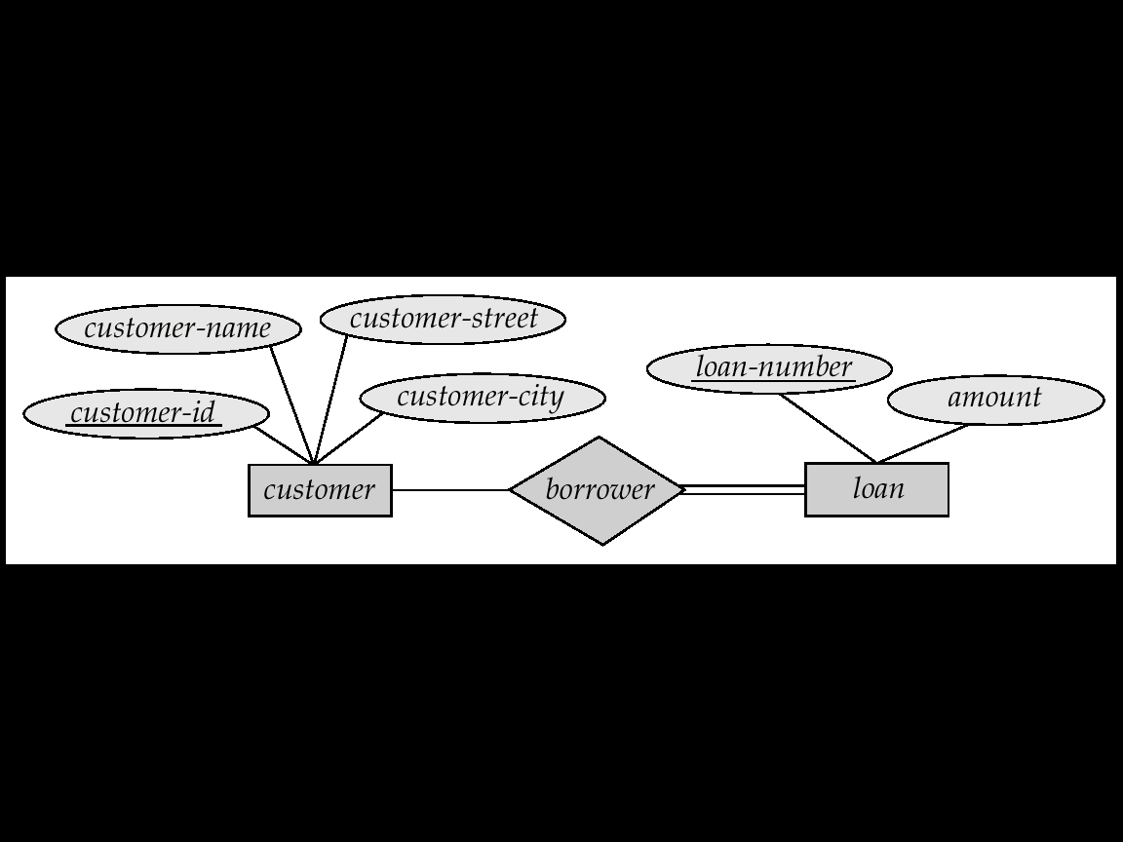
Participation of an Entity Set in a Relationship Set
Total participation (indicated by double line): every entity in the entity set participates in at least one relationship in the relationship set
E.g. participation of loan in borrower is total
every loan must have a customer associated to it via borrower
Partial participation: some entities may not participate in any relationship in the relationship set
E.g. participation of customer in borrower is partial

Slide 5
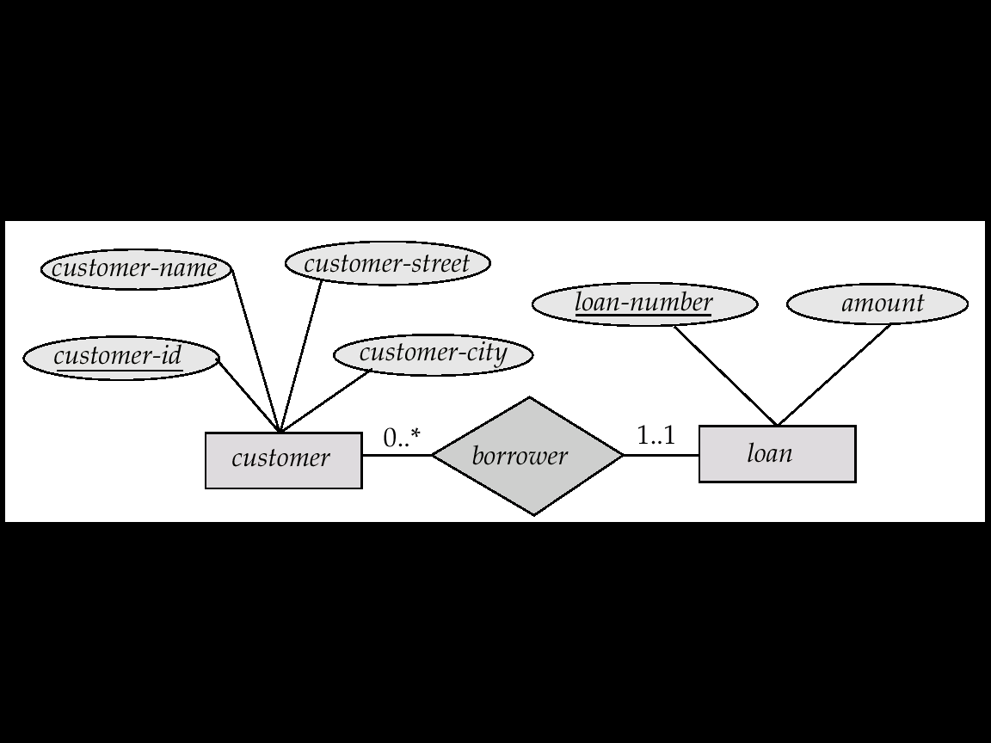
Alternative Notation for Cardinality Limits
Cardinality limits can also express participation constraints

Slide 6
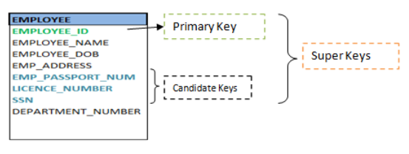
Keys
A super key of an entity set is a set of one or more attributes whose values uniquely determine each entity.
A candidate key of an entity set is a minimal super key
Although several candidate keys may exist, one of the candidate keys is selected to be the primary key.
Every candidate key is a super key but, every super key may or may not be a candidate key.

Slide 7
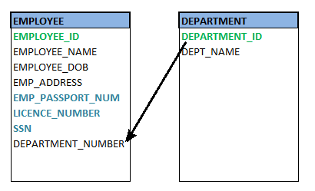
Foreign Keys
Foreign Key of the entity attribute is the entity which is the primary key of the related entity. Foreign key helps to establish the mapping between two or more entities.

Slide 8
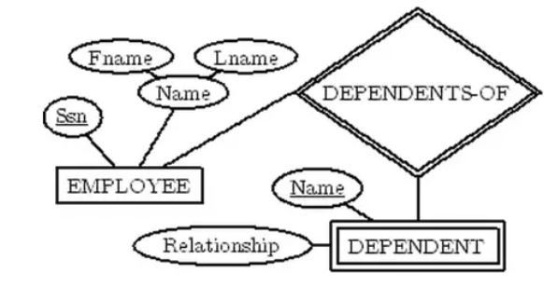
Weak Entity Sets
An entity set that does not have a primary key is referred to as a weak entity set.
The existence of a weak entity set depends on the existence of a identifying entity set
The discriminator (or partial key) of a weak entity set is the set of attributes that distinguishes among all the entities of a weak entity set.
We depict a weak entity set by double rectangles.

Slide 9
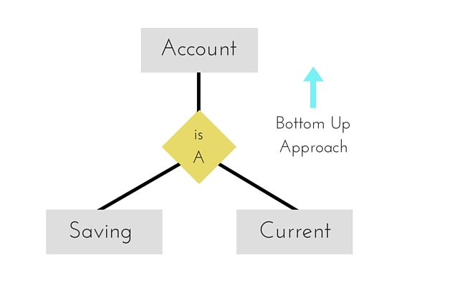
Generalization
Generalization is a bottom-up approach in which two lower level entities combine to form a higher level entity. In generalization, the higher level entity can also combine with other lower level entity to make further higher level entity.

Slide 10
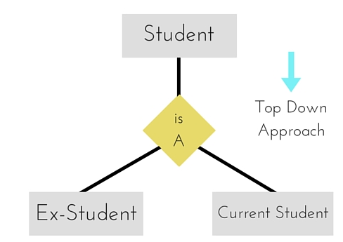
Specialization
Specialization is
opposite to Generalization.
It is a top-down approach
in which one higher level
entity can be broken down
into two lower level entity.
In specialization, some
higher level entities may
not have lower-level entity
sets at all.

Slide 11
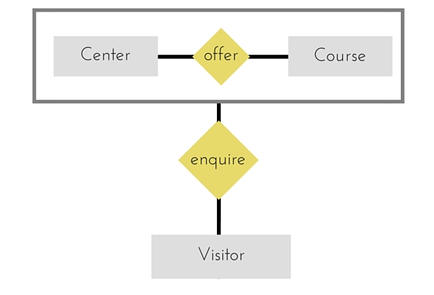
Aggregation
Aggregation is a process when relation between two entity is treated as a single entity. Here the relation between Center and Course, is acting as an Entity in relation with Visitor.

Slide 12
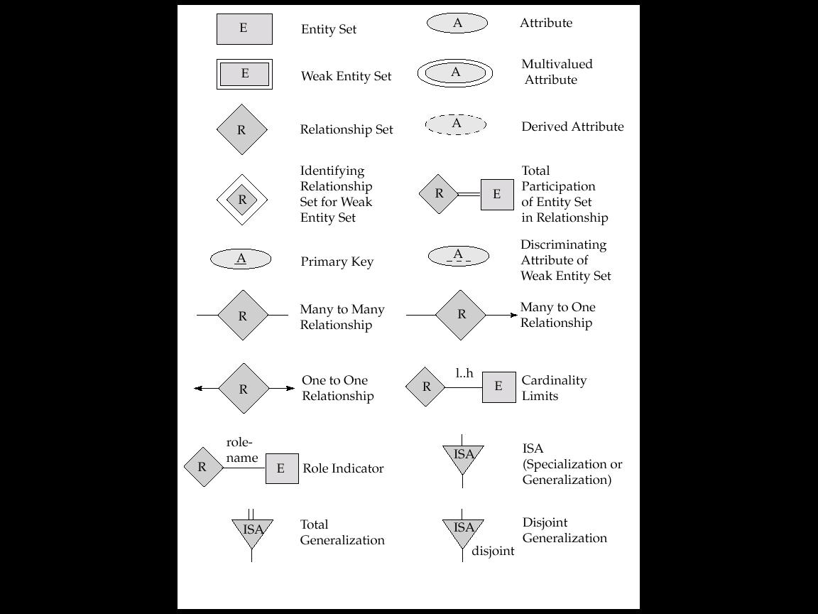
Summary of Symbols Used in E-R Notation

Slide 13
Draw ER Diagram From The Provided Scenario
In a University Management System, a student can attend class. Every class must have a student associated with it via attendance. Every student does not have to be associated with class via attendance. Class has sections. The existence of section is totally dependent on class. Class is taken by teacher. Lecturer and Professor can be generalized as teacher. Student can register for course. Course is made of lectures. Lectures contain assignment. Assignment can be specialized into homework, exam and project. Guardians can come and enquire about course and lecture. Now draw an ER diagram according to the mentioned scenario.

Slide 14
THANK YOU

