Slide 1
Introduction to Database Lecture 13: Normalization

Slide 2
Learning Objectives
To know about:
Normalization
Anomalies
First Normal Form
Second Normal Form
Third Normal Form
Other Normal Forms
Example

Slide 3
Normalization
Normalization is a method for organizing data elements in a database into tables.
Advantages
Flexibility->Structure supports many ways to look at the data
Data Integrity->Modification of anomalies( Deletion, Insertion, Update)
Efficiency->Eliminate redundant data and save space

Slide 4
Anomaly
Anomaly
An error or inconsistency that may result when a user attempts to update a table that contains redundant data.
There are three types of Anomaly –
1. Insertion Anomaly
2. Deletion Anomaly
3. Modification Anomaly

Slide 5
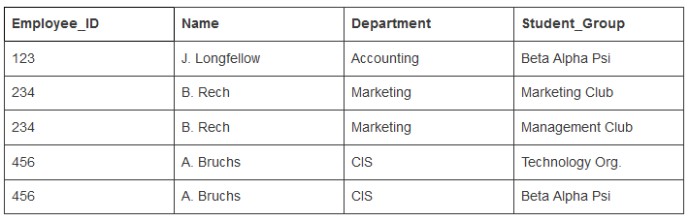
Insertion Anomaly
An insertion anomaly is the inability to add data to the database due to absence of other data. For example, assume Student_Group is defined so that null values are not allowed. If a new employee is hired but not immediately assigned to a Student_Group then this employee could not be entered into the database. This results in database inconsistencies due to omission.

Slide 6
Modification Anomaly
An update anomaly is a data inconsistency that results from data redundancy and a partial update. For example, each employee in a company has a department associated with them as well as the student group they participate in.
If A. Bruchs’ department is an error it must be updated at least 2 times or there will be inconsistent data in the database. If the user performing the update does not realize the data is stored redundantly the update will not be done properly.

Slide 7
Deletion Anomaly
A deletion anomaly is the unintended loss of data due to deletion of other data. For example, if the student group Beta Alpha Psi disbanded and was deleted from the table above, J. Longfellow and the Accounting department would cease to exist. This results in database inconsistencies and is an example of how combining information that does not really belong together into one table can cause problems

Slide 8
Normal Form
First Normal Form
Second Normal Form
Third Normal Form

Slide 9


First Normal Form
First Normal Form (1NF)
A relation is in 1NF if each attribute contains only one value (not a set of values)
t_id | skill
1 | C
1 | C++
1 | Java
2 | ADBMS
2 | IDB
3 | COA
t_id | skill
1 | C,C++,Java
2 | ADBMS, IDB
3 | COA

Slide 10
Second Normal Form
Second Normal Form
Remove Partial Dependencies
Must be in First Normal Form(1NF)
Partial Dependency
A type of functional dependency where an attribute is functionally dependent on only part of the primary key
Functional Dependency
The value of one attribute in a table is determined entirely by the value of another

Slide 11
Third Normal Form
Third Normal Form (3NF)
Remove Transitive dependencies.
Must be in Second Normal Form(2NF)
Transitive Dependency
A Functional Dependency between two (or more) non-key attributes.

Slide 12
Other Normal Forms
Unnormalized Form (UNF)
First Normal Form (1NF)
Boyce-Codd Normal Form
Fourth Normal Form
Fifth Normal Form
Second Normal Form (2NF)
Third Normal Form (3NF)
Boyce-Codd Normal Form (BCNF)
Fourth Normal Form (4NF)
Fifth Normal Form (5NF)

Slide 13
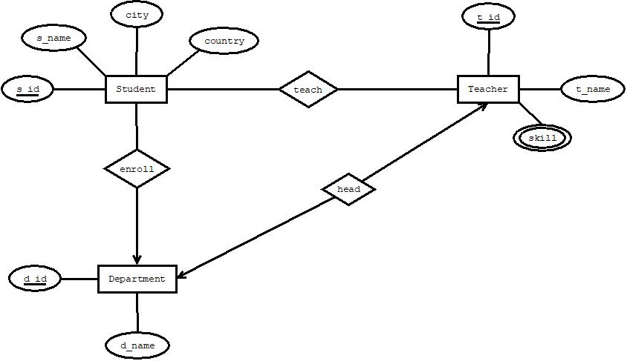
Example

Slide 14
Enroll
UNF
enroll(d_id,d_name,s_id,s_name,city,country)
1NF
There is no multi valued attribute. Relation already in 1NF.
1. d_id,d_name,s_id,s_name,city,country
2NF
1.d_id, d_name
2.s_id,s_name,city,country
3NF
1. d_id, d_name
2. s_id, s_name
3. city, country
Table Creation
1. d_id, d_name
2. s_id,s_name,a_id,d_id
3. a_id,city,country

Slide 15
Teach
UNF
teach(s_id,s_name,city,country, t_id, t_name,skill)
1NF
Skill is a multi valued attribute.
1. s_id,s_name,city,country, t_id, t_name,skill
2NF
1. s_id,s_name,city,country
2.t_id, t_name,skill
3NF
1. s_id,s_name
2. city,country
3. t_id, t_name,skill
Table Creation
1. s_id, s_name, a_id
2. a_id,city,country
3. t_id, t_name,skill
4. s_id,t_id

Slide 16
Head
UNF
head(d_id,d_name,t_id, t_name,skill)
1NF
Skill is a multi valued attribute.
1. d_id,d_name,t_id, t_name,skill
2NF
1. d_id,d_name
2.t_id, t_name,skill
3NF
There is no transitive dependency. Relation already in 3NF.
1. d_id,d_name
2. t_id, t_name,skill
Table Creation
1. d_id, d_name, t_id OR 1. d_id, d_name
2. t_id, t_name,skill 2. t_id, t_name,skill, d_id

Slide 17
Temporary Tables
1. d_id, d_name
2. s_id,s_name,a_id,d_id
3. a_id,city,country
4. s_id, s_name, a_id
5. a_id,city,country
6. t_id, t_name,skill
7. s_id,t_id
8. d_id, d_name, t_id
9. t_id, t_name,skill
PROBLEM!!
t_id | skill
1 | C
1 | C++
2 | Java
Not possible to insert same value more than once as primary key value MUST be unique!!
For solution check slide no. 18

Slide 18
Final Tables
1. s_id,s_name,a_id,d_id
2. a_id,city,country
3. s_id,t_id
4. d_id, d_name, t_id
5. t_id, t_name,skill1, skill2, skill3, …, skilln OR
t_id, t_name,skill OR
create separate table for multi valued attribute

Slide 19
THANK YOU

