Slide 1
Introduction to Database Lecture 16: Relational Algebra

Slide 2
Learning Objectives
To know about:
Relational Algebra
Basic Operators of Relational Algebra
Example Queries
Cartesian Product
Natural Join
Outer Join

Slide 3
Relational Algebra
Created by Edgar F. Codd
Defined as a family of algebras with a well-founded semantics used for modeling the data stored in relational databases, and defining queries on it
Main application is to provide a theoretical foundation for relational databases

Slide 4
Relational Algebra
Procedural query language
Takes instances of relations as input and yields instances of relations as output
Uses operators to perform queries
Operator can be either unary or binary
Accept relations as their input and yield relations as their output
Relational algebra is performed recursively on a relation and intermediate results are also considered relations
Basic operators e.g.
1. select: σ
2. project: ∏
The operators take one or two relations as inputs and produce a new relation as a result.

Slide 5
Select Operation
Relation r
A
B
C
D
α
α
β
β
α
β
β
β
1
5
12
23
7
7
3
10
σ_{A=B ^ D > 5} (r)
A
B
C
D
α
β
α
β
1
23
7
10

Slide 6
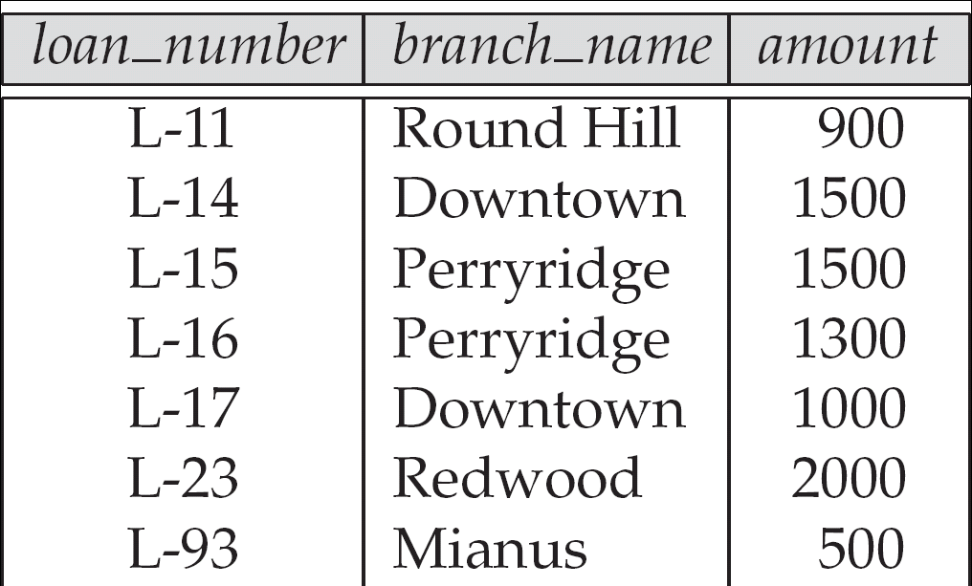
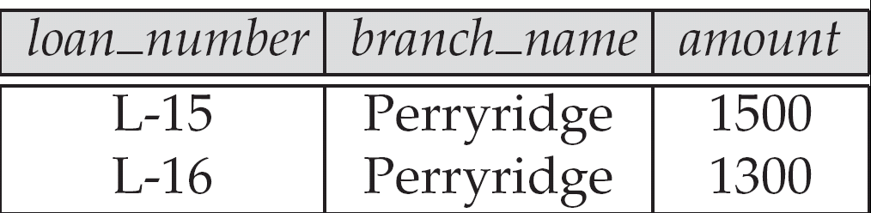
Select Operation
1. Select only those rows of data where branch_name is Perryridge from the Loan Table.
Table: Loan
σ_{branch_name = “Perryridge”} (loan)

Slide 7
Project Operation
Relation r:
A
B
C
α
α
β
β
10
20
30
40
1
1
1
2
∏_{A,C} (r)
A
C
A
C
α
α
β
β
1
1
1
2
=
α
β
β
1
1
2

Slide 8
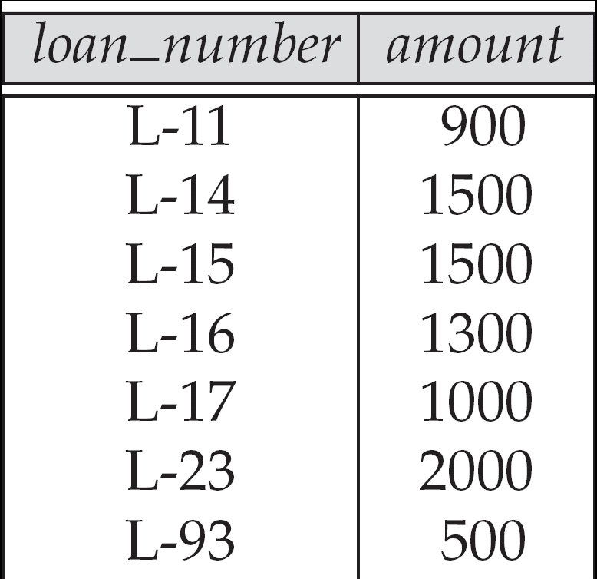
Project Operation
1. Project the Loan number and the amount of
the loan from the loan table
Table: Loan
∏_{loan_number,amount}(Loan)

Slide 9
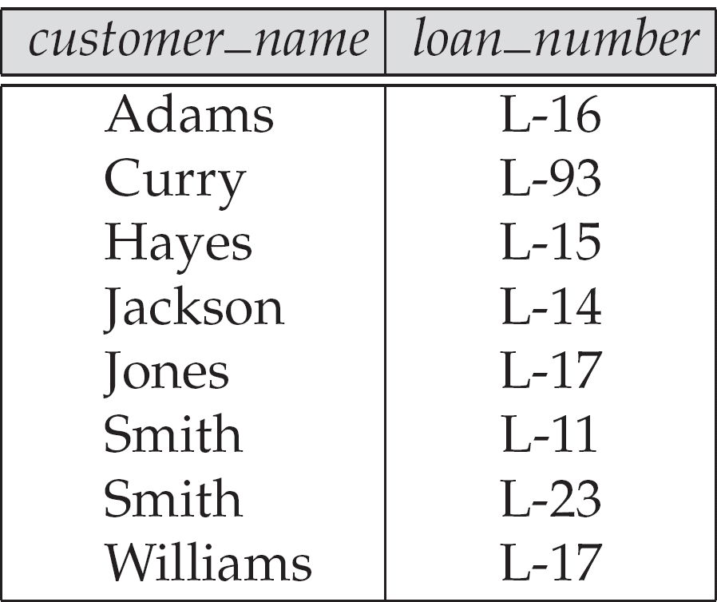
Composition of Relational Operations
1. Find the name of the customer whose loan number is L-23.
∏_{customer_name} (σ _{loan_number=“L-23”}(Borrower))
Table: Borrower

Slide 10
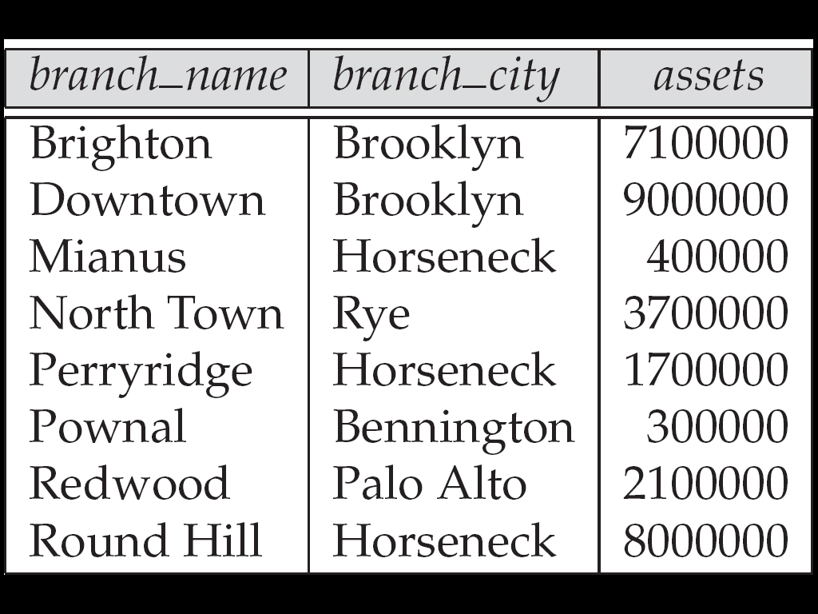
Example Queries
Find the name of the branch where branch city is Rye.
Find the loan number where amount is greater than $1200
Find assets and branch city where branch name is Redwood.
Table: Branch
∏_{branch_name} (σ_{branch_city} _{= “Rye”} (Branch))
∏_{loan_number} (σ_{amount} _{> 1200} (Loan))
Table: Loan
∏_{assets,branch_city} (σ_{branch_name=“Redwood”} (Branch))

Slide 11
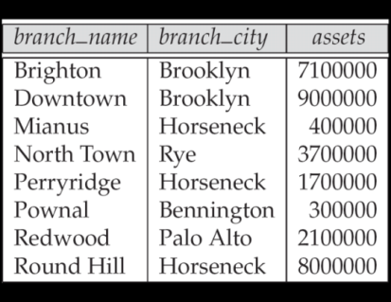
Exercise
Table 1: Branch
Solve (One has been done for you):
1. Find the name of the branch whose branch_city is Rye.
Answer:
∏_{branch_name}(σ_{branch_city= “Rye”} (Branch))
2. Find assets where branch name is Downtown.
3. Find the name of the branch where asset is less than 3700000.

Slide 12
THANK YOU

