Slide 1

Errors and Exceptions
The objectives of this chapter are:
To understand the exception handling mechanism defined in Java
To explain the difference between errors and exceptions
To show the use and syntax of exceptions
To describe how to create your own exception classes.

Slide 2

Traditional Methods of Handling Errors
In most procedural languages, the standard way of indicating an error condition is by returning an error code.
The calling code typically did one of the following:
  Testing the error code and taking the appropriate action.
  Ignoring the error code.
It was considered good programming practice to only have one entry point and one exit point from any given function.
  This often lead to very convoluted code.
  If an error occurred early in a function, the error condition would have to be carried through the entire function to be returned at the end. This usually involved a lot of if statements and usually lead to gradually complex code.

Slide 3
Error handling through Exceptions
Gradually, programmers began to realize that the traditional method of handling errors was too cumbersome for most error handling situations.
This gave rise to the Exception concept
  When an error occurs, that represents an Exceptional condition
  Exceptions cause the current program flow to be interrupted and transferred to a registered exception handling block.

Slide 4
Exception -Terminology
When an error is detected, an exception is thrown
Any exception which is thrown, must be caught by an exception handler
  If the programmer hasn't provided one, the exception will be caught by a catch-all exception handler/default exception handler provided by the system.
  The default exception handler may terminate the application.
Exceptions can be rethrown if the exception cannot be handled by the block which caught the exception
Java has 5 keywords for exception handling:
  try
  catch
  finally
  throw
  throws

Slide 5
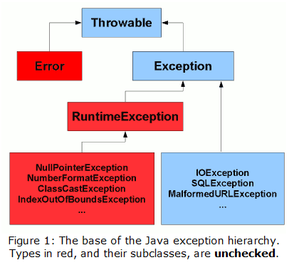
Exception -Class Hierarchy
Errors: An error represents a condition
serious enough that most reasonable
applications should not try to catch.
- Virtual Machine Error
- out of memory
- stack overflow
- Thread Death
- Linkage Error
Exceptions: An error which reasonable
Applications should catch
  - Array index out of bounds
  - Arithmetic errors (divide by zero)
  - Null Pointer Exception
  - I/O Exceptions
See the Java API Specification for more.

Slide 6
Exceptions -Checked and Unchecked
Java allows for two types of exceptions:
  Checked.
    If your code invokes a method which is defined to throw checked exception, your code MUST provide a catch handler
    The compiler generates an error if the appropriate catch handler is not present
    Checked exceptions are subclassed from Exception class
  Unchecked
    These exceptions can occur through normal operation of the virtual machine. You can choose to catch them or not.
    If an unchecked exception is not caught, it will go to the default catch-all handler for the application
    All Unchecked exceptions are subclassed from RuntimeException

Slide 7
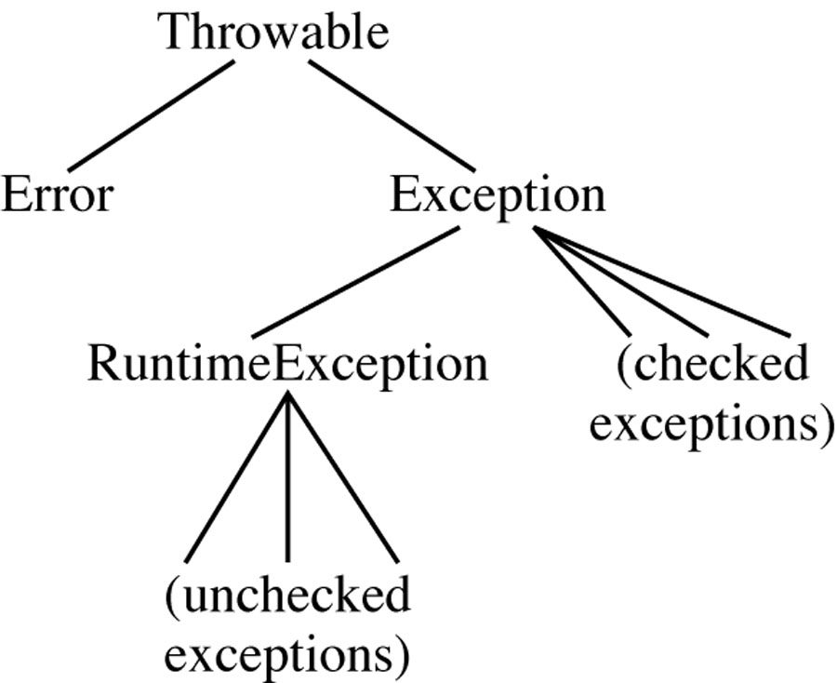
1) virtual machine errors
2)
3) everything else

Slide 8
Exceptions -Syntax
try
{
// Code which might throw an exception
// ...
}
catch(FileNotFoundException x)
{
// code to handle a FileNotFound exception
}
catch(IOException x)
{
// code to handle any other I/O exceptions
}
catch(Exception x)
{
// Code to catch any other type of exception
}
finally
{
// This code is ALWAYS executed whether an exception was thrown
// or not. A good place to put clean-up code. ie. close
// any open files, etc...
}

Slide 9
Exceptions -Defining checked exceptions
Any code which throws a checked exception MUST be placed within a try block.
Checked exceptions are defined using the throws keyword in the method definition:
public class PrintReader extends Reader
{
public int read() throws IOException
[...]
public void method1()
{
PrintReader aReader;
[... initialize reader ...]
try
{
int theCharacter = aReader.read();
}
catch(IOException x)
{
[...]

Slide 10
Exceptions -throwing multiple exceptions
A Method can throw multiple exceptions.
Multiple exceptions are separated by commas after the throws keyword:
public class MyClass
{
public int computeFileSize()
throws IOException, ArithmeticException
[...]
public void method1()
{
MyClass anObject = new MyClass();
try
{
int theSize = anObject.computeFileSize();
}
catch(ArithmeticException x)
{
// ...
}
catch(IOException x)
{
// ...

Slide 11
Exceptions -catching multiple exceptions
Each try block can catch multiple exceptions.
Start with the most specific exceptions
  FileNotFoundException is a subclass of IO Exception
  It MUST appear before IOException in the catch list
public void method1()
{
FileInputStream aFile;
try
{
aFile = new FileInputStream(...);
int aChar = aFile.read();
//...
}
catch(FileNotFoundException x)
{
// ...
}
catch(IOException x)
{
// ...

Slide 12
Exception -The catch-all Handler
Since all Exception classes are a subclass of the Exception class, a catch handler which catches "Exception" will catch all exceptions.
It must be the last in the catch List
public void method1()
{
FileInputStream aFile;
try
{
aFile = new FileInputStream(...);
int aChar = aFile.read();
//...
}
catch(IOException x)
{
// ...
}
catch(Exception x)
{
// Catch All Exceptions

Slide 13
The finally block
public void method1()
{
FileInputStream aFile;
try
{
aFile = new FileInputStream(...);
int aChar = aFile.read();
//...
}
catch(IOException x)
{
// ...
}
catch(Exception x)
{
// Catch All other Exceptions
}
finally
{
try
{
aFile.close();
}
catch (IOException x)
{
// close might throw an exception
}
}

Slide 14
Throwing Exceptions
You can throw exceptions from your own methods
To throw an exception, create an instance of the exception class and "throw" it.
If you throw checked exceptions, you must indicate which exceptions your method throws by using the throws keyword
public void withdraw(float anAmount) throws InsufficientFundsException
{
if (anAmount<0.0)
throw new IllegalArgumentException("Cannot withdraw negative amt");
if (anAmount>balance)
throw new InsuffientFundsException("Not enough cash");
balance = balance - anAmount;
}

Slide 15
Re-throwing Exceptions
If you catch an exception but the code determines it cannot reasonably handle the exception, it can be rethrown:
public void addURL(String urlText) throws MalformedURLException
{
try
{
URL aURL = new URL(urlText);
// ...
}
catch(MalformedURLException x)
{
// determine that the exception cannot be handled here
throw x;
}
}

Slide 16
Automatically Passing Exceptions
If your method is defined to throw an exception, you need not catch it within your method
public void addURL(String urlText) throws MalformedURLException
{
URL aURL = new URL(urlText);
// if the above throws a MalformedURLException, we need not have a try/catch block here because the method is defined to
// throw that exception. Any method calling this method //MUST have a try/catch block which catches //MalformedURLExceptions.
// Control is automatically transferred to that catch block.
}

Slide 17
Defining Your Own Exceptions
To define your own exception you must do the following:
  Create an exception class to hold the exception data.
  Your exception class must subclass "Exception" or another exception class
    Note: to create unchecked exceptions, subclass the RuntimeException class.
  Minimally, your exception class should provide a constructor which takes the exception description as its argument.
To throw your own exceptions:
  If your exception is checked, any method which is going to throw the exception must define it using the throws keyword
  When an exceptional condition occurs, create a new instance of the exception and throw it.

