Slide 1
Lecture-1
Eigenvalues & Eigenvectors

Slide 2
Objective:
Discussion about eigenvalues & eigenvectors
How to find eigenvalues & eigenvectors of a matrix

Slide 3
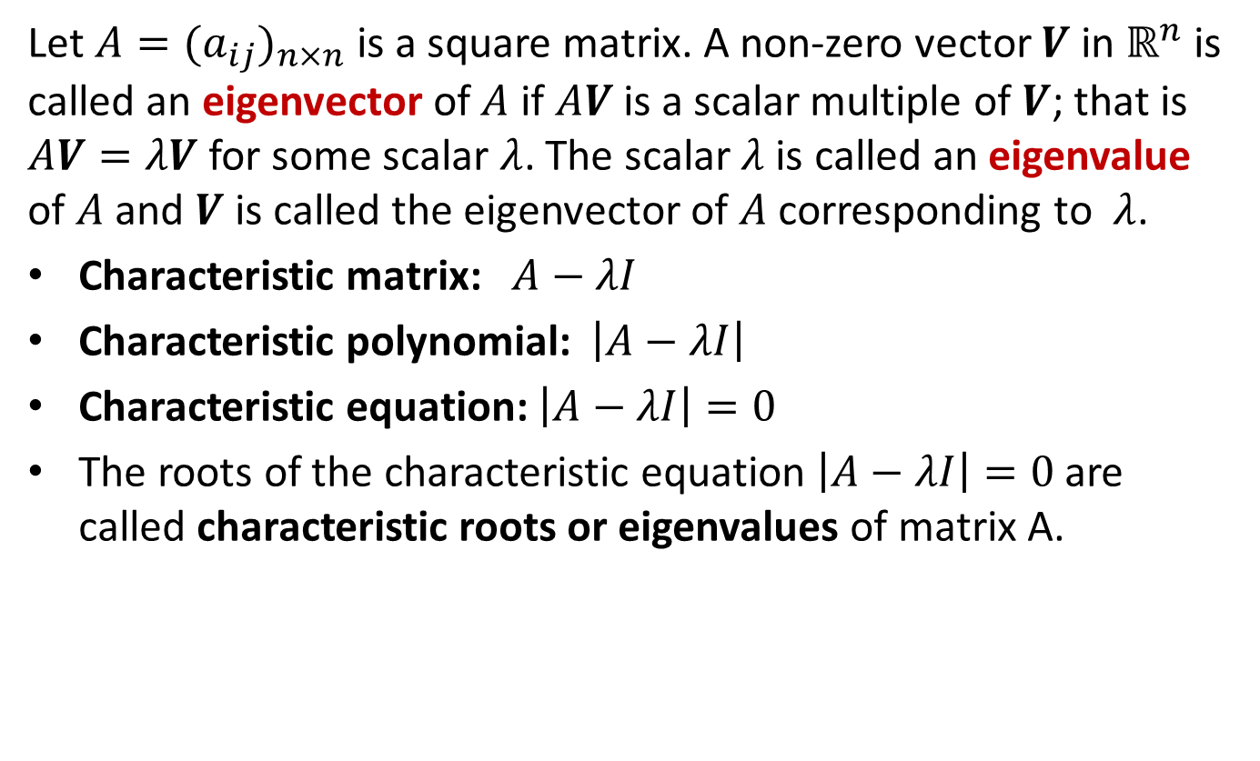
What are eigenvalues and eigenvectors?
Let $A=(a_{ij})_{n×n}$ is a square matrix. A non-zero vector $V$ in $ℝ^{n}$ is called an eigenvector of $A$ if $AV$ is a scalar multiple of $V$; that is $AV=λV$ for some scalar $λ$. The scalar $λ$is called an eigenvalue of $A$ and $V$ is called the eigenvector of $A$ corresponding to$λ$.
Characteristic matrix: $A−λI$
Characteristic polynomial: $\left|A−λI\right|$
Characteristic equation: $\left|A−λI\right|=0$
The roots of the characteristic equation $\left|A−λI\right|=0$ are called characteristic roots or eigenvalues of matrix A.

Slide 4
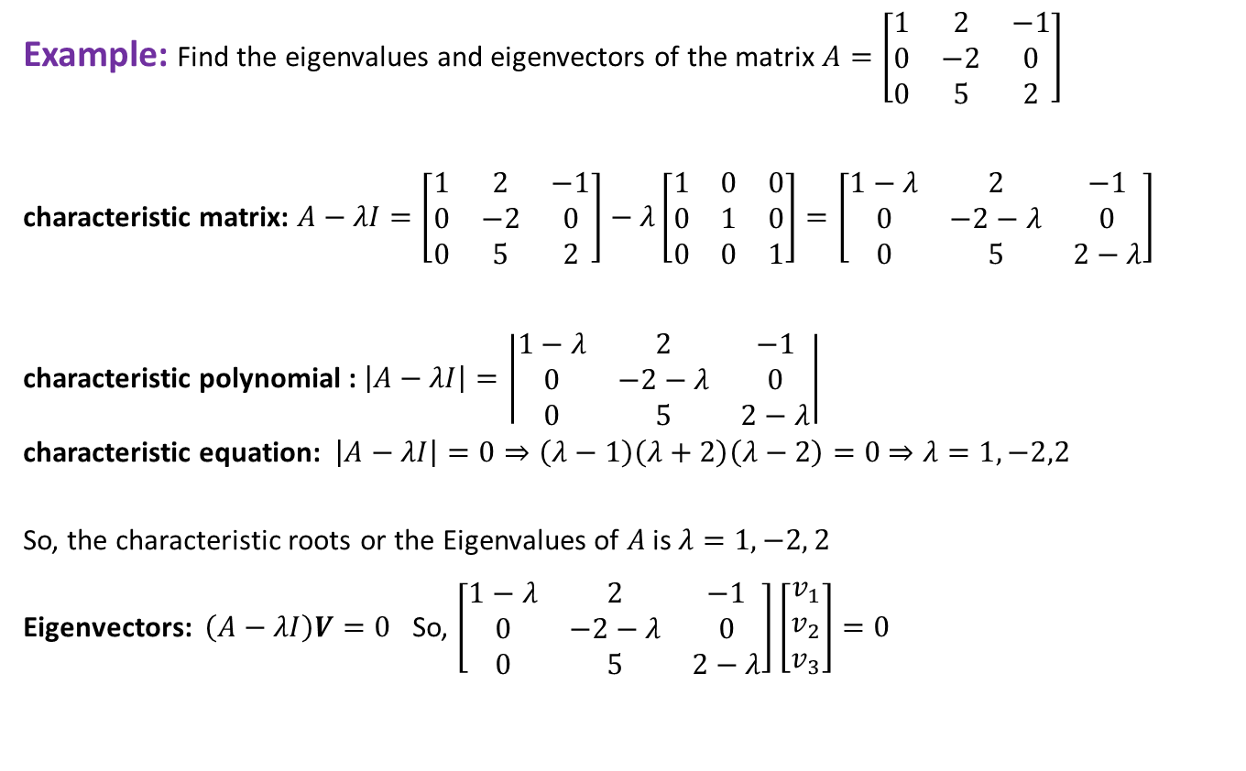
Finding eigenvalues
Example: Find the eigenvalues and eigenvectors of the matrix $A=\left[\begin{matrix}1 & 2 & −1 \\ 0 & −2 & 0 \\ 0 & 5 & 2\end{matrix}\right]$
characteristic matrix: $A−λI=\left[\begin{matrix}1 & 2 & −1 \\ 0 & −2 & 0 \\ 0 & 5 & 2\end{matrix}\right]−λ\left[\begin{matrix}1 & 0 & 0 \\ 0 & 1 & 0 \\ 0 & 0 & 1\end{matrix}\right]=\left[\begin{matrix}1−λ & 2 & −1 \\ 0 & −2−λ & 0 \\ 0 & 5 & 2−λ\end{matrix}\right]$
characteristic polynomial : $\left|A−λI\right|=\left|\begin{matrix}1−λ & 2 & −1 \\ 0 & −2−λ & 0 \\ 0 & 5 & 2−λ\end{matrix}\right|$
characteristic equation: $\left|A−λI\right|=0⇒\left(λ−1\right)\left(λ+2\right)\left(λ−2\right)=0$ $⇒λ=1,−2,2$
So, the characteristic roots or the Eigenvalues of $A$ is $λ=1,−2, 2$
Eigenvectors: $\left(A−λI\right)V=0$ So, $\left[\begin{matrix}1−λ & 2 & −1 \\ 0 & −2−λ & 0 \\ 0 & 5 & 2−λ\end{matrix}\right]\left[\begin{matrix}v_{1} \\ v_{2} \\ v_{3}\end{matrix}\right]=0$

Slide 5
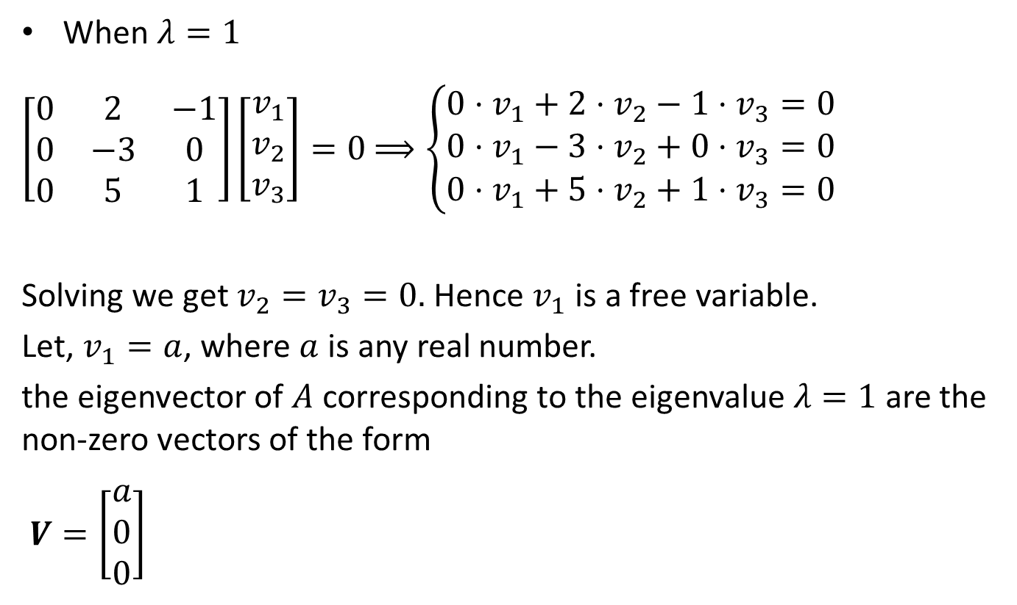
Finding eigenvectors
When $λ=1$
$\left[\begin{matrix}0 & 2 & −1 \\ 0 & −3 & 0 \\ 0 & 5 & 1\end{matrix}\right]\left[\begin{matrix}v_{1} \\ v_{2} \\ v_{3}\end{matrix}\right]=0$ $⟹\left\{\begin{matrix}0⋅v_{1}+2⋅v_{2}−1⋅v_{3}=0 \\ 0⋅v_{1}−3⋅v_{2}+0⋅v_{3}=0 \\ 0⋅v_{1}+5⋅v_{2}+1⋅v_{3}=0 \end{matrix}\right.$
Solving we get $v_{2}=v_{3}=0.$ Hence $v_{1}$ is a free variable.
Let, $v_{1}=a$, where $a$ is any real number.
the eigenvector of $A$ corresponding to the eigenvalue $λ=1$ are the non-zero vectors of the form
$V=\left[\begin{aligned}a \\ 0 \\ 0\end{aligned}\right]$

Slide 6
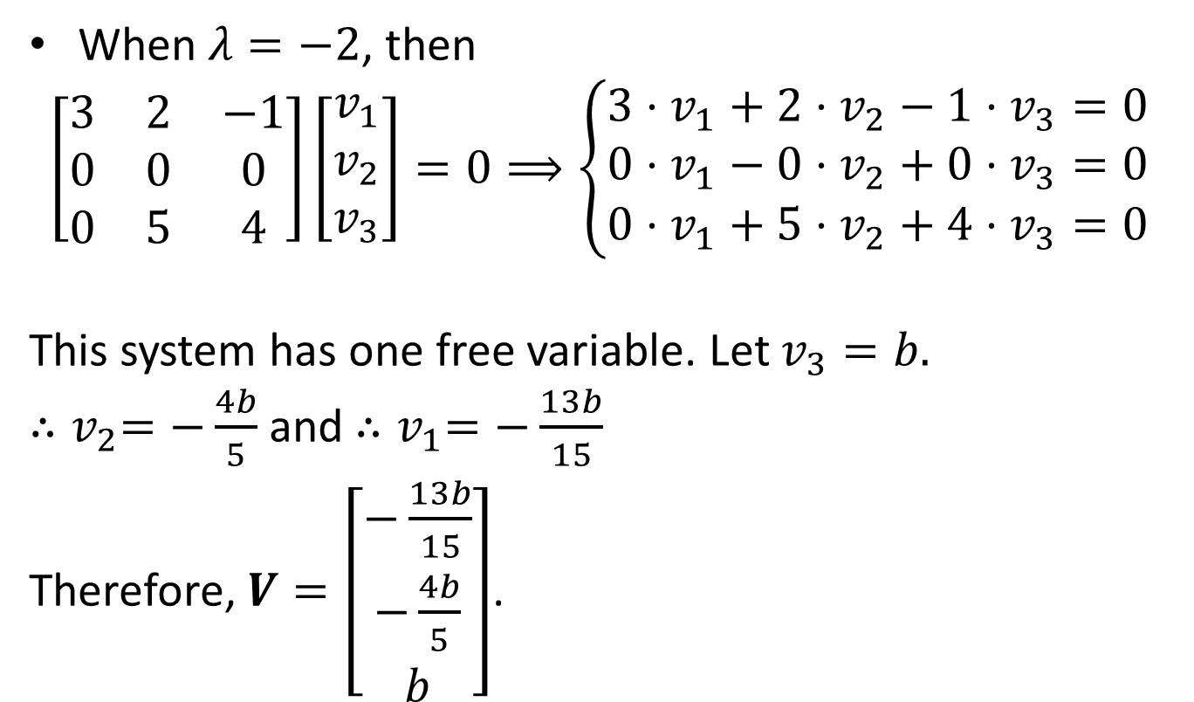
Finding eigenvectors(continued)
When $λ=−2$, then
$$\left[\begin{matrix}3 & 2 & −1 \\ 0 & 0 & 0 \\ 0 & 5 & 4\end{matrix}\right]\left[\begin{matrix}v_{1} \\ v_{2} \\ v_{3}\end{matrix}\right]=0⟹\left\{\begin{matrix}3⋅v_{1}+2⋅v_{2}−1⋅v_{3}=0 \\ 0⋅v_{1}−0⋅v_{2}+0⋅v_{3}=0 \\ 0⋅v_{1}+5⋅v_{2}+4⋅v_{3}=0 \end{matrix}\right.$$
This system has one free variable. Let $v_{3}=b.$
${∴v}_{2}=−\frac{4b}{5}$ and ${∴v}_{1}=−\frac{13b}{15}$
Therefore, $V=\left[\begin{aligned}−\frac{13b}{15} \\ −\frac{4b}{5} \\ b\end{aligned}\right]$.

Slide 7
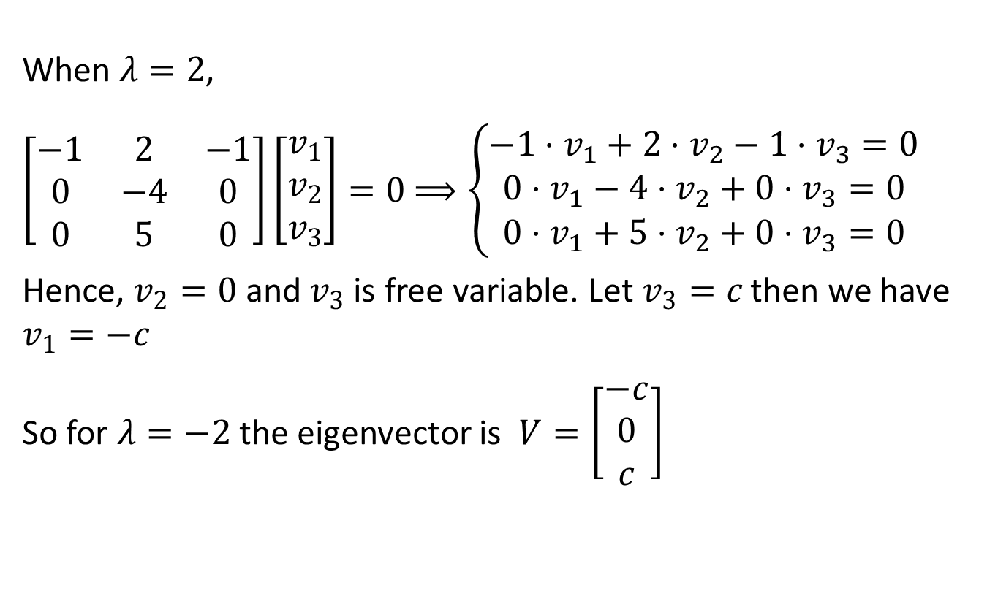
Finding eigenvectors(continued)
When $λ=2$,
$\left[\begin{matrix}−1 & 2 & −1 \\ 0 & −4 & 0 \\ 0 & 5 & 0\end{matrix}\right]\left[\begin{matrix}v_{1} \\ v_{2} \\ v_{3}\end{matrix}\right]=0$ $⟹\left\{\begin{matrix}−1⋅v_{1}+2⋅v_{2}−1⋅v_{3}=0 \\ 0⋅v_{1}−4⋅v_{2}+0⋅v_{3}=0 \\ 0⋅v_{1}+5⋅v_{2}+0⋅v_{3}=0 \end{matrix}\right.$
Hence, $v_{2}=0$ and $v_{3}$ is free variable. Let $v_{3}=c$ then we have $v_{1}=−c$
So for $λ=−2$ the eigenvector is $V=\left[\begin{aligned}−c \\ 0 \\ c\end{aligned}\right]$

Slide 8

Sample Question
Find the eigenvalues and eigenvectors of the following matrices
a) $\left[\begin{matrix}1 & 2 \\ 2 & 1\end{matrix}\right]$ b) $\left[\begin{matrix}−1 & 0 \\ 3 & 2\end{matrix}\right]$ c) $\left[\begin{matrix}1 & 2 & −1 \\ 0 & −2 & 0 \\ 0 & −5 & 2\end{matrix}\right]$ d) $\left[\begin{matrix}2 & 3 & 3 \\ 1 & 3 & 2 \\ −1 & −4 & −3\end{matrix}\right]$

Slide 9
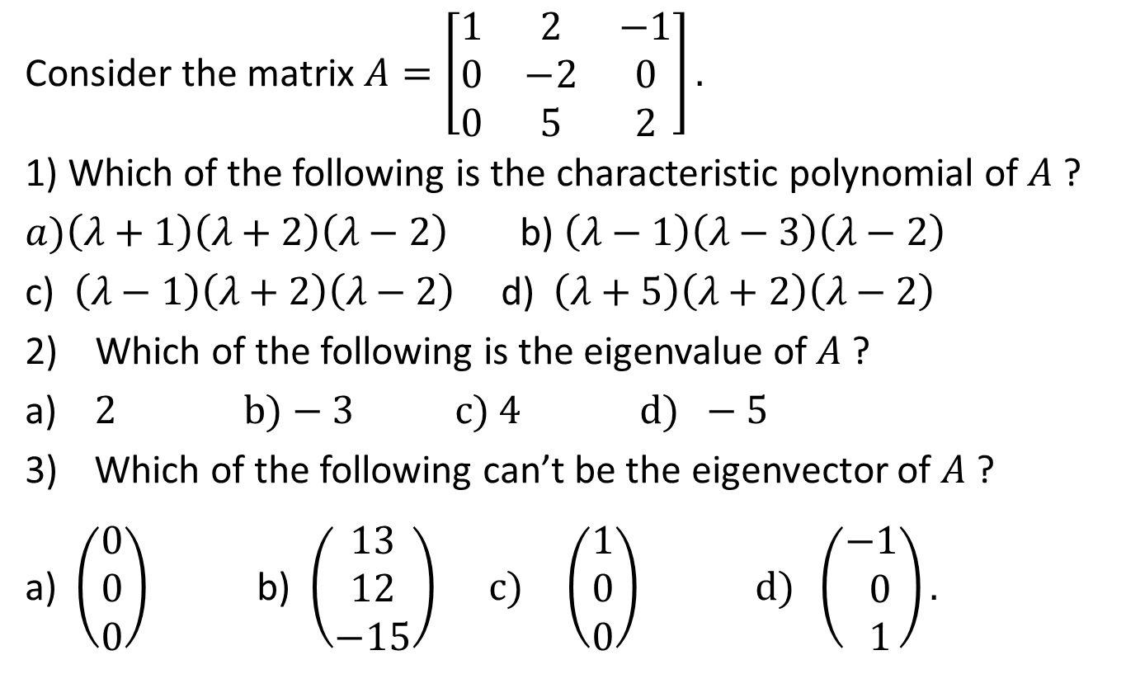
Sample MCQ
Consider the matrix $A=\left[\begin{matrix}1 & 2 & −1 \\ 0 & −2 & 0 \\ 0 & 5 & 2\end{matrix}\right].$
1) Which of the following is the characteristic polynomial of$A$?
$a)\left(λ+1\right)\left(λ+2\right)\left(λ−2\right)$b) $\left(λ−1\right)\left(λ−3\right)\left(λ−2\right)$
c) $\left(λ−1\right)\left(λ+2\right)\left(λ−2\right)$d) $\left(λ+5\right)\left(λ+2\right)\left(λ−2\right)$
2) Which of the following is the eigenvalue of$A$?
a) $2 b)−3 c)$ $4 d) −5$
Which of the following can’t be the eigenvector of $A$?
a) $\left(\begin{matrix}0 \\ 0 \\ 0\end{matrix}\right)$b) $\left(\begin{matrix}13 \\ 12 \\ −15\end{matrix}\right) c) \left(\begin{matrix}1 \\ 0 \\ 0\end{matrix}\right) d) \left(\begin{matrix}−1 \\ 0 \\ 1\end{matrix}\right).$

Slide 10
Outcome
After this lecture students
Will know about eigenvalues and eigenvectors
Will be able to calculate eigenvalues
Will be able to calculate eigenvectors

Slide 11
Next class
Application of eigenvalue and eigenvector to Solve system of differential equation

