Slide 1
Lecture-3
Cayley-Hamilton theorem

Slide 2
Objective:
Discussion about Cayley-Hamilton theorem
Verification of Cayley-Hamilton theorem
Finding inverse of a square matrix
Methodology
We will find inverse using Cayley-Hamilton theorem

Slide 3
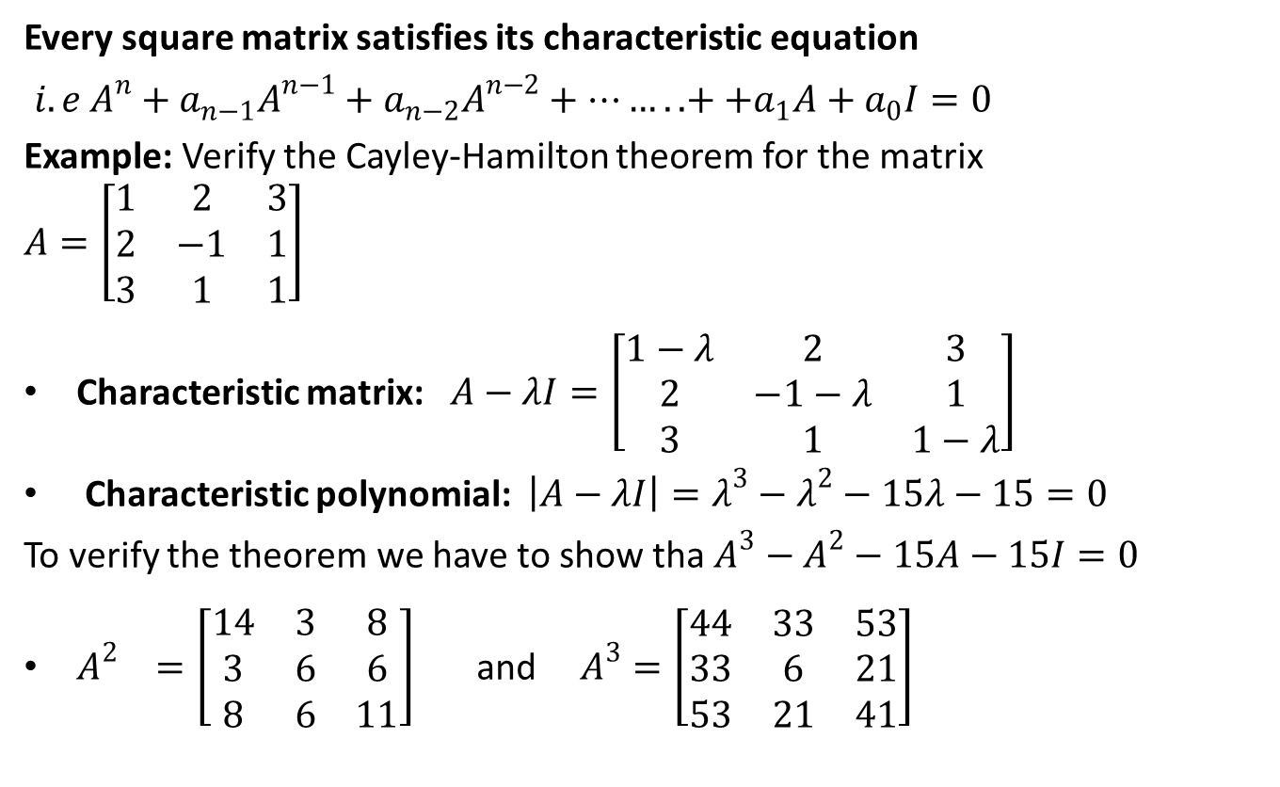
Cayley-Hamilton theorem
Every square matrix satisfies its characteristic equation
$i.e A^{n}+a_{n−1}A^{n−1}+a_{n−2}A^{n−2}+……..++a_{1}A+a_{0}I=0$
Example: Verify the Cayley-Hamilton theorem for the matrix $A=\left[\begin{matrix}1 & 2 & 3 \\ 2 & −1 & 1 \\ 3 & 1 & 1\end{matrix}\right]$
Characteristic matrix: $A−λI=\left[\begin{matrix}1−λ & 2 & 3 \\ 2 & −1−λ & 1 \\ 3 & 1 & 1−λ\end{matrix}\right]$
Characteristic polynomial: $\left|A−λI\right|=λ^{3}−λ^{2}−15λ−15=0$
To verify the theorem we have to show tha $A^{3}−A^{2}−15A−15I=0$
$A^{2} =\left[\begin{matrix}14 & 3 & 8 \\ 3 & 6 & 6 \\ 8 & 6 & 11\end{matrix}\right]$ and $A^{3}=\left[\begin{matrix}44 & 33 & 53 \\ 33 & 6 & 21 \\ 53 & 21 & 41\end{matrix}\right]$

Slide 4

Verification
$${∴A}^{3}−A^{2}−15A−15I$$
$=\left[\begin{matrix}44 & 33 & 53 \\ 33 & 6 & 21 \\ 53 & 21 & 41\end{matrix}\right]−\left[\begin{matrix}14 & 3 & 8 \\ 3 & 6 & 6 \\ 8 & 6 & 11\end{matrix}\right]−15\left[\begin{matrix}1 & 2 & 3 \\ 2 & −1 & 1 \\ 3 & 1 & 1\end{matrix}\right]−15\left[\begin{matrix}1 & 0 & 0 \\ 0 & 1 & 0 \\ 0 & 0 & 1\end{matrix}\right]$
$=\left[\begin{matrix}0 & 0 & 0 \\ 0 & 0 & 0 \\ 0 & 0 & 0\end{matrix}\right]=0$
${∴A}^{3}−A^{2}−15A−15I=0$
Hence Cayley-Hamilton theorem is verified.

Slide 5
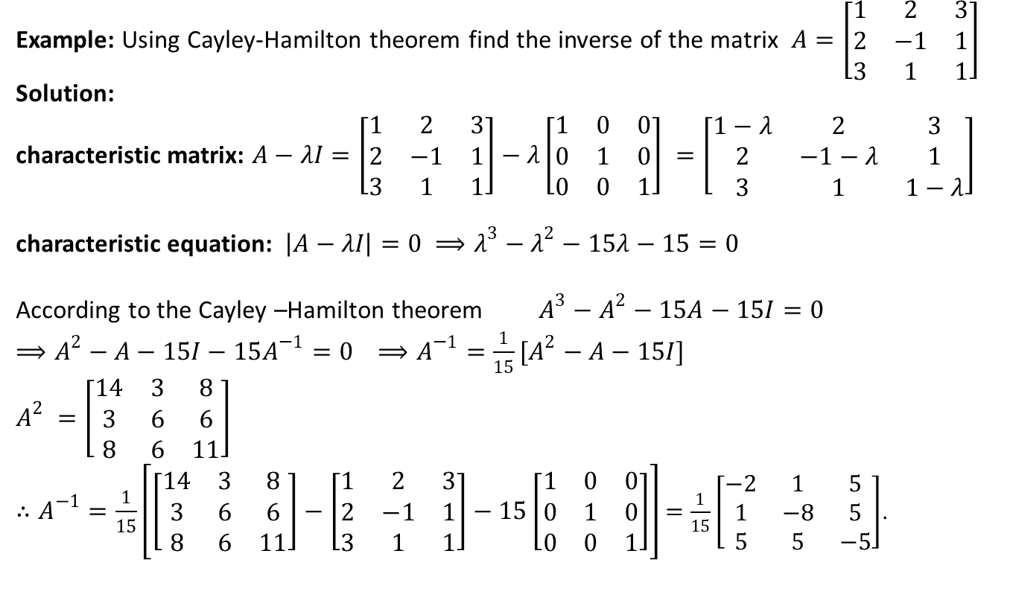
Finding Inverse
Example: Using Cayley-Hamilton theorem find the inverse of the matrix $A=\left[\begin{matrix}1 & 2 & 3 \\ 2 & −1 & 1 \\ 3 & 1 & 1\end{matrix}\right]$
Solution:
characteristic matrix: $A−λI=\left[\begin{matrix}1 & 2 & 3 \\ 2 & −1 & 1 \\ 3 & 1 & 1\end{matrix}\right]−λ\left[\begin{matrix}1 & 0 & 0 \\ 0 & 1 & 0 \\ 0 & 0 & 1\end{matrix}\right] =\left[\begin{matrix}1−λ & 2 & 3 \\ 2 & −1−λ & 1 \\ 3 & 1 & 1−λ\end{matrix}\right]$
characteristic equation: $\left|A−λI\right|=0 ⟹λ^{3}−λ^{2}−15λ−15=0$
According to the Cayley –Hamilton theorem $A^{3}−A^{2}−15A−15I=0$
$⟹A^{2}−A−15I−15A^{−1}=0$ $⟹A^{−1}=\frac{1}{15}[A^{2}−A−15I]$
$A^{2} =\left[\begin{matrix}14 & 3 & 8 \\ 3 & 6 & 6 \\ 8 & 6 & 11\end{matrix}\right]$
$∴A^{−1}=\frac{1}{15}\left[\left[\begin{matrix}14 & 3 & 8 \\ 3 & 6 & 6 \\ 8 & 6 & 11\end{matrix}\right]−\left[\begin{matrix}1 & 2 & 3 \\ 2 & −1 & 1 \\ 3 & 1 & 1\end{matrix}\right]−15\left[\begin{matrix}1 & 0 & 0 \\ 0 & 1 & 0 \\ 0 & 0 & 1\end{matrix}\right]\right]$ $=\frac{1}{15}\left[\begin{matrix}−2 & 1 & 5 \\ 1 & −8 & 5 \\ 5 & 5 & −5\end{matrix}\right]$.

Slide 6

Sample Question
State the Cayley-Hamilton theorem. Hence find the inverse of the following matrices using Cayley –Hamilton theorem and verify your result.
$a) A=\left[\begin{matrix}2 & 0 & 1 \\ −2 & 3 & 4 \\ −5 & 5 & 6\end{matrix}\right]$ b) $A=\left[\begin{matrix}1 & 2 & 3 \\ 2 & 5 & 3 \\ 1 & 0 & 8\end{matrix}\right]$ c) $A=\left[\begin{matrix}1 & −1 & 1 \\ 2 & −1 & 0 \\ 1 & −1 & 0\end{matrix}\right]$

Slide 7
Outcome
After this lecture students
Will be able to verify Cayley-Hamilton theorem
Will be able to find the inverse of a square matrix using Cayley-Hamilton theorem

Slide 8
Next class
Vector Space
Linear combination

