Slide 1
Lecture 4
Vector Space

Slide 2
Objective:
To have knowledge on Vector space and subspace,
To find linear combination of vectors,
To check the linear dependency and independency of vectors.

Slide 3
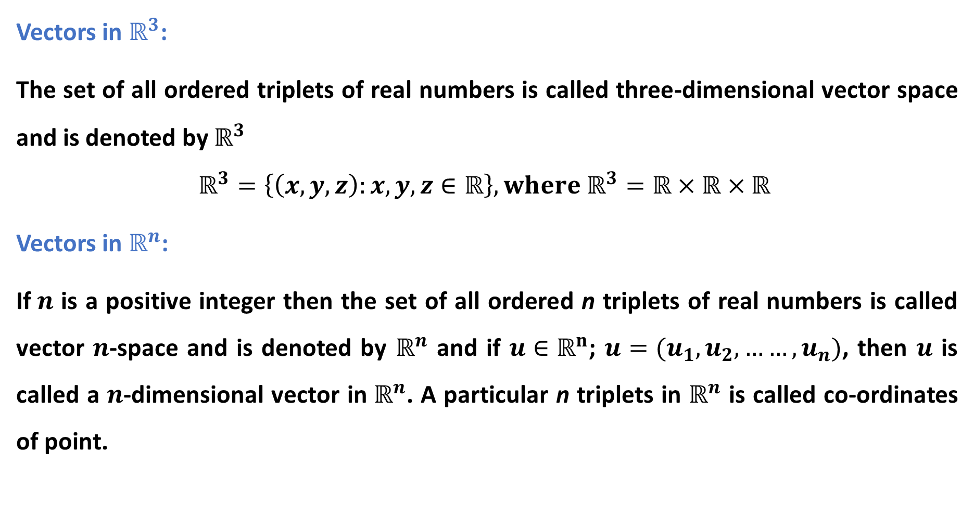
Vectors in $ℝ^{3}$:
The set of all ordered triplets of real numbers is called three-dimensional vector space and is denoted by $ℝ^{3}$
$$ℝ^{3}=\left\{\left(x,y,z\right):x,y,z∈ℝ\right\}, where ℝ^{3}=ℝ×ℝ×ℝ$$
Vectors in $ℝ^{n}$:
If$n$ is a positive integer then the set of all ordered n triplets of real numbers is called vector $n$-space and is denoted by $ℝ^{n}$ and if $u∈ℝ^{n}$; $u=(u_{1},u_{2},……,u_{n})$, then $u$ is called a $n$-dimensional vector in $ℝ^{n}$. A particular n triplets in $ℝ^{n}$ is called co-ordinates of point.

Slide 4
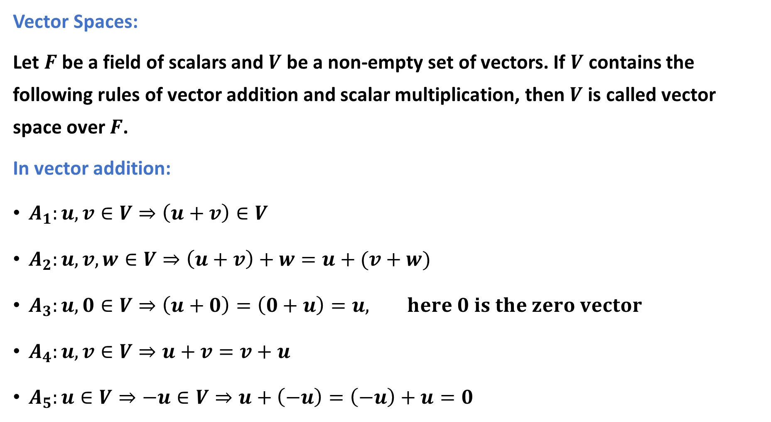
Vector Spaces:
Let $F$ be a field of scalars and $V$ be a non-empty set of vectors. If $V$ contains the following rules of vector addition and scalar multiplication, then $V$ is called vector space over $F$.
In vector addition:
$A_{1}:u,v∈V⇒\left(u+v\right)∈V$
$A_{2}:u,v,w∈V⇒\left(u+v\right)+w=u+(v+w)$
$A_{3}:u,0∈V⇒\left(u+0\right)=\left(0+u\right)=u, here 0 is the zero vector$
$A_{4}:u,v∈V⇒u+v=v+u$
$A_{5}:u∈V⇒−u∈V⇒u+\left(−u\right)=\left(−u\right)+u=0$

Slide 5
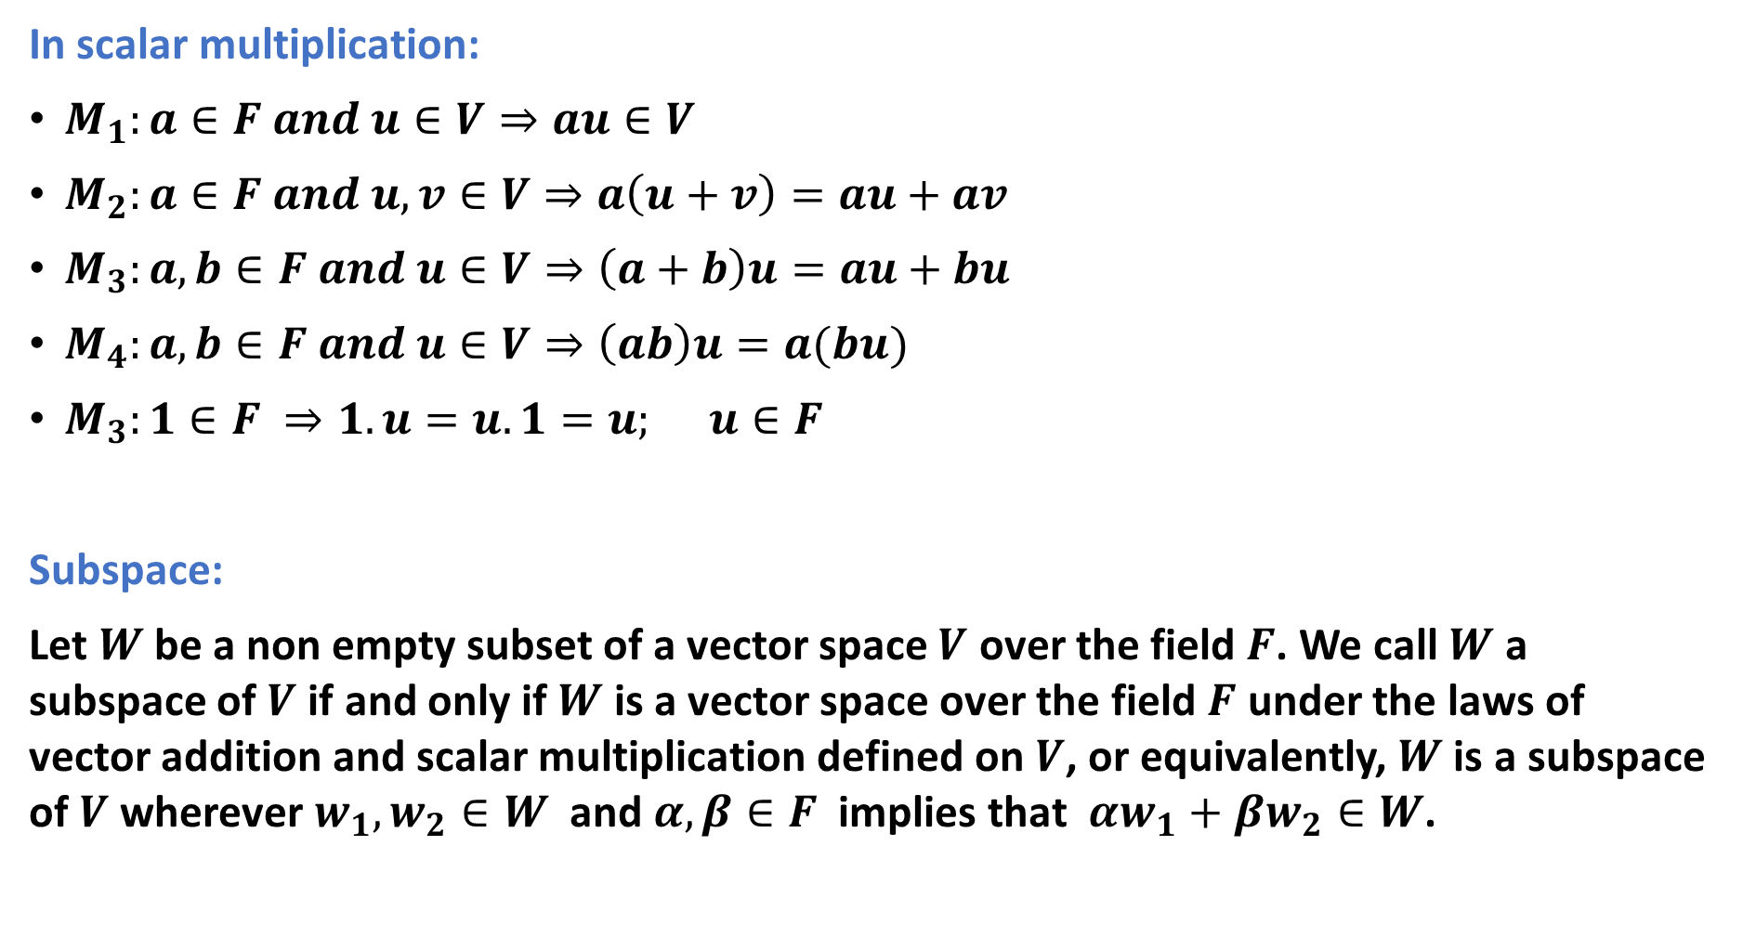
In scalar multiplication:
$M_{1}:a∈F and u∈V⇒au∈V$
$M_{2}:a∈F and u,v∈V⇒a\left(u+v\right)=au+av$
$M_{3}:a,b∈F and u∈V⇒\left(a+b\right)u=au+bu$
$M_{4}:a,b∈F and u∈V⇒\left(ab\right)u=a(bu)$
$M_{3}:1∈F ⇒1.u=u.1=u; u∈F$
Subspace:
Let $W$ be a non empty subset of a vector space $V$ over the field$F$. We call $W$ a subspace of $V$ if and only if $W$ is a vector space over the field $F$ under the laws of vector addition and scalar multiplication defined on $V$, or equivalently, $W$ is a subspace of $V$ wherever $w_{1},w_{2}∈W$ and $α,β∈F$ implies that $αw_{1}+βw_{2}∈W$.

Slide 6
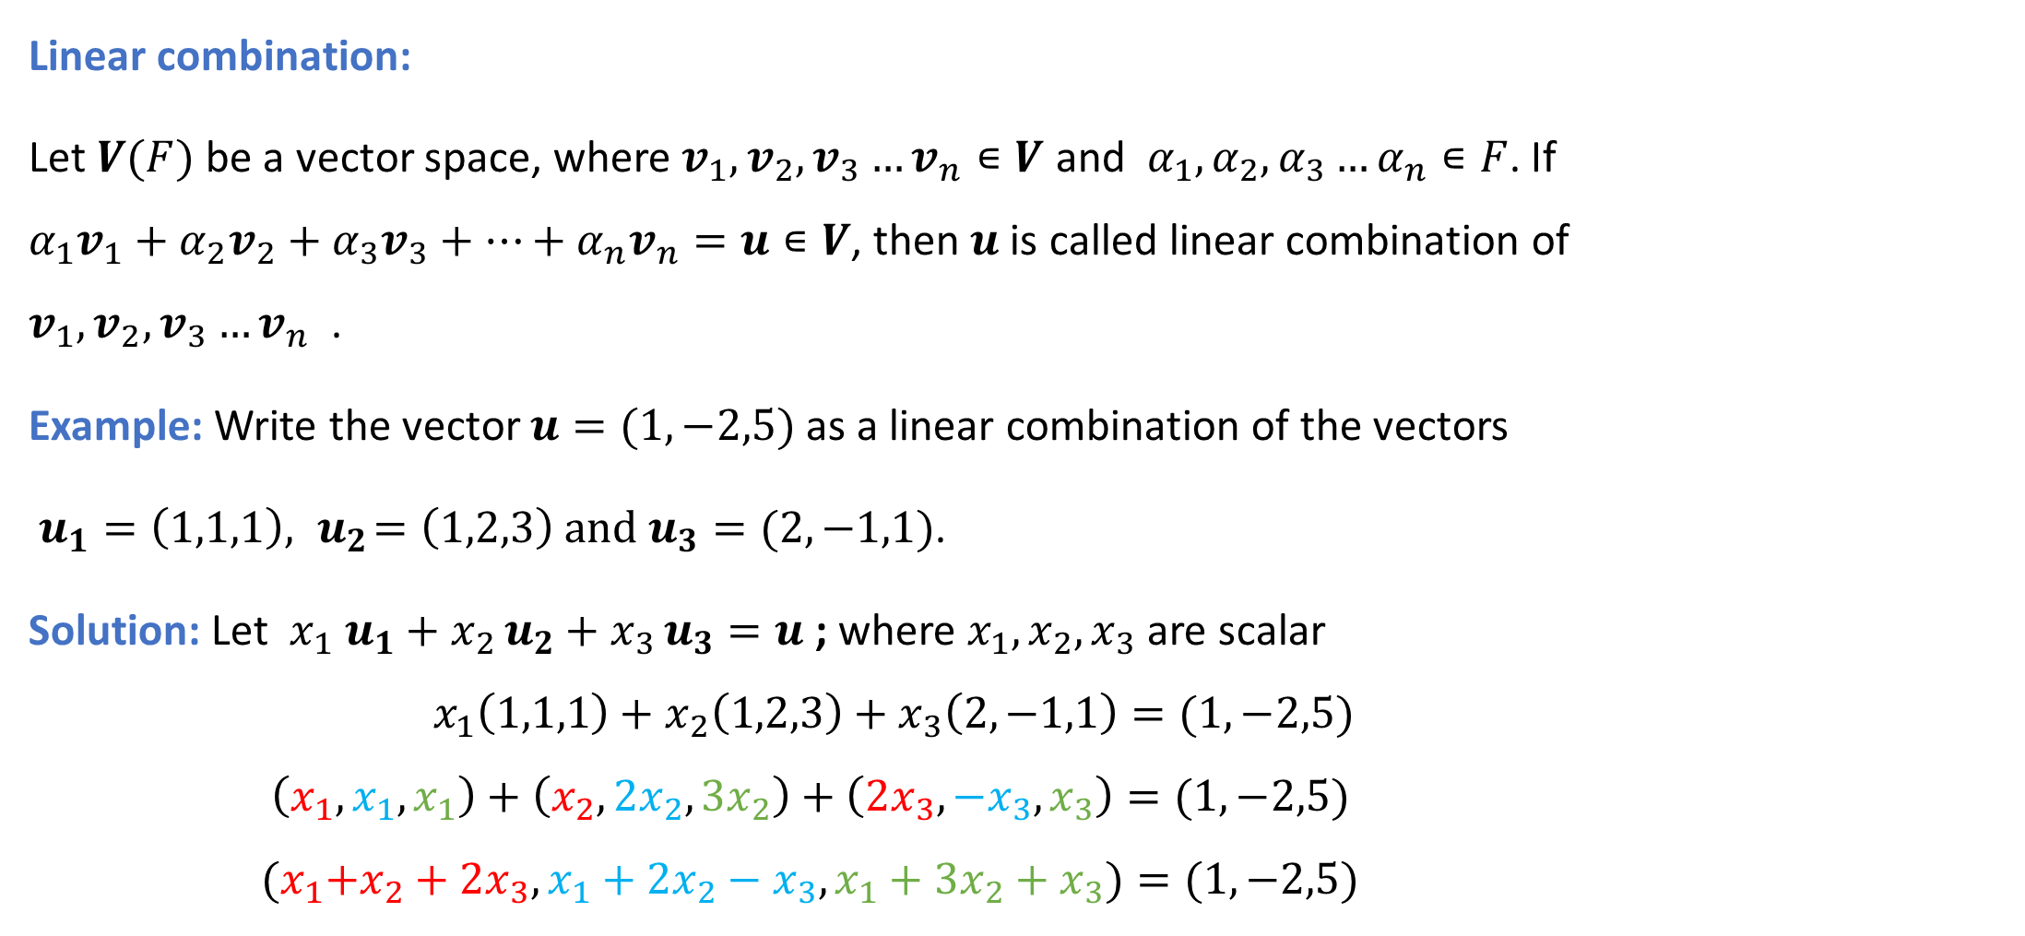
Linear combination:
Let $V(F)$ be a vector space, where $v_{1},v_{2},v_{3}…v_{n}∊V$ and $α_{1},α_{2},α_{3}…α_{n}∊F$. If ${α_{1}v}_{1}+{α_{2}v}_{2}+{α_{3}v}_{3}+…+α_{n}v_{n}=u∊V$, then $u$ is called linear combination of $v_{1},v_{2},v_{3}…v_{n}$ .
Example: Write the vector $u=(1,−2,5)$ as a linear combination of the vectors
$u_{1}=\left(1,1,1\right),{ u}_{2}=\left(1,2,3\right) and{ u}_{3}=(2,−1,1)$.
Solution: Let ${x_{1} u}_{1}+{x_{2 }u}_{2}+x_{3 }u_{3}=u$ ; where $x_{1},x_{2},x_{3}$ are scalar ${ x}_{1}\left(1,1,1\right)+x_{2}\left(1,2,3\right)+x_{3}\left(2,−1,1\right)=(1,−2,5)$
$$\left(x_{1},x_{1},x_{1}\right)+\left(x_{2},{2x}_{2},{3x}_{2}\right)+\left(2x_{3},−x_{3},x_{3}\right)=(1,−2,5)$$
$${(x}_{1}+x_{2}+{2x}_{3},x_{1}+{2x}_{2}−x_{3}, x_{1}+{3x}_{2}+x_{3})=(1,−2,5)$$

Slide 7
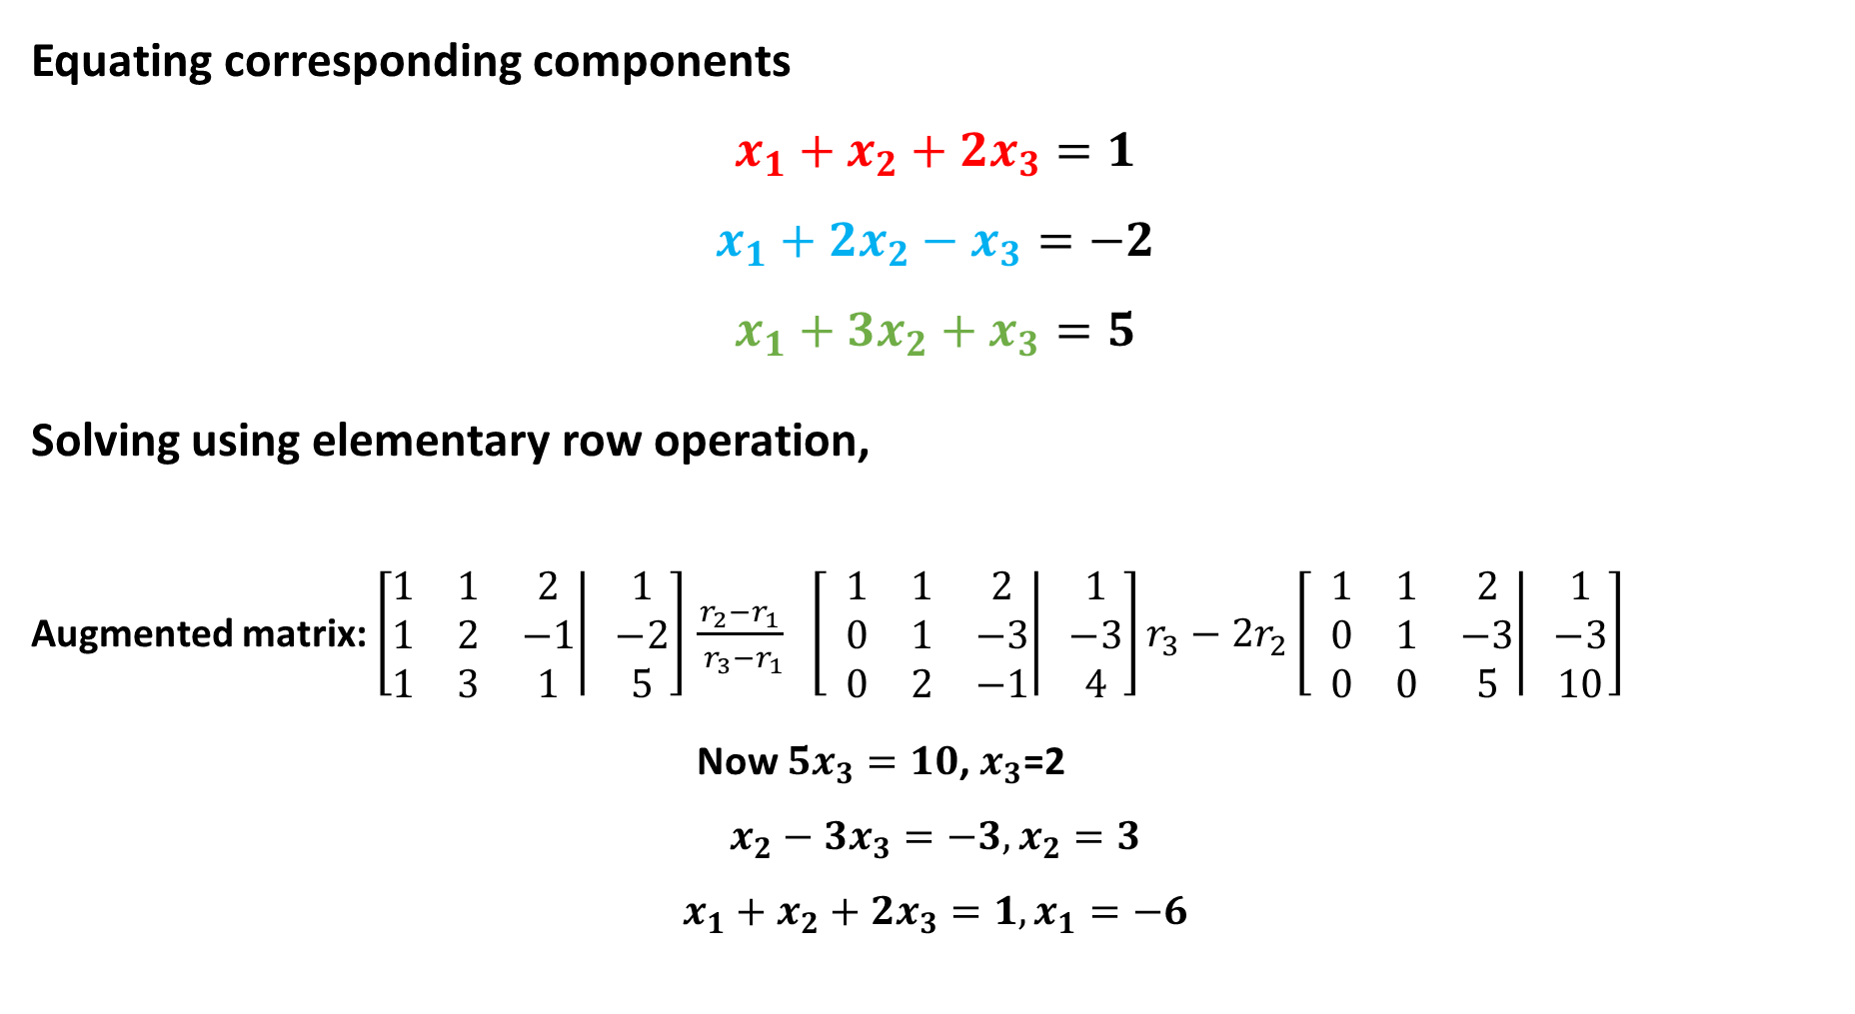
Equating corresponding components
$$x_{1}+x_{2}+{2x}_{3}=1$$
$$x_{1}+{2x}_{2}−x_{3}=−2$$
$$x_{1}+{3x}_{2}+x_{3}=5$$
Solving using elementary row operation,
Augmented matrix: $\left[\left.\begin{matrix}1 & 1 & 2 \\ 1 & 2 & −1 \\ 1 & 3 & 1\end{matrix}\right| \begin{matrix}1 \\ −2 \\ 5\end{matrix}\right]$ $\frac{r_{2}−r_{1}}{ r_{3}−r_{1}}$ $\left[ \left.\begin{matrix}1 & 1 & 2 \\ 0 & 1 & −3 \\ 0 & 2 & −1\end{matrix}\right| \begin{matrix}1 \\ −3 \\ 4\end{matrix}\right]r_{3}−{2r}_{2}\left[ \left.\begin{matrix}1 & 1 & 2 \\ 0 & 1 & −3 \\ 0 & 0 & 5\end{matrix}\right| \begin{matrix}1 \\ −3 \\ 10\end{matrix}\right]$
Now $5x_{3}=10$, $x_{3}$=2
$$x_{2}−3x_{3}=−3,x_{2}=3$$
$$x_{1}+x_{2}+2x_{3}=1,x_{1}=−6$$

Slide 8

we get $x_{1}=−6,x_{2}=3 and x_{3}=2$.
∴${−6 u}_{1}+{3u}_{2}+2u_{3}=u$
Hence $u$ is a linear combination of the vectors ${ u}_{1},u_{2} and u_{3}$.

Slide 9
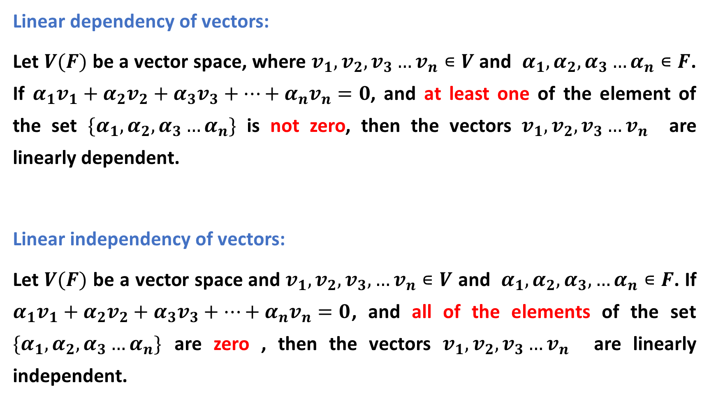
Linear dependency of vectors:
Let $V(F)$ be a vector space, where $v_{1},v_{2},v_{3}…v_{n}∊V$ and $α_{1},α_{2},α_{3}…α_{n}∊F$. If ${α_{1}v}_{1}+{α_{2}v}_{2}+{α_{3}v}_{3}+…+α_{n}v_{n}=0$, and at least one of the element of the set $\{α_{1},α_{2},α_{3}…α_{n}\}$ is not zero, then the vectors $v_{1},v_{2},v_{3}…v_{n}$ are linearly dependent.
Linear independency of vectors:
Let $V(F)$ be a vector space and $v_{1},v_{2},v_{3},…v_{n}∊V$ and $α_{1},α_{2},α_{3},…α_{n}∊F$. If ${α_{1}v}_{1}+{α_{2}v}_{2}+{α_{3}v}_{3}+…+α_{n}v_{n}=0$, and all of the elements of the set $\{α_{1},α_{2},α_{3}…α_{n}\}$ are zero , then the vectors $v_{1},v_{2},v_{3}…v_{n}$ are linearly independent.

Slide 10
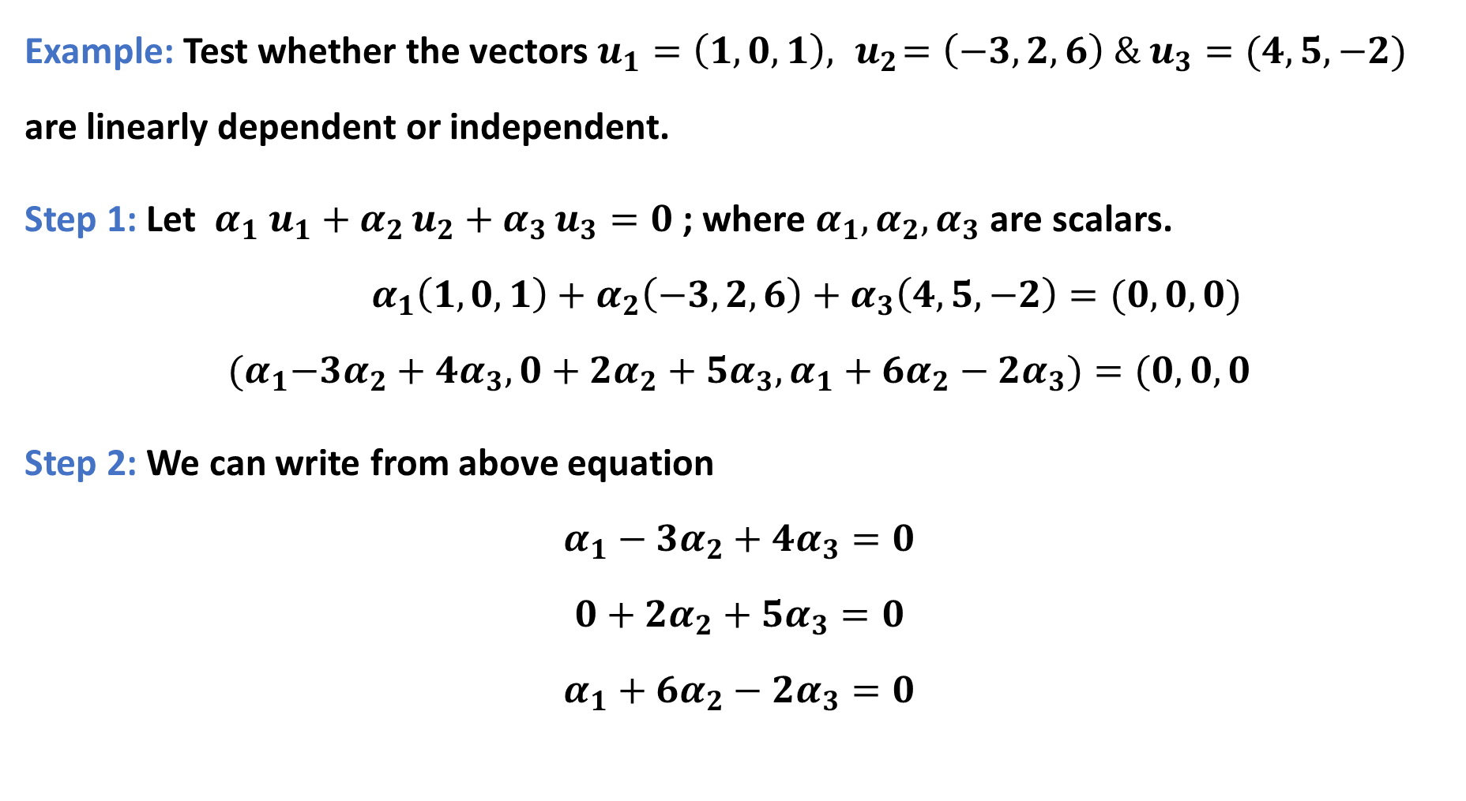
Example: Test whether the vectors $u_{1}=\left(1, 0, 1\right),{ u}_{2}=\left(−3, 2, 6\right) \& u_{3}=(4, 5,−2)$ are linearly dependent or independent.
Step 1: Let ${α_{1} u}_{1}+{α_{2 }u}_{2}+α_{3 }u_{3}=0$ ; where $α_{1},α_{2},α_{3}$ are scalars. ${ α}_{1}\left(1, 0, 1\right)+α_{2}\left(−3, 2, 6\right)+α_{3}\left(4, 5,−2\right)=(0, 0, 0)$
$${(α}_{1}−3α_{2}+{4α}_{3},0+{2α}_{2}+{5α}_{3}, α_{1}+{6α}_{2}−2α_{3})=(0, 0, 0$$
Step 2: We can write from above equation
$$α_{1}−{3α}_{2}+{4α}_{3}=0$$
$$0+{2α}_{2}+{5α}_{3}=0$$
$$α_{1}+{6α}_{2}−2α_{3}=0$$

Slide 11

Step 3: Solving the above linear system, we get
$α_{1}=0,{ α}_{2}=0 and α_{3}=0$.
Hence the vectors ${ u}_{1},u_{2}and u_{3}$ are linearly independent.

Slide 12
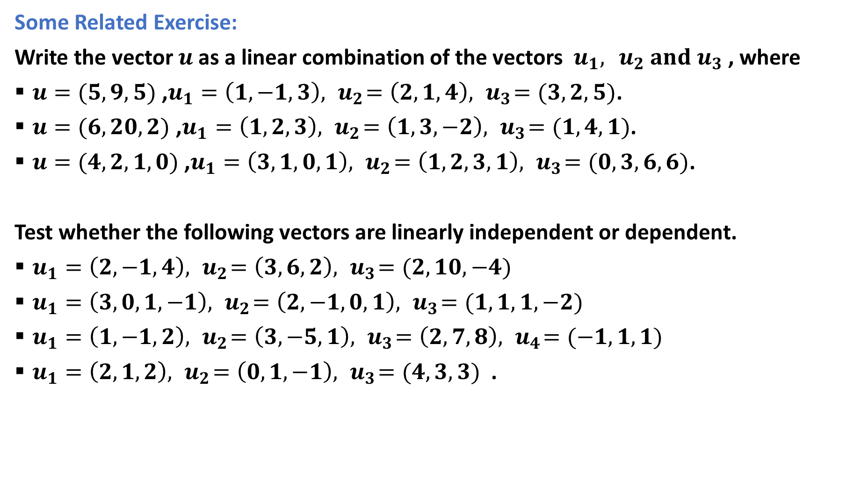
Some Related Exercise:
Write the vector $u$as a linear combination of the vectors $u_{1},{ u}_{2} and{ u}_{3}$ , where
$u=(5, 9, 5)$ ,$u_{1}=\left(1,−1, 3\right),{ u}_{2}=\left(2, 1, 4\right),{ u}_{3}=(3, 2, 5)$.
$u=(6, 20, 2)$ ,$u_{1}=\left(1, 2, 3\right),{ u}_{2}=\left(1, 3, −2\right),{ u}_{3}=(1, 4,1)$.
$u=(4, 2, 1, 0)$ ,$u_{1}=\left(3, 1, 0, 1\right),{ u}_{2}=\left(1, 2, 3, 1\right),{ u}_{3}=(0, 3, 6, 6)$.
Test whether the following vectors are linearly independent or dependent.
$u_{1}=\left(2,−1, 4\right),{ u}_{2}=\left(3, 6, 2\right),{ u}_{3}=(2, 10, −4)$
$u_{1}=\left(3, 0, 1, −1\right),{ u}_{2}=\left(2, −1, 0, 1\right),{ u}_{3}=(1, 1, 1, −2)$
$u_{1}=\left(1, −1, 2\right),{ u}_{2}=\left(3, −5, 1\right),{ u}_{3}=\left(2, 7,8\right),{ u}_{4}=(−1, 1, 1)$
$u_{1}=\left(2, 1, 2\right),{ u}_{2}=\left(0, 1, −1\right),{ u}_{3}=(4, 3, 3)$ .

Slide 13
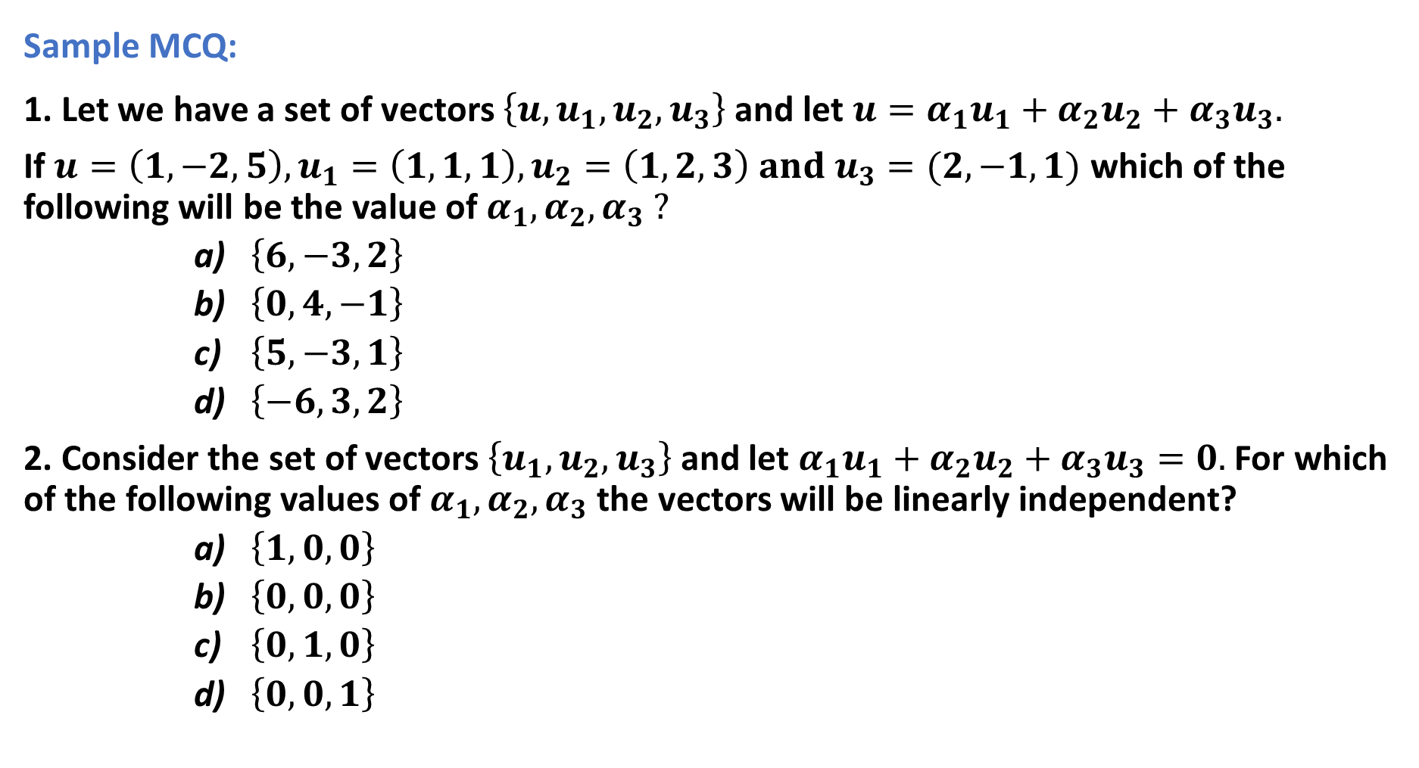
Sample MCQ:
1. Let we have a set of vectors $\left\{u,u_{1},u_{2},u_{3}\right\}$ and let $u=α_{1}u_{1}+α_{2}u_{2}+α_{3}u_{3}.$
If $u=\left(1,−2,5\right),u_{1}=\left(1,1,1\right),u_{2}=\left(1,2,3\right) and{ u}_{3}=(2,−1,1)$ which of the following will be the value of $α_{1}, α_{2}, α_{3} ?$
$\left\{6, −3, 2\right\}$
$\left\{0, 4, −1\right\}$
$\left\{5, −3, 1\right\}$
$\left\{−6, 3, 2\right\}$
2. Consider the set of vectors $\left\{u_{1},u_{2},u_{3}\right\}$and let $α_{1}u_{1}+α_{2}u_{2}+α_{3}u_{3}=0.$ For which of the following values of $α_{1}, α_{2}, α_{3}$the vectors will be linearly independent?
$\left\{1, 0, 0\right\}$
$\left\{0, 0, 0\right\}$
$\left\{0, 1, 0\right\}$
$\left\{0, 0, 1\right\}$

Slide 14
Outcome:
Students got the knowledge on Vector space and subspace,
They can easily find linear combination of vectors,
It will be easy for the students to check the linear dependency and independency of vectors.

