Slide 1
Lecture 5
Coordinate Systems

Slide 2
Objective:
To know the relationship between three coordinate systems
To know how to transfer point & vector from one coordinate to another.

Slide 3
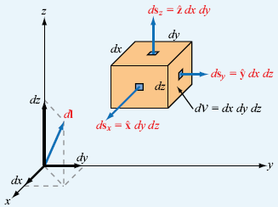
Cartesian coordinates:
Figure: Differential length, area, and volume in Cartesian coordinates.

Slide 4
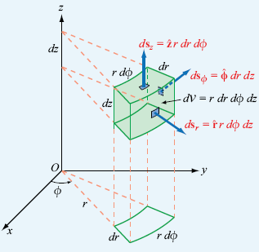
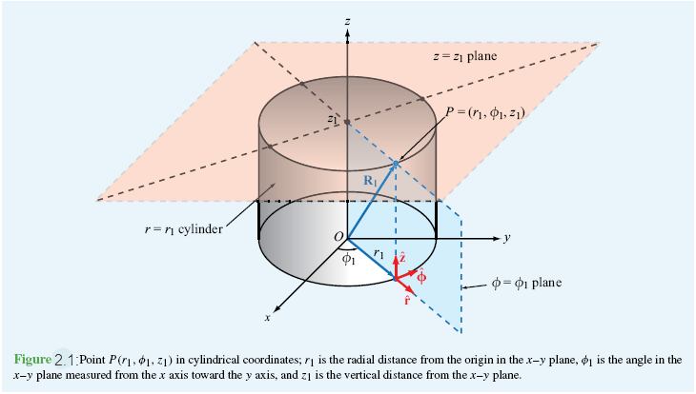

Cylindrical coordinates:
Figure: Differential length, area, and volume in cylindrical coordinates.
Figure: Point $P\left(r_{1},φ_{1},z_{1}\right)$ in cylindrical coordinates; $r_{1}$is the radial distance from the origin in the $xy$plane, $φ_{1}$is the angle in $xy$ plane measured from the $x$ axis toward the $y$ axis, and $z_{1}$ is the vertical distance from the $xy$ plane.

Slide 5
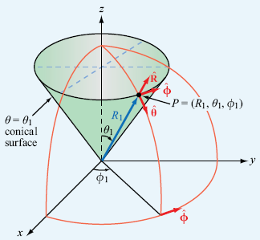
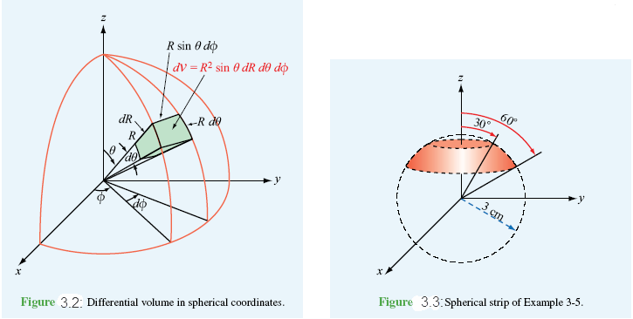

Spherical coordinates:
Figure: point $P(R_{1}, θ_{1}, φ_{1})$ in spherical coordinates.
Figure: Differential volume in spherical coordinates.

Slide 6
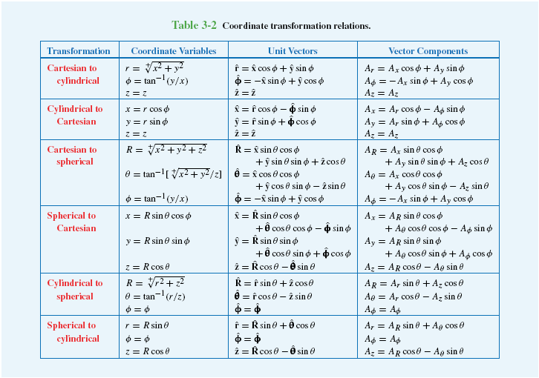
Relation between the coordinate systems:

Slide 7

Point Transformation:
Example 1: Transform $\left(\sqrt{2},\frac{3π}{4},3\right)$ from cylindrical coordinates to Cartesian coordinates.
Solution: $x=r\cos{φ=\sqrt{2}\cos{\frac{3π}{4}=−1}}$,
$y=r\sin{φ=\sqrt{2}\sin{\frac{3π}{4}=1}}$,
$z=z=3$
So, Cartesian point $\left(x,y,z\right)=(−1,1,3)$

Slide 8
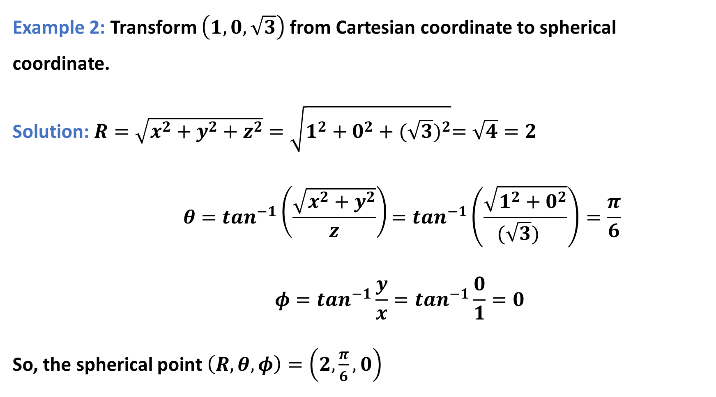
Example 2: Transform $\left(1,0,\sqrt{3}\right)$ from Cartesian coordinate to spherical coordinate.
Solution: $R=\sqrt{x^{2}+y^{2}+z^{2}}=\sqrt{1^{2}+0^{2}+{(\sqrt{3})}^{2}}=\sqrt{4}=2$
$$θ=\tan^{−1}\left(\frac{\sqrt{x^{2}+y^{2}}}{z}\right)=tan^{−1}\left(\frac{\sqrt{1^{2}+0^{2}}}{{(\sqrt{3})}^{}}\right)=\frac{π}{6}$$
$$φ=\tan^{−1}{\frac{y}{x}}=\tan^{−1}{\frac{0}{1}=0}$$
So, the spherical point $\left(R,θ,φ\right)=\left(2,\frac{π}{6},0\right)$

Slide 9
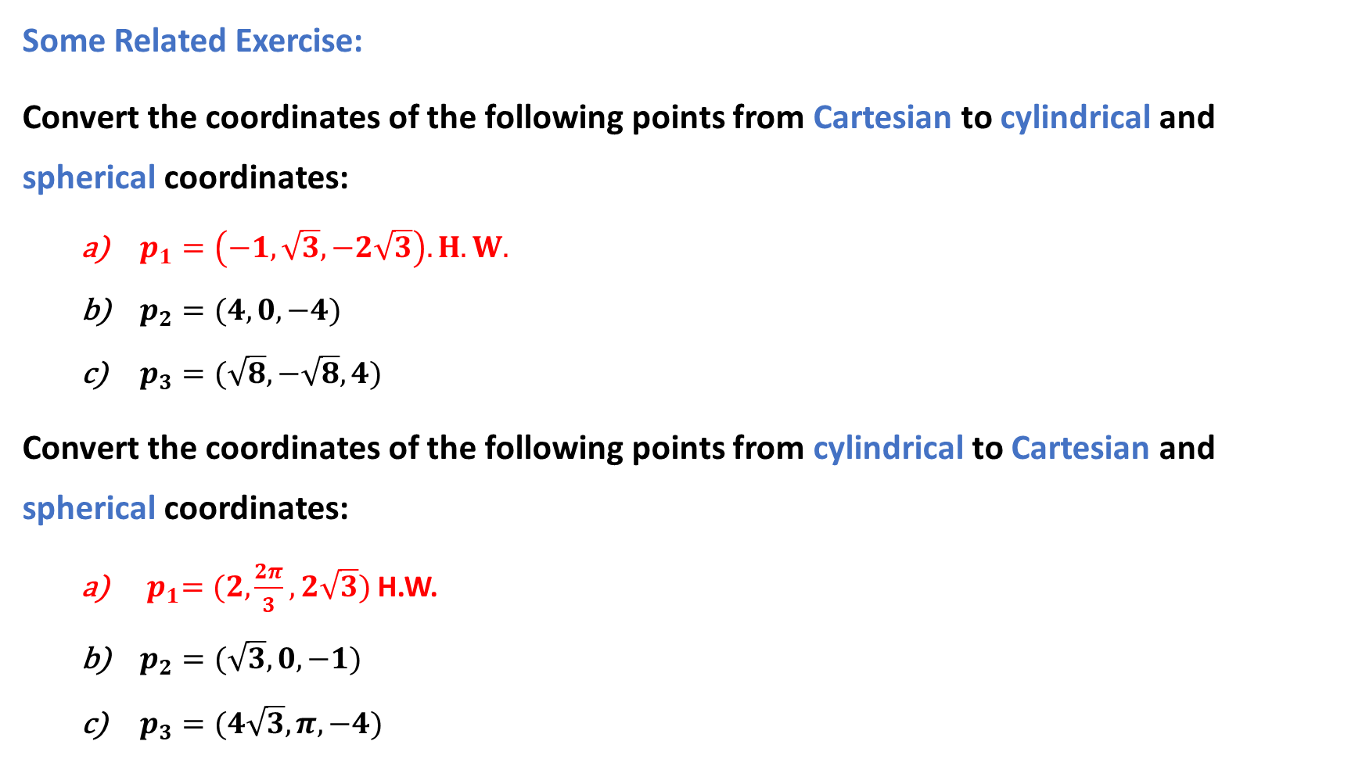
Some Related Exercise:
Convert the coordinates of the following points from Cartesian to cylindrical and spherical coordinates:
$p_{1}=\left(−1, \sqrt{3}, −2\sqrt{3}\right).H.W.$
$p_{2}=(4, 0, −4)$
$p_{3}=(\sqrt{8}, −\sqrt{8}, 4)$
Convert the coordinates of the following points from cylindrical to Cartesian and spherical coordinates:
${ p}_{1}=(2, \frac{2π}{3},2\sqrt{3})$ H.W.
$p_{2}=(\sqrt{3}, 0,−1)$
$p_{3}=(4\sqrt{3},π,−4)$

Slide 10
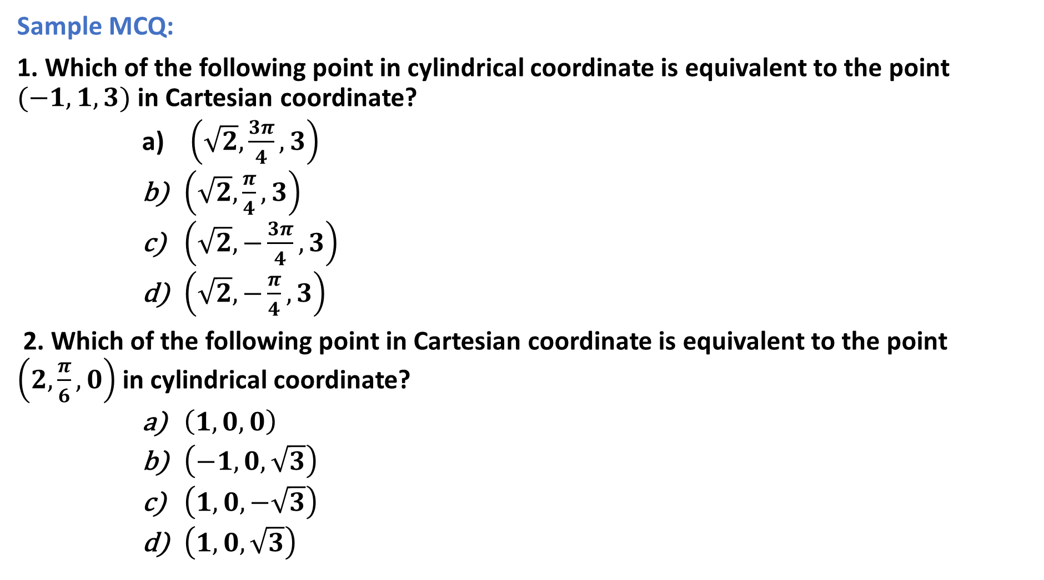
Sample MCQ:
1. Which of the following point in cylindrical coordinate is equivalent to the point $(−1, 1, 3)$ in Cartesian coordinate?
$\left(\sqrt{2}, \frac{3π}{4}, 3\right)$
$\left(\sqrt{2}, \frac{π}{4}, 3\right)$
$\left(\sqrt{2}, −\frac{3π}{4}, 3\right)$
$\left(\sqrt{2}, −\frac{π}{4}, 3\right)$
2. Which of the following point in Cartesian coordinate is equivalent to the point $\left(2, \frac{π}{6}, 0\right)$ in cylindrical coordinate?
$\left(1, 0, 0\right)$
$\left(−1, 0, \sqrt{3}\right)$
$\left(1, 0, −\sqrt{3}\right)$
$\left(1, 0, \sqrt{3}\right)$

Slide 11

3. Which of the following could be true for the point$\left(2, 0, −2\right)$ ?
it is a point in cylindrical coordinate
it is a point in Cartesian coordinate
both of them
none of them

Slide 12
Outcome:
Clear concept about three coordinate systems and the relationship between them.
Point & vector can be easily transformed from one coordinate to another.

