Slide 1
Lecture 8
Divergence and Curl

Slide 2
Objective
To discuss about divergence
To discuss about curl

Slide 3
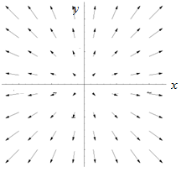
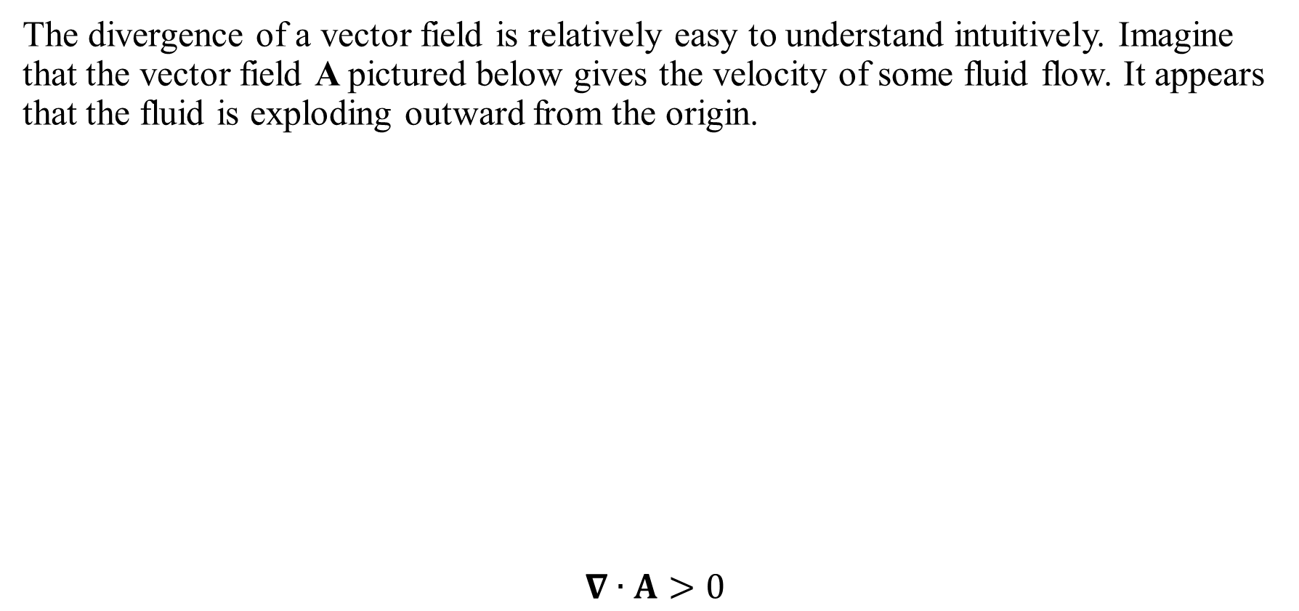
The divergence of a vector function
The divergence of a vector field is relatively easy to understand intuitively. Imagine that the vector field A pictured below gives the velocity of some fluid flow. It appears that the fluid is exploding outward from the origin.
$$∇∙A>0$$

Slide 4
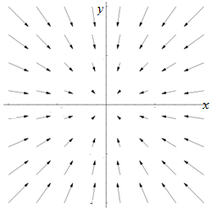
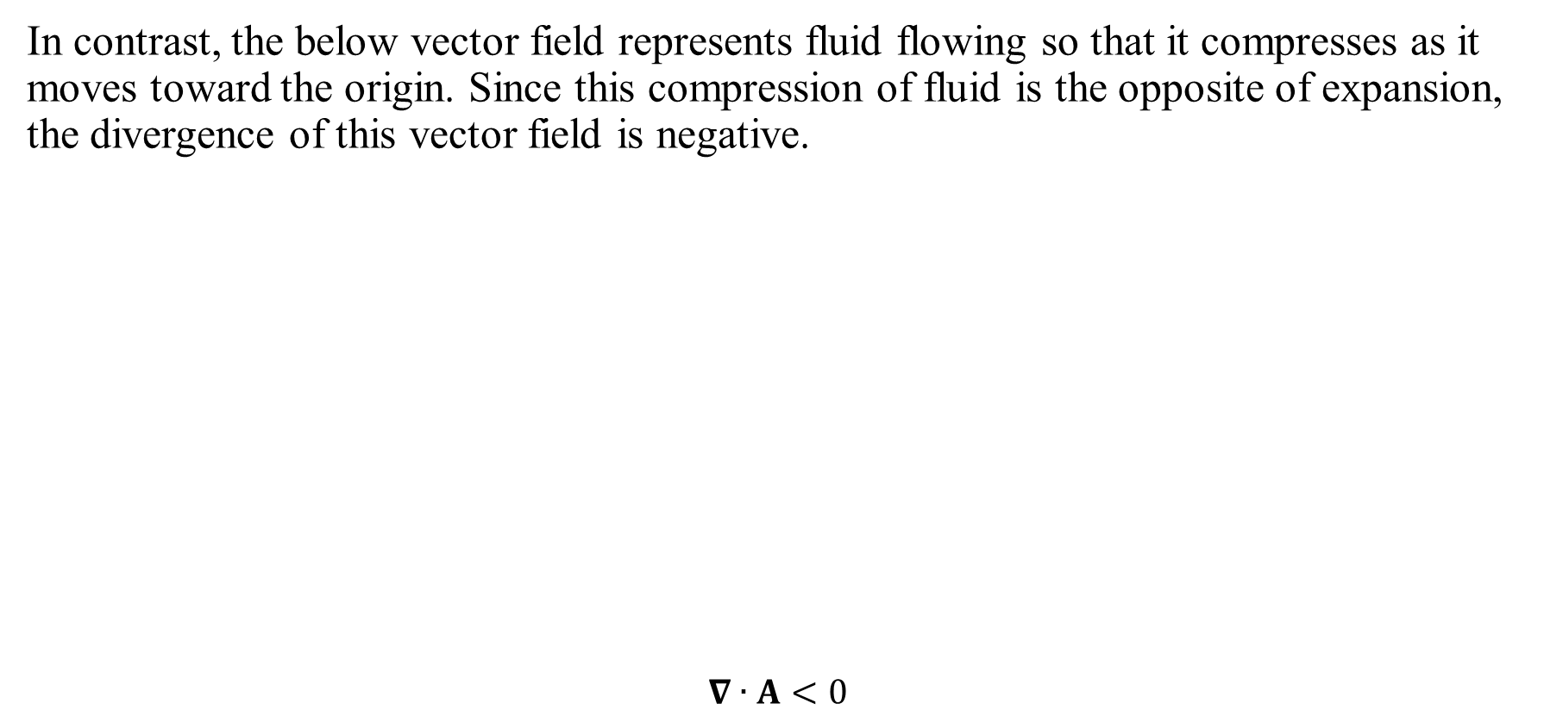
The divergence of a vector function
In contrast, the below vector field represents fluid flowing so that it compresses as it moves toward the origin. Since this compression of fluid is the opposite of expansion, the divergence of this vector field is negative.
$$∇∙A<0$$

Slide 5
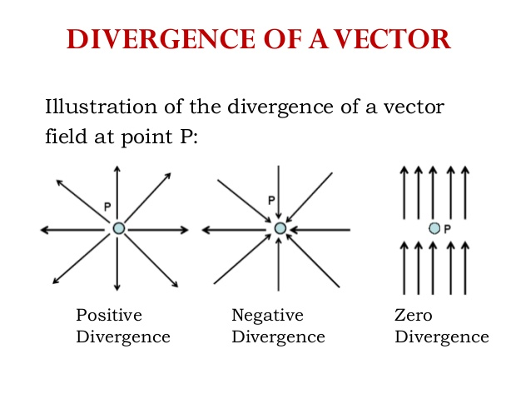

The divergence of a vector function
Lastly, a solenoidal vector field (also known as an incompressible vector field, a divergence-free vector field) is a vector field $A$ with divergence zero at all points in the field. That is $$∇∙A=0$$

Slide 6
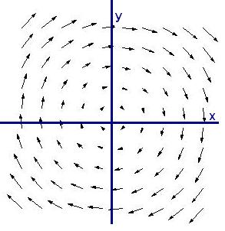

The curl of a vector function
The curl of a vector field captures the idea of how a flow may rotate.
If $curlA=0$ then $A$is called conservative or irrotational.

Slide 7
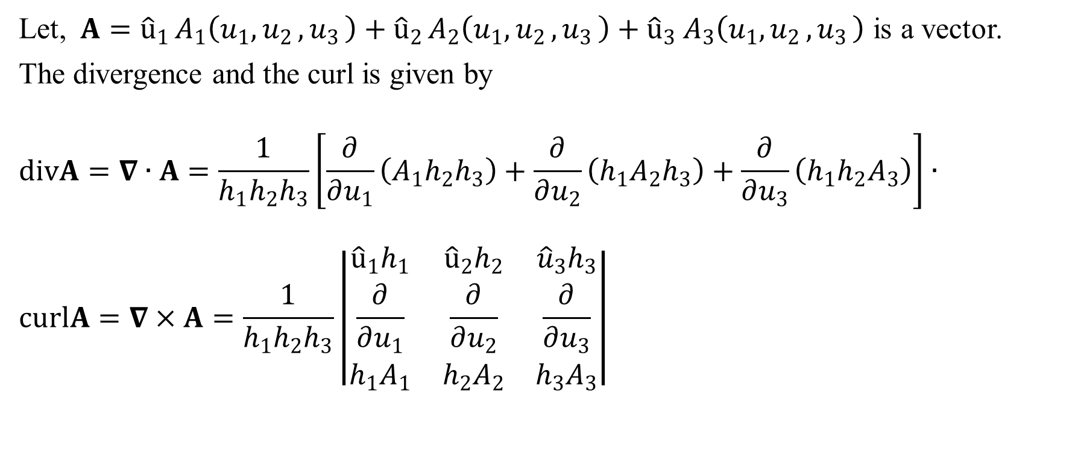
Formula for divergence and curl
Let, $A={\hat{u}}_{1 }A_{1}\left(u_{1}{, u}_{2}{, u}_{3}\right)+{\hat{u}}_{2 }A_{2}{\left(u_{1}{, u}_{2}{, u}_{3}\right)+{\hat{u}}_{3} A}_{3}\left(u_{1}{, u}_{2}{, u}_{3}\right)$ is a vector.
The divergence and the curl is given by
$$divA=∇∙A=\frac{1}{h_{1}h_{2}h_{3}}\left[\frac{∂}{∂u_{1}}\left(A_{1}h_{2}h_{3}\right)+\frac{∂}{∂u_{2}}\left(h_{1}A_{2}h_{3}\right)+\frac{∂}{∂u_{3}}\left(h_{1}h_{2}A_{3}\right)\right]∙$$
$$curlA=∇×A=\frac{1}{h_{1}h_{2}h_{3}}\left|\begin{matrix}{{\hat{u}}_{1}h}_{1} & {\hat{u}}_{2}h_{2} & {\hat{u}}_{3}h_{3} \\ \frac{∂}{∂u_{1}} & \frac{∂}{∂u_{2}} & \frac{∂}{∂u_{3}} \\ h_{1}A_{1} & h_{2}A_{2} & h_{3}A_{3}\end{matrix}\right|$$

Slide 8
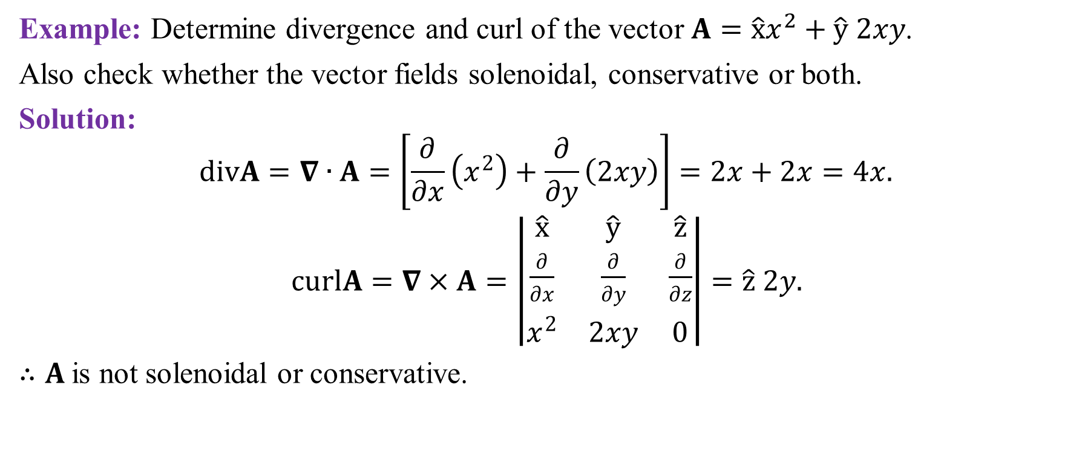
Example of divergence and curl
Example: Determine divergence and curl of the vector $A=\hat{x}x^{2}+\hat{y} 2xy$.
Also check whether the vector fields solenoidal, conservative or both.
Solution:
$$divA=∇∙A=\left[\frac{∂}{∂x}\left(x^{2}\right)+\frac{∂}{∂y}\left(2xy\right)\right]=2x+2x=4x.$$
$curlA=∇×A=\left|\begin{matrix}\hat{x} & \hat{y} & \hat{z} \\ \frac{∂}{∂x} & \frac{∂}{∂y} & \frac{∂}{∂z} \\ x^{2} & 2xy & 0\end{matrix}\right|=\hat{z} 2y.$
$∴A$is not solenoidal or conservative.

Slide 9
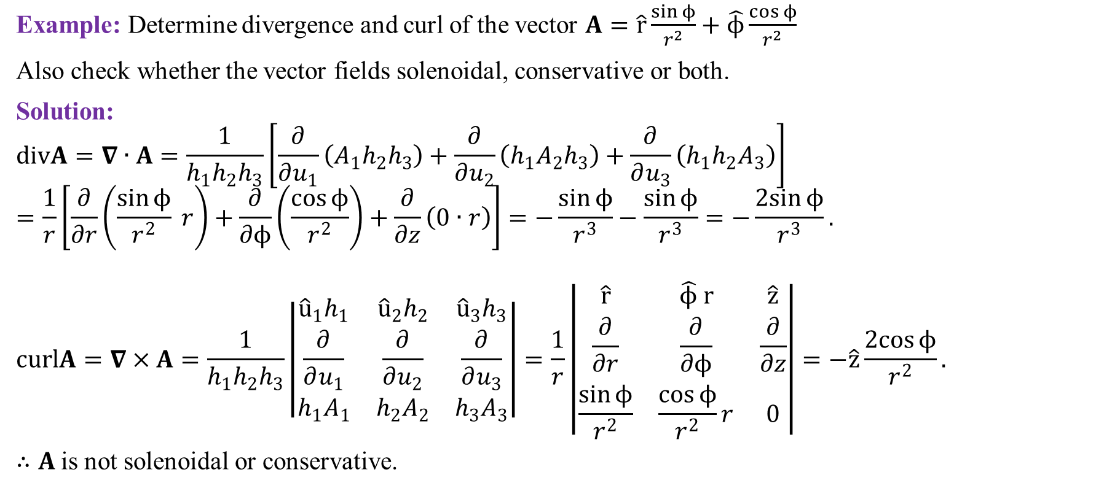
Example of divergence and curl
Example: Determine divergence and curl of the vector $A=\hat{r}\frac{\sin{ϕ}}{r^{2}}+\hat{ϕ}\frac{\cos{ϕ}}{r^{2}}$
Also check whether the vector fields solenoidal, conservative or both.
Solution:
$$divA=∇∙A=\frac{1}{h_{1}h_{2}h_{3}}\left[\frac{∂}{∂u_{1}}\left(A_{1}h_{2}h_{3}\right)+\frac{∂}{∂u_{2}}\left(h_{1}A_{2}h_{3}\right)+\frac{∂}{∂u_{3}}\left(h_{1}h_{2}A_{3}\right)\right]$$
$$=\frac{1}{r}\left[\frac{∂}{∂r}\left(\frac{\sin{ϕ}}{r^{2}} r\right)+\frac{∂}{∂ϕ}\left(\frac{\cos{ϕ}}{r^{2}}\right)+\frac{∂}{∂z}\left(0∙r\right)\right]=−\frac{\sin{ϕ}}{r^{3}}−\frac{\sin{ϕ}}{r^{3}}=−\frac{2sin{ϕ}}{r^{3}}.$$
$$curlA=∇×A=\frac{1}{h_{1}h_{2}h_{3}}\left|\begin{matrix}{{\hat{u}}_{1}h}_{1} & {\hat{u}}_{2}h_{2} & {\hat{u}}_{3}h_{3} \\ \frac{∂}{∂u_{1}} & \frac{∂}{∂u_{2}} & \frac{∂}{∂u_{3}} \\ h_{1}A_{1} & h_{2}A_{2} & h_{3}A_{3}\end{matrix}\right|=\frac{1}{r}\left|\begin{matrix}\hat{r} & \hat{ϕ} r & \hat{z} \\ \frac{∂}{∂r} & \frac{∂}{∂ϕ} & \frac{∂}{∂z} \\ \frac{\sin{ϕ}}{r^{2}} & \frac{\cos{ϕ}}{r^{2}}r & 0\end{matrix}\right|=−\hat{z}\frac{2cos{ϕ}}{r^{2}}.$$
$∴A$is not solenoidal or conservative.

Slide 10
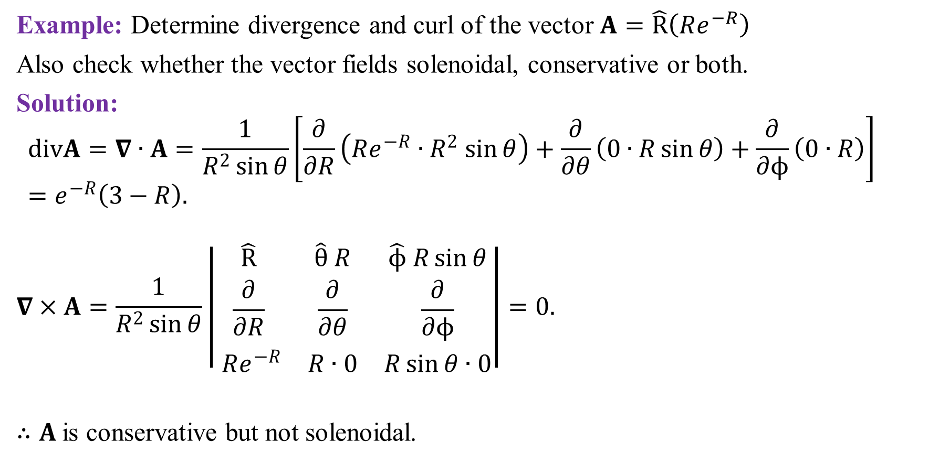
Example of divergence and curl
Example: Determine divergence and curl of the vector $A=\hat{R}\left(Re^{−R}\right)$
Also check whether the vector fields solenoidal, conservative or both.
Solution:
$$divA=∇∙A=\frac{1}{R^{2}\sin{θ}}\left[\frac{∂}{∂R}\left(Re^{−R}{∙R}^{2}\sin{θ}\right)+\frac{∂}{∂θ}\left(0∙R\sin{θ}\right)+\frac{∂}{∂ϕ}\left(0∙R\right)\right] =e^{−R}\left(3−R\right).$$
$$∇×A=\frac{1}{R^{2}\sin{θ}}\left|\begin{matrix}\hat{R} & \hat{θ} R & \hat{ϕ} R\sin{θ} \\ \frac{∂}{∂R} & \frac{∂}{∂θ} & \frac{∂}{∂ϕ} \\ Re^{−R} & R∙0 & R\sin{θ}∙0\end{matrix}\right|=0.$$
$∴A$is conservative but not solenoidal.

Slide 11
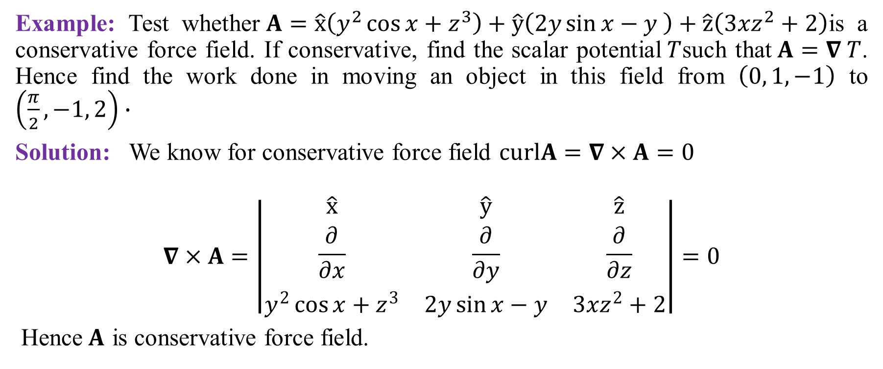
Example of divergence and curl
Example: Test whether$A=\hat{x}\left(y^{2}\cos{x}+z^{3}\right)+\hat{y}\left(2y\sin{x}−y \right)+\hat{z}\left(3xz^{2}+2\right)$is a conservative force field. If conservative, find the scalar potential$T$such that$A=∇ T$. Hence find the work done in moving an object in this field from $\left(0, 1, −1\right)$ to $\left(\frac{π}{2}, −1, 2\right)∙$
Solution: We know for conservative force field $curlA=∇×A=0$
$$∇×A=\left|\begin{matrix}\hat{x} & \hat{y} & \hat{z} \\ \frac{∂}{∂x} & \frac{∂}{∂y} & \frac{∂}{∂z} \\ y^{2}\cos{x}+z^{3} & 2y\sin{x−y} & 3xz^{2}+2\end{matrix}\right|=0$$
Hence$A$ is conservative force field.

Slide 12
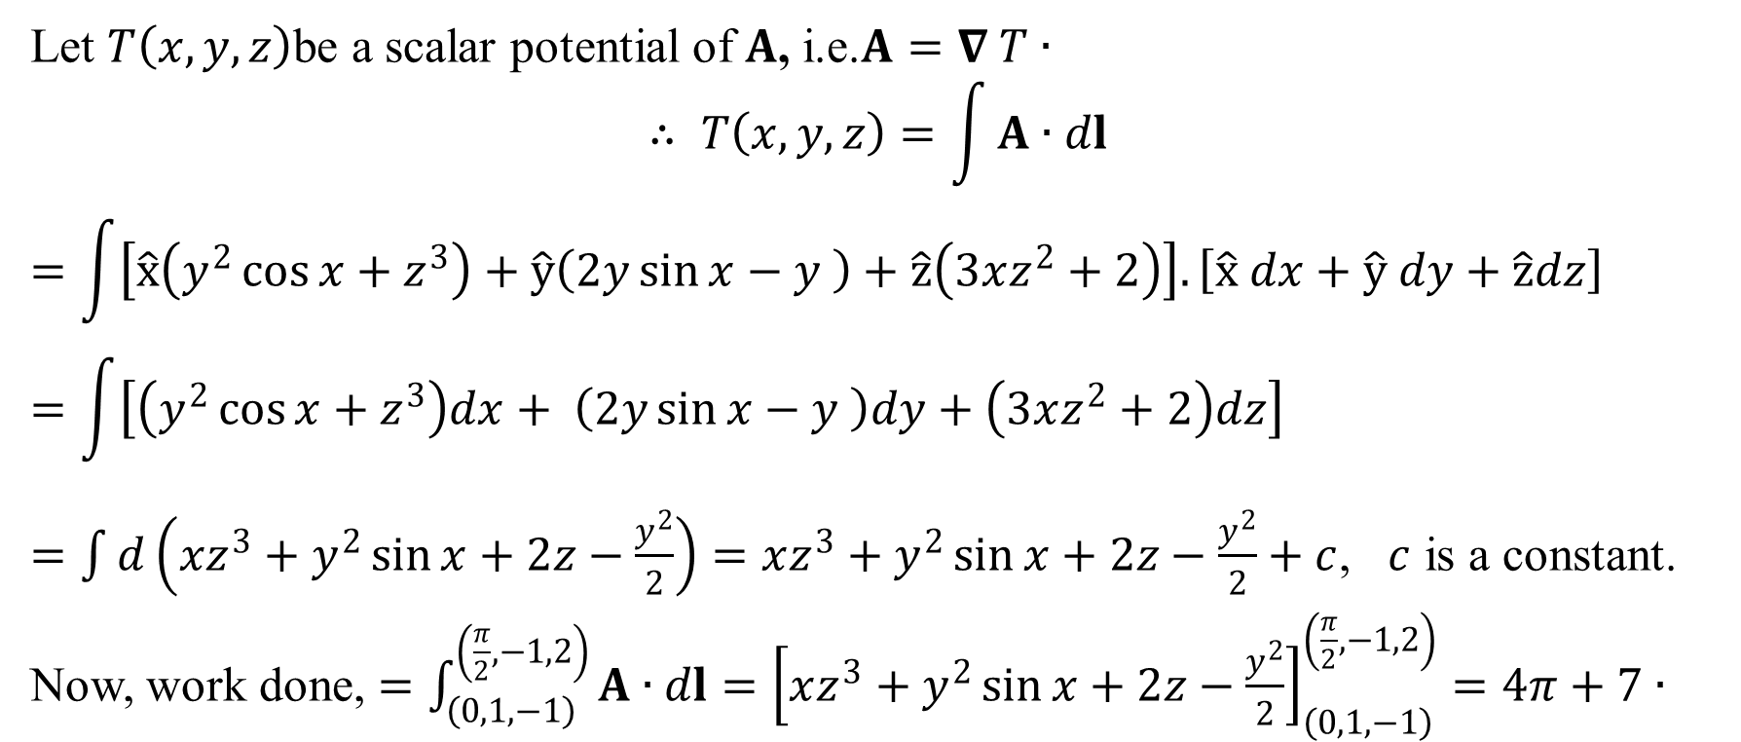
Example of divergence and curl (continued)
Let $T\left(x, y, z\right)$be a scalar potential of $A$, i.e.$A=∇ T∙$
$$∴ T\left(x, y, z\right)=\int{A∙dl}$$
$$=\int{\left[\hat{x}\left(y^{2}\cos{x}+z^{3}\right)+\hat{y}\left(2y\sin{x}−y \right)+\hat{z}\left(3xz^{2}+2\right)\right].\left[\hat{x} dx+\hat{y} dy+\hat{z}dz\right]}$$
$$=\int{\left[\left(y^{2}\cos{x}+z^{3}\right)dx+ \left(2y\sin{x}−y \right)dy+\left(3xz^{2}+2\right)dz\right]}$$
$=\int{d\left(xz^{3}+y^{2}\sin{x}+2z−\frac{y^{2}}{2}\right)}=xz^{3}+y^{2}\sin{x}+2z−\frac{y^{2}}{2}+c$, $c$ is a constant.
Now, work done, $=\int_{\left(0, 1, −1\right)}^{\left(\frac{π}{2}, −1, 2\right)}{A∙dl}={\left[xz^{3}+y^{2}\sin{x}+2z−\frac{y^{2}}{2}\right]}_{\left(0, 1, −1\right)}^{\left(\frac{π}{2}, −1, 2\right)}=4π+7∙$

Slide 13
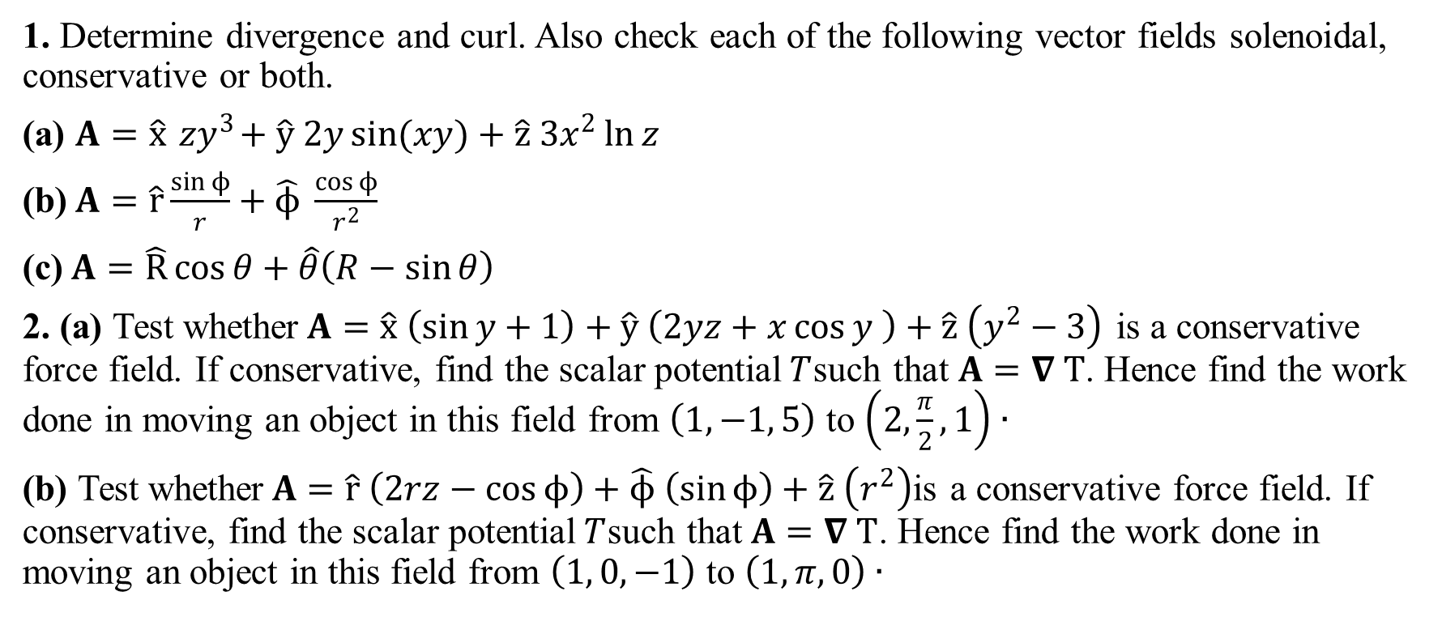
Sample Exercise
1. Determine divergence and curl. Also check each of the following vector fields solenoidal, conservative or both.
(a) $A=\hat{x}{ zy}^{3}+\hat{y} 2y\sin{(xy)}+\hat{z} 3x^{2}\ln{z}$
(b)$A=\hat{r}\frac{\sin{ϕ}}{r}+\hat{ϕ} \frac{\cos{ϕ}}{r^{2}}$
(c)$A=\hat{R}\cos{θ}+\hat{θ}\left(R−\sin{θ}\right)$
2. (a) Test whether$A=\hat{x} \left(\sin{y}+1\right)+\hat{y} \left(2yz+x\cos{y} \right)+\hat{z} \left(y^{2}−3\right)$ is a conservative force field. If conservative, find the scalar potential$T$such that$A=∇ T$. Hence find the work done in moving an object in this field from $\left(1, −1, 5\right)$ to $\left(2,\frac{π}{2}, 1\right)∙$
(b) Test whether$A=\hat{r} \left(2rz−\cos{ϕ}\right)+\hat{ϕ} \left(\sin{ϕ}\right)+\hat{z} \left(r^{2}\right)$is a conservative force field. If conservative, find the scalar potential$T$such that$A=∇ T$. Hence find the work done in moving an object in this field from $\left(1, 0, −1\right)$ to $\left(1, π, 0\right)∙$

Slide 14
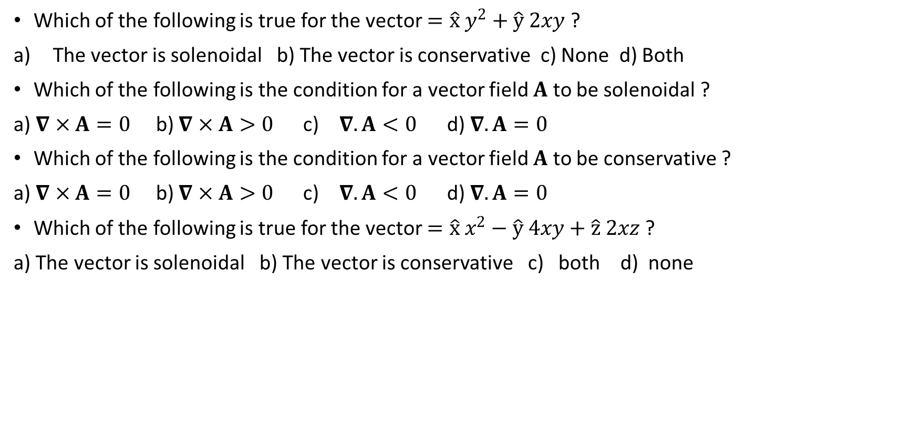
Sample MCQ
Which of the following is true for the vector $=\hat{x} y^{2}+\hat{y} 2xy$ ?
The vector is solenoidal b) The vector is conservative c) None d) Both
Which of the following is the condition for a vector field $A$ to be solenoidal ?
a) $∇×A=0$ b) $∇×A>0$ c) $∇.A<0$ d) $∇.A=0$
Which of the following is the condition for a vector field $A$ to be conservative ?
a) $∇×A=0$ b) $∇×A>0$ c) $∇.A<0$ d) $∇.A=0$
Which of the following is true for the vector $=\hat{x} x^{2}−\hat{y} 4xy+\hat{z} 2xz$ ?
a) The vector is solenoidal b) The vector is conservative c) both d) none

Slide 15
Outcome
After this lecture student will know
How to calculate divergence and curl
How to identify whether a vector is solenoidal or not
How to identify whether a vector field is conservative or not

Slide 16
Next class
Gauss Divergence theorem

