Slide 1

Home
Profile
My Clubs
Log Out
LitScope
Virtual Reading Club
Connecting readers...
LitScope

Slide 2
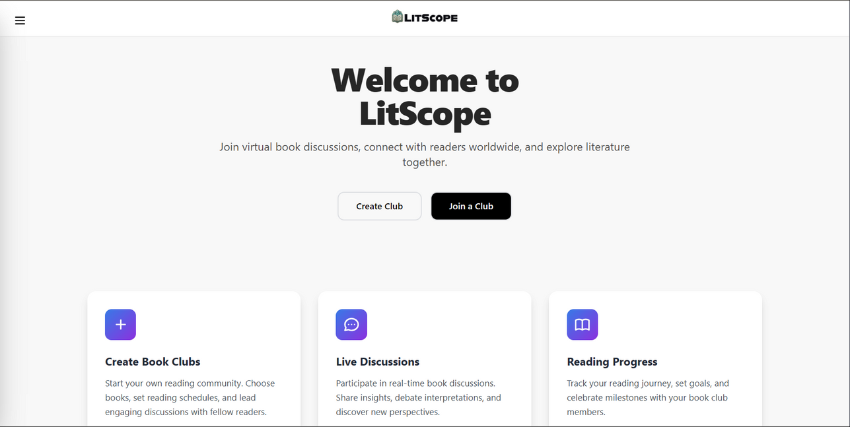
LitScope
Home
Profile
My Clubs
Log Out
Introduction
In a world where screens dominate our lives, ‘LitScope - A Virtual Reading Club’ brings back the joy of reading and shared ideas. This platform mainly focus connecting book lovers in the Bengali community around the world, allowing them to form clubs, discuss stories, and engage in real-time chats.
www.litscope.vercel.app

Slide 3

LitScope
Home
Profile
My Clubs
Log Out
Problem
Exists..
Lack of Engaging Virtual Reading Platforms
Disconnected Reading Communities
Payment App
LitScope
Barriers to Organizing Book Clubs

Slide 4
LitScope
Home
Profile
My Clubs
Log Out
So does
Solutions...
Generic platforms lack structure for meaningful book discussions. LitScope provides a dedicated space for organized and engaging book clubs.
LitScope
Readers often feel isolated in their reading journey. LitScope fosters connection by creating an interactive space for shared insights and discussions.
LitScope
Managing book clubs can be challenging. LitScope makes it easy to create and participate in book discussions with minimal effort.

Slide 5
LitScope
Home
Profile
My Clubs
Log Out
App’s Key
Features
1
2
Book Clubs
Live Discussions
Start your own reading community. Choose books, set reading schedules, and lead engaging discussions with fellow readers.
Participate in real-time book discussions. Share insights, debate interpretations, and discover new perspectives.
3
4
Reading Progress
Preview Books
LitScope
Track your reading journey, set goals, and celebrate milestones with your book club members.
Look for your desired books, get preview and add them to your shelf.

Slide 6
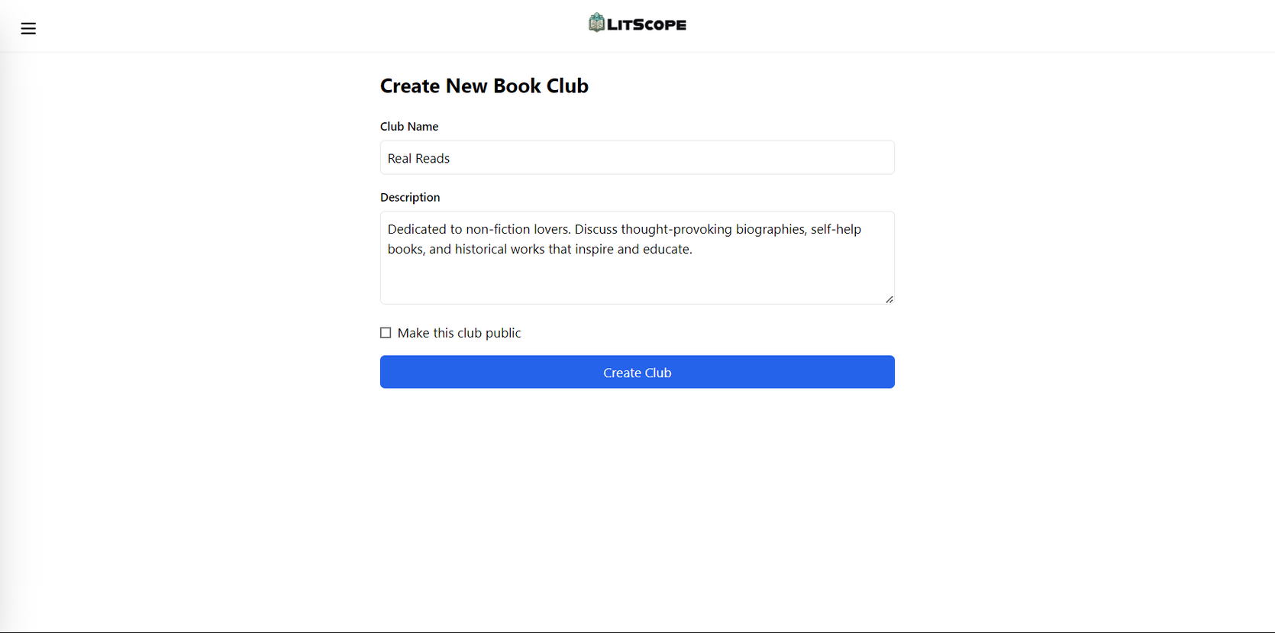
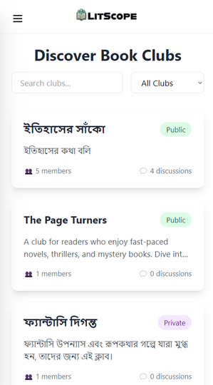
LitScope
Home
Profile
My Clubs
Log Out
Join or Create Your Own
Start your own reading community or join existing circles and start engaging
www.litscope.vercel.app

Slide 7
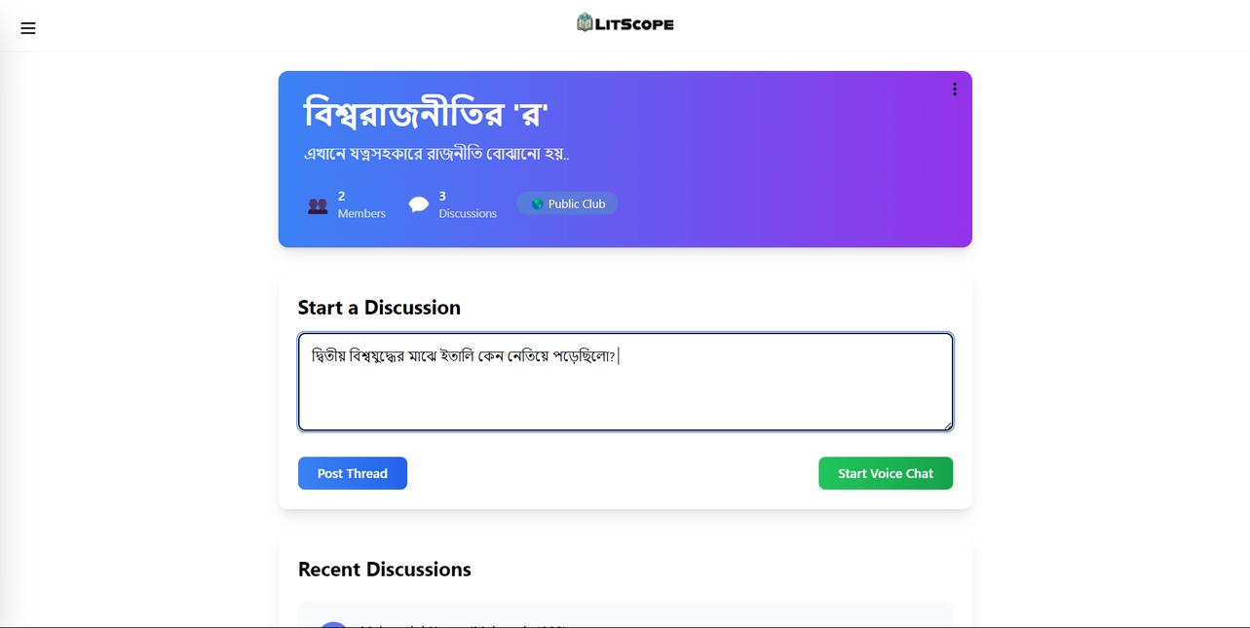
LitScope
Home
Profile
My Clubs
Log Out
Start Discussions
Participate in real-time book discussions. Share insights, debate interpretations, and discover new perspectives.
www.litscope.vercel.app

Slide 8
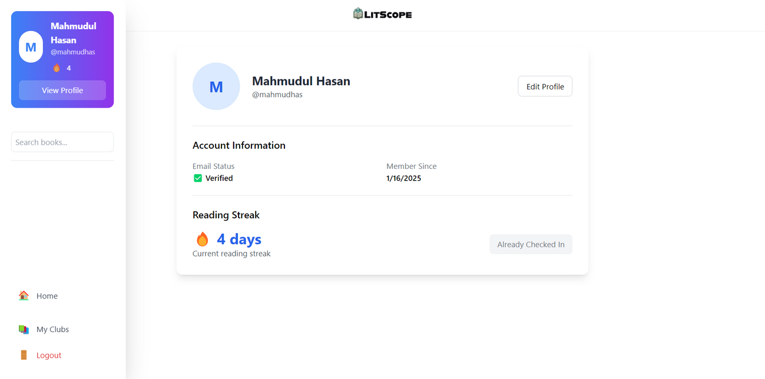
LitScope
Home
Profile
My Clubs
Log Out
Track Your Progress
Track your reading journey, set goals, and celebrate milestones with your book club members.
www.litscope.vercel.app

Slide 9
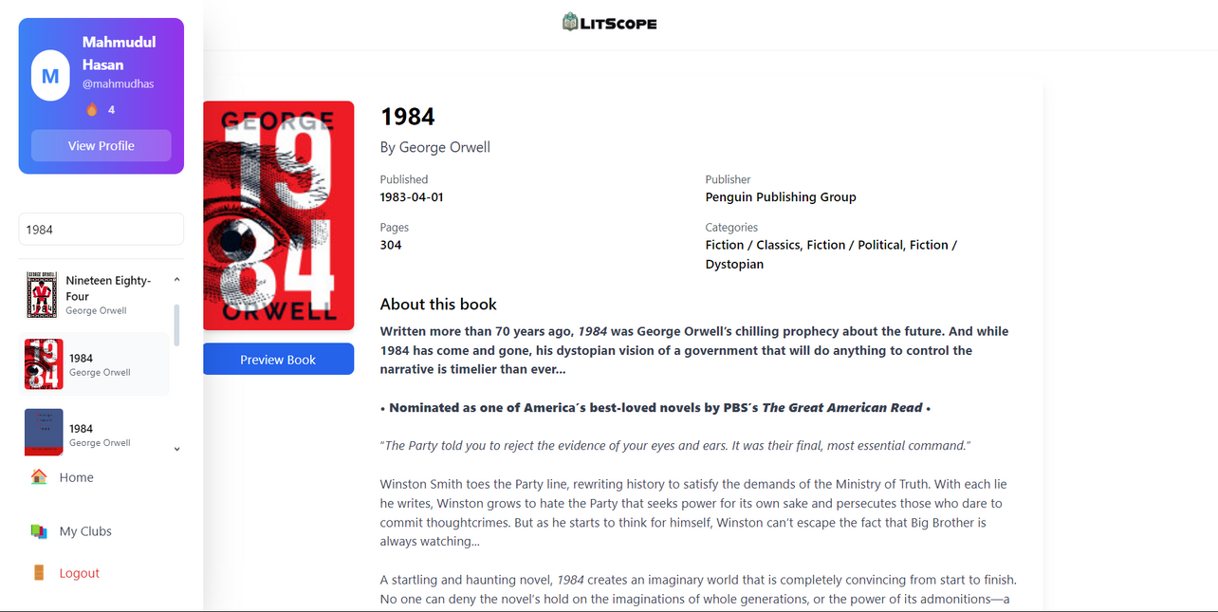
LitScope
Home
Profile
My Clubs
Log Out
Search For Books
Look for your desired books, get preview, add them to your shelf and discuss on them.
www.litscope.vercel.app

Slide 10
LitScope
Home
Profile
My Clubs
Log Out
...and even more to come...
New features are getting cooked to meet your needs and wants..
LitScope
Coming Soon...
LitScope
Coming Soon...
www.litscope.vercel.app

Slide 11
LitScope
Home
Profile
My Clubs
Log Out
Benefits
for Users
Users can connect with like-minded readers, fostering meaningful discussions and shared learning experiences.
Effortlessly create or join structured book clubs and discussion tables tailored to specific interests and genres.
Enjoy voice discussions, real-time chat, and collaborative tools, enhancing the reading and discussion experience.
LitScope

Slide 12

LitScope
Home
Profile
My Clubs
Log Out
User-Friendly
Interface
The UI/UX is maintained in such a way that makes the exploring hassle-free
LitScope
LitScope
LitScope

Slide 13
LitScope
Home
Profile
My Clubs
Log Out
Join LitScope Today!
LitScope
www.litscope.vercel.app

