Slide 1
Project -
Bank Management
System

Slide 2

Table of contents
Introduction
Motivation/Goal
Implementation
Output
Conclusion

Slide 3

Submitted to:
Dr. Mohammed Ashikur Rahman
Associate Professor
Department of CSE
Southeast University
Submitted by:
Name | ID
Jubair Abdullah | 2023200000773
Muhammad Faujul Kabir | 2023200000794
Md. Mahmud Hossain | 2023200000799

Slide 4
01
Introduction

Slide 5

Introduction
Concept:
A console-based Bank Account Management System.
Core Functionality:
              Admin: Create, delete, and list bank accounts.
            Customer: Deposit, withdraw, transfer money, check balance, and view transaction history.
The Main Focus: Four pillars of Object-Oriented Programming (OOP) in a practical, real-world application.

Slide 6
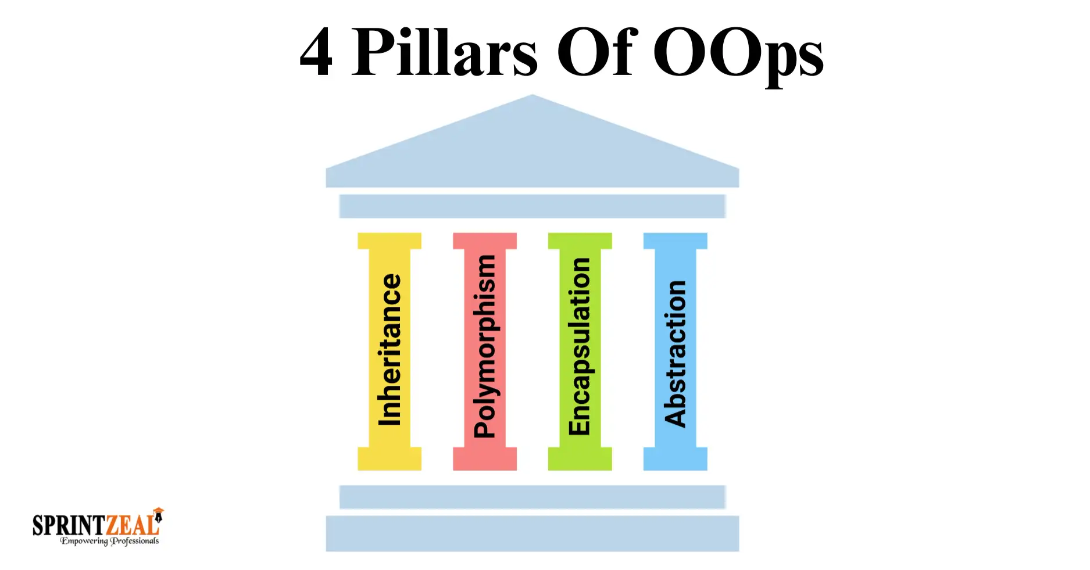
Introduction
The Four Pillars of OOP
Abstraction: Using an abstract Account class and Transactable interface.
Encapsulation: Protecting data (like balance) with private access and using public methods to interact with it.
Inheritance: Creating specialized accounts (Savings, Current, Student) that inherit common properties from the base Account class.
Polymorphism: Each account type overrides the withdraw() method to implement its own unique business rules.

Slide 7
Motivation & Goal
Why Did We Build This?
The Problem with Manual Systems:
  Prone to human errors and delays.
  Difficult to track transactions and enforce rules.
  No automated history or balance checks.
Our Goal: To build an automated, error-free, and efficient system that solves these problems.

Slide 8
Motivation & Goal
What Does Our System Solve?
Automates key banking operations.
Enforces critical business rules automatically:
  Savings Account: Must maintain a minimum balance.
  Current Account: Has an overdraft limit.
  Student Account: Has a per-transaction withdrawal limit.
Provides a clear, menu-driven interface for both admins and customers.

Slide 9

Implementation
Technology:
Language: Java (JDK 24)
IDE: Apache NetBeans
Key Concepts:
                1. Collections
                2. Exception Handling
                3. Input/Output
Core Structure: Bank class manages a collection of Account.
Account Types: Three concrete classes extending the abstract Account class, each with its own withdraw method implementation.

Slide 10
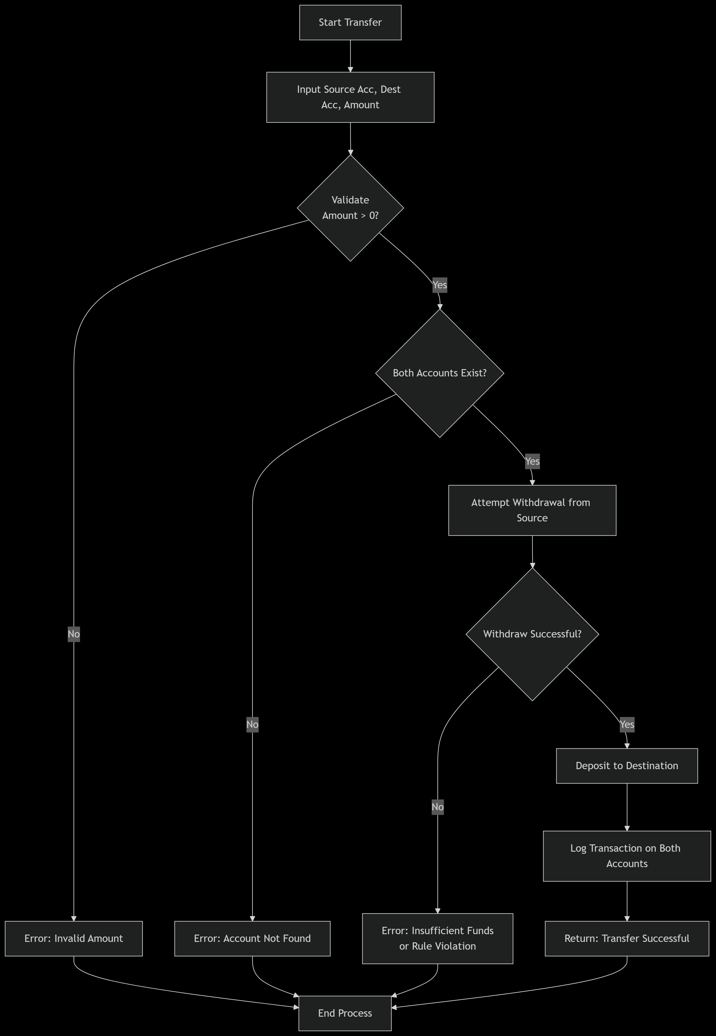
Implementation
Key Feature:
Input source and destination account numbers.
Input the amount.
Validate both accounts exist.
Call withdraw() on the source account (which automatically checks its specific rules).
If successful, call deposit() on the destination account.
Log the transaction in both accounts' histories.

Slide 11
Output
Admin Login: (admin / admin123)
  Create a new Savings Account for "John Doe" with ৳1000.
  Show: The account is created successfully with a generated number.
Customer Menu:
  Deposit: Add ৳500 to the new account.
  Transfer: Send ৳200 from this account to another pre-made account.
  Check History: Show the transaction log with timestamps for the account.

Slide 12
Conclusion
What We Learned & Achieved?
Achievement:
Successfully built a functional system applying all OOP principles.
Learning Outcomes:
Stronger Java programming skills.
Deep understanding of OOP design.
Experience with team collaboration and project planning.

Slide 13
Conclusion
How Can We Make It Better?
Future Improvements:
Database Integration: To save data permanently.
GUI: A graphical user interface for better user experience.
Enhanced Security: Password encryption and more user roles.
Mobile/Web Application: Expanding the system's reach.

Slide 14
Thank
You

Slide 15
Any
Question?

