Slide 1
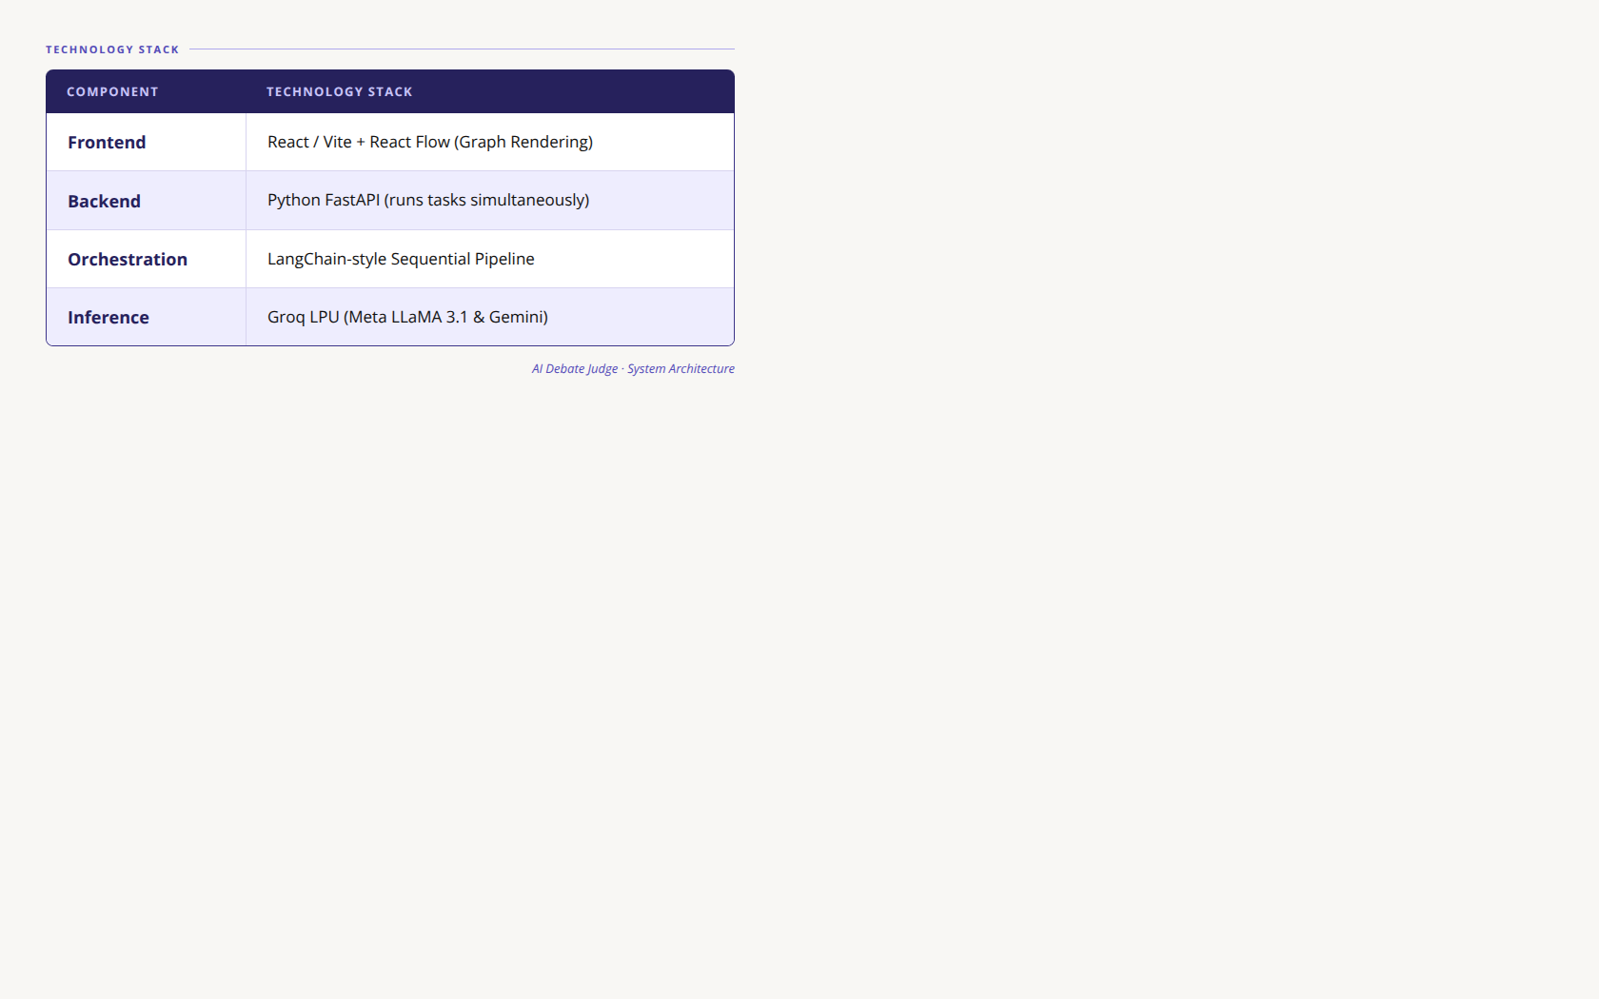
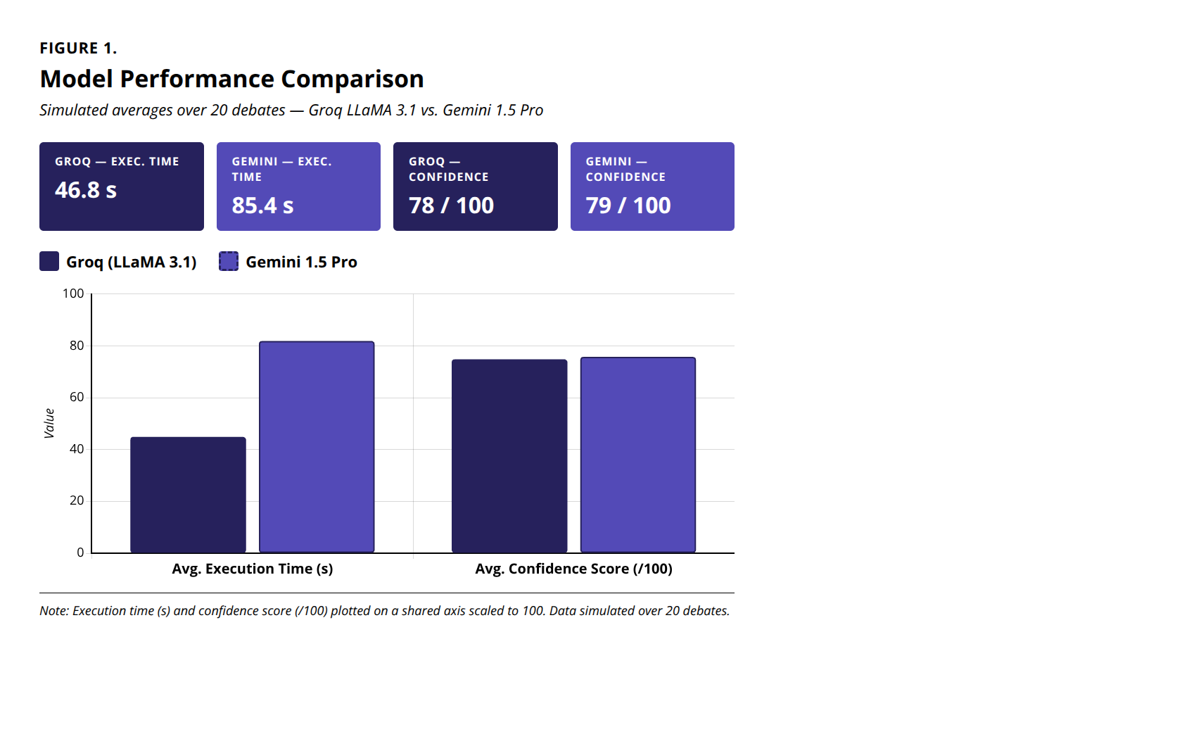
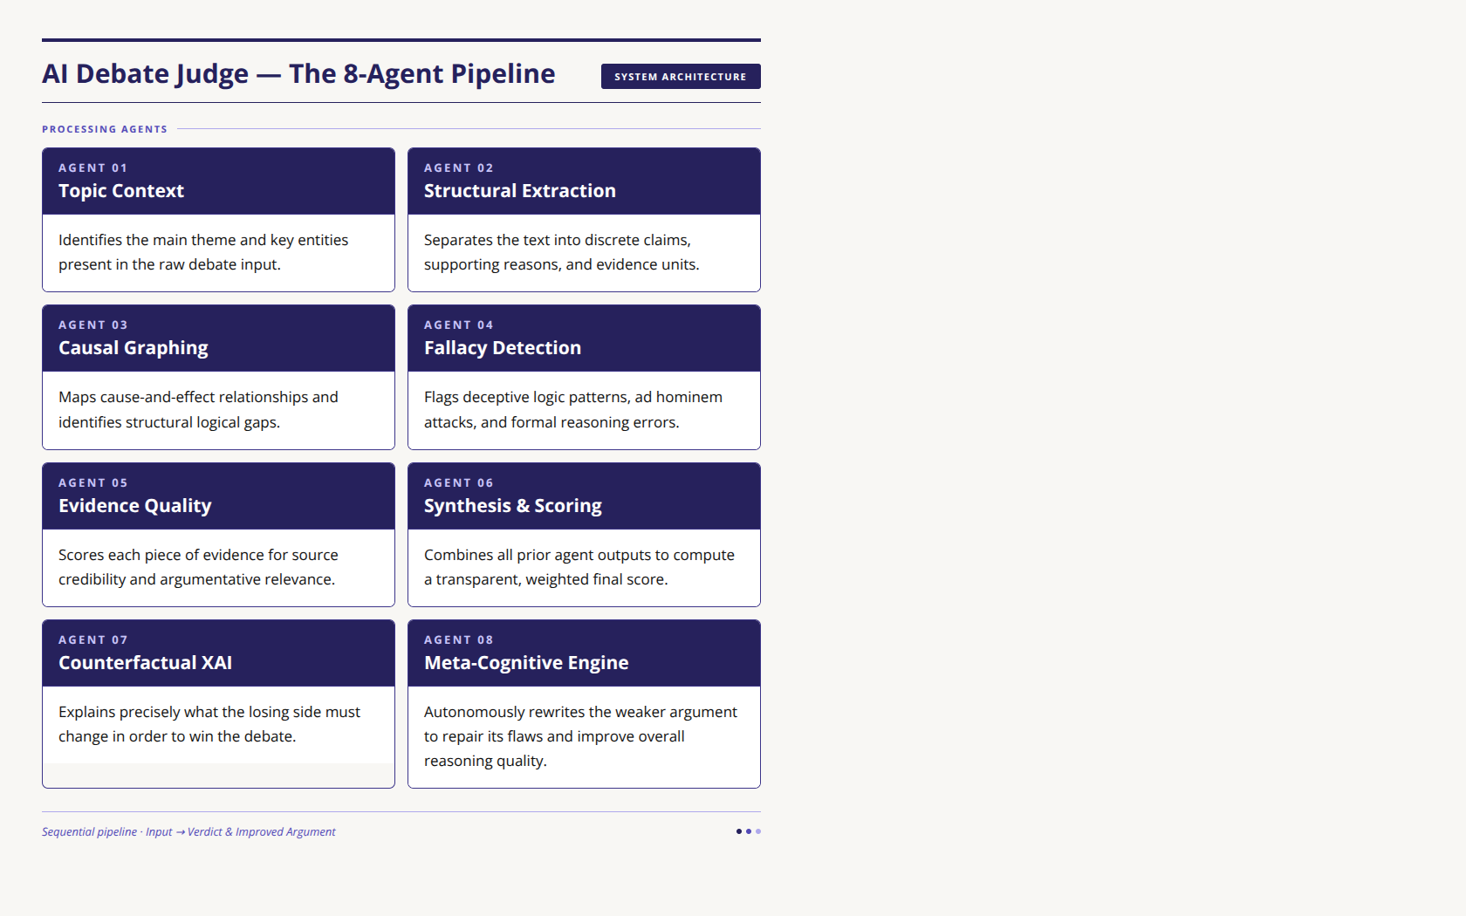
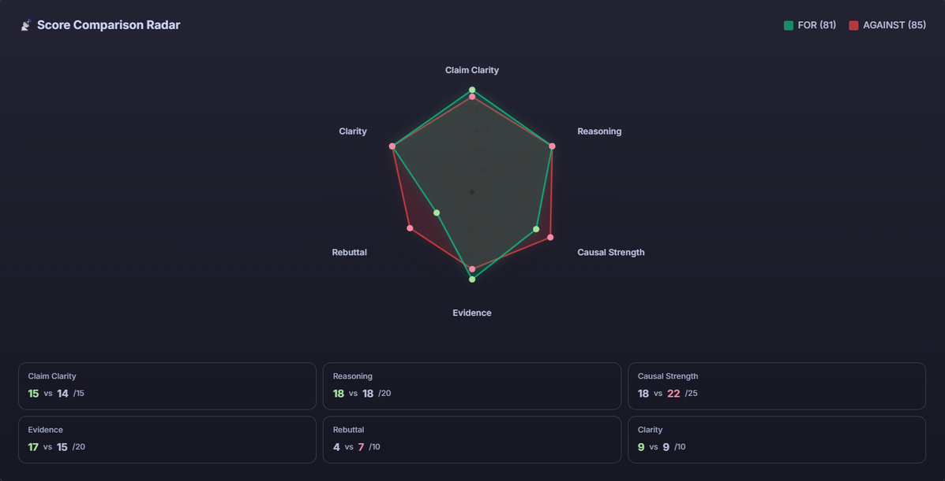
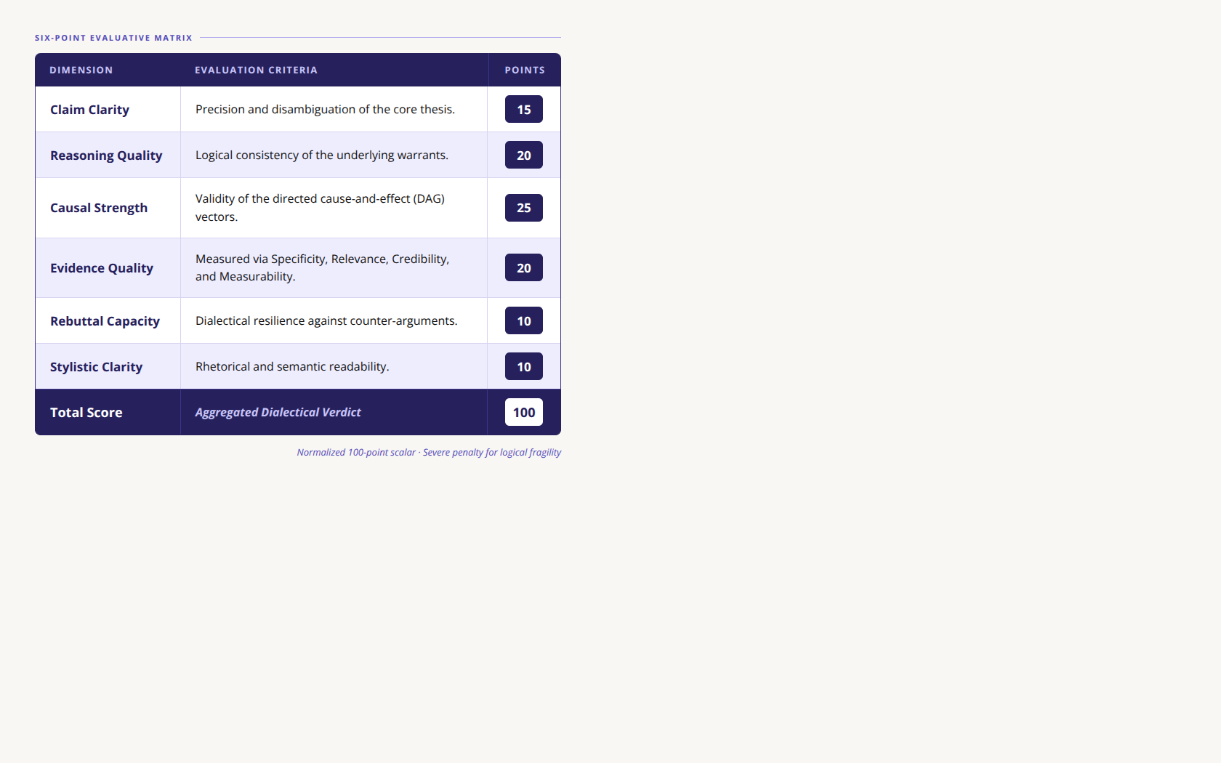
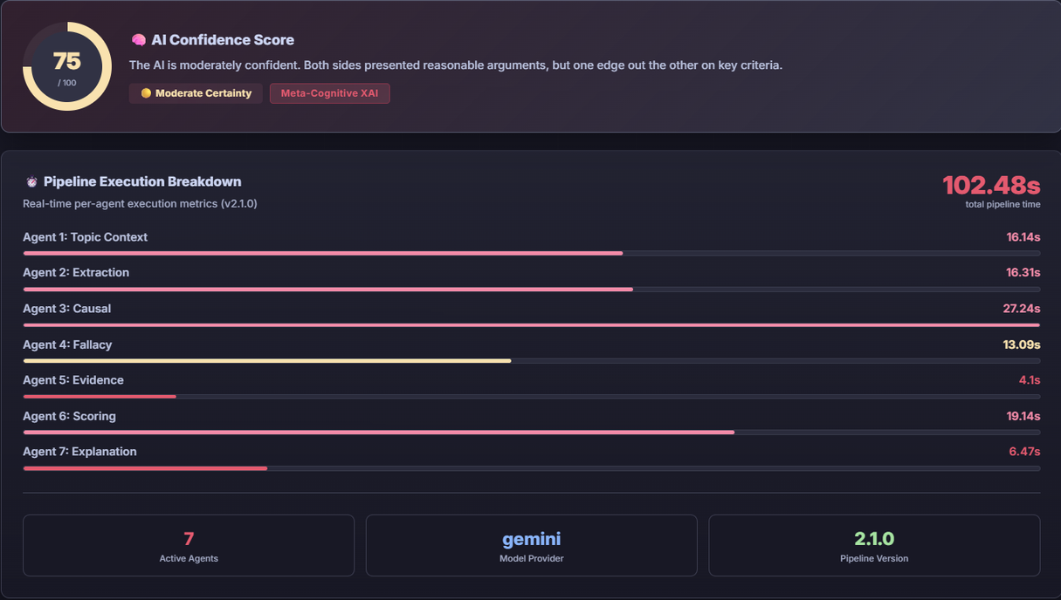

Causal AI Debate Judge:
A Multi-Agent Framework for Explainable Argument Analysis
Course Name: Artificial Intelligence Laboratory
Course Code: CSE-4202
Md. Refayatul Islam (2252421059), Md. Sakib Hasan (2252421083), Shahariar Hossain (2252421085), Rashik Mahmud Majumder (2252421097)
Lecturer Sayma Alam Suha
&
Lecturer Md. Mahabubur Rahman
Department of Computer Science and Engineering, Bangladesh University of Professionals
ABSTRACT
3. METHODOLOGY
4. TECHNOLOGICAL STACK
Model Performance Benchmarking: Across 20 simulated debates, the Groq/LLaMA 3 pipeline processed nearly 2x faster, while Google Gemini achieved slightly higher AI confidence through deeper contextual synthesis.
Large Language Models (LLMs) are very good models but their debate evaluations tend to be "black box" giving scores without any explanation. To address the problem we propose the Causal AI Debate Judge. This scheme decomposes analysis of arguments into discrete steps that are easily understood. Our system enables AI to be a reliable and structured judge by mapping cause-and-effect relationships, identifying logical fallacies and assessing the quality of evidence. It gives detailed scores, discusses alternative choices, and also provides analytical feedback and establishing a new benchmark in the clear and outlined debate on AI.
A "Glass-Box" Approach instead of asking a single AI to do everything at once, we use a step-by-step pipeline. This turns messy debate text into clear and logical maps that anyone can understand and verify.
The system runs tasks simultaneously (asynchronously) to speed up the evaluation process and provide real-time results.
Table-02: Technological Stacks
1. INTRODUCTION
5. RESULT AND ANALYSIS
While Large Language Models (LLMs) have been used successfully as zero-shot evaluators, their monolithic designs make it difficult to learn about their deductive processes behind the decisions they make. To overcome this opacity, we propose a multi-agent-based, compartmentalized approach to the evaluation process, which decomposes it. The proposed system will distribute specific cognitive tasks to distributed autonomous nodes in a systematic manner, allowing its deductive reasoning to be completely transparent, reproducible, and verifiable.
Our tests show the system is fast and reliable. The integrated dashboard provides real-time data on the evaluation process.
Score Comparison Radar: A chart comparing the FOR (81) and AGAINST (85) arguments across the six scoring areas.
Figure-04: Model Performance Benchmarking (n=20 Debates)
6. CONCLUSION
The Causal AI Debate Judge represents a paradigm shift in automated argumentation analysis. By fundamentally rejecting opaque methodologies, this framework proves that compartmentalized cognitive orchestration yields highly reproducible and explainable discourse analysis. Future iterations will integrate continuous Retrieval-Augmented Generation (RAG) to autonomously verify cited statistics against live academic databases.
Figure-01: Architectural Schematic of the 8-Agent Orchestration Pipeline
Six-Point Evaluative Matrix: The framework calculates a normalized 100-point scalar score by distributing evaluative weight across six orthogonal dimensions, severely penalizing logical fragility:
2. LITERATURE REVIEW
LLM Opacity: Monolithic LLMs frequently suffer from "attention collapse" during complex, multi-step logical evaluation, systematically prioritizing rhetorical fluency over deductive validity [1, 2].
Multi-Agent Orchestration: Distributing cognitive load across specialized autonomous agents (e.g., ChatEval) simulates deliberative "System 2" thinking, effectively mitigating generative hallucination and maximizing deterministic output [3].
Explainable AI (XAI): In the domain of Natural Language Processing, robust XAI requires actionable, structural counterfactuals rather than opaque scalar scores or post-hoc attention visualizations [4].
Table-01: Evaluation Metrices and Their Dedicated Criteria and Score
Figure-02: Score Comparison Radar
REFERENCES
AI Confidence Score & Pipeline Speed: Real-time data showing a 75/100 confidence score and a total processing time of 102.48s.
[1] Toulmin, S.E. The Uses of Argument, 1958.
[2] Dung, P.M. Artificial Intelligence, 1995.
[3] Kadavath, S. et al. arXiv preprint, 2022.
[4] Wang, L. et al. Frontiers of CS, 2024.
CODE & IMPLEMENTATION
Scan to view the Full 8-agent Python pipeline
&
UI source code.
Figure-03: AI Confidence & Pipeline Speed

