Slide 1
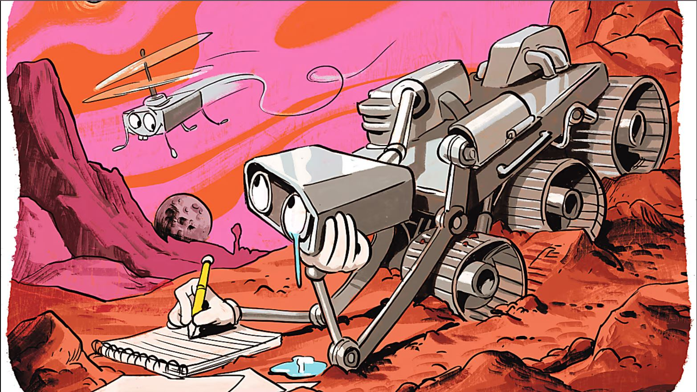
Leveraging Quantum Machine Learning for Advanced Terrain Recognition in Mars Rover Missions
Yeamin Mahmud
Promit Sarker
Fabiha Moyeen

Slide 2
Models we have implemented for A14MARS
Restnet (16000 Training Images & 2000 Test Images)
Unet ( 200 Training images & 20 Test Images)
DeeplabV3 ( 200 Training images & 20 Test Images)
Segnet ( 200 Training images & 20 Test Images)
Github Link: https://github.com/mahmudresin/Senior-Design-Project-499
Kaggle Link: https://www.kaggle.com/datasets/yeaminmahmudresin/mars-dataset

Slide 3
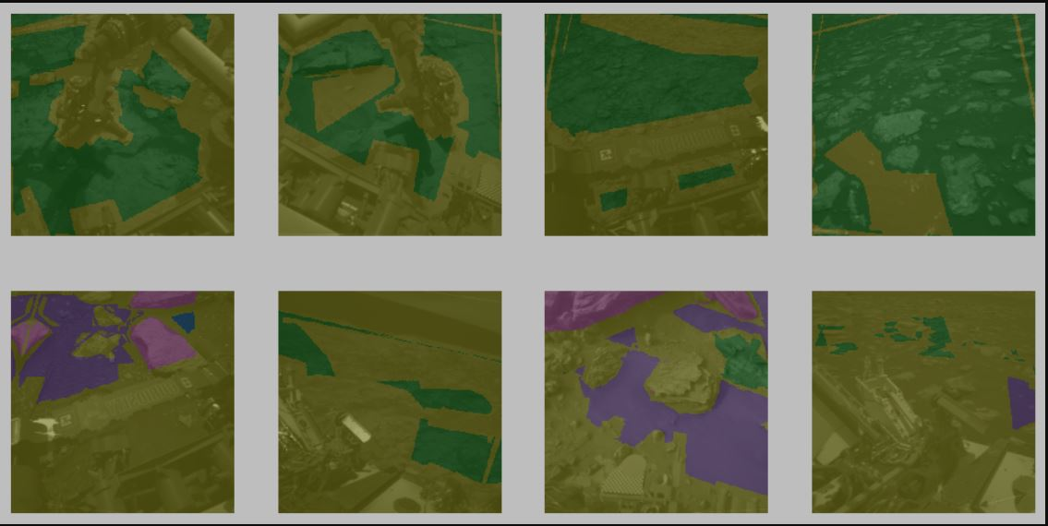
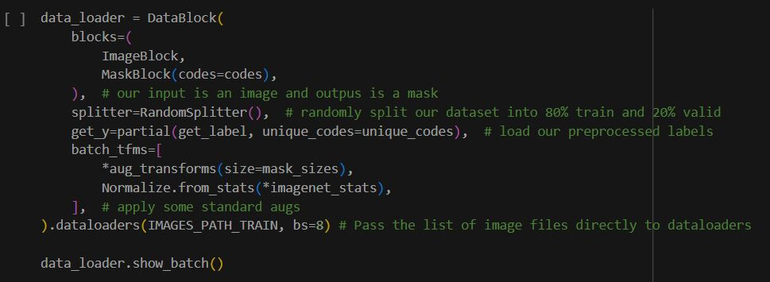
Labels:
Bedrock
Soil
Sand
Large rocks
Other possible obstacles

Slide 4
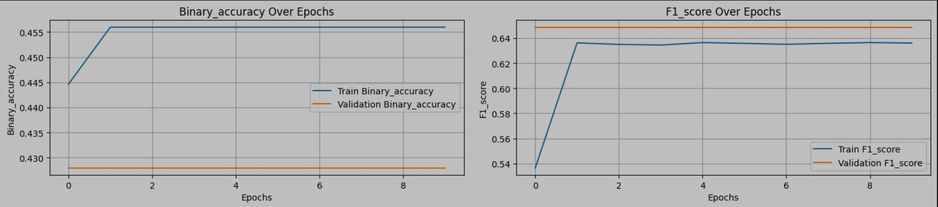
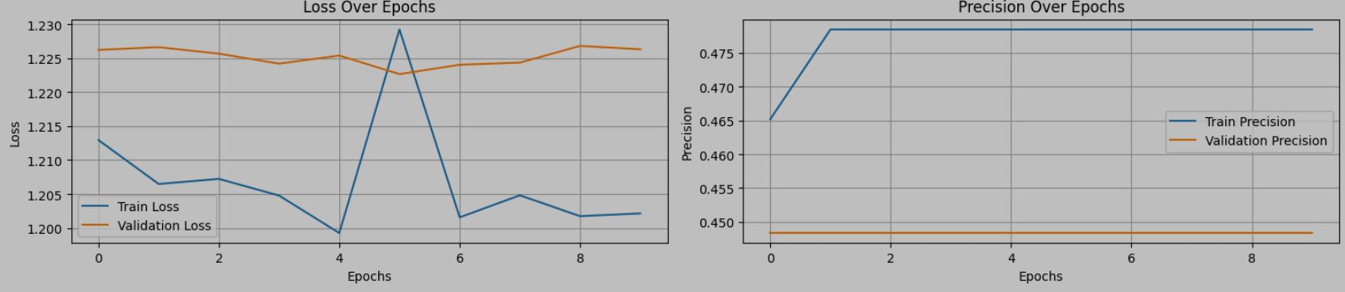
Results
100.00% [811712512/811706944 00:13<00:00]
/usr/local/lib/python3.10/dist-packages/fastai/vision/learner.py:303: UserWarning: `cnn_learner` has been renamed to `vision_learner` -- please update your code warn("`cnn_learner` has been renamed to `vision_learner` -- please update your code")
Model size: 11.72 million parameters
100.00% [811712512/811706944 00:13<00:00]
/usr/local/lib/python3.10/dist-packages/fastai/vision/learner.py:303: UserWarning: `cnn_learner` has been renamed to `vision_learner` -- please update your code warn("`cnn_learner` has been renamed to `vision_learner` -- please update your code")
Model size: 11.72 million parameters

Slide 5
