Slide 1
Welcome you all on Todays Presentation
Presented by-
Md. Mostofa Imrul Haque
Lecturer
Department of Physics
Pabna Cadet College,Pabna

Slide 2
The Topics of our Discussion
Present situation of our Academic Curriculum
How to recover the short-comings of our curriculum (Idea of British Council)
Discussions on our British Council training about teaching technique
About the ISA Award
What we should do?

Slide 3
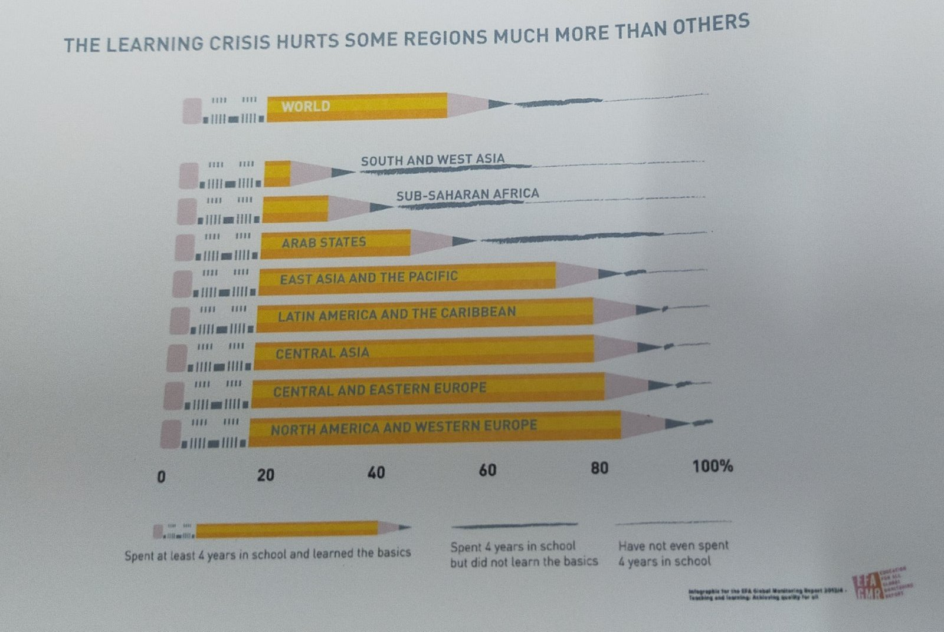
Present situation of our Academic Curriculum (Global Monitoring Report)
1. The pencil represents-
Spent at least 4 years
in school and achieved
the basic knowledge
2. Bold Line represents-
Spent at least 4 years
in school and did not
Achieve the basic
knowledge
3.Dotted Line represents-
Have not even spent
4 years in School.

Slide 4
Present situation of our Academic Curriculum Practical views about digital literacy
Our present learners-
What should they look like-
What should they look like-

Slide 5
How to recover the short-comings of our curriculum (Idea of British Council)
By Applying SDG’s
The 17 sustainable development goals (SDGs):
GOAL 1: No Poverty
GOAL 2: Zero Hunger
GOAL 3: Good Health and Well-being
GOAL 4: Quality Education
GOAL 5: Gender Equality
GOAL 6: Clean Water and Sanitation
GOAL 7: Affordable and Clean Energy
GOAL 8: Decent Work and Economic Growth
GOAL 9: Industry, Innovation and Infrastructure
GOAL 10: Reduced Inequality
GOAL 11: Sustainable Cities and Communities
GOAL 12: Responsible Consumption and Production
GOAL 13: Climate Action
GOAL 14: Life below Water
GOAL 15: Life on Land
GOAL 16: Peace and Justice Strong Institutions
GOAL 17: Partnerships to achieve the Goal

Slide 6
How to recover the short-comings of our curriculum (Idea of British Council)
According to British Council and UNESCO teaching Framework- Six Core Skills need to develop on our learners for achieving the SDG’s
1. Critical Thinking and problem solving
2. Creativity and Imagination
3. Collaboration and Communication
4. Citizenship knowledge
5. Digital literacy
6. Leadership quality

Slide 7
Discussions on our British Council training about teaching technique
Responsibility of teachers:
1. Increase Students Involvement-Good open question
2. Evaluation- Good feedback
3. Create lesson plan depending on the level of your students.

Slide 8
Understanding the learner’s receiving capacity
To understand the learner’s receiving capacity a teacher must have these knowledge:
Different learners level:
Verbal-Linguistic intelligence (Word Smart)
Logical-Mathematical Intelligence (Math Smart)
Spatial Intelligence (Picture Smart)
Musical Intelligence (Music Smart)
Bodily-Kinesthetic Intelligence (Body Smart)
Interpersonal Intelligence (People Smart)
Intrapersonal Intelligence (Self Smart)
Naturalistic Intelligence ( Nature Smart)

Slide 9
International School Award (ISA)

Slide 10
What is ISA?
ISA is a methodology or a confirm way to ensure the achievement of six core skills for the learners.

Slide 11
What is ISA?
By ensuring the achievement of six core skills for the learners an institute can achieve the special award for 3 years. Which is declared by British Council and announced by an award ceremony two times a year.
By ensuring the achievement of six core skills for the learners any institute may apply for the award.
Chairman, Governing body of Cadet colleges, Instructed us to apply for this award.

Slide 12
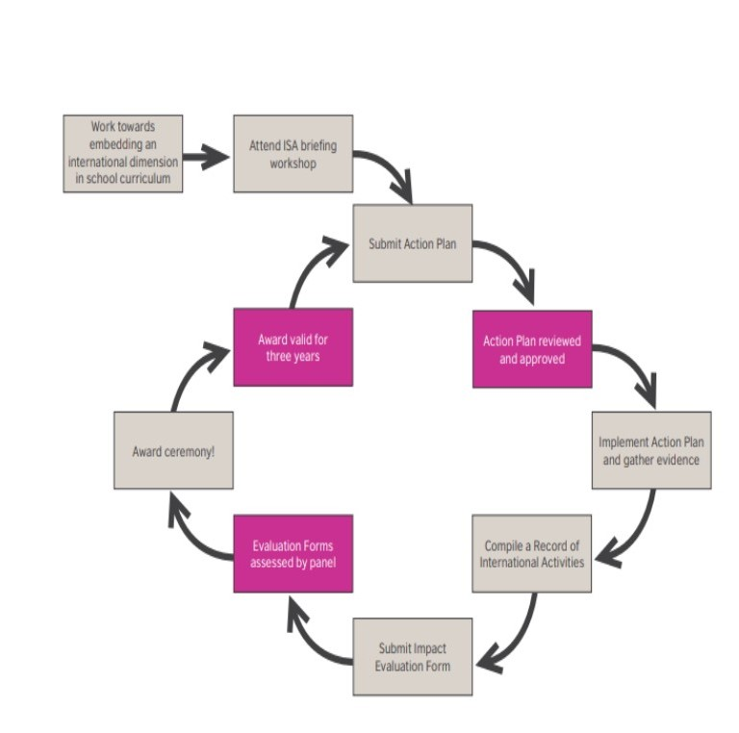
Process for applying ISA Award

Slide 13
What we need to do?
Making plan for seven projects from our text book for such a good teaching-learning technique which will ensure the achievement of one or more core skills and two or more SDG’s.
Share these ideas with our learners and give them the guideline for execute the plan by online of somehow practically.
Make an action plan by the given format.
By this time coordinator will communicate with the local partners and international partners and share their views with partner institution.

Slide 14
What we need to do?
5. And finally coordinator will help our learners to collaborate with the learners of Partner Institute.
6. And both the group of learners will do their project and share with each other and enrich their skills.
7. All these sharing materials and evidences will be stored officially and be submitted on a given format to the ISA Board.
8. In such a way we have to submit at least seven projects with at least three foreign institute and with other local Institute.
9. Side by side all the related persons/Institute needs to resister on ISA online forum.

Slide 15
ISA Project Sample
Bangladeshi Project sample-
ISA Project Sample-

Slide 16

Any Question?

Slide 17
Thanks to All for Patience Hearing.

