Slide 1

Famous Bangladeshi Personalities And Their Ranks within The Domain of Mathematics

Slide 2

Muhammad Habibar Rahman (1923-1971)
MS from Aligarh University
Professor in Dhaka College
Graduated from Cambridge
Chairman and Professor at RU

Slide 3

A F Mujibur Rahman
(1897-1945)
MS from Calcutta University with Highest Score
Judicial Branch
Studied in Oxford University

Slide 4
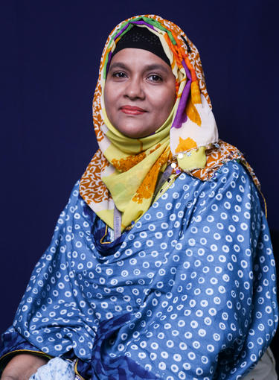
Dr. Hasibun Naher
PhD from the School of Mathematical Sciences, Universiti Sains Malaysia (USM)
Citation: 456

Slide 5
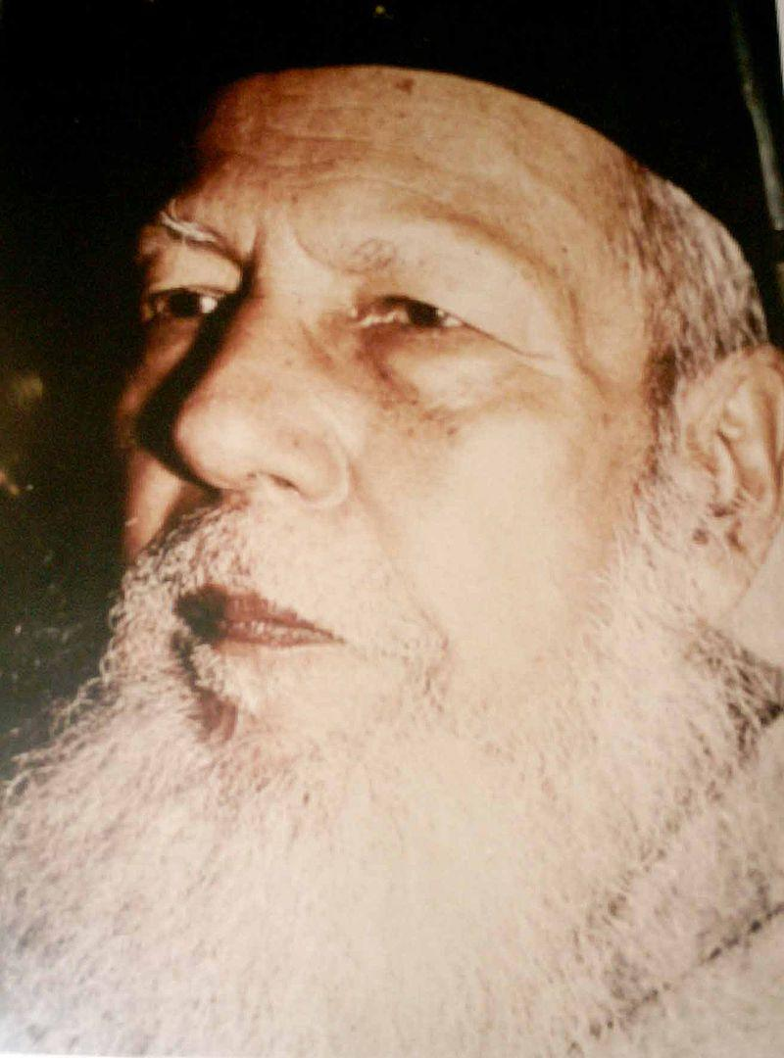
Qazi Motahar Hossain (1897-1981)
Author, scientist, statistician, chess player, and journalist.
Hossain Chain Rule
All India chess champion for seven times.

Slide 6
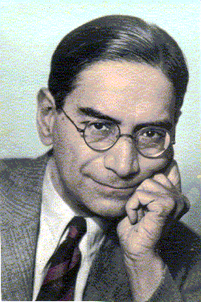
Prasanta Chandra Mahalanobis
(1893-972)
Mahalanobis distance
Members of the first Planning Commission of India.
Founded the Indian Statistical Institute

Slide 7
Kali S. Banerjee (1914-2002)
Professor of statistics at the University of Delaware
Cost of Living Index

Slide 8
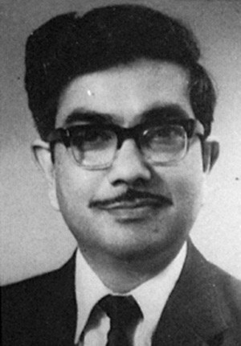
Jamal Nazrul Islam (1939-2013)
Mathematical physicist
Regularly cited by renowned scientists
The Ultimate Fate of the universe (1983)
An Introduction to Mathematical Cosmology (1992)
Rotating Fields in General Relativity (1985)

