Slide 1
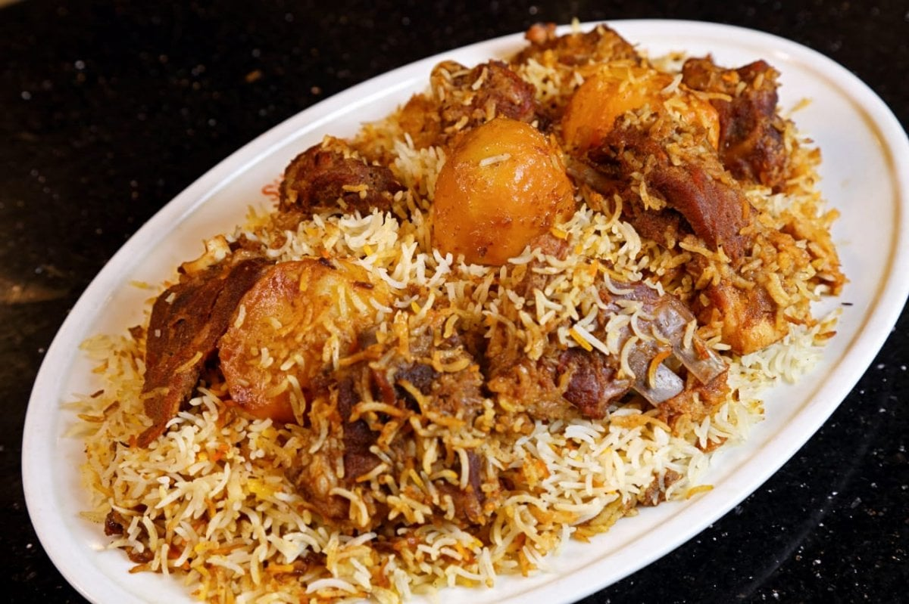
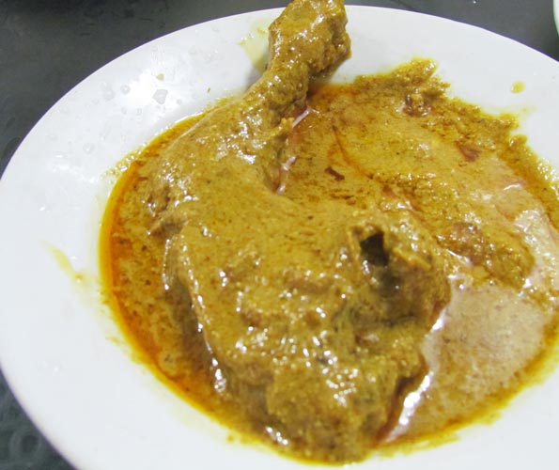
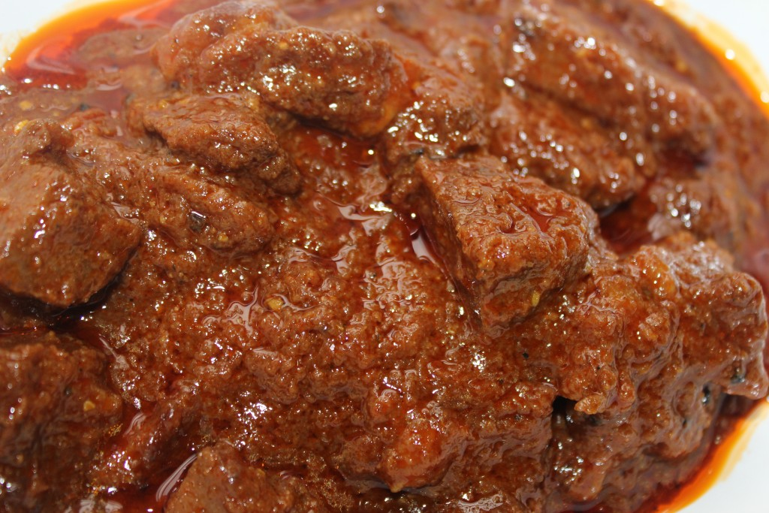
Kacchi.Com
Menu Available:
Kachhi
Roast
Beef
FA
Farhan’s Academy
Find your essential courses

Slide 2
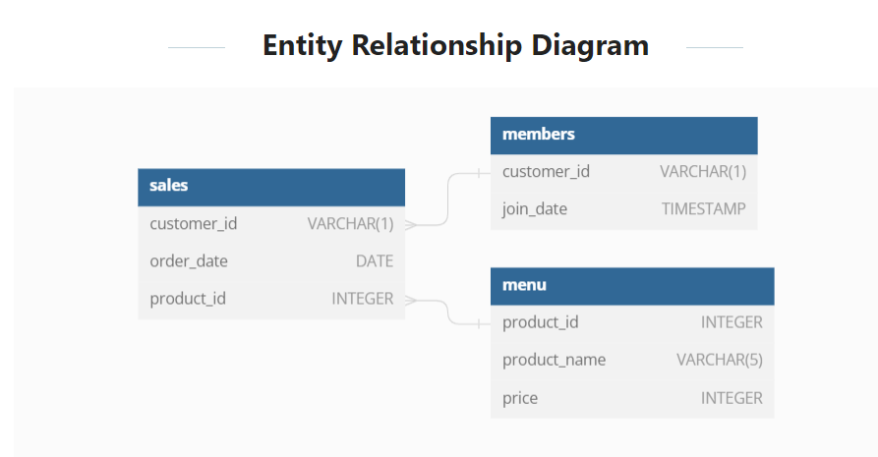
FA
Farhan’s Academy
Find your essential courses

Slide 3
Thank You

