Slide 1
Name: Mahmudul Haque Trainee ID: 1282769 Batch: WDPF/TCLK-M/60/01

Slide 2
School Management System using Laravel

Slide 3
DATABASE DESIGN

Slide 4
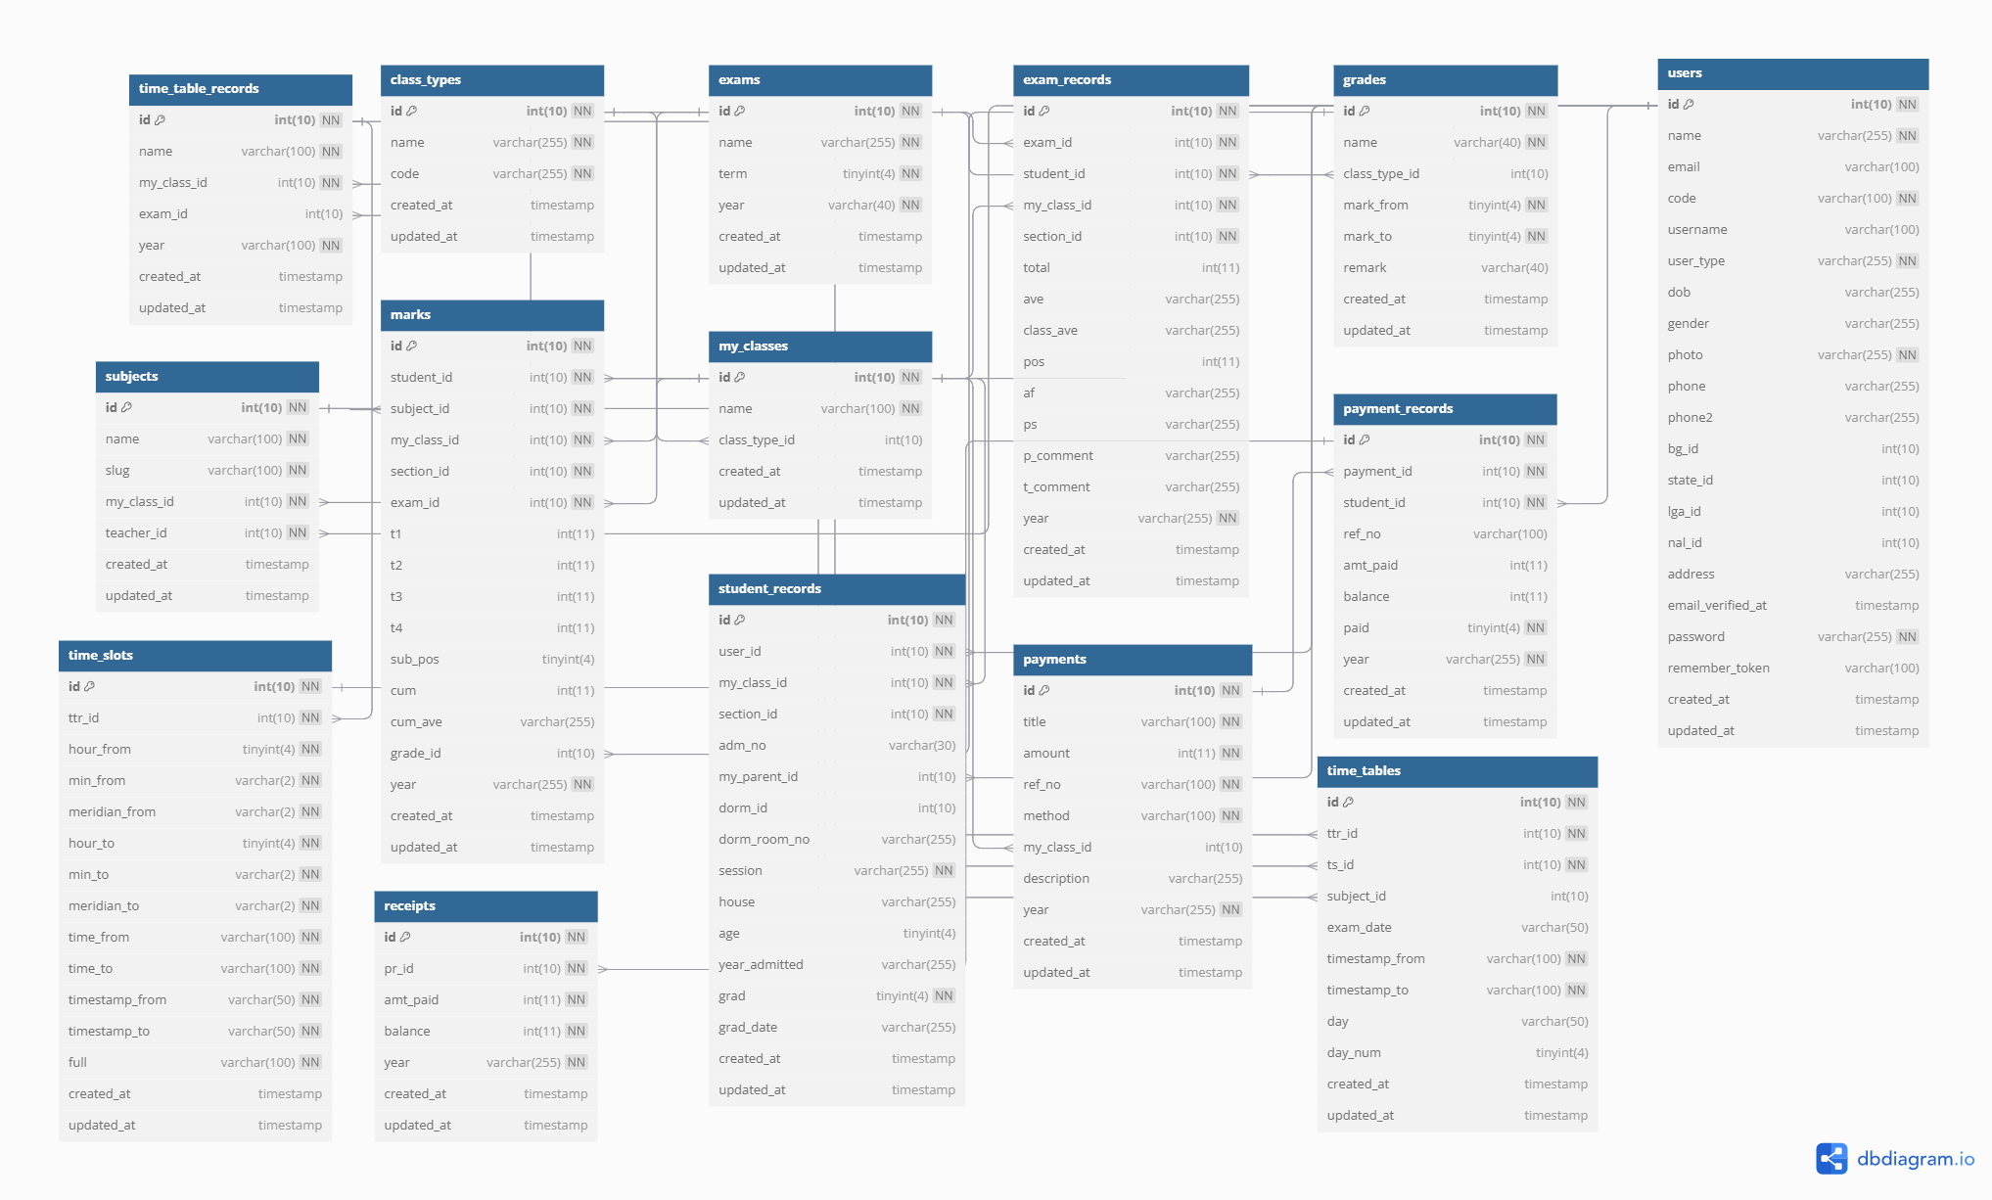

Slide 5
PROJECT FEATURES
Admin
ADAPTABILITY
Teacher
Student
Academics (Class, Attendance, Examination, Homework, Result)
Notice
Report
Fees
Salary

Slide 6
Technologies
Laravel 10
HTML 5
CSS 3
Bootstrap 4
PHP 8.2
MariaDB 10.4.32 (MySQL)
Envato Template
Blade templating

Slide 7
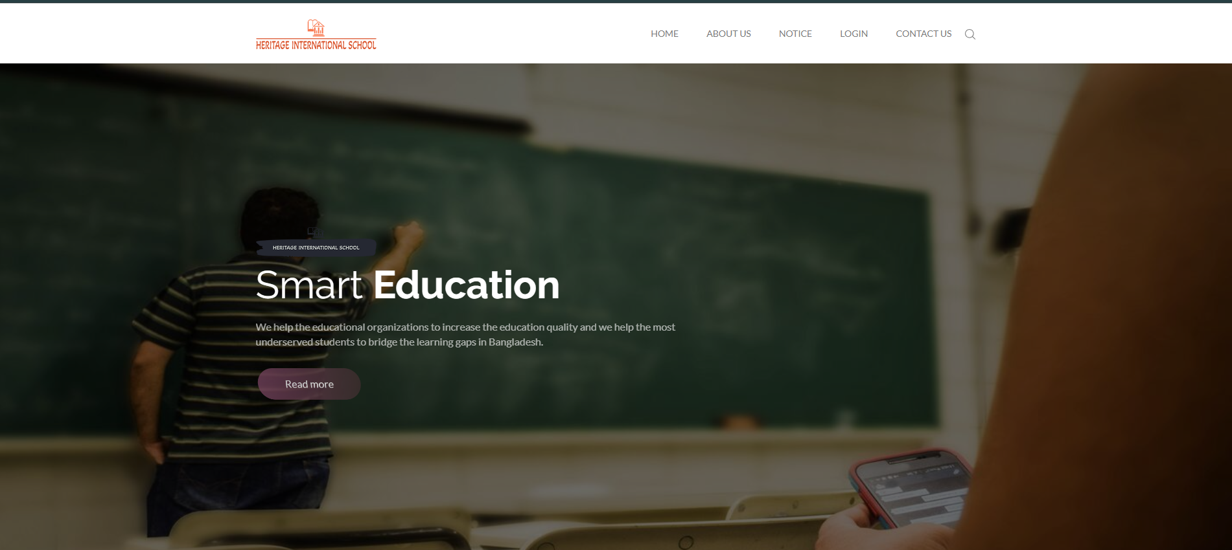
PROJECT FRONTEND

Slide 8
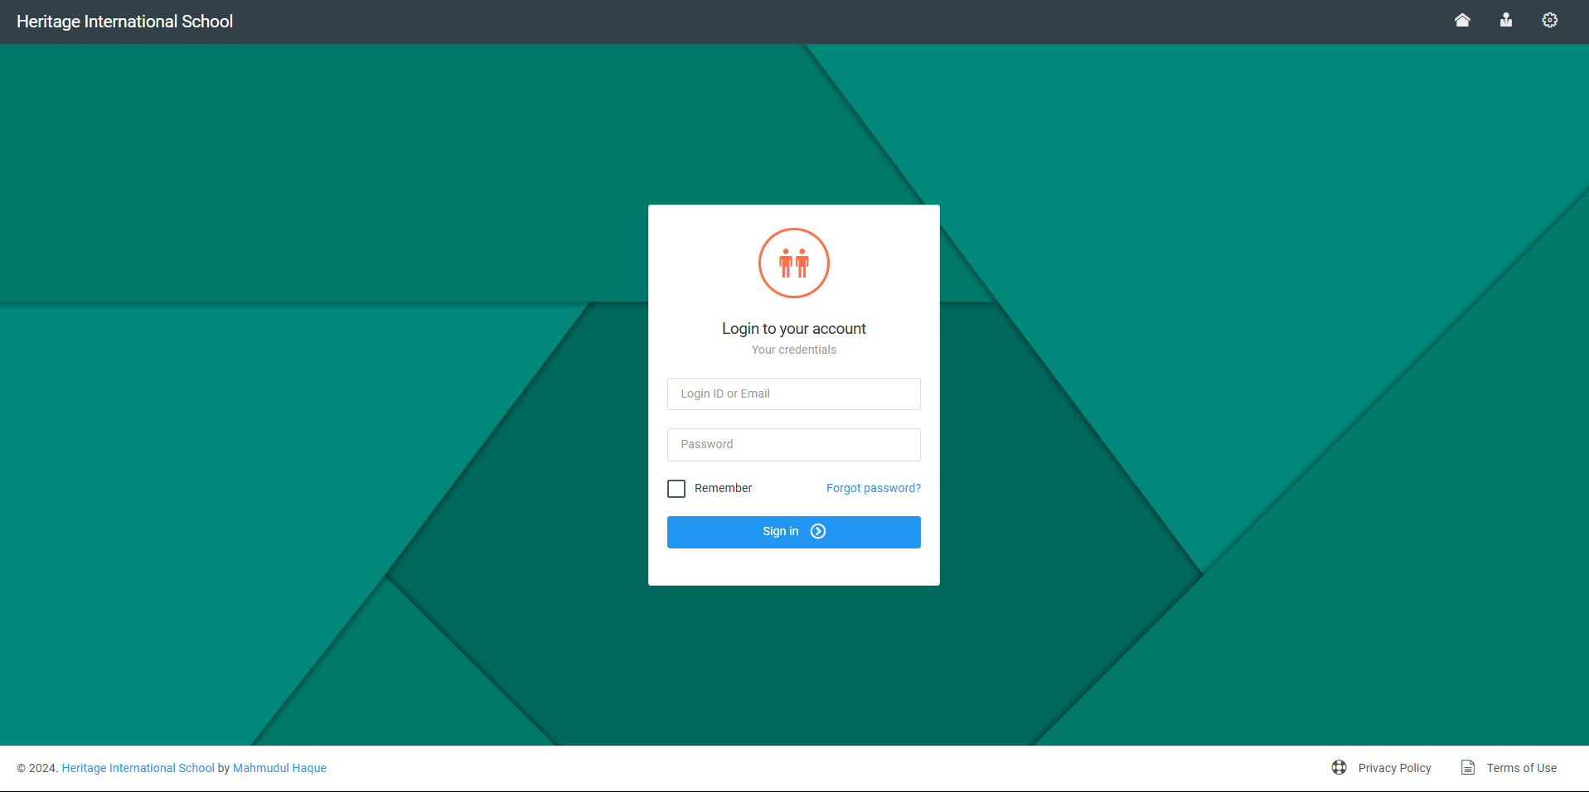
User Login Form

Slide 9
User Types
Admin
Teacher
Student
Staff

Slide 10
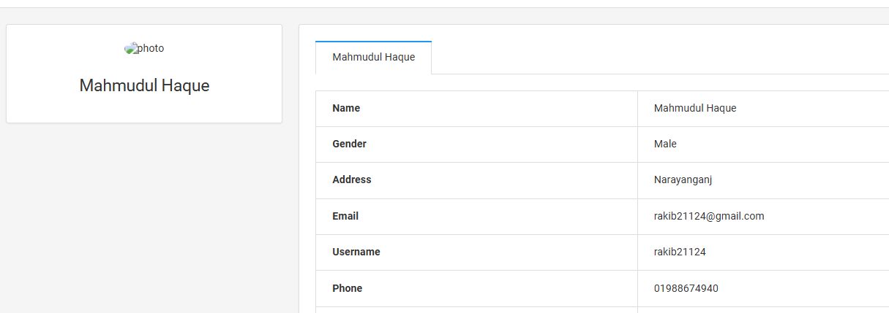
User Profile

Slide 11
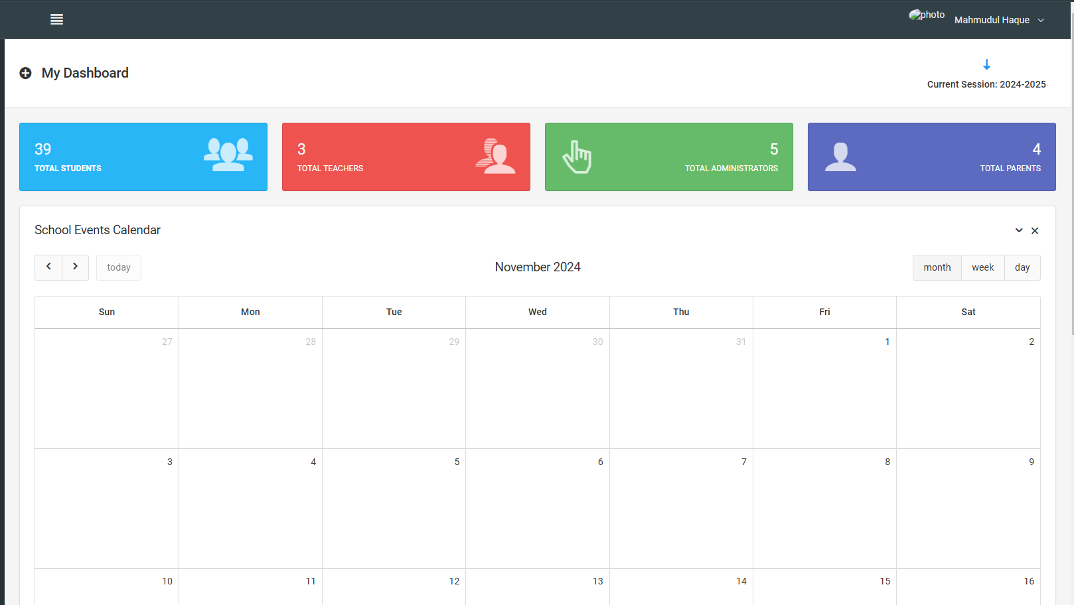
User Dashboard

Slide 12
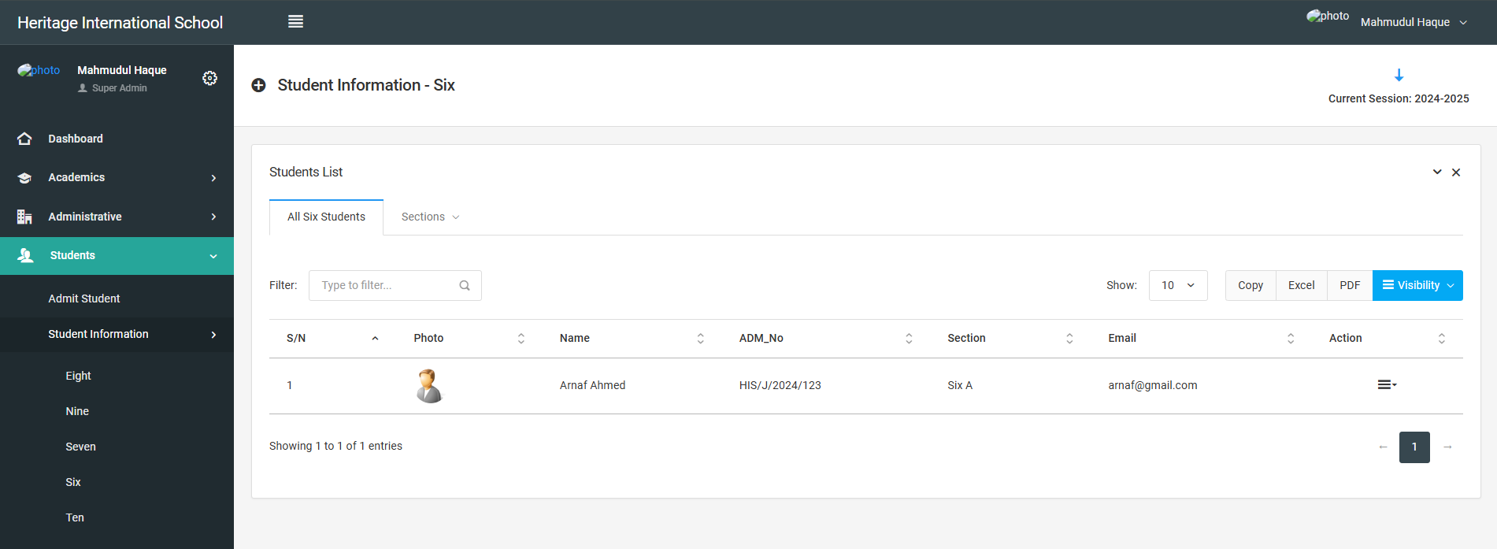
Students Management

Slide 13
THANK YOU

