Slide 1

DIGITAL DELTA
Offline-First Disaster Relief Logistics
HackFusion 2026 | Team Digital Delta

Slide 2

CHALLENGE
The Problem
Monsoon floods destroy roads and bridges in Bangladesh's Sylhet region
Relief camps isolated for weeks — no internet, no cellular
Critical supplies must reach camps within tight SLA windows
No way to predict which routes will fail next

Slide 3
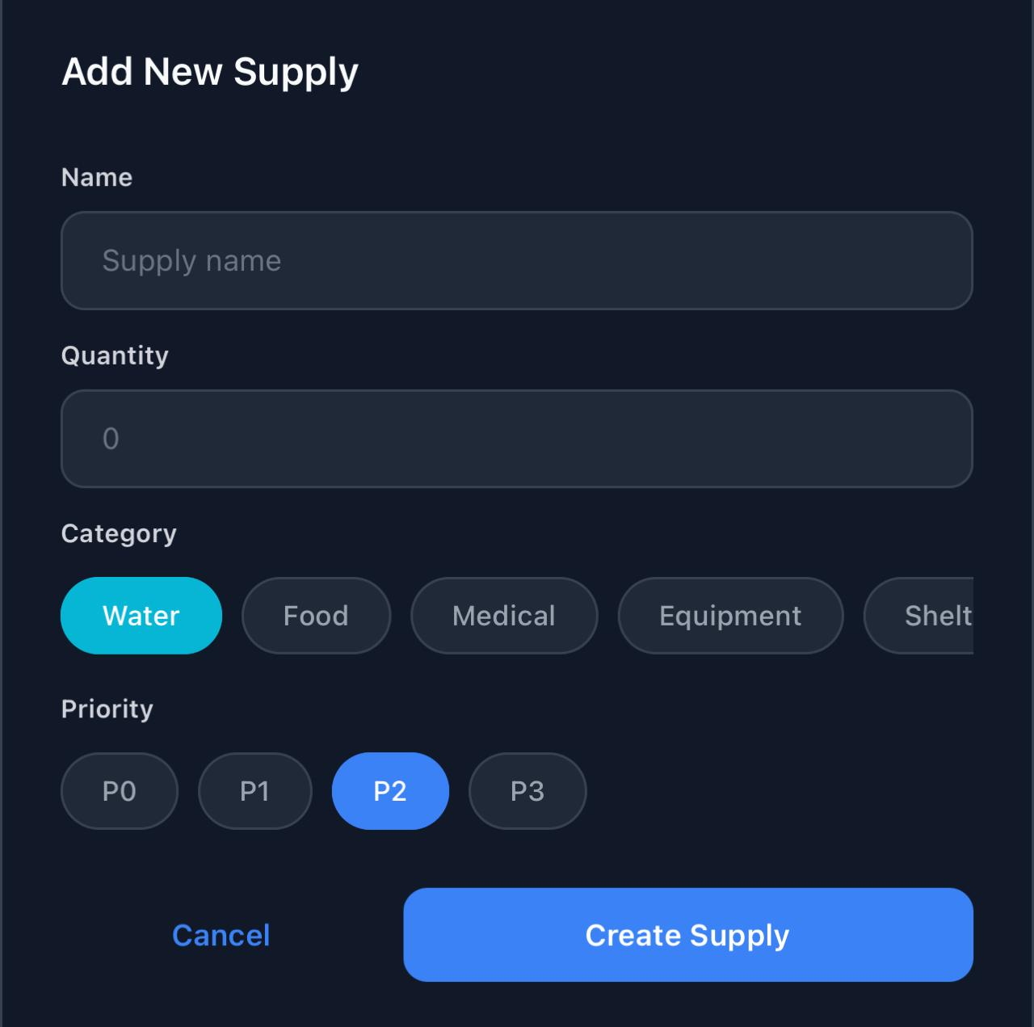
SOLUTION
Digital Delta
100% offline logistics via BLE mesh networking
ML flood predictions (98.3% accuracy)
CRDT sync — all devices converge automatically
Autonomous triage reroutes critical cargo
Cryptographic proof-of-delivery
Drone handoff for last-mile delivery

Slide 4
STACK
Technology Stack
Backend: Express.js + better-sqlite3 + WebSocket
Mobile: React Native 0.81 + Expo 54 + TypeScript
Database: SQLite on server and device (14 tables)
Security: Ed25519, x25519, JWT, TOTP (RFC 6238)
ML: Pure JS logistic regression (98.3% accuracy)
Sync: Custom CRDT (LWW-Map, Vector Clocks)
Mesh: BLE with store-and-forward relay

Slide 5
ARCHITECTURE
System Architecture
Mobile App (React Native + Expo) connects via WebSocket to Backend API (Express + SQLite)
BLE Mesh enables peer-to-peer device communication offline
Shared CRDT Library (LWW-Map, Vector Clock) syncs state across all nodes
Chaos Server (Flask) simulates flood events on network edges
9 Screens | 9 Route Handlers | 9 Services | 14 DB Tables

Slide 6
MODULES 1 - 4
Engineering Modules (Part 1)
M1 Secure Auth (9 pts) — Ed25519 keypairs, TOTP offline OTP, RBAC, hash-chained audit
M2 CRDT Sync (10 pts) — LWW-Map, vector clocks, BLE delta-sync, conflict UI
M3 Mesh Network (9 pts) — Store-and-forward relay, x25519 E2E encryption
M4 Vehicle Routing (10 pts) — Dijkstra pathfinding, truck/boat/drone constraints

Slide 7
MODULES 5 - 8
Engineering Modules (Part 2)
M5 Proof-of-Delivery (7 pts) — QR challenge-response, Ed25519 signatures, nonce protection
M6 Triage Engine (7 pts) — SLA breach prediction, autonomous rerouting, P0-P3 priority
M7 Predictive Decay (9 pts) — ML classifier (98.3% accuracy), proactive rerouting
M8 Drone Handoff (9 pts) — Reachability analysis, rendezvous computation

Slide 8
KEY FEATURE
Offline-First CRDT Sync
LWW-Map: Each supply record is a map of Last-Writer-Wins registers
Vector Clocks track causal ordering across all devices
Delta-Sync: Only changed records transmitted (under 10 KB)
Zero Central Arbiter — backend is a peer, not authority
Conflicts: Higher timestamp wins, tie-break on node ID

Slide 9
ML / AI
ML-Powered Flood Prediction
Trained on 200 rows from Bangladesh weather stations
Features: rainfall, humidity, altitude, soil saturation
Logistic regression — gradient descent (1000 epochs)
Runs in pure JavaScript on-device, no ML libraries
High-risk edges penalized in Dijkstra routing weights
98.3% Accuracy | 97.2% Precision | 100% Recall | F1: 0.986

Slide 10
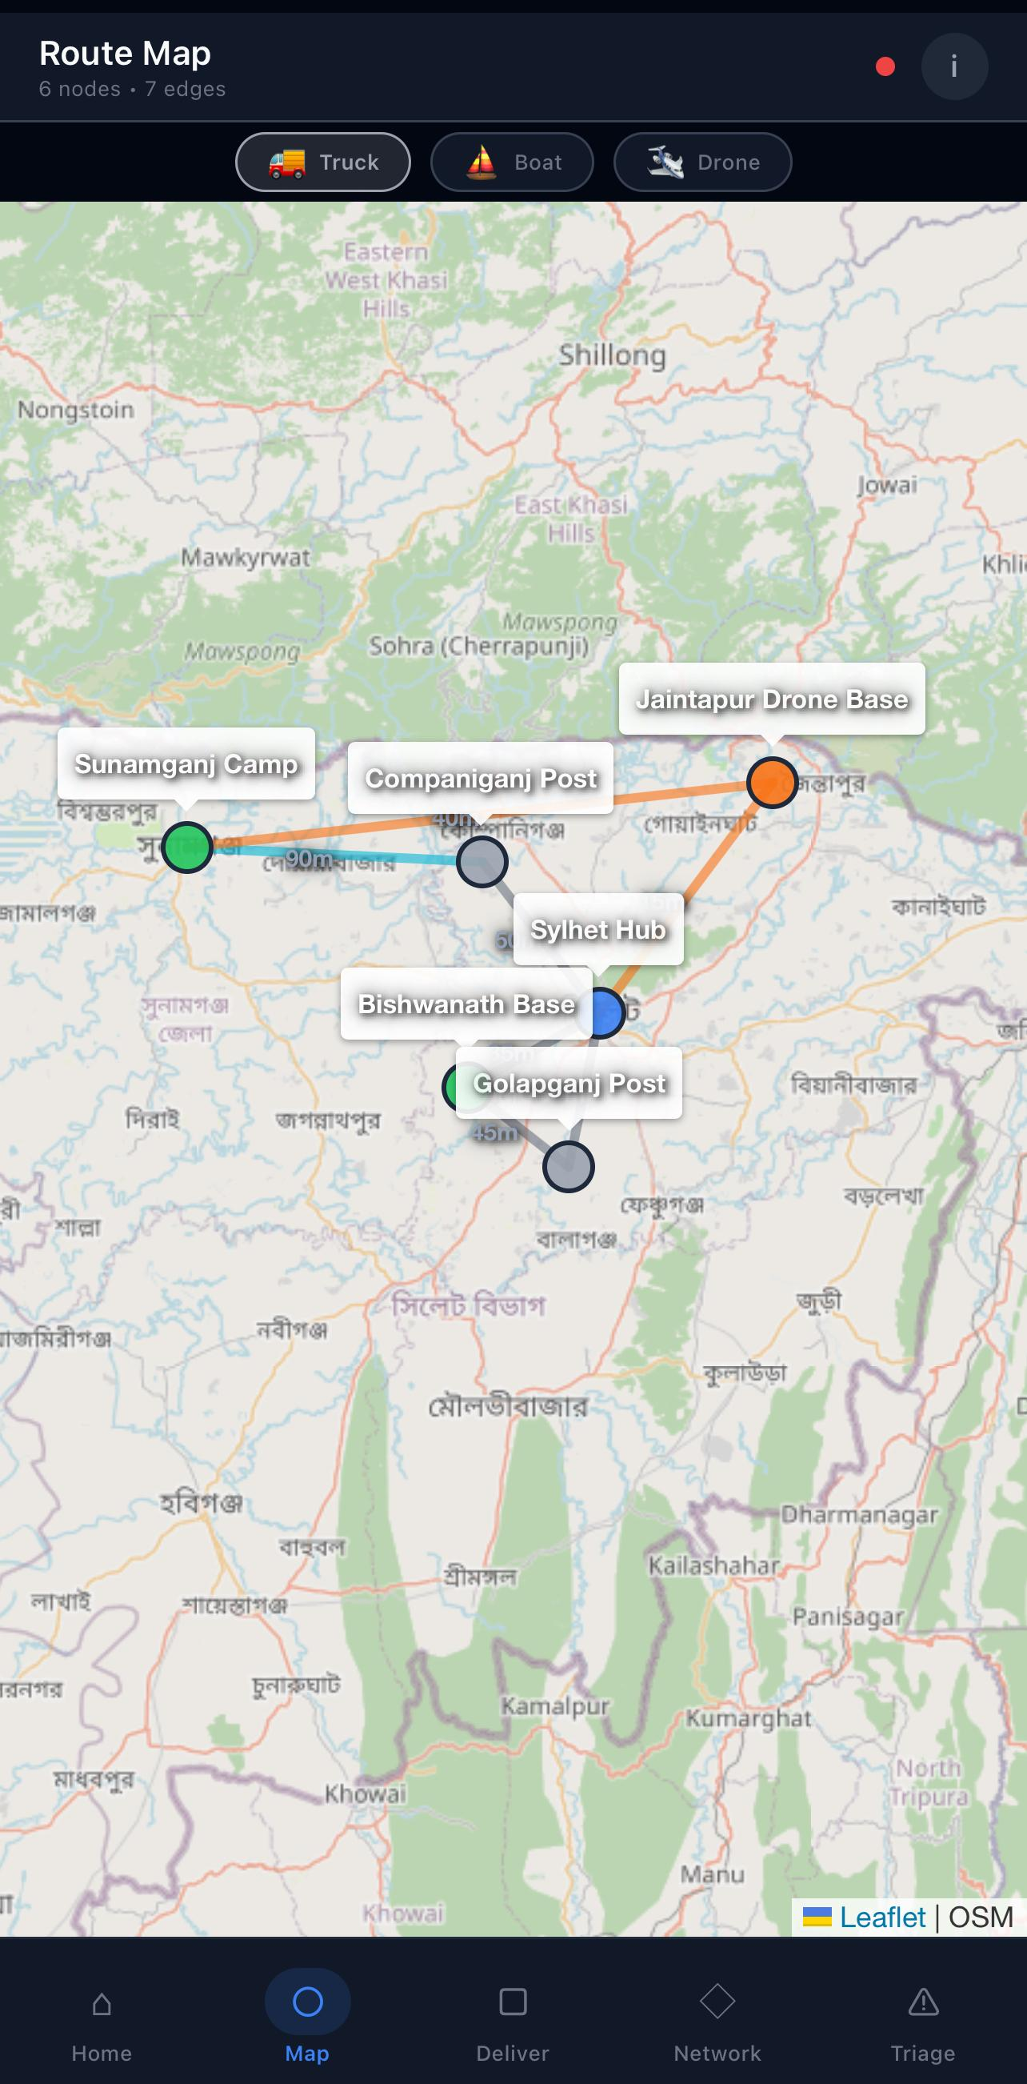
ROUTING
Multi-Modal Vehicle Routing
6 nodes across Sylhet district, 7 weighted edges
Truck = Road | Boat = Waterway | Drone = Airway
Dijkstra shortest-path, risk-aware cost
Dynamic rerouting via WebSocket on failure
Drone max payload: 15 kg
cost = travel_time x (1 + risk_score)

Slide 11
TRUST AND COMPLIANCE
Security and Accessibility
Security
Ed25519 digital signatures for all critical operations
x25519 E2E encryption on mesh (zero-knowledge relays)
Hash-chained audit log with tamper detection
Nonce replay protection on proof-of-delivery
Accessibility (WCAG)
High contrast dark theme: 19.4:1 ratio (exceeds AA 4.5:1)
Color-independent indicators: text labels alongside color
Semantic typography scale, 44px minimum touch targets

Slide 12

THANK YOU
Digital Delta
When infrastructure fails, coordination doesn't.
HackFusion 2026

