Slide 1
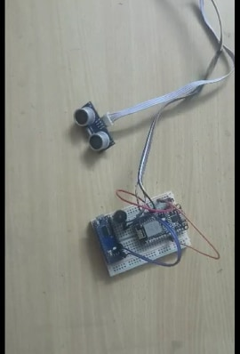
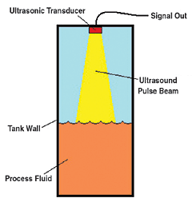
Water Level Detection with IOT
Presented by: Mahmudul Islam
ABSTRACT
Water tank overflow often leads to the wastage of water. Present electronic device can raise an alarm upon getting the water tank full or to a preset level. This simple ultrasonic sensor based water level indicator circuit is very useful to indicate the water level in a tank. Whenever the tank is filled, user gets alert on particular levels. Here, we have created levels by alarms & we have also created a mobile application to indicate the level of water and one buzzer to indicate full level. When tanks get filled completely we get beep sound from the buzzer. So now we do not have to worry about overflow and water out anymore
COMPONENTS
MECHANISM
WORKING PRINCIPLE
NodeMCU: An open source LUA based firmware developed for ESP8266 wifi chip that supports serial communication protocols.
Ultrasound sensors: It converts electric energy into acoustic wave and vice versa with a frequency > 18KHz
Arduino nano: A small, complete, and breadboard-friendly board, based on the ATmega328 (Arduino Nano 3x).
Buzzer: An arduino signaling device which may be mechanical or piezoelectric.
Breadboard: A solderless device for temporary prototype with electronics and test circuit design.
The goal was to design a water level detection device that is small enough in size to be installed in various places. It works on the basic principal of calculating distance by the travelling time of the sound pulses. The ultrasound sensor has two transducer bands, the trigger band and the echo band, the trigger band sends out ultrasonic signals from the sensor. The signal that was sent out bounces on any obstacle within the distances of 2 and 400 cm and reflects back to the sensor. The echo band receives the reflected signal. The time it took the signal to travel and return back will be recorded by the sophisticated circuitry in the sensor. With this time which ranges from 150µS to 25000µS, we can compute the distance of the sensor from the obstacle.
CALCULATION
APPLICATIONS
ADVANTAGES
Speed of the ultrasound (m/s) = [2 x water level (m)] / time (s).
Water level = [Speed of the ultrasound x time]/2
In present case,
Speed of the ultrasound = 340 m/s.
So, water level = 170 x time (s) - - (1)
For test case, time = 250 µS.
Water level = 4.25 cm.
Water tank in households.
Dam.
Flood management.
Drainage system.
Open well.
Water pumping for irrigation.
Water level control for industrial production process.
Smaller in size so that it can easily be installed in the places where there is space restriction.
Can be used in as an alarming device in case of flood management specially in underdeveloped countries where flood management systems aren’t much sophisticated.
Easy to install and less maintenance is required.
User friendly interface of the app makes it easier for the untrained people to use it effectively.
FUTURE IMPROVEMENTS
Instead of breadboard the design should be implemented on the PCB (printed circuit board).
Wireless communication between ultrasound sensor and the rest of the circuit will make it more compact.
Data recording system should be installed for future causalities prediction in case of flood management. .
Smart Sensor and Measurement

