Slide 1

ConvoCorner
Computer Networking Lab Project

Slide 2


Team
Fahim Shakil
Roll - 06
Md. Mahmudul Hasan
Roll - 10
CEO

Slide 3

Overview
"ConvoCorner" is a dynamic chat room platform fostering global connections through seamless communication, collaboration, and empowering interactions.

Slide 4
Key Features
1
Secure User Authentication
2
Personalized Chat Room Creation
3
Real-Time Messaging
4
Seamless File Sharing

Slide 5
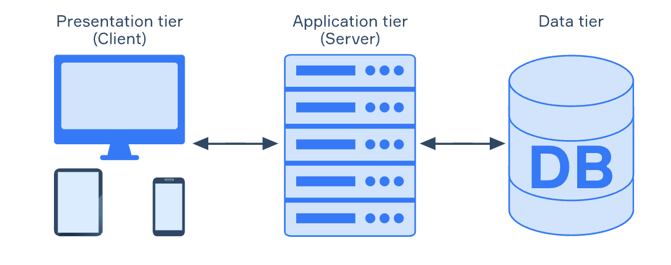
Architecture: Three Tier

Slide 6
Networking Tools
TCP New Reno
Web Caching
Web Socket
To Provide Reliable Data Transfer
To Enhance Performance and Reduce Server Load
To Provide Real-Time Messaging

Slide 7
Technology Stack
Design
Tailwind-CSS
Backend
FastAPI & Python
1
3
2
Frontend
React-JS
4
Database
PostgreSQL

Slide 8

Applications
01 | Social Networking Platforms
02 | Online Learning Platforms
03 | Customer Support Portals
04 | Gaming Platforms

Slide 9

Future Plans
1
Voice Call
2
Video Call
3
CEO
CFO
Sales Director
Personalized AI Assistant
Berry Books
Vinny Viewer
Wendy Writer

Slide 10
Thank you.

