Slide 1
github network Social network analysis Mahnaz Taheri 989363

Slide 2
github
GitHub is a developer platform that allows developers to create, store, manage and share their code.
Users can follow each other and see others’ codes.

Slide 3
Exploring the github network

Slide 4
Dataset
Social network of Github developers gathered in June 2019.
Nodes are developers who have starred at least 10 repositories and edges are mutual following relationships between them.

Slide 5
network
Nodes are Github users who are either web developers or machine learning developers.
Edges are present between two vertices if they follow each other.
Number of Nodes | Number of Edges
37700 | 289003
ML developer | Web developer
9739 | 27961

Slide 6
Network characteristics
Density | Min degree | Max degree | Mean degree | Median | Standard deviation | Hubs (99th percentile)
0.0004066 | 1.0 | 9458 | 15.3317 | 6.0 | 80.7870 | 377

Slide 7
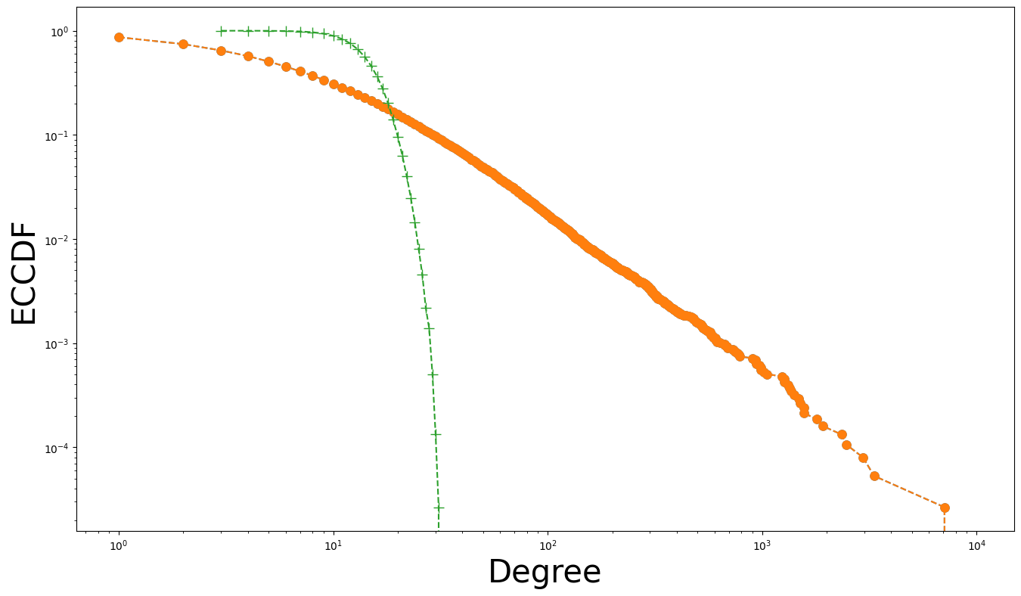
Degree distribution
Quasi linear plot of ECCDF.
Degree distribution follows a Power Law.
Scale-free network.

Slide 8
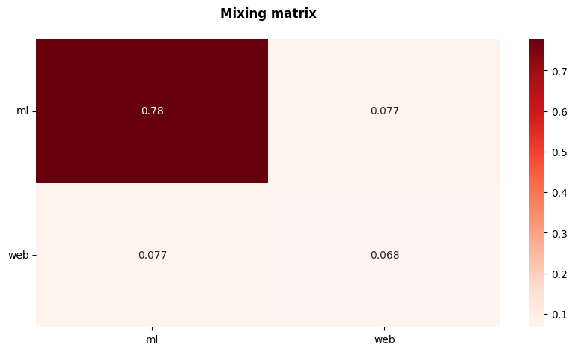
assortativity
78% of the edges are between ml nodes. This result indicates a high degree of homophily among machine learning developers.
Attribute assortativity is 0.3778 which suggests that there is a moderate tendency for nodes in the network to connect with others that have similar attributes.
Degree assortativity is -0.07521 suggesting a weak tendency for nodes to connect to other nodes with different degrees. In other words, there is a slight preference for developers with many connections (high-degree nodes) to connect with developers who have fewer connections (low-degree nodes), and vice versa.

Slide 9
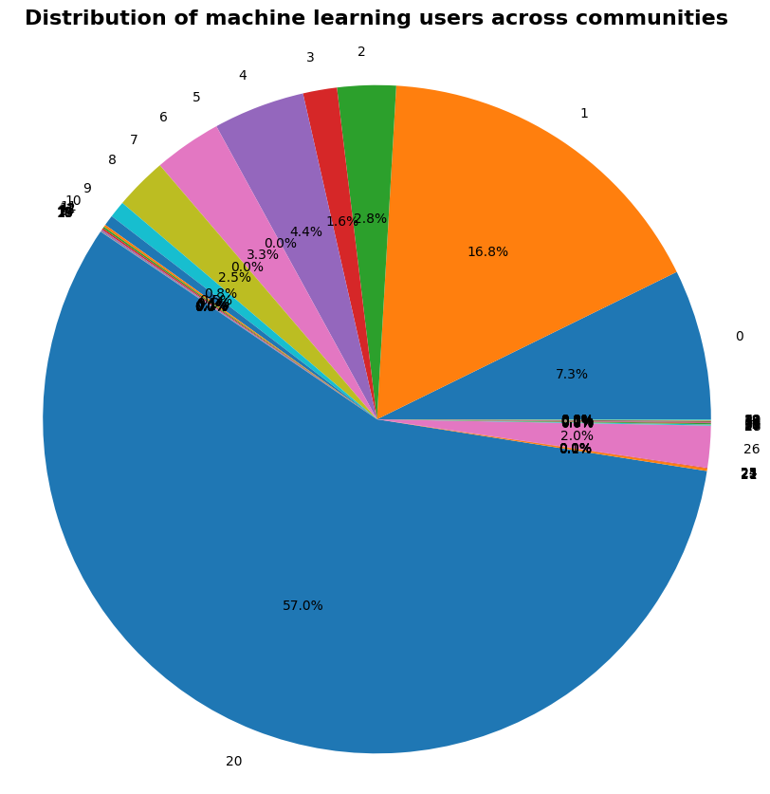
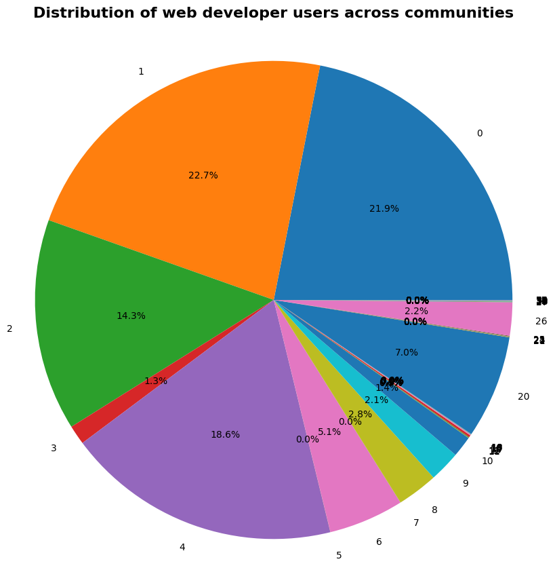
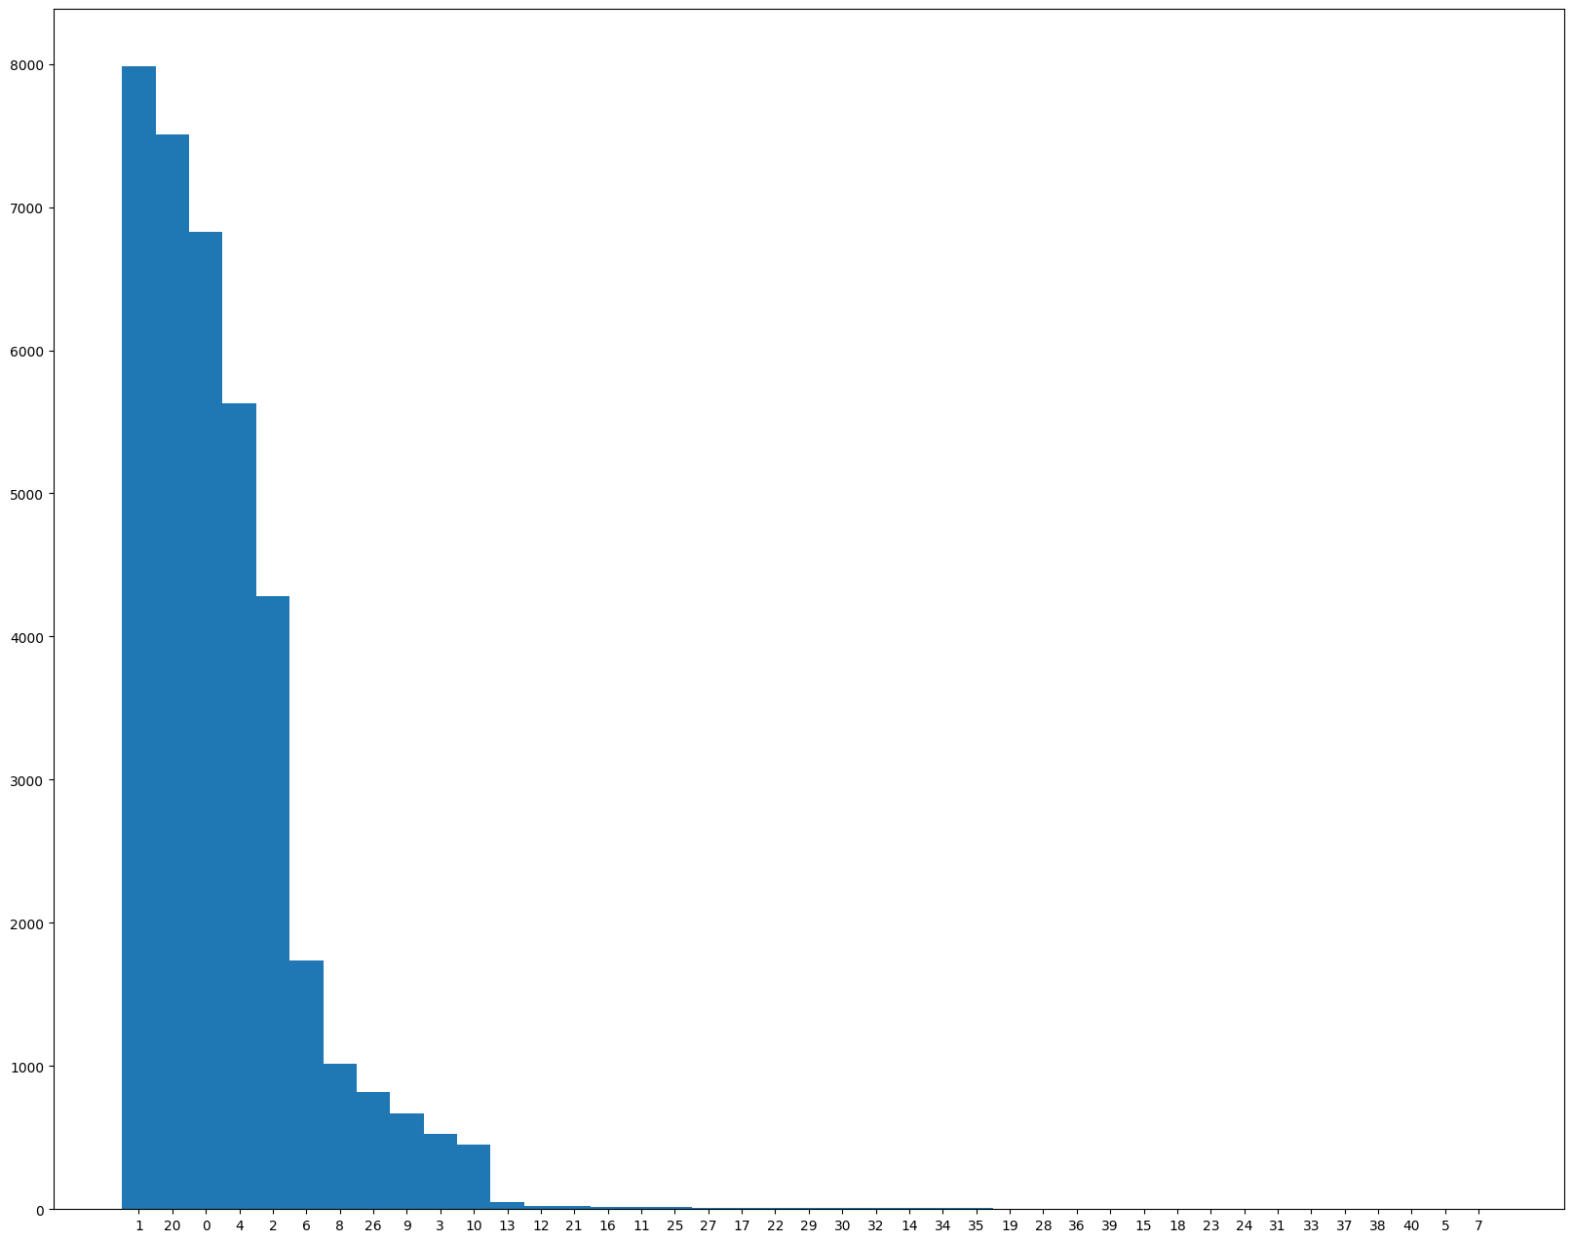
Community detection
41 distinct communities
One community with around 8000 nodes.
Five communities with more than 4000 nodes.

Slide 10
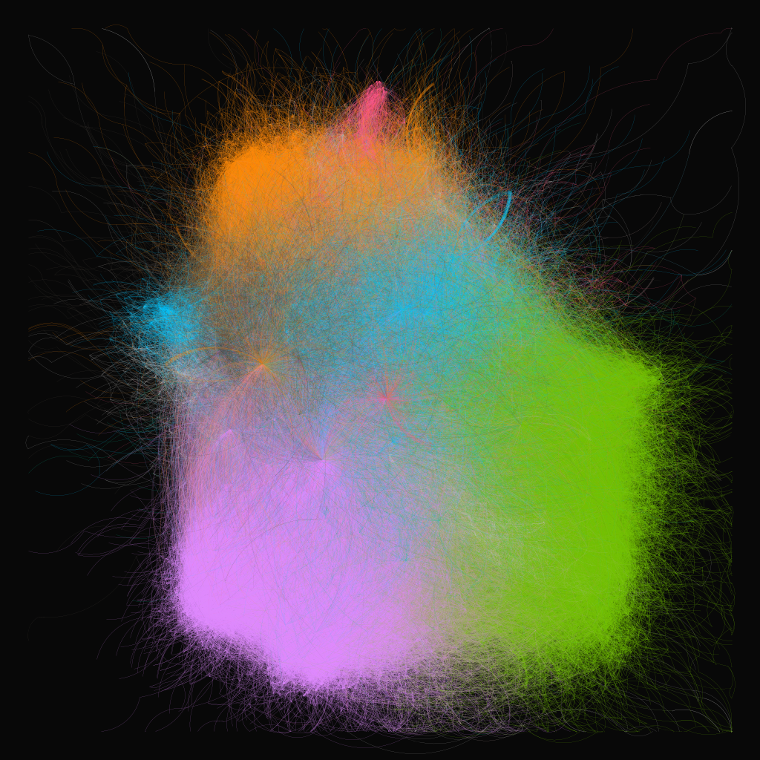
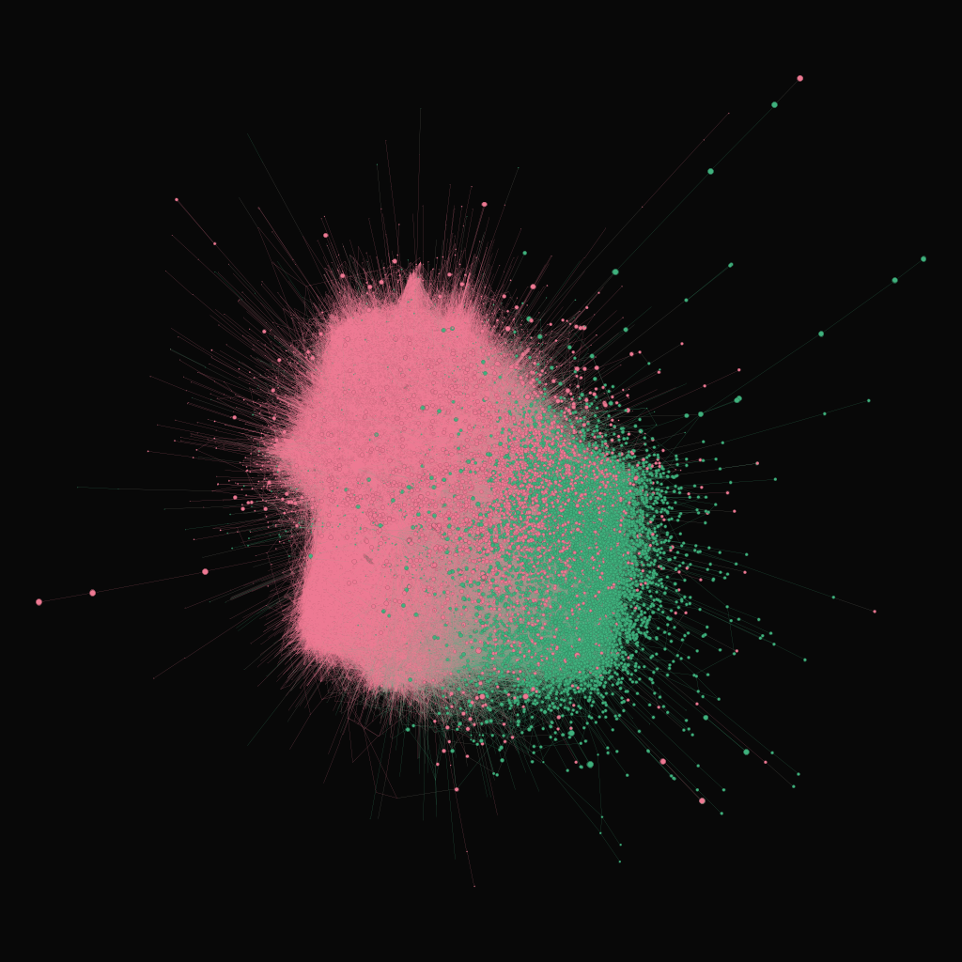
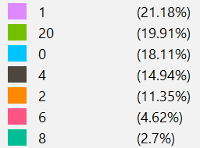

Gephi representation of communities
GEPHI REPRESENTATION OF ML/WEB

Slide 11
THANK YOU!

