Slide 1
ZYNXIS FINAL CAPSTONE
Intern Performance Predictor
An end-to-end machine learning system for predicting intern success
Syeda Mahnoor Fatima • Zynxis Internship Program • Week 8

Slide 2
The Problem
Zynxis tracks rich performance data on every intern — but deciding who's on track to succeed still relies on manual review.
What we track per intern
Technical Score
Project Completion Rate
Attendance & Punctuality
Goal: predict, from measurable metrics, whether an intern will become a high performer — giving coordinators an early, data-driven signal to guide mentorship.
Soft Skills Rating
Code Review Score
Prior Experience
Education Level
2

Slide 3
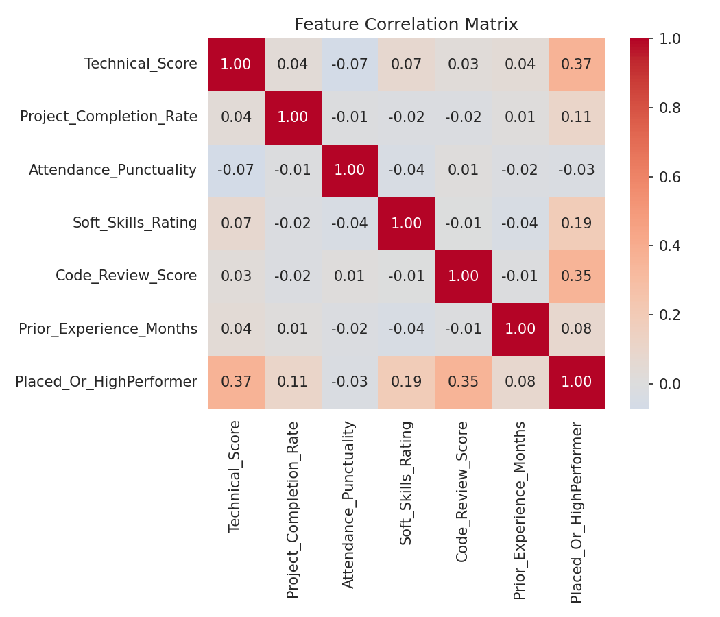
Data Collection & Preparation
500
7
0
62/38
Intern records
Input features
Missing values
Class balance
Preprocessing steps
1
One-hot encode Education_Level (drop_first)
2
Standardize 6 numeric features (fit on train only)
3
80/20 stratified train/test split (seed=42)
3

Slide 4
Model Training
Random Forest Classifier
Also evaluated
Chosen for its ability to capture non-linear interactions between features and its built-in, interpretable feature importance scores.
Logistic Regression — baseline linear model
Single Decision Tree — prone to overfitting
n_estimators
100
Random Forest won on both accuracy and interpretability, so it's the model deployed in the final app.
max_depth
7
min_samples_split
4
random_state
42
4

Slide 5
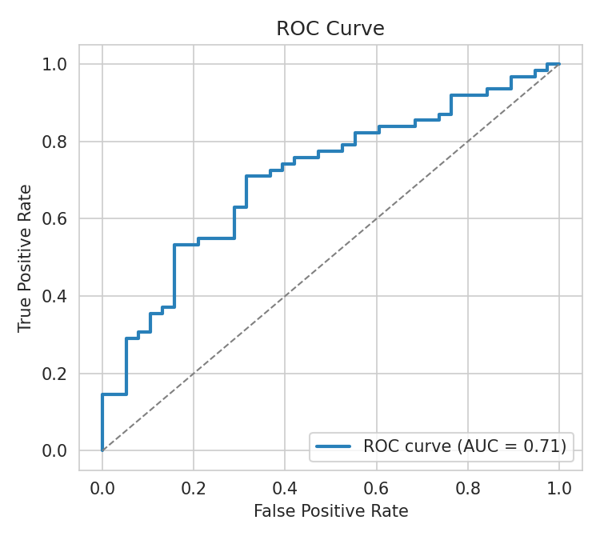
Evaluation Results
ROC-AUC = 0.71 — well above the 0.50 random baseline
5

Slide 6
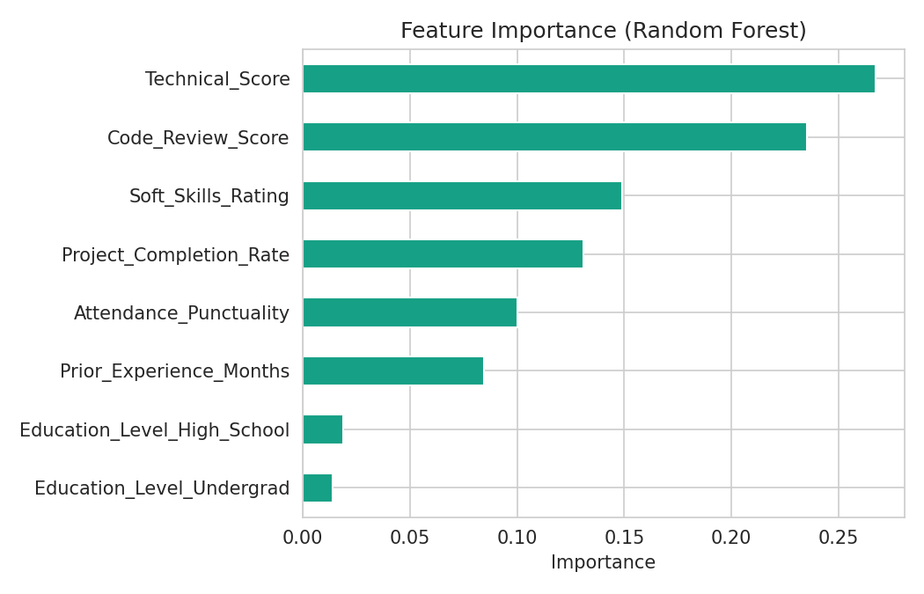
What Drives the Prediction?
Key takeaway
Technical Score and Code Review Score together drive roughly half of the model's decisions.
Education Level barely matters — the model rewards demonstrated performance over credentials, a fair outcome for an evaluation tool.
6

Slide 7
Deployed Interface
A Streamlit web app lets a coordinator enter an intern's metrics and get an instant, explainable prediction.
📊 Zynxis Intern Performance Predictor
Predict: verdict + probability + plain-language “why”
✅ High Performer / Likely to be Placed
Batch Prediction: upload a CSV, screen a whole cohort
Model Comparison: RF vs. Logistic Regression vs. Tree
Predicted Probability
91%
Feature Importance: interactive chart of what matters
streamlit run app.py — runs locally or on Streamlit Community Cloud
7

Slide 8
Limitations & Future Work
Current limitations
Planned improvements
• Modest dataset size (500 records)
• Larger dataset + class-weighting or SMOTE
• 69% accuracy — supports, doesn't replace, human judgment
• SHAP-based explanations per prediction
• Weaker recall (58%) on the “Needs Support” class
• Batch CSV upload to screen a full cohort
8

Slide 9
Thank You
A complete pipeline — data, model, evaluation, and a deployed app — giving Zynxis a data-backed signal for intern success.

