Slide 1

BLUE TEAM · DETECTION ENGINEERING
Home-Lab SIEM
Detection Build
Setting up Wazuh from scratch, writing custom detection rules,
and proving each one fires on a real attack.
Wazuh 4.14.7
4 custom rules
MITRE mapped
Notes:
Week 2 task: build a working SIEM in a home lab and prove custom detection rules fire on real attack behaviour.

Slide 2


THE GOAL
Reading about detection is not the same as building it
Build a real SIEM
Attack it on purpose
Catch it with my own rules
Install Wazuh in a lab and connect a machine to watch.
Generate failed logins, escalations and new accounts.
Write detection logic and prove each rule triggers.
A rule that never fires is worth nothing. Every rule here has a screenshot of it firing.
2

Slide 3
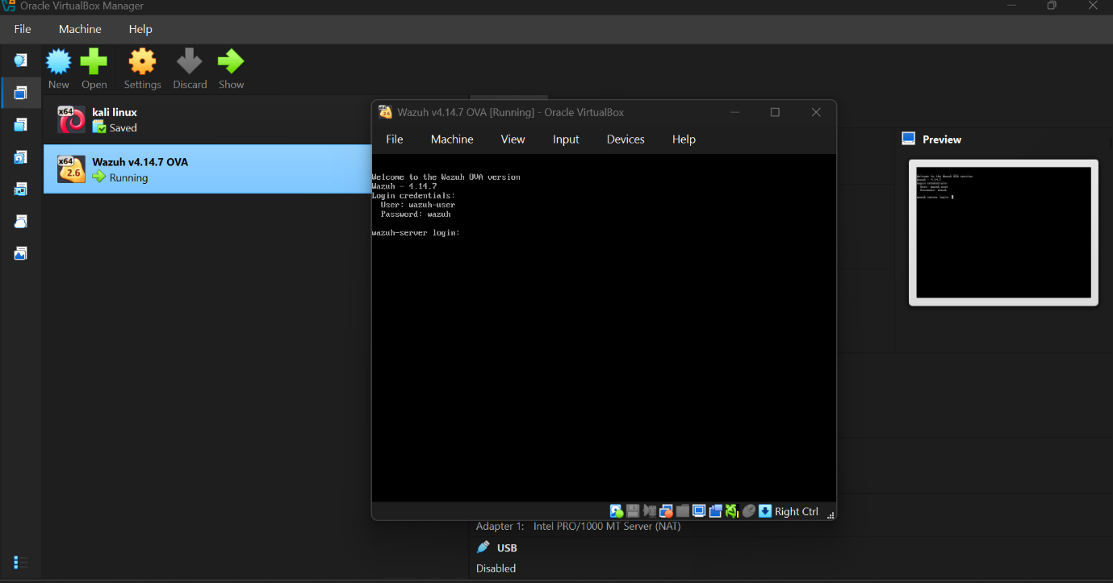


STEP 1 · THE LAB
Two machines, one private network
The SIEM
Wazuh 4.14.7 appliance — manager, indexer and dashboard
The endpoint
Kali Linux, running the Wazuh agent
The network
A private VirtualBox network, kept away from my home Wi-Fi
Only the dashboard port is shared back to my laptop, so the lab stays sealed off.
3

Slide 4
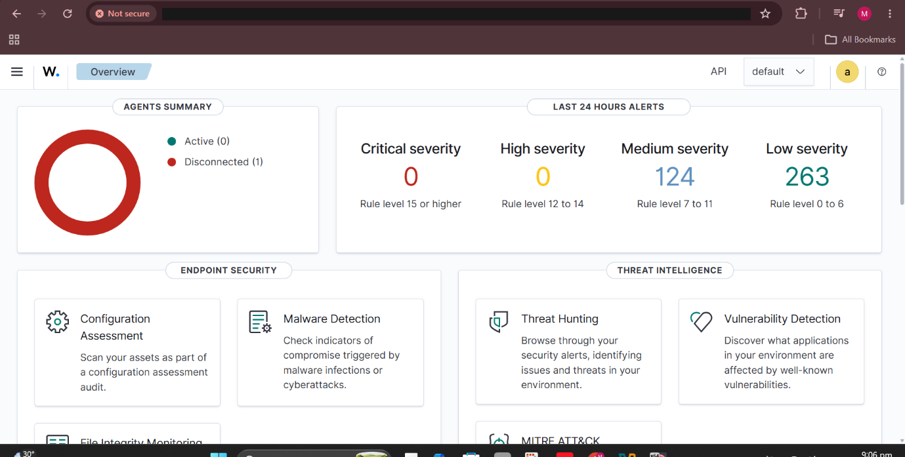
STEP 2 · INSTALLATION
Wazuh is three services, not one
1
Manager
Reads the logs and decides what is an alert
2
Indexer
Stores every alert so it can be searched
3
Dashboard
The screen an analyst actually looks at
I checked all three before opening the browser — if one is down, the symptoms look identical.
4

Slide 5
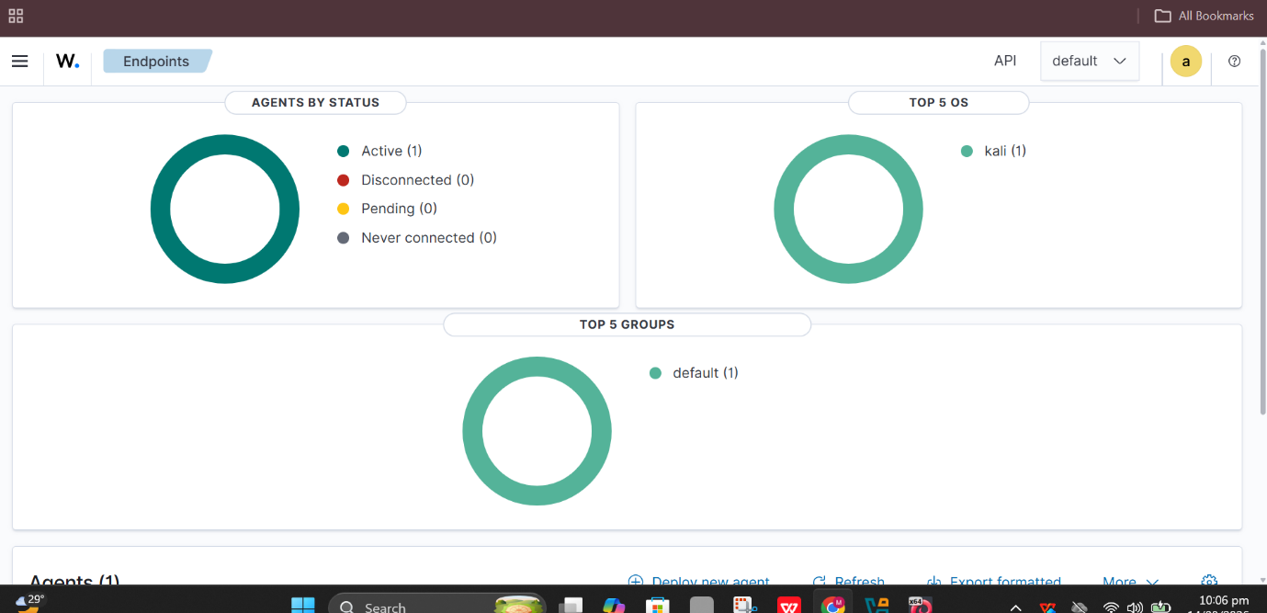
STEP 3 · THE ENDPOINT
One machine, now being watched
1
agent active
Before installing anything
Checked the machines could reach each other
Checked both agent ports were open
Then the agent connected first try
5

Slide 6
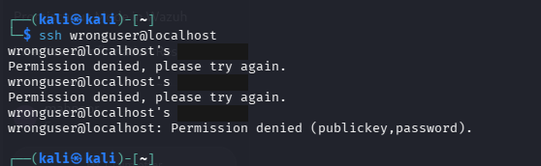
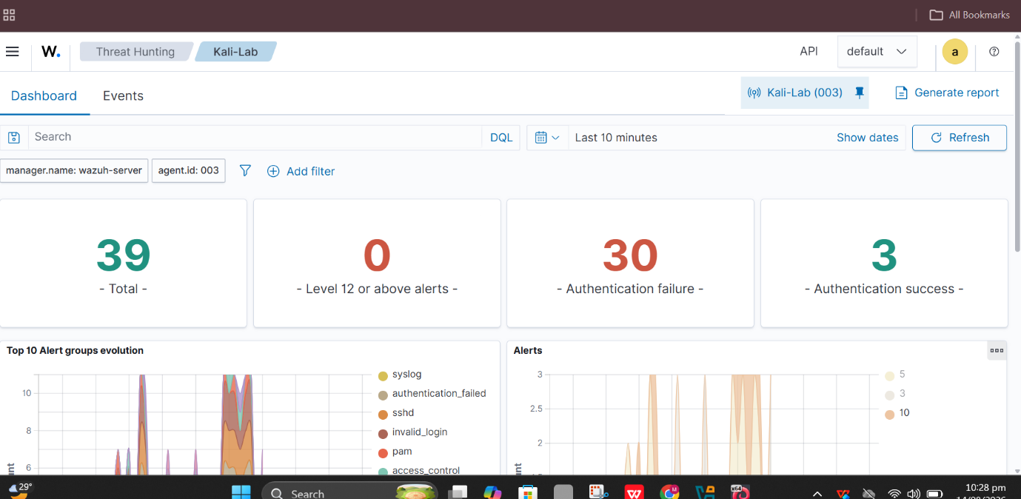
STEP 4 · TEST EVENTS
Breaking into my own machine
I turned on SSH and failed the login on purpose, over and over, to see whether the events actually reached the SIEM.
30
3
39
failed logins
successful logins
events captured
6

Slide 7




THE DETECTION CONTENT
Four rules I wrote myself
The task asked for three. The fourth was the quickest way to prove my rule file was loading at all.
SSH brute force
Repeated sudo to root
Someone guessing passwords
Someone escalating again and again
Rule 100100
T1110
Rule 100101
T1548.003
New local account
System discovery
Someone creating a way back in
Someone looking around the machine
Rule 100103
T1136.001
Rule 100102
T1033
7

Slide 8
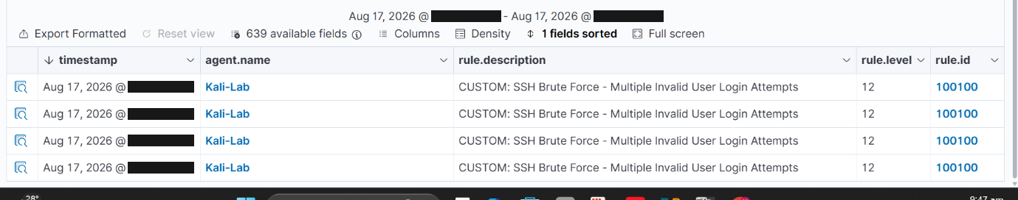
RULE 1 · BRUTE FORCE
Someone guessing SSH passwords
Rule 100100
Level 12
T1110 Credential Access
WHAT IT SPOTS
Five failed logins for accounts that do not exist, all inside one minute.
WHY IT MATTERS
One failed login is noise. Five in a minute means something is working through a username list.
HOW IT WORKS
Counts the built-in failed-login event and fires once it hits five in 60 seconds.
Caught in the SIEM
8

Slide 9
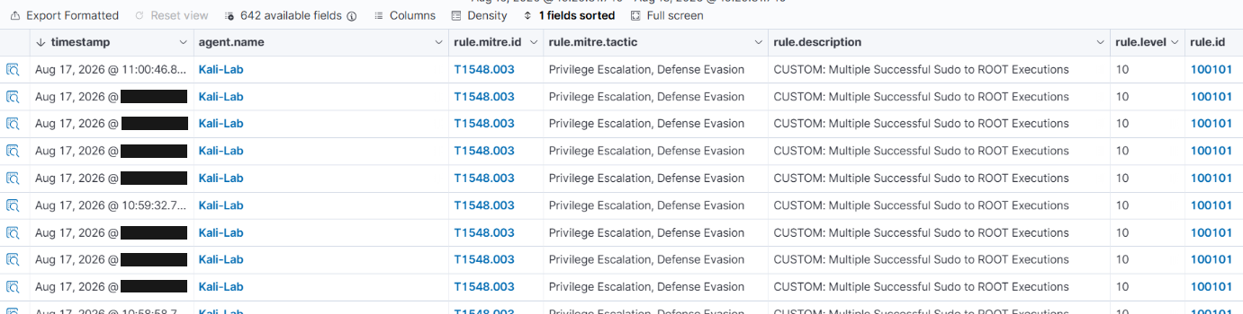
RULE 2 · PRIVILEGE ESCALATION
Someone jumping to root over and over
Rule 100101
Level 10
T1548.003 Privilege Escalation
WHAT IT SPOTS
The same account escalating to root three times inside a minute.
WHY IT MATTERS
Using sudo is normal, which is exactly why attackers use it. The giveaway is the speed, not the act.
HOW IT WORKS
Counts successful sudo-to-root events and fires at three in 60 seconds.
Caught in the SIEM
9

Slide 10
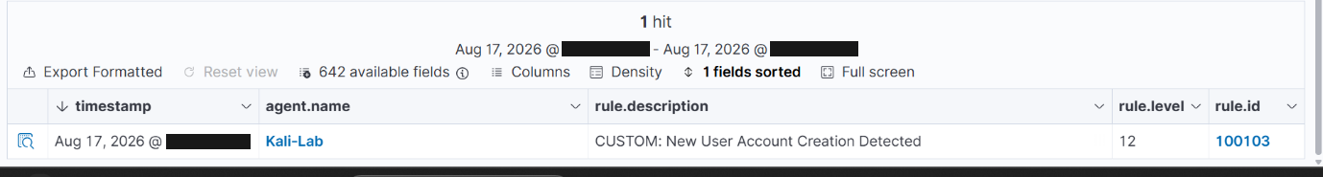
RULE 3 · PERSISTENCE
Someone creating a way back in
Rule 100103
Level 12
T1136.001 Persistence
WHAT IT SPOTS
A brand new local user account being created on the machine.
WHY IT MATTERS
Attackers add their own account so they keep access even after the stolen password is changed.
HOW IT WORKS
Fires on a single account-creation event — no counting needed, one is enough.
Caught in the SIEM
10

Slide 11
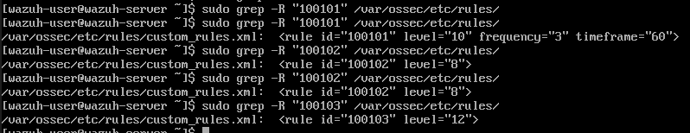
RULE 4 · BONUS RULE
Someone looking around the machine
Rule 100102
Level 8
T1033 Discovery
WHAT IT SPOTS
Basic snooping commands that reveal who and where the attacker is.
WHY IT MATTERS
These are the first commands run after breaking in — cheap to catch, but noisy on a busy machine.
HOW IT WORKS
Fires on a single matching command. I wrote this one first to prove my rule file was loading.
Caught in the SIEM
11

Slide 12
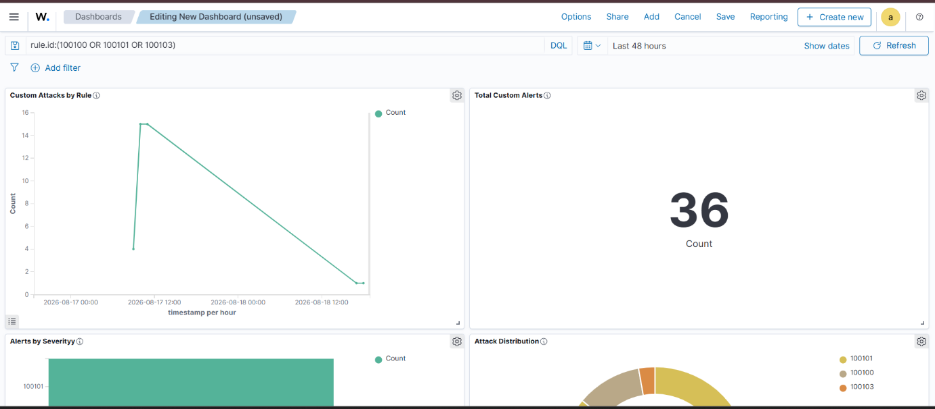
BONUS · REPORTING
A dashboard that shows what is firing
Custom alerts over 48 hours
36
1,349
custom alerts caught
total alerts in the system
12

Slide 13
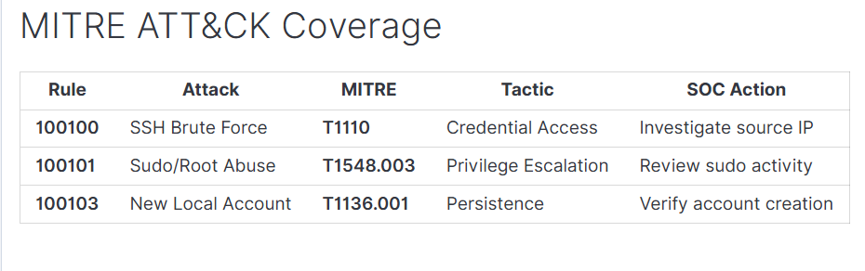
BONUS · ATTACK MAPPING
Every rule tied to a known attacker move
MITRE ATT&CK is the shared language SOC teams use to name attacker behaviour. Each rule carries its technique inside the rule itself, so the label travels with every alert.
1
Get in
Brute force
2
Gain power
Sudo to root
3
Look around
Discovery
Together the four rules cover an attacker's whole path: breaking in, gaining power, looking around, and staying in.
4
Stay in
New account
13

Slide 14

RESULTS
What the task asked for, and what was built
Working SIEM with one agent
Three custom rules
Wazuh running, Kali connected and reporting
Four written, all deployed to the manager
Each rule shown triggering
Clear documentation per rule
Screenshot of every rule firing on real activity
What it spots, why it matters, how it works
Dashboard of alert volume
MITRE ATT&CK mapping
Saved dashboard, filtered to my own rules
Technique built into each rule definition
14

Slide 15

HONEST LIMITS
What I would fix before this went near a client
The thresholds are mine
NEXT STEPS
They were tuned against my own typing, not a real week of traffic.
Add a Windows machine so the same attacks are caught on two platforms
One rule is too noisy
The discovery rule would flood an analyst on a machine someone actually works on.
Add active response so a brute force gets blocked automatically
One rule needs exceptions
Account creation is normal when IT onboards someone — that needs an allow-list.
Keep the rules in version control so changes can be reviewed
Only one machine
I could not test what happens when the same attack hits several hosts at once.
15

Slide 16
Built, attacked, and caught.
A SIEM running from scratch, four rules of my own, and a screenshot of every single one firing.
4
36
4
rules
alerts
techniques

