Slide 1
Direct Data Entry Devices
An Overview of Input Devices

Slide 2
Introduction
Direct data entry devices are tools that allow users to input data directly into a computer or system without the need for intermediate processing or paper-based records.
These devices are used to speed up data entry, improve accuracy, and streamline operations

Slide 3
Types of Direct Data Entry Devices
Some common types of direct data entry devices include:
1. Card Readers
2. Remote Access Device (RAD Readers)
3.Optical Mark Recognition (OMR) and Optical Character Recognition (OCR)
4. QR Code Reader
5. Bar Code Reader

Slide 4
Card Reader
A card reader is a device that reads data from a card with an embedded chip or magnetic stripe. It allows quick data entry and verification.
.

Slide 5
How Card Readers Work :
Card readers capture data stored on cards either via physical contact, as in the case of magnetic stripe cards, or using wireless communication for Radio Frequency Identification card (RFID) cards.

Slide 6
Types of Card readers And Their Working :
Magnetic Stripe Card Readers:
Reads data encoded in the magnetic strip on cards such as credit/debit cards.
Smart Card Readers:
Reads information from embedded microchips, often used for secure identification or authentication.

Slide 7
Types of Card readers:
Contactless (RFID) Readers:
Reads data using radio-frequency identification, used in NFC (Near Field Communication) payments, public transport systems.
Chip and Pin Readers:
Common in POS systems (point of sale), read the chip on cards and require PIN entry for secure transactions.

Slide 8
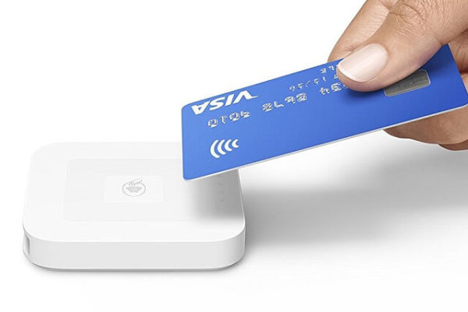
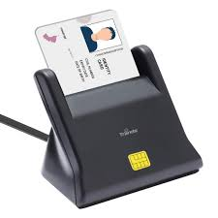
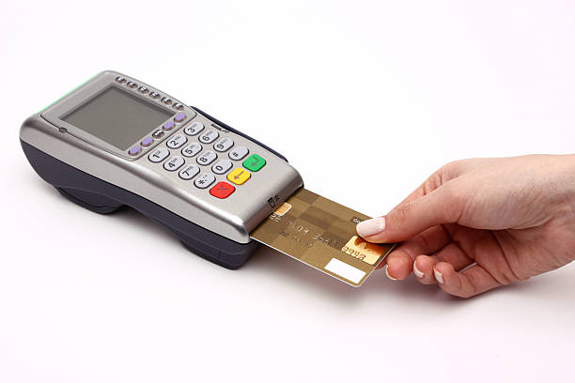
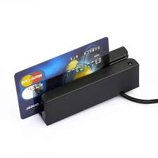
types of card readers :
Contactless (RFID) Readers
Smart Card Readers
Chip and Pin Readers
Magnetic Stripe Card Readers

Slide 9
Applications of Card Readers
Card readers are widely used in:
1. Banking and ATM transactions
2. Access control in secured areas
3. Public transportation systems
4. Retail payment systems
Importance:
Widely used in banking, retail, and secure access systems for efficient and secure data processing

