Slide 1
Caravel FPGA Labs Lab 1
張瑋鑫Allen
20230424

Slide 2
Outline
Lab goal and system design
HLS side design
Vivado block design
HLS IP export bug
FPGA host code

Slide 3
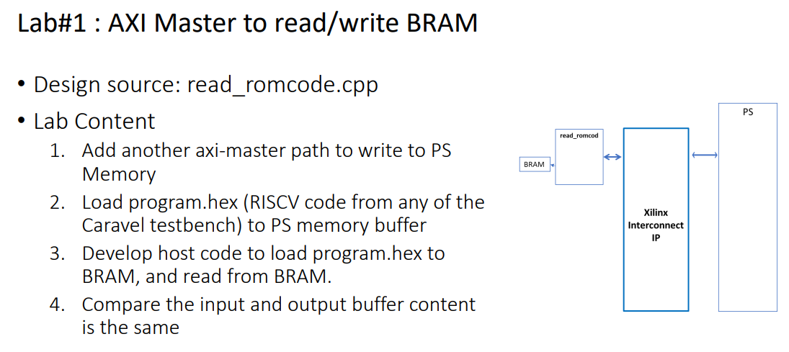
Lab goal

Slide 4
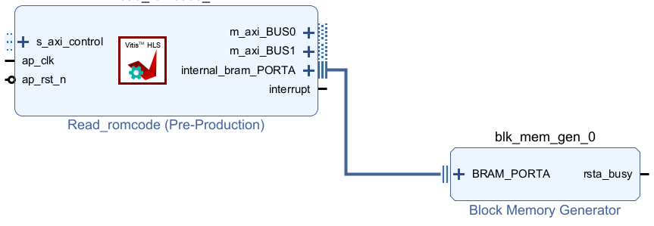
IP design
DRAM
Interface def
ROM code
Write back ROM code
R/W control register
PS (ARM co-processor)

Slide 5
Control flow
IP read ROM code from DRAM
PS set m_axi_BUS0 base address
PS send read command
IP start read DRAM ROM code
PS wait for IP done
IP write ROM code to DRAM
PS set m_axi_BUS1 base address
PS send write command
IP start write ROM code to DRAM
PS wait for IP done

Slide 6
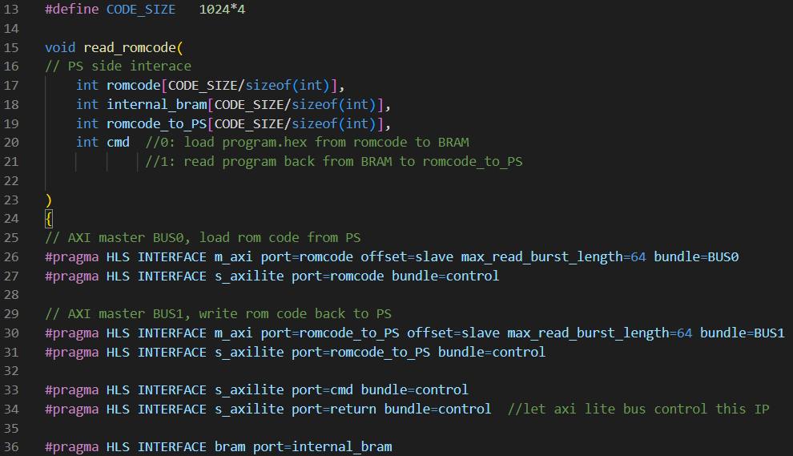
HLS source code – interface
Set romcode as AXI master, and set base address by axi_lite bus
As the same with romcode
Bundle cmd to axi_lite as control register
Bundle return: let axi_lite control IP start
Set internal_bram as block ram interface

Slide 7
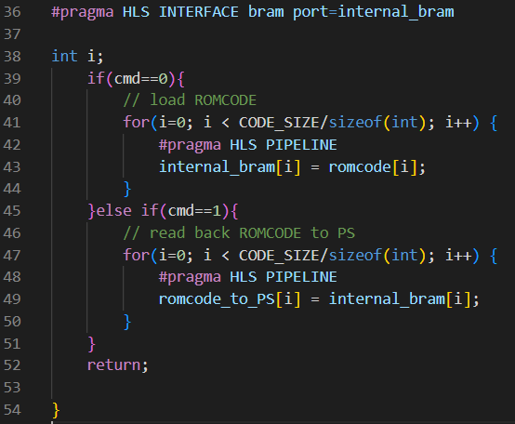
HLS source code - behavior
If cmd ==0, read romcode from DRAM from m_axi_BUS0 base address
If cmd ==1, write romcode to DRAM from m_axi_BUS1 base address

Slide 8
Export IP and import into vivado
Refer to
https://github.com/bol-edu/course-lab_1/blob/2022.1/2022.1-Workbook-Lab1.pdf

Slide 9
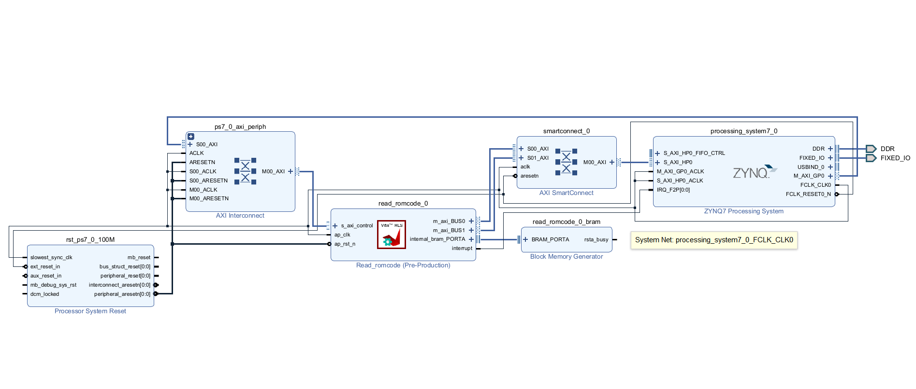
Vivado Block design

Slide 10
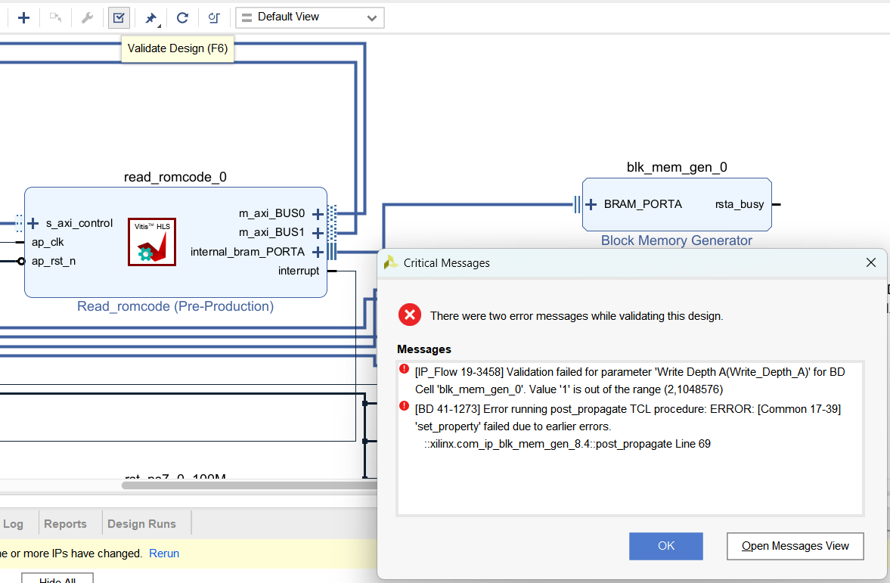
Validate design fail

Slide 11
Error
[IP_Flow 19-3458] Validation failed for parameter 'Write Depth A(Write_Depth_A)' for BD Cell 'read_romcode_0_bram'. Value '1' is out of the range (2,1048576)
Solution ref: https://support.xilinx.com/s/question/0D52E00006hpKsASAU/validation-failed-for-parameter-writedeptha-using-u200-in-vivado-20192?language=en_US
Bug in “run_ippack.tcl” of vitis_hls, which define "mem_depth "1""

Slide 12
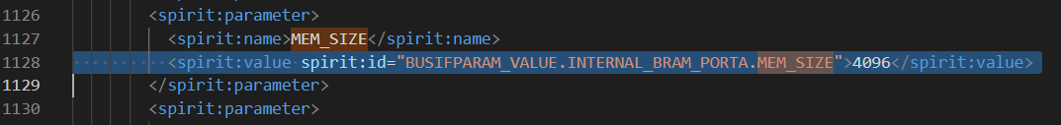
Solution(hacking)
Modify solution_dir/impl/ip/component.xml
Change MEM_SIZE from 4 to 4*depth = 4096
Delete IP in block design, add and connect again, the validation will pass.

Slide 13
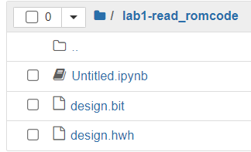
FPGA host flow
Export .bit and .hwh from vivado
Upload to PYNQ-Z2
Ref: “OnlineFPGA 系統使用者手冊”

Slide 14
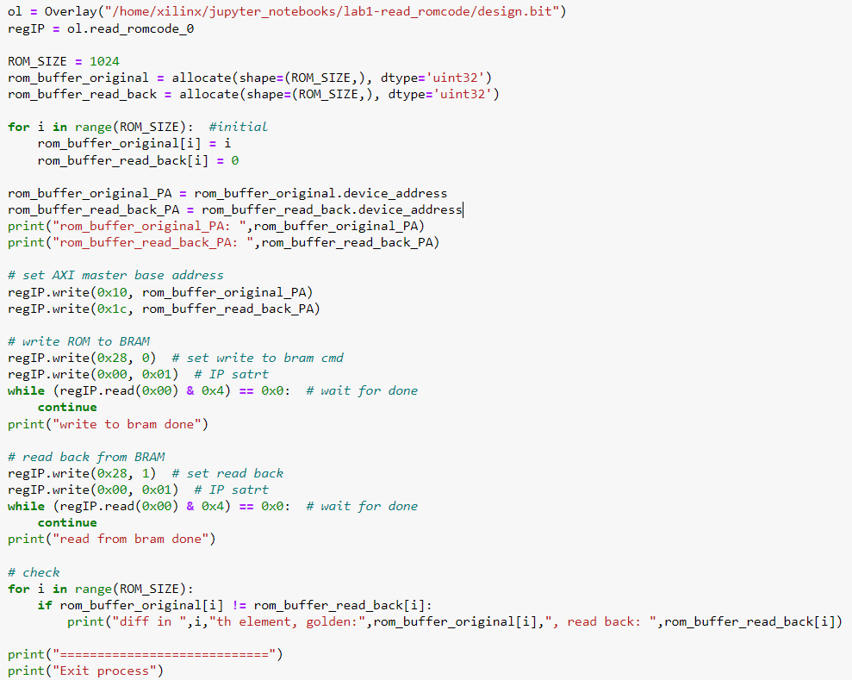
FPGA host code

Slide 15
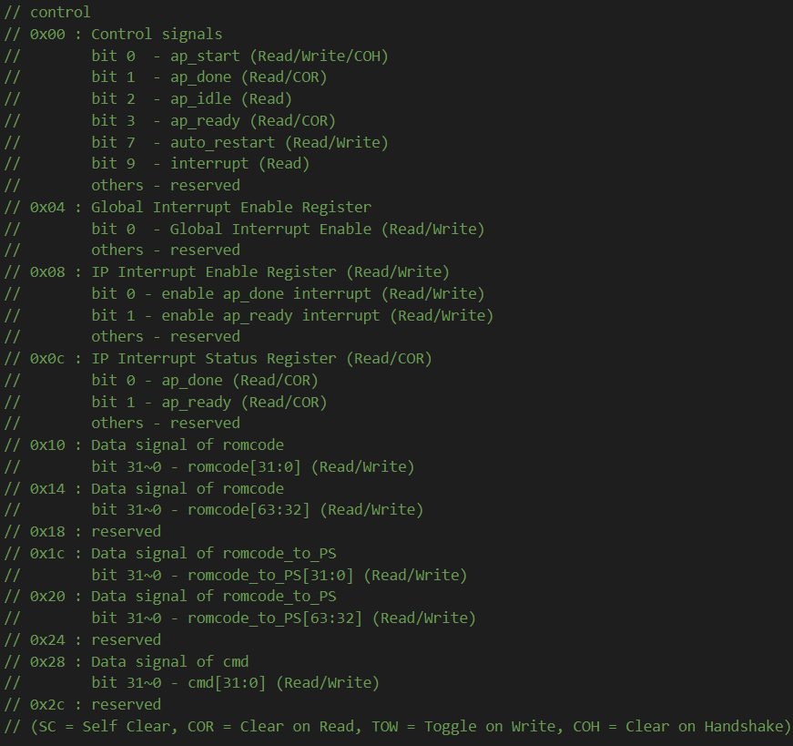
Control register def
Control register def file path
solution1\impl\misc\drivers\ [read_romcode_v1_0]\src\ [xread_romcode]_hw.h

Slide 16
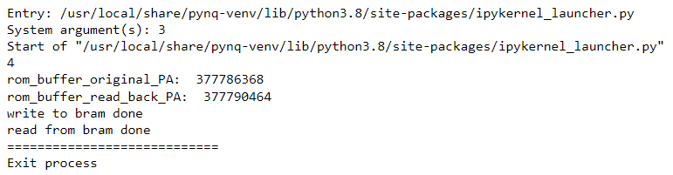
FPGA result
No mismatch been print, pass.

