Slide 1
SPI Device Simulation LAB2
2023/05/15 Bow

Slide 2
Contents
SPI spec introduction
Our SPI design spec introduction
Synchronous Reset
Asynchronous Reset
Synchronous & Asynchronous Compare
Design bug

Slide 3
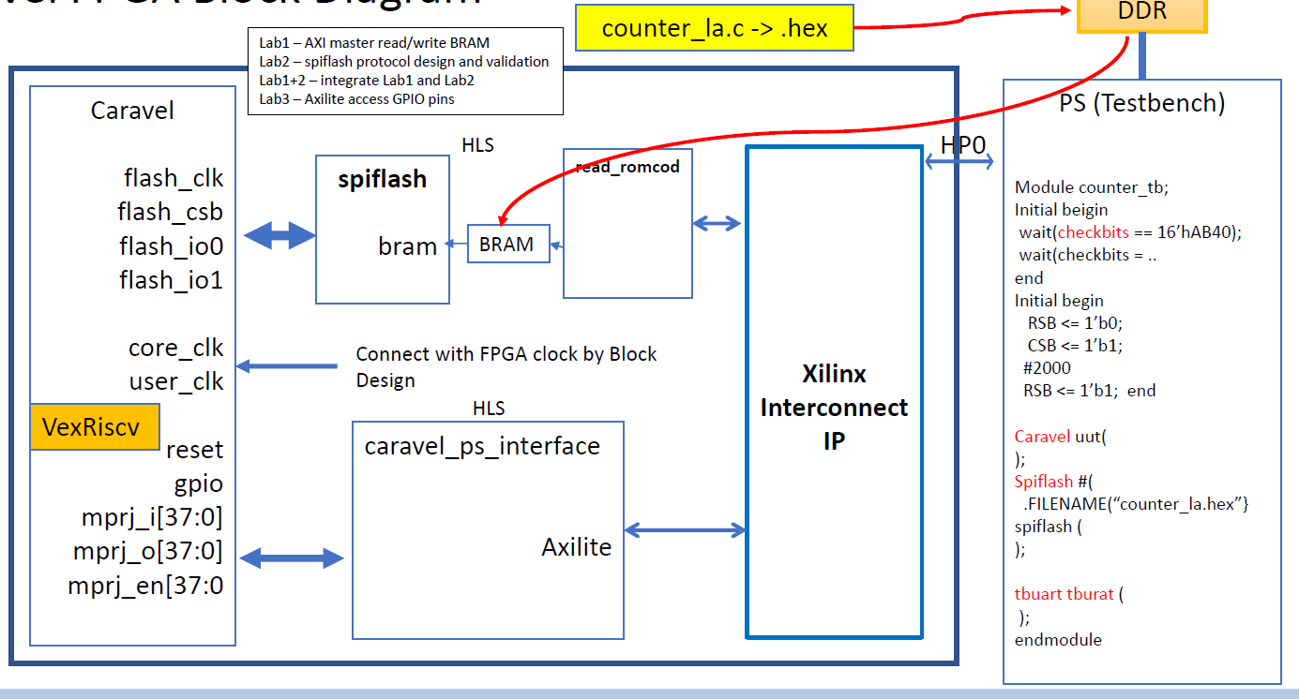
SPI spec introduction

Slide 4
SPI spec introduction
Caravel SOC
SPI Slave
BRAM
SPI Master
APCLK
SPICLK
MISO/IO1
MOSI/IO0
CSB

Slide 5
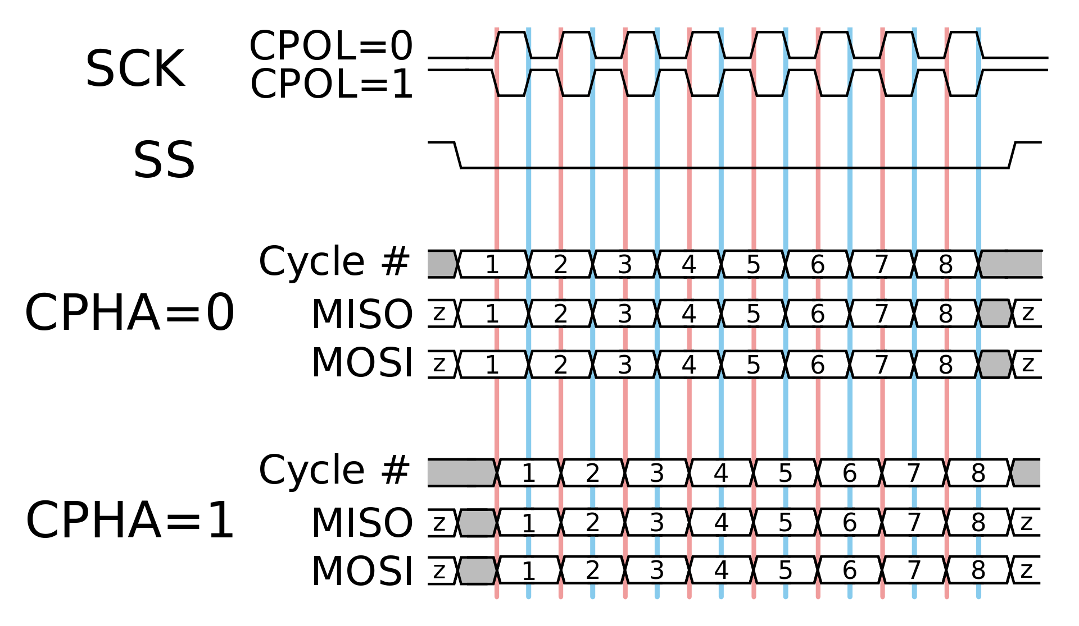
SPI spec introduction
CPOL： Clock polarity
CPHA： Clock phase
Our SPI device design only support
CPOL = 0
MISO CPHA = 0，MOSI CPHA = 1

Slide 6
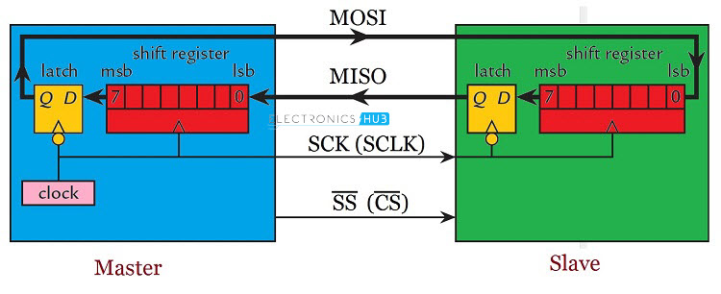
SPI spec introduction

Slide 7
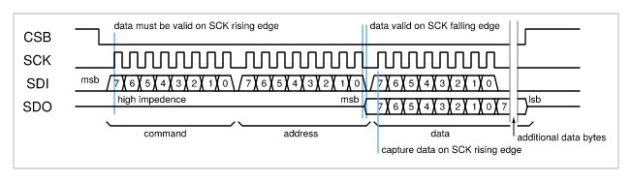
SPI spec introduction
Our SPI device design only support 0x03(read command)
https://caravel-harness.readthedocs.io/en/latest/housekeeping-spi.html

Slide 8

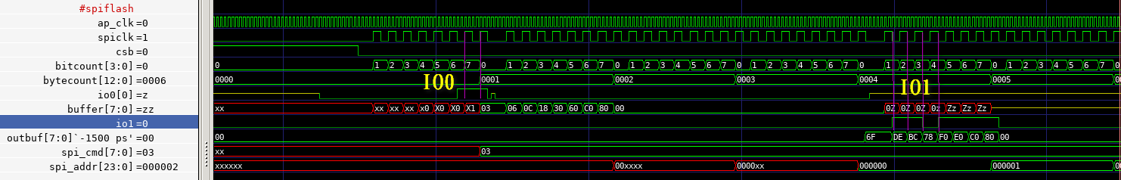
Our SPI design spec introduction
ap_clk runs at FPGA clock
spiclk is 1/4 of ap_clk
io0 is input and sampled at spiclk rising
io1 is output and output at spiclk falling

Slide 9
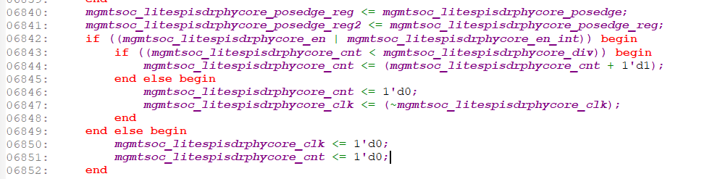
Clock：
{mgmt_core} input core_clk[wire] --- > sys_clk[wire] --- >sdrio_clk[wire]
always @(posedge sdrio_clk) begin
--- > mgmtsoc_litespisdrphycore_clk[reg 1’d0] ---> flash_clk
end
Divisor
mgmtsoc_litespisdrphycore_storage [reg [7:0]]--- > mgmtsoc_litespisdrphycore_spi_clk_divisor[wire [7:0]] --- > mgmtsoc_litespisdrphycore_div[wire [7:0]]

Slide 10
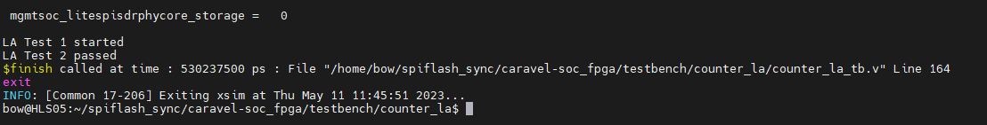

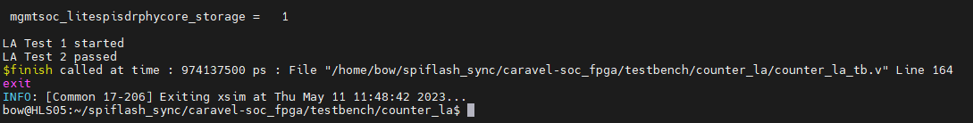

Default value
ap clk | div | spi clk
2 | 0 | 1
4 | 1 | 1
6 | 2 | 1
8 | 3 | 1
10 | 4 | 1
12 | 5 | 1
14 | 6 | 1
16 | 7 | 1
18 | 8 | 1
20 | 9 | 1
22 | 10 | 1

Slide 11
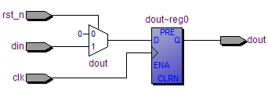
Synchronous Reset
module clk_rst_sync (
clk,
rst_n,
din,
dout
);
input clk;
input rst_n;
input din;
output dout;
reg dout;
always@(posedge clk) begin
if(!rst_n) begin
dout <= 1'b0;
end else begin
dout <= din;
end
end
endmodule
Synchronous
Notes:
Asynchronous Synchronized
recovery time = setup time
removal time = hold time

Slide 12
Synchronous Reset
Advantages
Make sure clock & reset is 100% synchronous
Filter some glitch
Make sure reset trigger on right clock edge
Disadvantages
More gate count

Slide 13
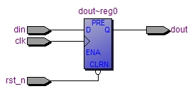
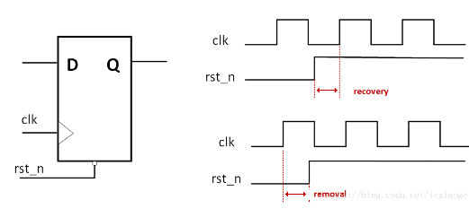
Asynchronous Reset
module clk_rst_sync (
clk,
rst_n,
din,
dout
);
input clk;
input rst_n;
input din;
output dout;
reg dout;
always@(posedge clk or negedge rst_n) begin
if(!rst_n) begin
dout <= 1'b0;
end else begin
dout <= din;
end
end
endmodule
Asynchronous

Slide 14
Asynchronous Reset
Advantages
Reset anytime don’t care clock
Reduce gate count
Disadvantages
Glitch affect reset release easier
These resets have to follow a special condition and logic to fix up reset recovery time and reset removal time.

Slide 15
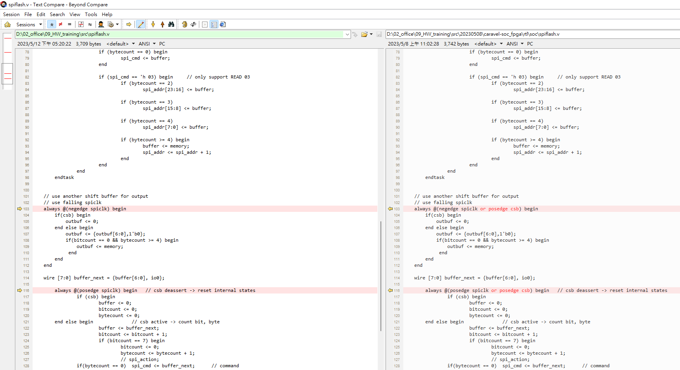
Synchronous & Asynchronous Compare
Synchronous
Asynchronous

Slide 16
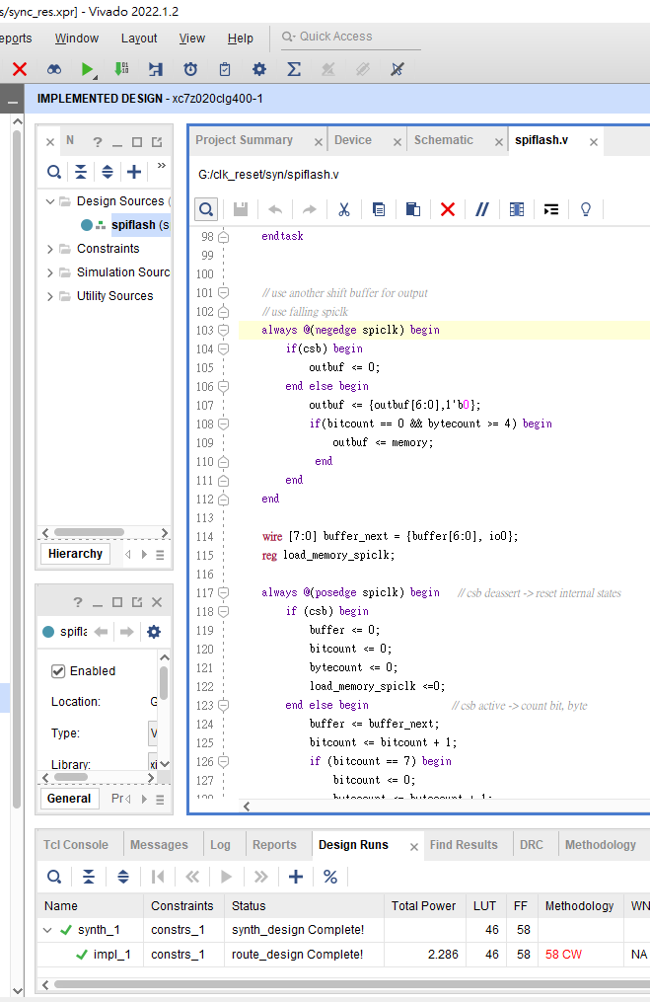
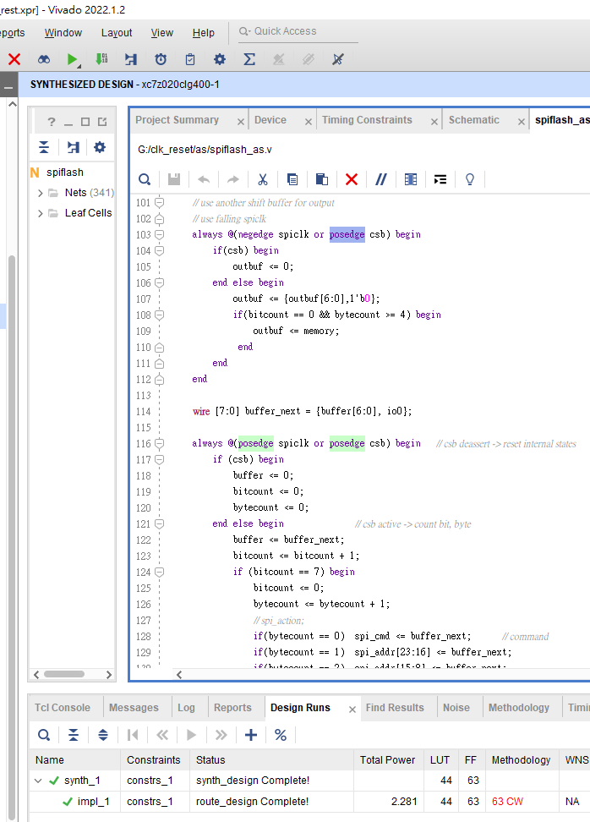
Synchronous & Asynchronous Compare
Synchronous
Asynchronous
Total power : 2286
LUT: 46
Total power : 2281
LUT: 44

Slide 17
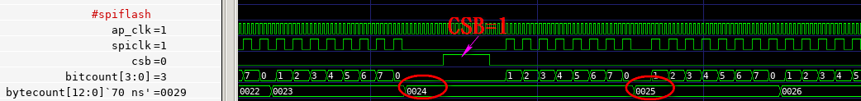
Design bug
Synchronous
Asynchronous

Slide 18
Reference
https://www.intel.com/content/www/us/en/docs/programmable/683082/22-1/using-asynchronous-resets.html
https://blog.csdn.net/Jackiezhang1993/article/details/85319001
https://magicjackting.pixnet.net/blog/post/164725144
https://en.wikipedia.org/wiki/Serial_Peripheral_Interface#Mode_numbers
https://www.electronicshub.org/basics-serial-peripheral-interface-spi/
https://www.twblogs.net/a/5c265c9fbd9eee16b3db96f2

