Slide 1
FACSanadu
in brief
Johan Henriksson

Slide 2
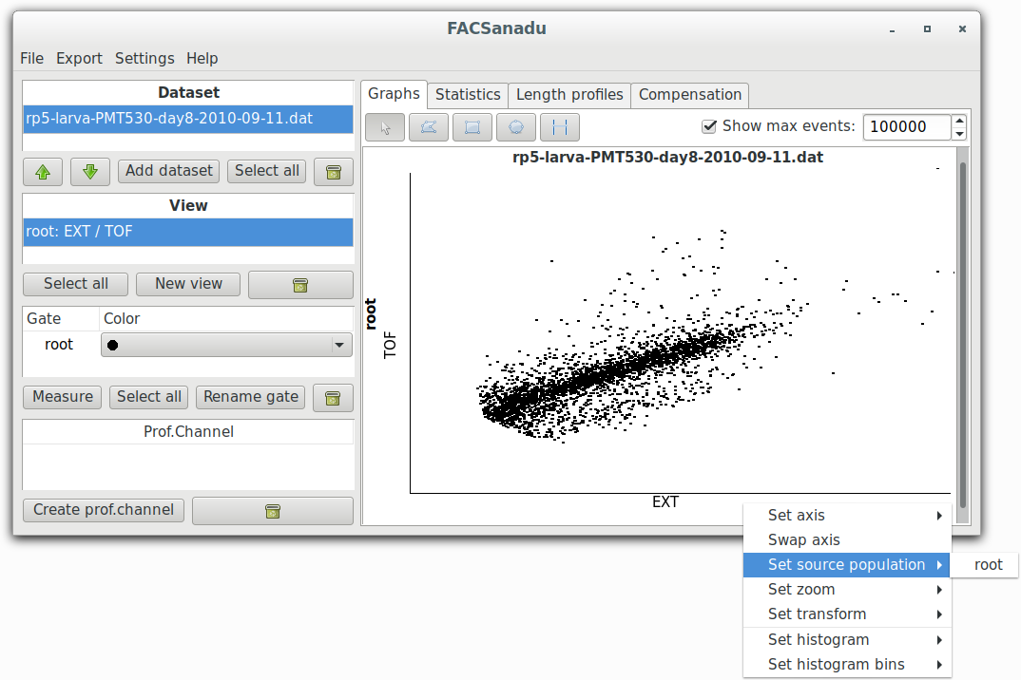
View manipulation
You can speed up the software by only viewing the first N events
List of available views
Create a new view
Left-click on an axis for options
Source population: Only show observations from this gate

Slide 3
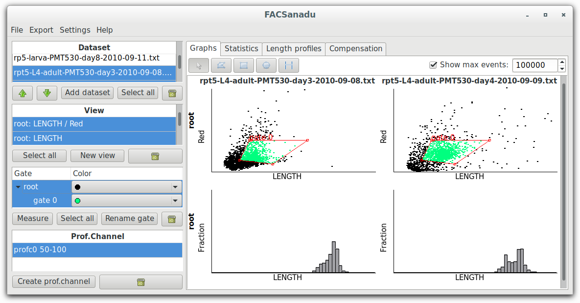
Multiple views
Select one or more datasets
to view. Use ctrl+ and shift+ left button
to select several
Select one or more views
Here we display 2 datasets * 2 views

Slide 4
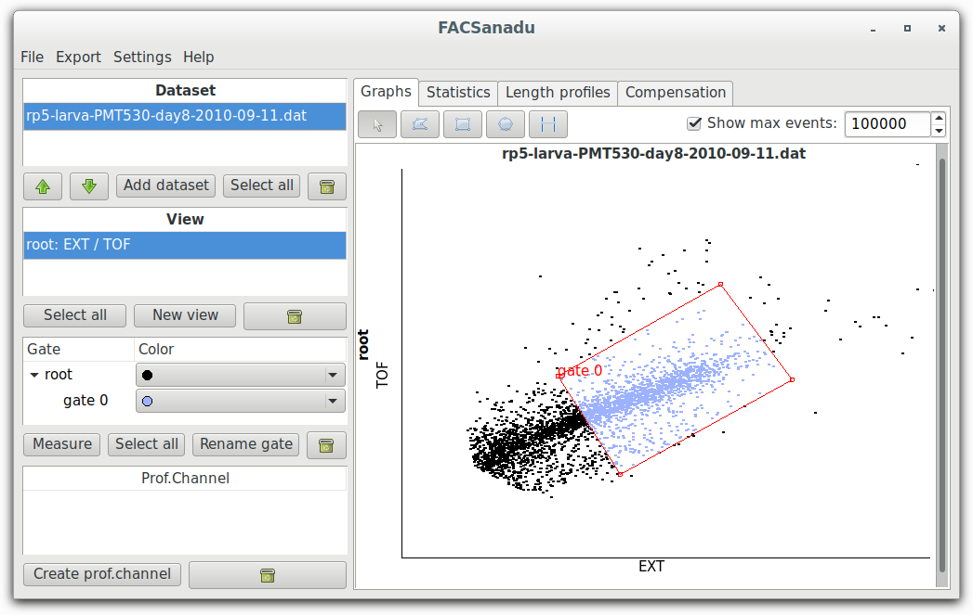
Creating gates
First select a tool: Polygon, rectangles, ellipses and ranges. For histograms you can only use ranges
First select a tool: Polygon, rectangles, ellipses and ranges. For histograms you can only use ranges
Change color and name here
Gate is always made a child of
currently selected gate
Draw a polygon by clicking in each corner. Finish by double-clicking

Slide 5
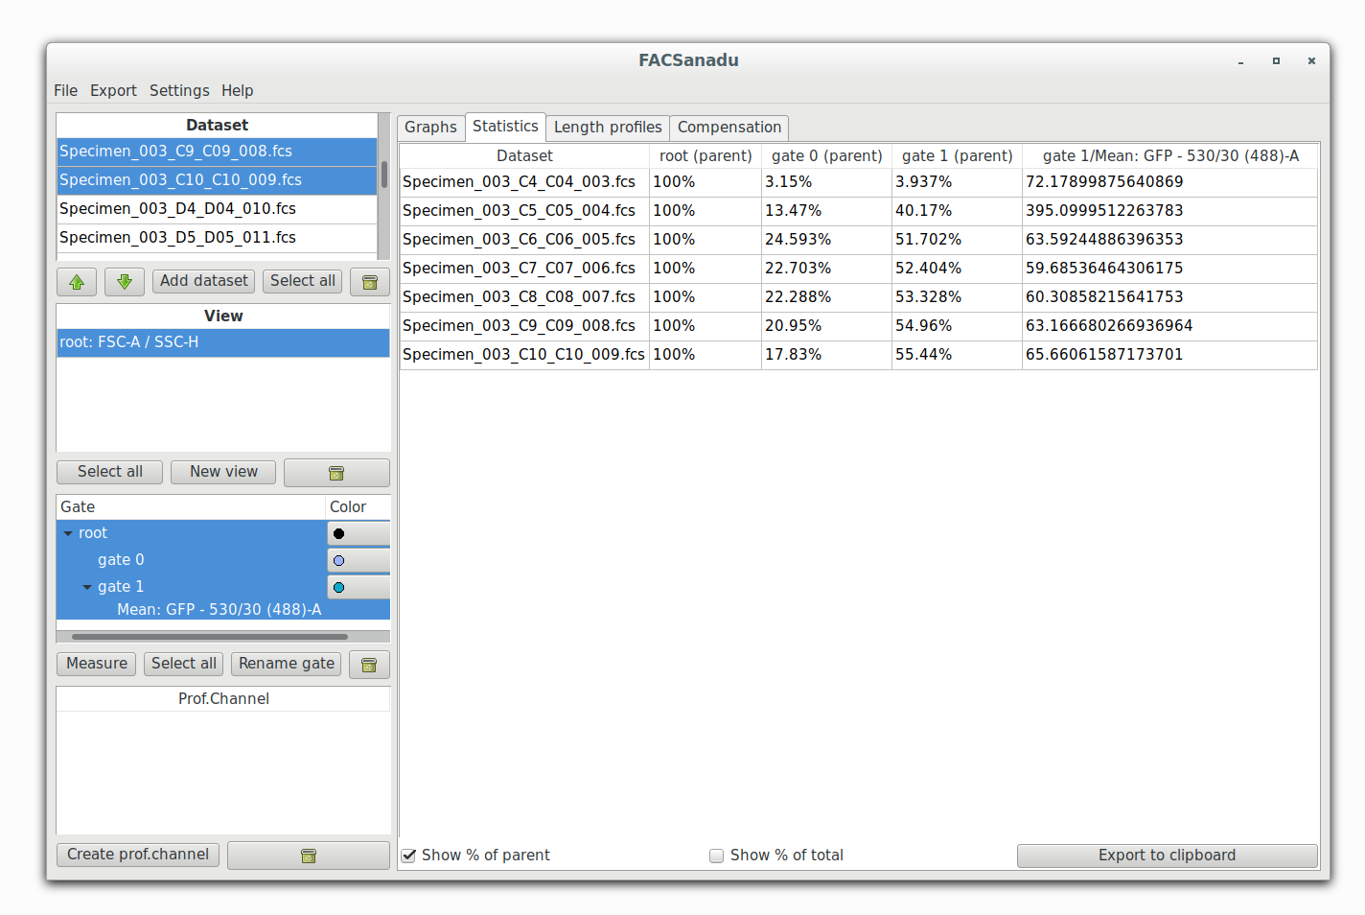
Gating statistics
Data is show for each dataset & each gate/measure
Select one or more
datasets to view
Select one or more
gates/measures
Can show observations relative
to parent or total (root)
Export data for further analysis. Paste into
a spreadsheet program of your choice (or raw text editor)

Slide 6
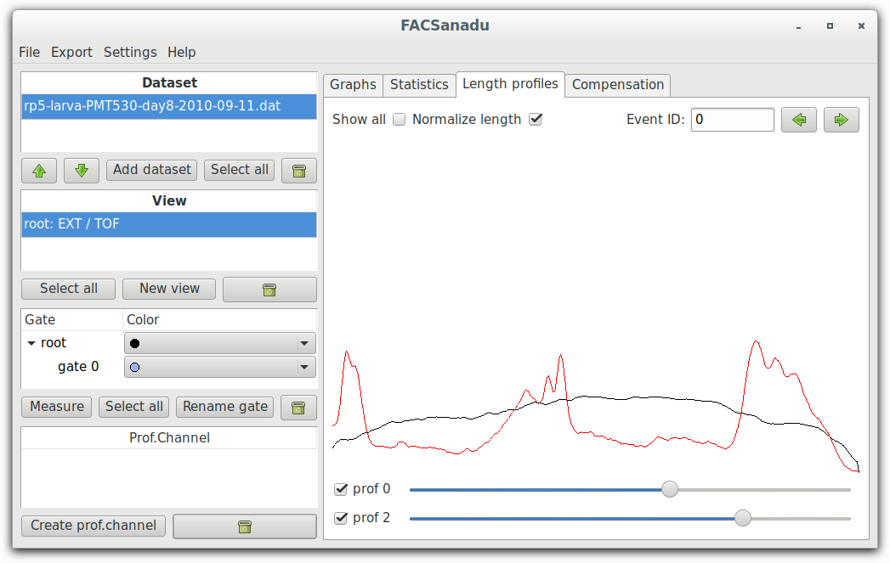
Viewing COPAS profiles
Stretch profiles for comparison
Observation to show
Get an overview by showing all profiles
in current gate
Channels to show and a scaling for each

Slide 7
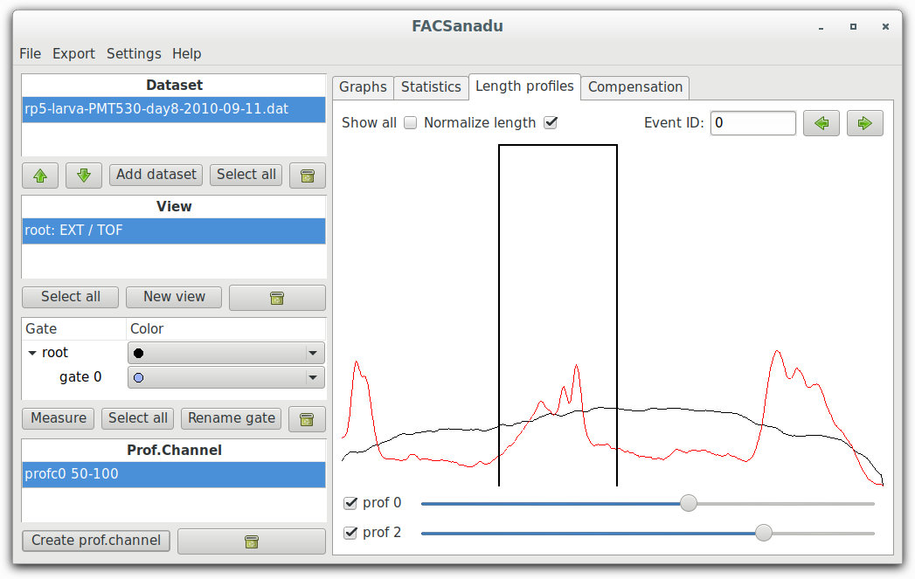
Measuring in COPAS profiles
Select normalization to perform it prior to integration. Affects currently displayed profile channel
List of profiles, also
provided as channels
Create a new profile. The first currently
selected channel will be measured
Region to integrate, can be adjusted by
dragging the ends using left mouse button
Color of gate indicates channel used

