Slide 1
Brain Computer Interface Feature Selection Using Genetic Algorithm
Timothy Mahoney and Marcus Gallagher

Slide 2
Summary
Motivation
Scope and Aim
Pre-processing
Methods
Results
Discussion
Conclusions

Slide 3
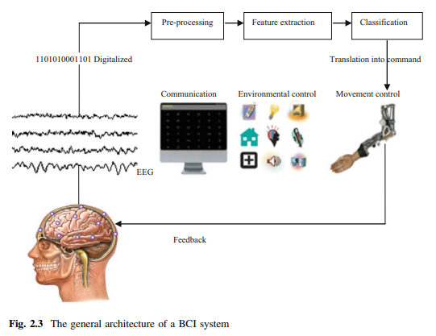
Brain Computer Interfacing
Challenges include:
Difficult to get clean signal (heaps of noise, non-invasive…)
Hardware requirements – many channels, gell, preparation time
Difficult to classify – features are separated spatially, temporally and in frequency

Slide 4
Aim
The aim of this project is:
Develop a feature selection method to find an appropriate and small subset of EEG features for the purposes of motor- imagery event classification.
The data processing pathway should simulate an online BCI system. As such methods should be:
Completely automated
Computationally efficient
Robust to slow sampling

Slide 5
Scope
Dataset - PhysioNet Motor Movement/Imagery set
109 Subjects, three repeated two minute recordings
64 channel EEG sampled at 160Hz
Task 2: subject imagines closing their fist on the left or right in response to a visual cue
All processing completed in MATLAB.

Slide 6
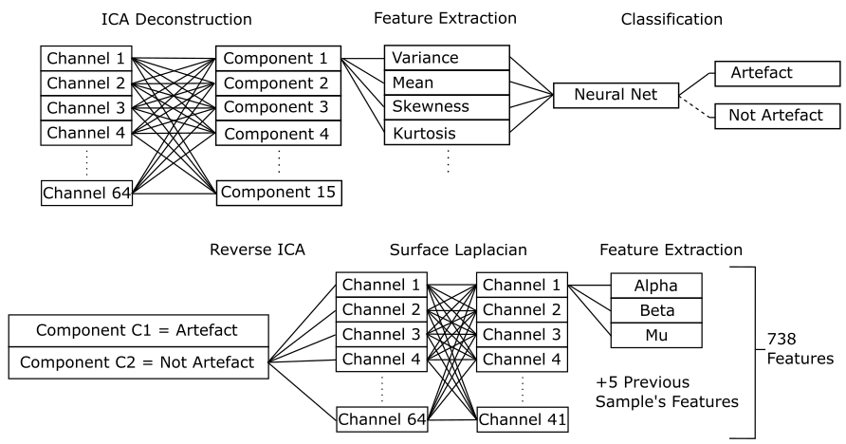
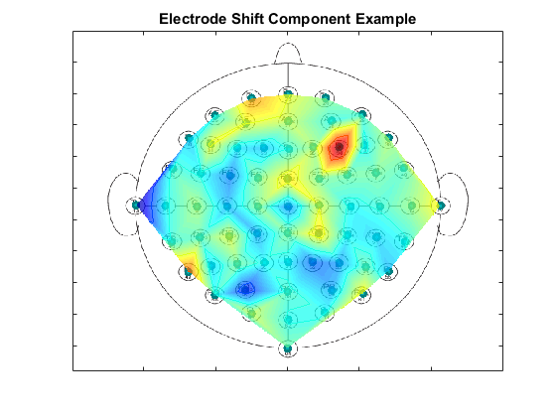
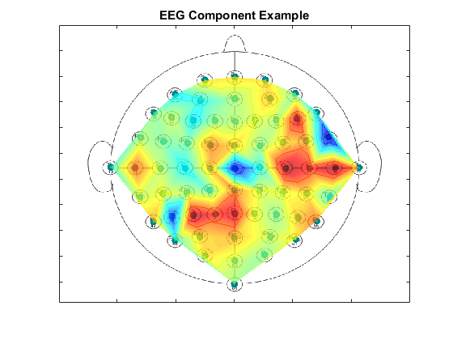
Pre-processing
Bandpass (1-80Hz) and Notch (60Hz) Filter
Automated Artefact Removal (AAR)
Artefacts include:
Noise from muscles (EMG)
Eye movements and blinking (EOG)
Electrode shift
Surface Laplacian – improves spatial resolution
Features – spatial, temporal and frequency based

Slide 7
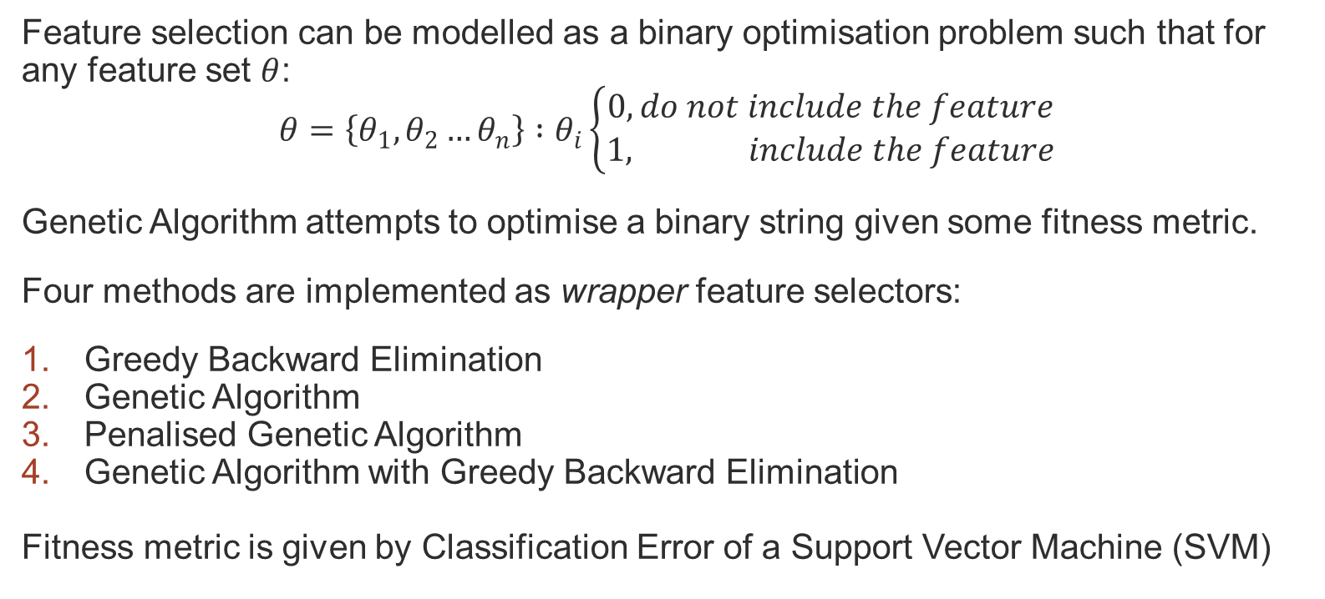
Methods – Genetic Algorithm
Feature selection can be modelled as a binary optimisation problem such that for any feature set $θ$:
$$θ=\left\{θ_{1},θ_{2}…θ_{n}\right\} :θ_{i}\left\{\begin{aligned}0,do not include the feature \\ 1, include the feature\end{aligned}\right.$$
Genetic Algorithm attempts to optimise a binary string given some fitness metric.
Four methods are implemented as wrapper feature selectors:
Greedy Backward Elimination
Genetic Algorithm
Penalised Genetic Algorithm
Genetic Algorithm with Greedy Backward Elimination
Fitness metric is given by Classification Error of a Support Vector Machine (SVM)

Slide 8
Greedy Backward Elimination
Pseudo Code:
Start with full feature set
Compute fitness of new candidate sets given the removal of a single feature. That is, given a current set with n included features, there are n candidates each excluding a different feature.
Next set is the set from candidates with the best computed fitness
Repeat from 2 until no features remain
Select the feature set which best balances fitness and number of included features
A simple method to compare GA against.

Slide 9
Genetic Algorithm (GA)
The algorithm is applied as follows:
Eight candidate sets are sampled at random from the feature space to create the candidate pool.
Evaluate candidate pool scores.
Automatically include the two highest scoring candidates (elite children) in the new candidate pool
Create a mating pool which includes two copies of the highest scoring candidate and one of each of the next two highest scoring candidates.
Select six sets of two different parents from the mating pool at random and perform uniform crossover to produce the remaining six candidates for the candidate pool.
Apply mutation with a probability of 0.01 to every candidate except for the best.
Repeat from step 2 until reaching a stopping criterion of 1000 generations.
Search for an appropriate feature set.
Does not consider number of features included.

Slide 10
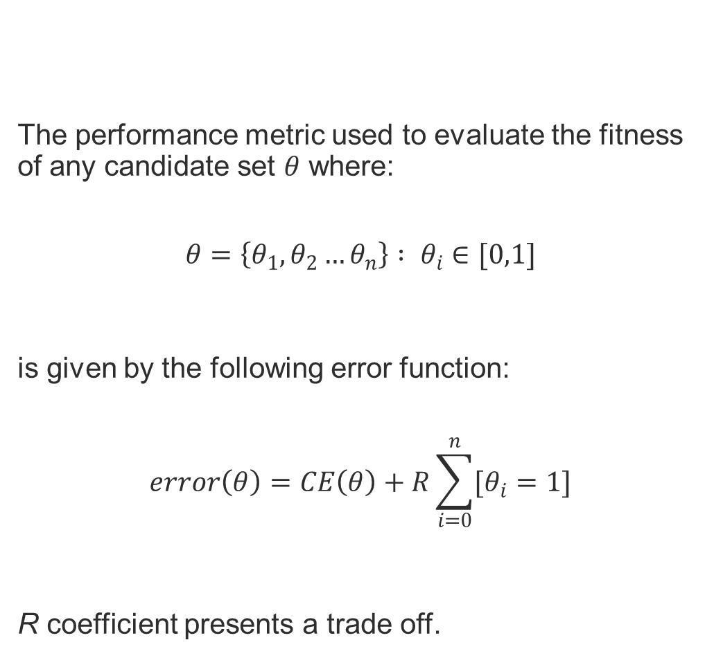
Penalised GA
The performance metric used to evaluate the fitness of any candidate set $θ$ where:
$$θ=\left\{θ_{1},θ_{2}…θ_{n}\right\} : θ_{i}∈[0,1]$$
is given by the following error function:
$$error\left(θ\right)=CE\left(θ\right)+R\sum_{i=0}^{n}{[θ_{i}=1]}$$
R coefficient presents a trade off.
Encourages an appropriate and small feature set.

Slide 11
GA with Greedy Backward Elimination
First perform GA as usual until reaching stopping criterion.
The resulting set is the starting set for Greedy Backward Elimination
An appropriate set is then selected to include benefits from the high accuracy starting set and low feature inclusion of backward elimination
Combined effort to first search for a suitable feature set, followed by dimension reduction.

Slide 12
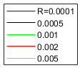
Results
Penalised GA
 | Classification Error (Test Data) | Number of Features | Score (R=0.001)
GBE | 0.2350 | 80 | 0.3150
GA | 0.2091 | 328 | 0.5371
Penalised GA | 0.2410 | 131 | 0.3720
GA w GBE | 0.1864 | 52 | 0.2384

Slide 13
Discussion
Given enough time, Penalised GA could perform as well as GA with Greedy Backward Elimination
However,
GA operations do not discriminate between including or excluding features.
As a result,
Penalised GA spends generations producing and searching poor candidates because it includes more features without knowing the effect this has on the candidates score.
GA with Greedy Backward Elimination utilises both algorithms in ways they were designed to be used:
GA to find an appropriate feature set and
Backward Elimination to determine how many features can be ignored while maintaining classification performance
Why did GA with Greedy Backward Elimination outperform Penalised GA?

Slide 14
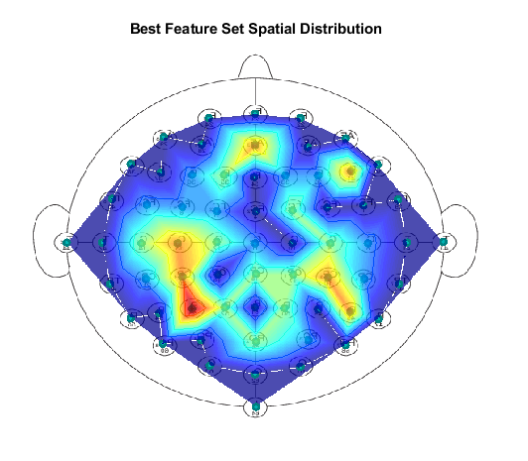
The Feature Set
Reduced to 28 channels

Slide 15
Further Investigation
Incorporating feature reduction into GA operations
Investigate and optimising performance of other classifiers
Reduce reliance on temporal data
Expanding classifier to include ‘rest’ class
Testing on live data

Slide 16
Conclusion
The project has been successful in satisfying the aim to:
Develop a feature selection method to find an appropriate and small subset of EEG features for the purposes of motor-imagery event classification.
The method with the best performance:
Genetic Algorithm with Greedy Backward Elimination

