Slide 1
Intro slide make it interesting BCI definition?
Quote or BCI potential or some shit
Brief outline of seminar

Slide 2
The problem – introduce BCI Define BCI

Slide 3
What are the challenges?
Difficult to get good signal (heaps of noise, non-invasive…)
Hardware requirements – many channels, gell, prep time
Difficult to classify
We don’t fully understand the brain

Slide 4
EEG
Explain concept
Highlight many temporal, spatial and frequency features to consider, emphasise that there is a lot of data
Go through bands (what they might relate to), channels briefly
Montage
Homonculous

Slide 5
Previous Studies
1:
Quite good classification
Smaller dataset, feature set, uses ‘accuracy’
Ways to improve? Possibly considering a broader range of features?
As far as I’m aware, no one has used optimisation methods with feature selection, especially concerning the features I’m using

Slide 6
Feature Selection for Brain Computer Interface using Particle Swarm Optimisation and Genetic Algorithm
Scope – MATLAB, designed for online use (which presents many challenges), aims to reduce complexity and possibly hardware requirements by streamlining processing – only taking information needed to classify signal.

Slide 7
Project Timeline
Preprocessing
Feature Extraction
Feature Selection
Classification
‘Rest of seminar will explain the project along this chronological structure’

Slide 8
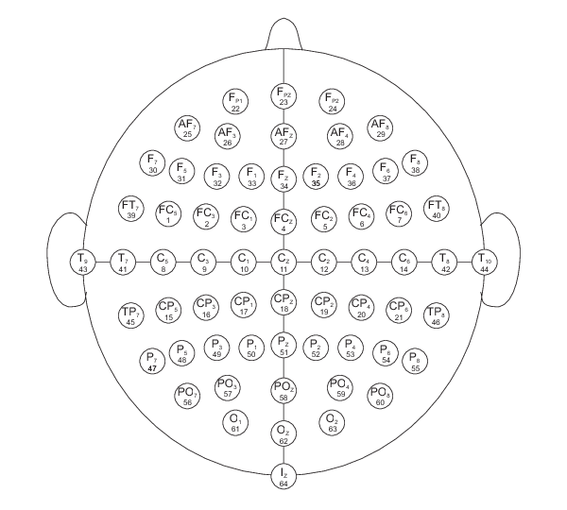
Physionet – EEG Motor Imagery/Movement Dataset
Subjects undertake a number of movement / imagery tasks during EEG recordings
Task 2 – Subject imagines opening/closing left/right fists
109 Subjects, 3x2 minute recordings each with annotations
64 Channel EEG sampled at 160 Hz

Slide 9
Artefact Removal
Preprocessing
Feature Extraction
Feature Selection
Classification
Examples of EEG artefacts:
Blinks
EMG
Mains coupling
Electrode shift
Removal techniques:
Epoch removal
Filtering
Independent Component Analysis (ICA)
Automated Artefact Removal (AAR)

Slide 10
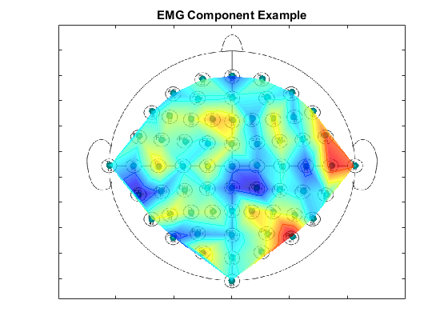
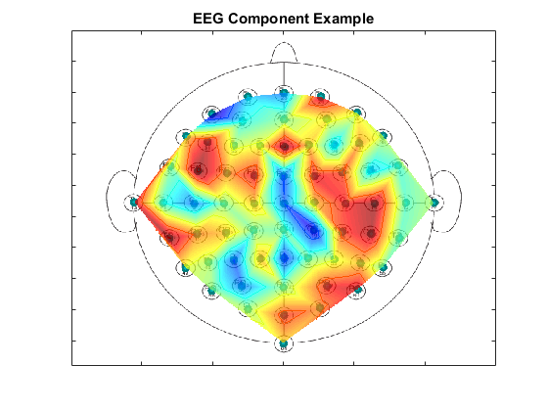
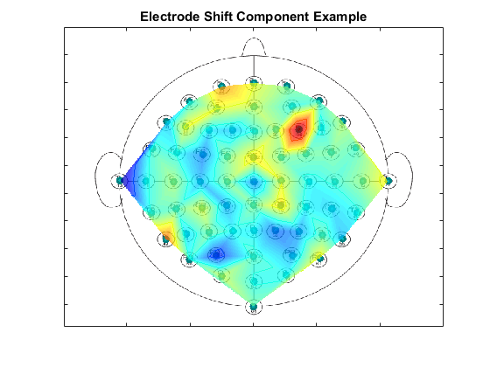
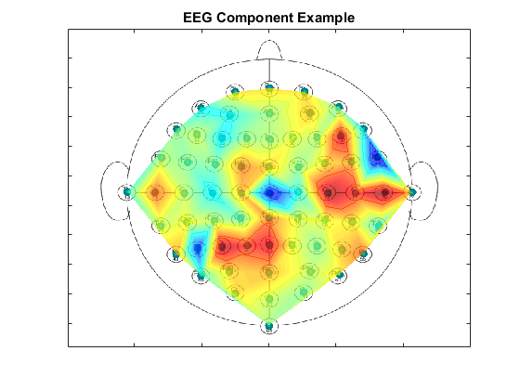
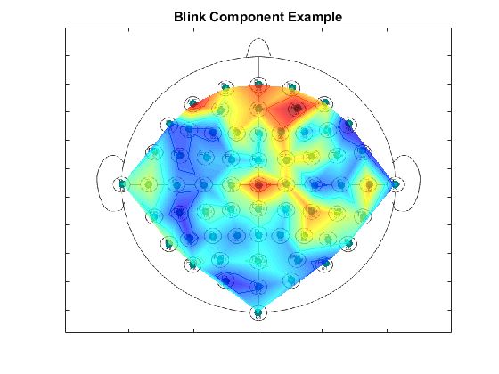
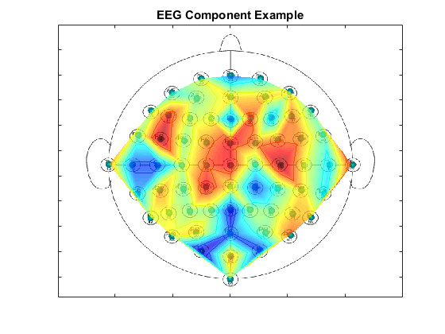
ICA
Voice in a crowd
Labelled 3000 samples PHD candidates helped
I used FastICA

Slide 11
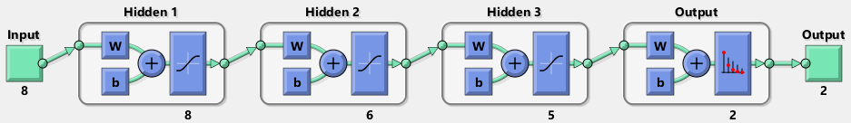
Results
Preprocessing
Feature Extraction
Feature Selection
Classification
Different classifiers
Network topology
Drawbacks – could spend more time doing more samples however not the focus, could also use different dataset with labelled artefact samples (BCI competition IV)

Slide 12
Features
Preprocessing
Feature Extraction
Feature Selection
Classification
Temporal, spatial, frequency
SL transform
ERS, ERD
Power density

Slide 13
PSO
Preprocessing
Feature Extraction
Feature Selection
Classification

Slide 14
GA
Preprocessing
Feature Extraction
Feature Selection
Classification

Slide 15
Optimisation Performance
Preprocessing
Feature Extraction
Feature Selection
Classification
Filter method with some performance metric
Why?

Slide 16
Classifiers
Preprocessing
Feature Extraction
Feature Selection
Classification
Can be used to compare with previous studies

Slide 17
Further research
Other datasets
Live EEG-BCI data collection

