Slide 1

Building Real Time Apps with Horizon
Alex Miller
@amahopa

Slide 2

Goals
I want you to be able to:
1. Install it
2. Start breaking it
3. Know where the manual is

Slide 3
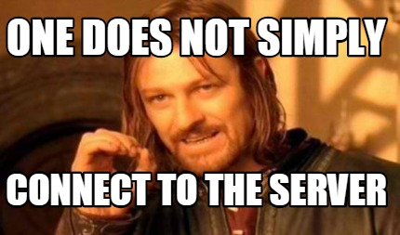
Why Horizon?
Write less middle tier code
Real time
Freedom: Modularity & No Lock-In

Slide 4

Horizon Clients
Web Sockets
Horizon Server
Database

Slide 5
Getting Started
Install RethinkDB
npm install –g horizon
hz init myApp
hz serve --dev

Slide 6
Database
noSQL
designed for real time interactions
Pushes changes to queries out to clients
Platforms
Mac & Linux
Windows in Beta

Slide 7
Server

Slide 8
Client – Getting Data In

Slide 9
Client – Getting Data Out

Slide 10

Security
HTTPS in production mode by default
JSON Web token on the client side for user info
3 Authentication Modes
Unauthenticated
Anonymous: Random token for each user
Token: OAuth integration

Slide 11

Demo Time!

Slide 12
Resources
Horizon Docs
http://horizon.io/docs/
RethinkDB
https://www.rethinkdb.com/
Demo Code & Slides
https://github.com/mahopa/Horizon-ngHouston

