Slide 1
NLTK
مهدی حسین‌زاده

Slide 2
NLP or Why Analyze Text
To get information out of textual data
Sentiment analysis of messages
Spam filtering
Document similarity (plagiarism detection)
Document categorization (topic detection)
Social media data analysis

Slide 3
NLP and Machine Learning
How can we make a computer understand language?
Based on language rules, patterns, or statistics
Statistics are more accurate and popular
Natural Language Processing requires flexibility, which generally comes from machine learning.

Slide 4
Languages
Formal
Natural
Strict, unchanging rules
No ambiguity
Inflexible: no new terms
Parsable by regex
Generally application-specific (math etc.)
Flexible and evolving
Ambigous: redundancy
Very flexible
Difficult to parse
Used in many domains

Slide 5
What is NLTK
NLTK: Natural Language toolkit
Several text processing utilities and corpora
Interface to over 50 corpora and lexical resources
Focus on Machine Learning
Free and Open Source
Numpy and Scipy under the hood
Fast and Formal
Does not work well with Persian. other libraries like spaCy and Hazm can be used instead.

Slide 6
NLTK Design Goals
Requirements
Non-requirements
Ease of use
Consistency
Extensibility
Documentation
Simplicity
Modularity
Comprehensiveness
Efficiency
Performance
Cleverness

Slide 7
NLTK Features
Tokenization
Stemming
Tagging
Parsing
Chunking
Classification

Slide 8
NLTK Modules
corpora: a package containing modules of example text
tokenize: functions to separate text strings
probability: for modeling frequency distributions and probabilistic systems
Stem: package of functions to stem words of text
Wordnet: interface to the WordNet lexical resource
Chunk: identify short non-nested phrases in text
etree: for hierarchical structure over text
tag: tagging each word with part-of-speech, sense, etc.
parse: building trees with recursive descent, shift-reduce, probabilistic, etc.
cluster: clustering algorithms
draw: visualize NLP structures and processes
contrib: various pieces of software from outside contributors

Slide 9
NLTK Good Parts
Trained models can be very fast
Well known algorithms can be very accurate
3 Classification Algorithms
9 Part-of-Speech Tagging Algorithms
Stemming Algorithms for 15 Languages
5 Word Tokenization Algorithms
Sentence Tokenizers for 16 Languages
60 included corpora

Slide 10
NLTK Bad Parts
NLProc is hard
Few out-of-the-box solutions (see Pattern)
Not designed for big-data (see Mahout)
Doesn’t have latest algorithms (see Scikits-Learn)
No online or active learning algorithms
Models can use a lot of memory

Slide 11
Install NLTK & Download Corpora
Installing NLTK: http://nltk.org/install
Training sets and corpora should be downloaded first
A corpus is a collection of documents to learn about
Resource wordnet not found
Please use the NLTK Downloader to obtain the resource
Python console:
>>> import nltk
>>> nltk.download('wordnet')

Slide 12
Tokenization
First steps in NLP:
Sentence segmentation
Word tokenization
Token:
A string of contiguous characters
Space is the most common delimiter

Slide 13
POS Tagging
CC | Coordinating conjunction
CD | Cardinal number
DT | Determiner
EX | Existential "there"
FW | Foreign word
IN | Prepostion or subordination conjunction
JJ | Adjective
JJR | Adjective- comparative
JJS | Adjective- superlative
LS | List item marker
MD | Modal
NN | Noun- singular or mass
NNS | Noun- plural
NP | Proper noun- singular
NPS | Proper noun- plural
Part of speech:
Whether it is a noun, a verb, etc.
Helps to understand the sentence
Used when parsing the text
Needs training
So is based on statistics

Slide 14
Normalization
Stemming
Lemmatization
Works on affixes
Just some predefined rules
No additional knowledge required
More soffisticated than stemmer
Needs knowledge about dictionary
Also may need pos tags for homonyms

Slide 15
Stopwords
Are common words with little value:
Like is, the, are, a, and etc.
May depend on the domain
Specifying the stopwords:
Can define them manually
Use idf or tf-idf to detect them

Slide 16
Chunking and Parsing
How do we get a machine to understand the text?
We need structure
Generate parse tree:
Root - the sentence
Intermediate - noun phrase, verb phrase etc.
Leaf - the words
Chunking or shallow parsing:
Group words that represent a single idea or thing

Slide 17
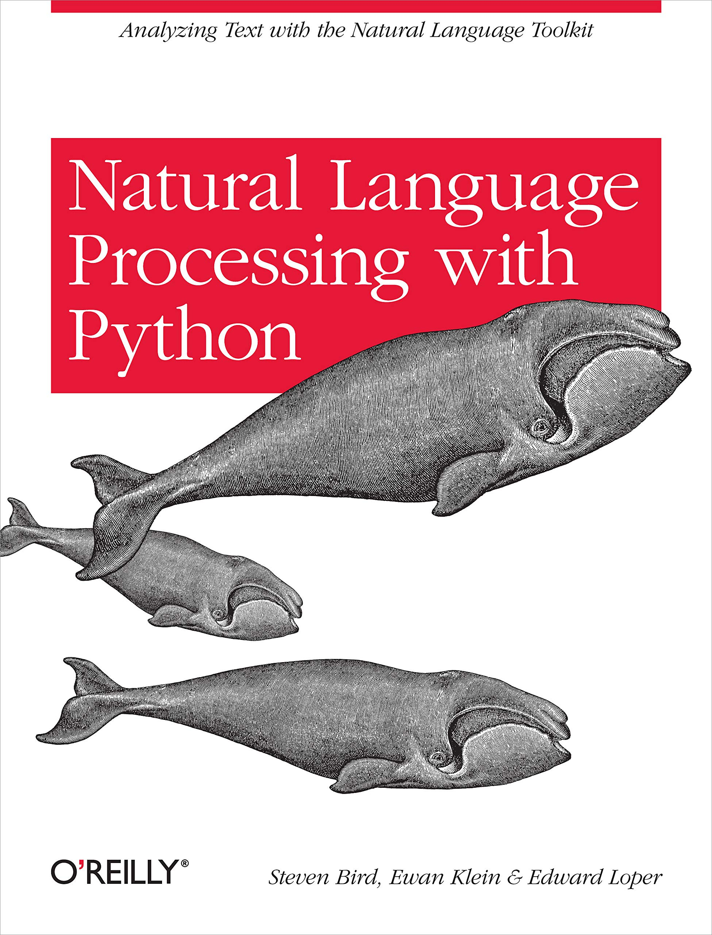
NLTK Learning Resource

