Slide 1
Investigating the Robustness of Transfer Entropy Through Synthetic Data
Clayton Barham

Slide 2
Research Question & Relevance
Question:
When ranking nodes in a complex network by their localizable influence, how sensitive is the outcome to higher order relationships?
Relevance & Novelty
Transfer Entropy Networks are a widely used tool for analyzing complex networks
They have been criticized by James et al.
The practical impact of higher order relationships has not been quantified

Slide 3
Relevance & Novelty
H(A,B) = higher order relationship
Small H(A,B)
False localization will not change rankings
Large H(A,B)
False localization may change rankings
A
Contributor | Influence
A | 10
B | 8
H(A,B) | 0.5 or 5
C
B
Node Ranking
A
B
Contributor | Influence
A | 10
B | 8.5
Node Ranking
B
A
Contributor | Influence
A | 10
B | 13

Slide 4
Method: Multi-Agent System
Simulate social media activity
Use Watts-Strogatz graph to define connectivity of agents
Weight edges to quantify probability that child node responds to parent
Add a cascade of high weight edges
Augment graph with higher order relationships, defined using geometric mean
Ex: Node 1 <- √((Node 0)² * (Node 2)²)

Slide 5
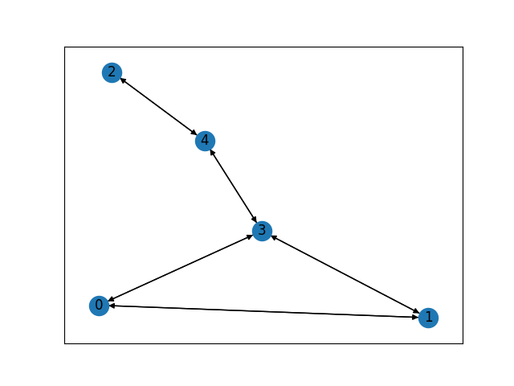
Method: Multi-Agent System

Slide 6
Method: Simulation
At each time step, each agent may:
Send a message independently
Send messages in response to parent nodes
Send messages in response to higher order relationships
After simulation
Each agent’s message sending behavior extracted
Time series binarized

Slide 7
Method: Transfer Entropy Network
Calculate Transfer Entropy for each pair of Nodes
Use mean value as filter
Use filtered TE values as weights to define edges of TE Network
Use betweenness Centrality to weight nodes in both graphs
Calculate rank correlation of the two rankings
Use Graph Edit Distance to compare graphs

Slide 8
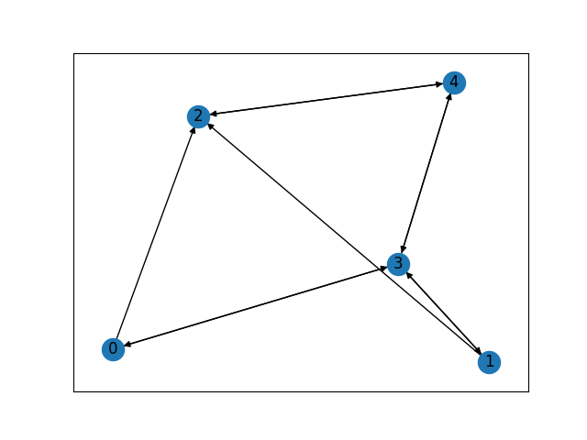
Method: Transfer Entropy Network

Slide 9
Ranking and Metrics
Use betweenness Centrality to weight nodes in both graphs
Calculate rank correlation of the two rankings
Use Graph Edit Distance to compare graphs

Slide 10
Best Preliminary Results So Far
Graph Size = 5
Cascade = 0 -> 3 -> 4 -> 2
Higher Order Relationships
Node 1 <- Geo Mean(Node 0, Node 2)
Node 4 <- Geo Mean(Node 1, Node 2, Node 3
Graph Edit Distance = 4
Rank Correlation = 0.975
Ground Truth | TE Network
Node 3: 0.67 | Node 3: 0.67
Node 4: 0.50 | Node 4: 0.33

