Slide 1
Hand Gesture Recognition using Random Forest Classifier
EE 277A
Fall-2019
Submitted by:
Mahrang Saeed
Shifa Shaikh
Submitted to:
Prof. Abbas Rahimi

Slide 2
What did we do?
Raw data
Pre-processing
Hyper-parameters
Training/Testing
Performance improvement
Results

Slide 3
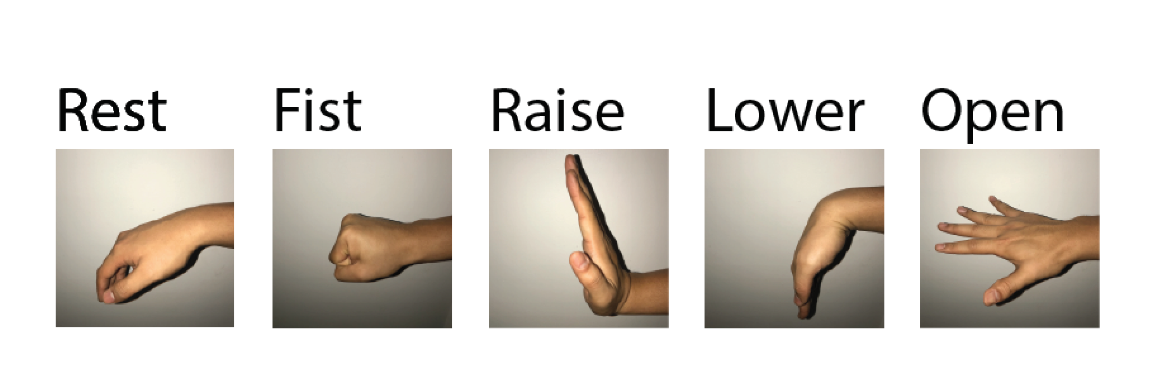
Raw data 1/3
64 Electrodes
5 Gestures
5 seconds each
Subject 1, Session 1 (10 training + 10 testing trials)
Image reference: An EMG Gesture Recognition System with Flexible High-Density Sensors and Brain-Inspired High-Dimensional Classifier

Slide 4
Raw data 2/3
Sampling rate : 1 kHz
Time for each trial : 28 seconds
Total samples in each trial : 28,000 samples

Slide 5
Raw data 3/3
Before
After
Time for each gesture: 5 seconds
Samples in each trial: 28,000
Used: middle 3 seconds
Reduction to: 14,995 samples

Slide 6
Pre-processing
Scale
Notch & Bandpass Filter
Absolute value
Normalization
Moving Average
Filter

Slide 7
Pre-processing
Scale

Slide 8
Pre-processing
Accuracy improvement:
Scaled the raw data by factor of 10
Scale

Slide 9
Pre-processing
Scale
Notch & Bandpass Filter

Slide 10
Pre-processing
Notch & Bandpass Filter
Notch filter:
Eliminates power line interference
Butterworth Band-pass filter:
Undesired frequency removal

Slide 11
Pre-processing
Scale
Notch & Bandpass Filter
Absolute value
Normalization
Moving Average
Filter

Slide 12
Pre-processing
Extraction of Envelope
Absolute value
Normalization
Moving Average
Filter

Slide 13
Pre-processing
Scale
Notch & Bandpass Filter
Absolute value
Normalization
Moving Average
Filter

Slide 14
Hyper-parameters
GridSearchCV with 5-fold cross-validation
To get BEST hyper-parameters

Slide 15
Training/Testing
Best Hyper-parameters
Train Random Forest Models
Generation of trees having different performance

Slide 16
Training/Testing
Best Hyper-parameters
Train Random Forest Models
Result:
The Best Random Forest Model
Best performance trees

Slide 17
Principal Components Analysis (PCA)
Performs feature reduction
Clusters correlated features into PC, Z
PC are vectors comprised of features
Each PC is perpendicular to another
Model trained on PC instead of features

Slide 18
Performance Improved? Yes!
Use the Best Forest Model
+
Best Principal Components

Slide 19
Performance Improved? No!
Use the Best Forest Model
excluding
Principal Components

Slide 20
Results 1/6
# of trials used | 1 | 2 | 3 | 4 | 5 | 6 | 7 | 8 | 9 | 10
# of trees | 90 | 80 | 30 | 60 | 30 | 30 | 20 | 65 | 40 | 85
Test accuracy before PCA | 85.80 | 92.46 | 95.47 | 96.30 | 96.67 | 96.73 | 96.45 | 97.00 | 96.14 | 96.48
# of principle components | 8 | 40 | 8 | 28 | 32 | 32 | 32 | 64 | 40 | 40
Test accuracy after PCA | 90.57 | 90.78 | 91.47 | 94.36 | 95.47 | 93.31 | 95.51 | 94.86 | 96.31 | 94.18
Highest test accuracy | 90.57 | 92.46 | 95.47 | 96.30 | 96.67 | 96.73 | 96.45 | 97.00 | 96.31 | 96.48

Slide 21
Results 2/6
TEST
ACCURACY
# of Trials

Slide 22
Results 3/6
BEST PERFORMANCE
# of trials used | 1 | 2 | 3 | 4 | 5 | 6 | 7 | 8 | 9 | 10
# of trees | 90 | 80 | 30 | 60 | 30 | 30 | 20 | 65 | 40 | 85
Test accuracy before PCA | 85.80 | 92.46 | 95.47 | 96.30 | 96.67 | 96.73 | 96.45 | 97.00 | 96.14 | 96.48
# of principle components | 8 | 40 | 8 | 28 | 32 | 32 | 32 | 64 | 40 | 40
Test accuracy after PCA | 90.57 | 90.78 | 91.47 | 94.36 | 95.47 | 93.31 | 95.51 | 94.86 | 96.31 | 94.18
Highest test accuracy | 90.57 | 92.46 | 95.47 | 96.30 | 96.67 | 96.73 | 96.45 | 97.00 | 96.31 | 96.48

Slide 23
Results 4/6
ACCURACY
VALUE
# of Trials

Slide 24
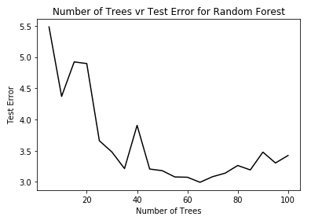
Results 5/6
8 Trials

Slide 25
Results 6/6
Random Forest Classifier
Hyper-Dimensional Classifier
Maximum Accuracy: 97.00%
# trials= 8
# samples/trial= 14,995
Maximum Accuracy: 96.64%
# trials= 3
# samples/trial= 5

Slide 26
Conclusion
Random Forest Classifier improves accuracy by 0.36% but requires larger training set than HD Classifier.

Slide 27
References
An EMG Gesture Recognition System with Flexible High-Density Sensors and Brain-Inspired High-Dimensional Classifier by Ali Moin, Andy Zhou, Abbas Rahimi, Simone Benatti, Alisha Menon, Senam Tamakloe, Jonathan Ting, Natasha Yamamoto, Yasser Khan, Fred Burghardt, Luca Benini, Ana C. Arias, Jan M. Rabaey.
Forests for randomized trees; scikit learn userguide.
Random Forest wikipedia.com
A One-Stop Shop for Principal Component Analysis by Matt Brems April 17, 2017.

Slide 28
Thank you for your precious time!
Questions are always welcome

