Slide 1
DB Connection & PHP

Slide 2




HTML / PHP Editor
VS Code
>> https://code.visualstudio.com/
Sublime Text
>> http://www.sublimetext.com/
Notepad++
>> https://notepad-plus-plus.org/
Brackets
>> http://brackets.io/

Slide 3
Languages
For Web based project
HTML
PHP + MySQL
Java
https://www.journaldev.com/1854/java-web-application-tutorial-for-beginners
Python using Django
Software based project using
Java GUI
C#
Android apps

Slide 4
PHP & MySQL
Consider a very small DB named ‘student_info’
It contains 1 table named ‘student’ which has two attributes name and phoneNo.
name | phoneNo
Nandi | 01242223423
Kamal | 0245252525

Slide 5
Setting up .php file to run on Browser
Go to XAMPP directory where XAMPP is installed.
Example.
“C:\xampp ”
(default XAMPP directory)
2. Open the folder named ‘htdocs’.
3. Open a new folder over there named ‘MyWebApp’.

Slide 6
Before!
** On top of your File Explorer you will see a window like this (if windows 8 or above)-
** On windows 7, it’s generally on the left top corner.

Slide 7
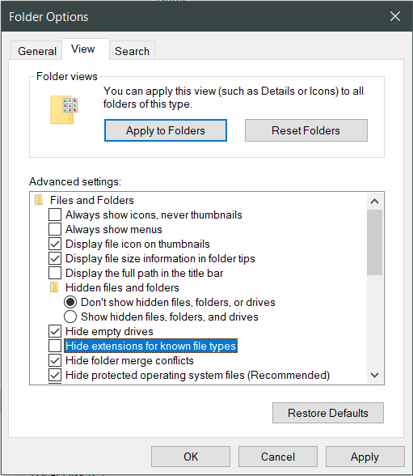
** Unmark the highlighted option. Press “Apply”.

Slide 8
Now on the newly opened “MyWebApp” folder created a “text document” file ‘dbconnection.txt’.
Rename it as ‘dbconnection.php’.
In order to write PHP code, you will need to start you code like this.
<?php
(write your code overhere)
?>

Slide 9
Database connection
Inside the newly opened ‘dbconnection.php’ file you will need to declare some variable to connect to your database.
$servername = "localhost";
$username = "root";
$password = "";
$dbname = “student_info";
In order to set up a connection type –
$connection = mysqli_connect ($servername, $username, $password, $dbname);

Slide 10
3. Now we will need to check if our connection has established to DB or not.
if (!$connection) {
die("Connection failed: " . mysqli_connect_error());
}
else{
echo "Successfully Connected";
}
echo " <br> </br> ";
4. Now power up you XAMPP with Apache and MySQL services.

Slide 11
5. Go to your web-browser and on the address bar type
localhost/MyWebApp/
6. Now from there select the ‘dbconnection.php’ file and click on it.
** Observe the output.

Slide 12
7. Inside File Explorer open a new file name ‘view.php’.
This page will be used to get data from our stored database.
8. This page will also require a connection to database. So from the start of this .php page type this-
<?php
require 'connection.php';
?>
9. Now write your query inside a new variable.
$sql = "SELECT * FROM info";

Slide 13
10. We will need some function to see data or the number of data.
$result = mysqli_query($connection, $sql);
$resultCheck = mysqli_num_rows($result);
Print the number of row found from database.
echo "Row found: ".$resultCheck." in total";
12. We can design a html outlook in order to show the data.
echo "< table border ='1‘ >";
echo “ <tr> <td> Studnet ID </td> <td> Studnet Name </td> </tr>";
(show the data here)
echo "</table>";
** Go to the browser and go to localhost/CSE411/
Now select, view.php

Slide 14
13. In order to show the data use following code-
while($row = mysqli_fetch_assoc($result)){
echo "<tr> <td> " . $row[‘student_id']. " </td> <td>" . $row[‘stundet_name']. " </td>";
}
** Go to browser and reload the page ‘view.php’

