Slide 1
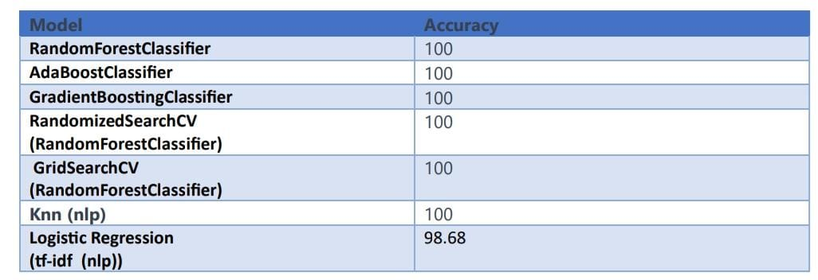
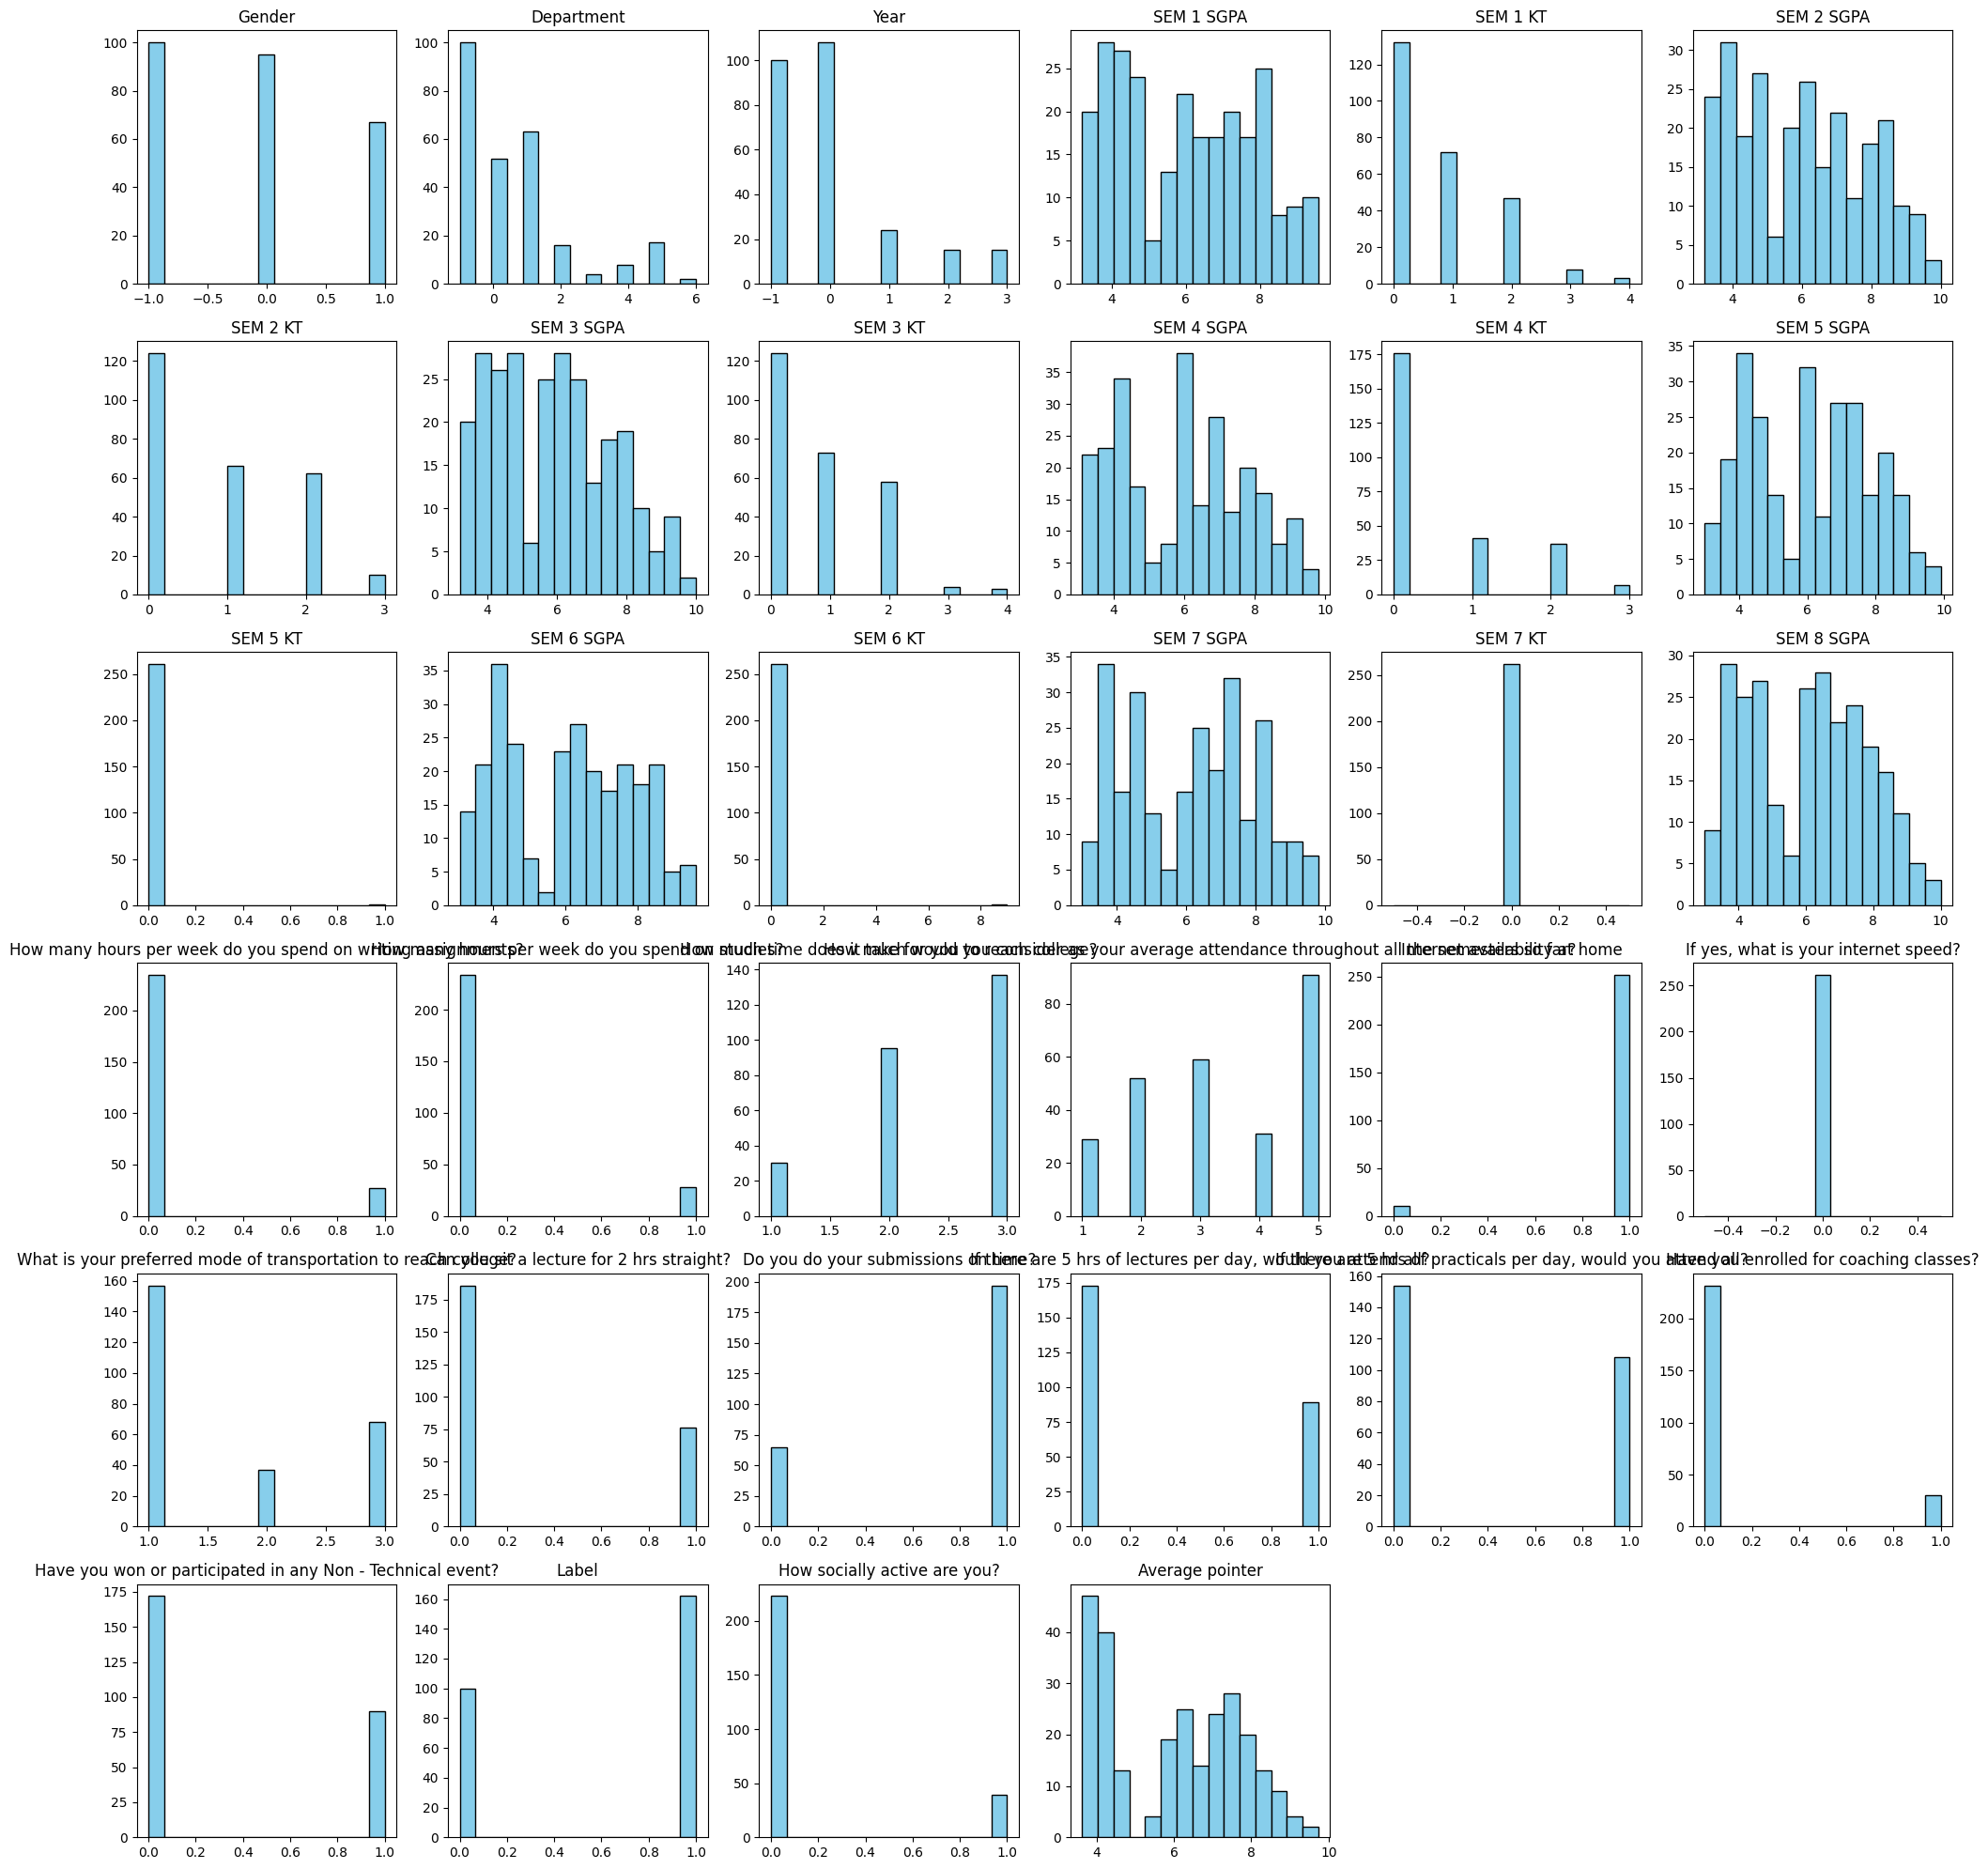
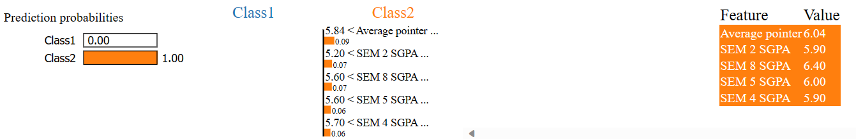
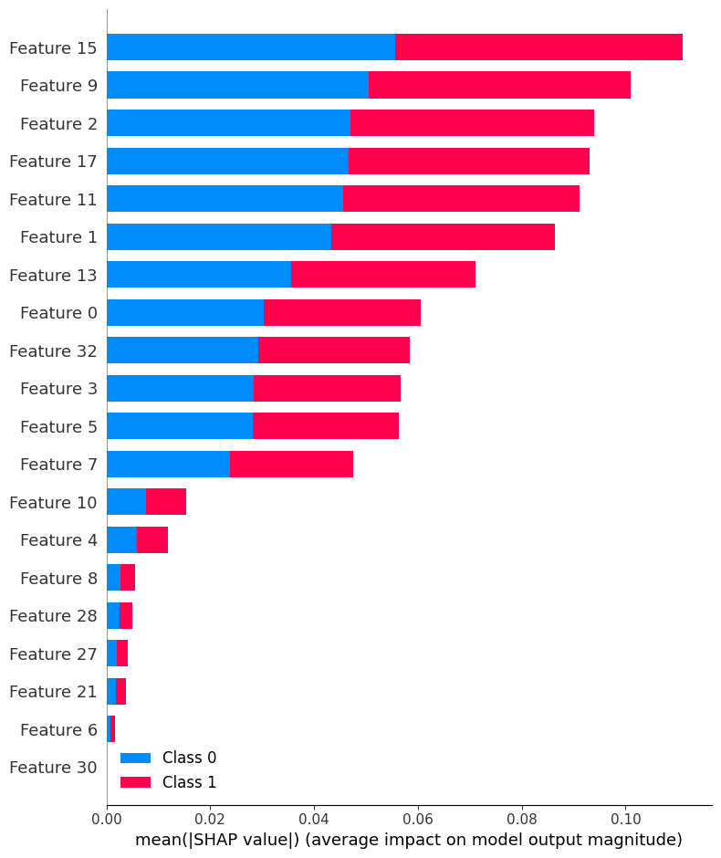
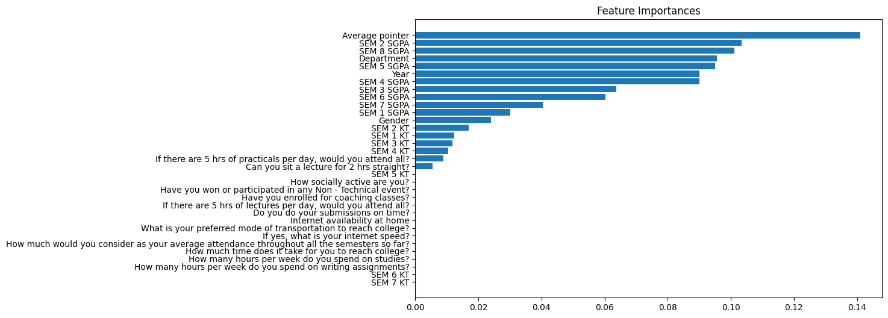
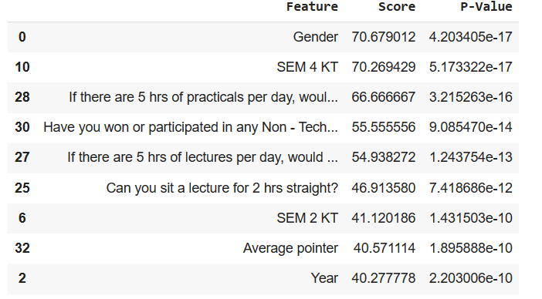
Enhancing Student Retention through Data Mining: A Predictive Approach to Identifying Dropout Risks
Marina Reda Abdullah - Aly Maher Abdelfattah - Hamza Nashaat Abdelbaki - Mohamed Ahmed Fathi - Omar Adly Mahmoud Nasr
Galala University, Faculty of Computer Science and Engineering, Artificial Intelligence Science Program
ABSTRACT
MATERIALS & METHOD
RESULTS
RESULTS
CONCLUSION
"This project explores the application of machine learning and data mining techniques for predicting student dropouts in educational institutions. Using a comprehensive dataset, we employ various algorithms like RandomForestClassifier, AdaBoostClassifier, GradientBoostingClassifier, GridSearchCV and RandomizedSearchcv to identify patterns and factors influencing student retention. Our aim is to provide actionable insights for educational bodies to enhance their intervention strategies. The findings demonstrate the potential of data-driven approaches in addressing educational challenges and improving student outcomes."
To elaborate on the "Materials & Method" section of your presentation:
Data Collection: Sourced detailed student data, including demographics, academic records, attendance, and extracurricular activities from institutional databases.
Preprocessing: Cleaned and preprocessed the data for analysis. This included handling missing values, encoding categorical variables, and normalizing data.
Exploratory Data Analysis (EDA): Conducted an initial analysis to uncover trends, patterns, and anomalies. Utilized visualizations to understand the distribution of variables and their relationships.
Model Implementation and Selection: Implemented RandomForestClassifier, AdaBoostClassifier, and GradientBoostingClassifier. These models were chosen for their ability to handle complex datasets and provide robust predictions.
Model Evaluation: Evaluated models using metrics like accuracy, precision, recall, and F1-score. Performed cross-validation to ensure the model's generalizability.
Feature Importance Analysis: Identified key features influencing student dropout predictions, providing insights into factors affecting student retention.
Results Interpretation and Reporting: Analyzed and interpreted the results to draw meaningful conclusions and recommendations for educational institutions.
This study demonstrates the effectiveness of using machine learning algorithms to predict student dropouts. The results highlight key factors influencing student retention, providing actionable insights for educational institutions. By leveraging data-driven approaches, schools and colleges can implement targeted interventions to improve student outcomes. This project underscores the importance of integrating advanced analytics in education to address critical challenges and enhance the learning experience.
REFERENCES
Han, J., Pei, J., & Kamber, M. (2011). "Data Mining: Concepts and Techniques." Morgan Kaufmann.
James, G., Witten, D., Hastie, T., & Tibshirani, R. (2013). "An Introduction to Statistical Learning." Springer.
Breiman, L. (2001). "Random Forests." Machine Learning, 45(1), 5-32.
Freund, Y., & Schapire, R.E. (1997). "A Decision-Theoretic Generalization of On-Line Learning and an Application to Boosting." Journal of Computer and System Sciences, 55(1), 119-139.
Friedman, J.H. (2001). "Greedy Function Approximation: A Gradient Boosting Machine." Annals of Statistics, 29(5), 1189-1232.
OBJECTIVES
To develop a comprehensive understanding of the factors leading to student dropouts by analyzing educational data.
To apply advanced data mining techniques, specifically RandomForestClassifier, AdaBoostClassifier, and GradientBoostingClassifier, for accurate prediction of student dropouts.
To compare the effectiveness of algorithms in the context of educational data, evaluating their predictive power and applicability.
To extract meaningful insights from the data analysis, contributing to strategic decision-making in educational institutions.
To demonstrate the practical application of machine learning in educational settings, showcasing how data-driven approaches can inform policy and intervention strategies.
To contribute to the body of knowledge in educational data science, providing a model for future research and application in this field.
ACKNOWLEDGMENT
I extend my heartfelt thanks to my academic advisor, Dr.Mohamed Abdelaziz, for their guidance, and to the team for their support and provision of resources. and for their invaluable assistance and insights in this project.

