Slide 1
MAN 7916 Session 3: Manual Content Analysis
Aaron McKenny
1/22/2025

Slide 2
AGENDA
1 Homework review
2 This week’s readings
3 Whither manual content analysis
4 In class activity
5 For next week

Slide 3
Manual Content Analysis
Questions?
Points of Confusion?
What did you find?
Codebook development
Coder training
Reliability

Slide 4
AGENDA
1 Homework review
2 This week’s readings
3 Whither manual content analysis?
4 In class activity
5 For next week

Slide 5
Neuendorf Chapter 4: Variables and Predictions
Neuendorf highlights that “Failure to identify all the form and content/substance variables that distinguish a set of messages can result in misleading outcomes.”
What does she mean by this? What is our take-away?
What are Universal variables? How might these apply in our research?
What is the role of theory in variable selection/operationalization?
Neuendorf highlights possibilities for reusing content analysis/adapting non-CA measures
What do you think? Strengths/Weaknesses?

Slide 6
Neuendorf Chapter 5: Measurement and Validity
What is precision? What is its role in content analysis and measurement?
What are the various forms of validity and how do they apply in content analysis research?
How might we examine validity in content analysis? What are some of the challenges?
What are some key considerations for
Codebook development?
Coder selection?
Coder training?

Slide 7
Neuendorf Chapter 6: Reliability
What is reliability and why does it matter?
What are different types of reliability relevant to content analysis?
What is the difference between IRR and IRA?
What are some of the key threats to reliability and how can we address them?

Slide 8
Sonpar & Golden-Biddle: Theory Elaboration
What (dis-)advantages do content analysis methods offer for
refining theoretical constructs
relationships, and
boundaries in organizational research?
What techniques (protocols) did they use and what do these do?
How did they apply this to better understand the Attention-Based View?
Would this work equally well for all adolescent theory? Why?

Slide 9
O’Kane et al: Transparency and Trustworthiness w/ CAQDAS
What are transparency and trustworthiness?
What is the role of CAQDAS in facilitating these?
Why are we talking about this vs validity and reliability?
What does CAQDAS do to facilitate qualitative data analysis?
What are some of the capabilities/techniques of CAQDAS software?
How can researchers balance use of CAQDAS against depth and richness?

Slide 10
Choose Your Own Adventure
What article did you read?
What was the main premise/RQs/Hypotheses?
How did they use content analysis to examine this?
What was your assessment of their analysis?
Clear/rigorous/well-documented? Why (not)?
What was made explicit vs left implicit?

Slide 11
AGENDA
1 Homework review
2 This week’s readings
3 Whither manual content analysis?
4 In class activity
5 For next week

Slide 12
We have computers, why use humans?
Latent vs manifest content
Context and reading between the lines
Inductive elements
AI tools are getting better at these things
But, the human coder isn’t going anywhere soon
AI will be a bigger ‘tool’ in the toolbox

Slide 13

We said content analysis is systematic…
…but people are problematic
Confirmation bias
Role of expertise
Inattention
Fatigue
Recording errors
Inadequate scheme/coder training
Both within and between people
…sound familiar?

Slide 14
How did your codebook development go?
Were the constructs equally easy to measure?
How did coder training go?
What challenges did you face?
How did you resolve them?
What would you anticipate doing differently going forward?

Slide 15
So we implement a systematic process…
Theory and Codebook
Initial Training and Discussion
Joint Coding
Revisions and Training
Independent Coding
Check Reliability and Discuss
Revisions and Training
Final Coding
Final Interrater Reliability
(Based on Bundy, 2013; Neuendorf, 2016)

Slide 16
Avoid…
Theory and Codebook
Initial Training and Discussion
Joint Coding
Revisions and Training
Independent Coding
Check Reliability and Discuss
Revisions and Training
Final Coding
Final Interrater Reliability
(Based on Bundy, 2013; Neuendorf, 2016)

Slide 17
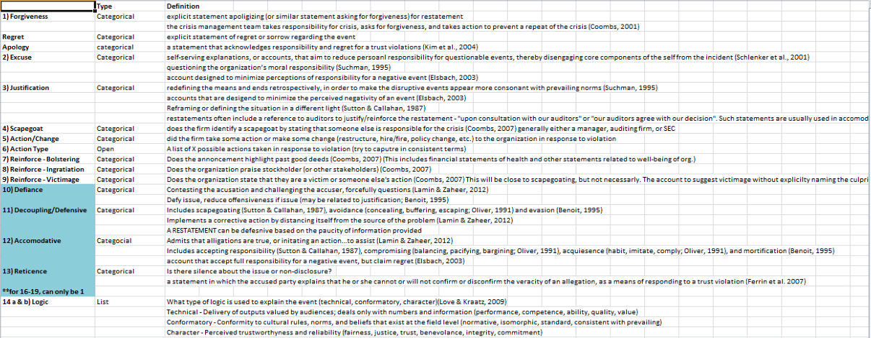
Sample Codebook
(Bundy, 2013)

Slide 18
Coder selection
Expert vs novice?
Should the researcher be a coder?
Should a random Joe/Jane off the street?
What role does familiarity with the ______ play?
Construct
Context
Method
Motivation/Timeliness
Conscientiousness
Consistency

Slide 19
Sampling considerations
At least 2 coders
10% overlap up to ~300 texts
Big corpora of texts…
Reliability
Subsample
Coder 1 | Coder 2 | Coder 3 | Coder 4 | Coder 5
Text 1 | Text 1 | Text 1 | Text 1 | Text 1
Text 2 | Text 2 | Text 2 | Text 2 | Text 2
Text 3 | Text 3 | Text 3 | Text 3 | Text 3
Text 4 | Text 4 | Text 4 | Text 4 | Text 4
Texts 5-100 | Texts 5-100 | Texts 5-100 | Texts 5-100 | Texts 5-100
Texts 101-300 | Texts 301-500 | Texts 501-700 | Texts 701-900 | Texts 901-1000
TOT: 300 | TOT: 300 | TOT: 300 | TOT: 300 | TOT: 200
Total: 1000

Slide 20
Reliability Metrics
Percentage agreement/Holsti’s PA₀
Straight agreement
It has its place, and it’s not in manual coding
Cohen’s Kappa
Agreement but accounting for chance
Most commonly reported metric in content analysis (my subjective reading)
Krippendorff’s Alpha
Agreement but accounting for chance
Gold standard

Slide 21

What if you get low reliability?
Not… ideal…
You have options, none great
Retraining
Drop variables
Drop coder
Are there some aspects of the variable that can be kept?
Certain codes in a nominal variable
This is why the iterative training process is so important

Slide 22
AGENDA
1 Homework review
2 This week’s readings
3 Whither manual content analysis?
4 In class activity
5 For next week

Slide 23

You will need to…
Resync your local MAN7916 environment with mine (if you haven’t recently)
“Sync fork” on GitHub.com
git pull
Or… if there are conflicts
git remote add upstream https://github.com/amckenny/MAN7916.git
git fetch upstream
Two options
git merge upstream/main
git rebase upstream/main

Slide 24
Resolving Git conflicts
Activate your virtual environment
source ./.venv/bin/activate (Mac/Linux/WSL)
.\.venv\Scripts/activate (Windows)
Download new packages
pip install -r requirements.txt

Slide 25
Part 1 – Kickstarter Data in a Notebook
Create a Jupyter Notebook (.ipynb) in your ‘scratch’ folder
Visit Kickstarter.com and choose a campaign
Get its URL
Use ‘requests’ to try to get the campaign story text from the URL
What do you find?
Verify that you still can access the Kickstarter campaign

Slide 26
Part 2 – Kickstarter Data via Browser Automation
Create a standard Python (.py) file in your ‘scratch’ folder
Copy the contents of the browser_automation.py template into the new file and test it
Iteration 1:
Change the URL to be the campaign URL
Is the story in the page_content?
with open(“filename”, “r”, encoding=“utf-8-sig”) as outfile:
outfile.write(page_content)

Slide 27
Part 2 – Kickstarter Data via Browser Automation
Create a standard Python (.py) file in your ‘scratch’ folder
Copy the contents of the browser_automation.py template into the new file and test it
Iteration 2:
Switch the order of:
page_content = await page.get_content()
_ = input("Press Enter to continue...")
Is the story in the page_content now?
Is this a scalable process?

Slide 28
Part 2 – Kickstarter Data via Browser Automation
Create a standard Python (.py) file in your ‘scratch’ folder
Copy the contents of the browser_automation.py template into the new file and test it
Iteration 3:
Change how we ‘wait’:
Comment out: _ = input("Press Enter to continue...")
Add a wait_for call to wait for the story data to be loaded
before retrieving page_content
Verify the story is in the page_content.
Save the page_content to a text file.

Slide 29
Part 3 – Kickstarter Data Parsing
Create a Jupyter Notebook (.ipynb) in your ‘scratch’ folder
Read the contents of the saved Kickstarter content
Use BeautifulSoup to extract:
Story
Images
Rewards

Slide 30
Part 4 – API Access to OpenAI (of ChatGPT Fame)
Create a .env file in your root MAN7916 directory
In the .env file, put:
OPENAI_KEY = “(MY_KEY)”
Replace (MY_KEY) with the key I give you in class
Run the get_environment_variables.py file from the templates directory
What happened?
Why might this be important/better than putting the key in your code directly?

Slide 31
Part 4 (continued) – API Access to OpenAI
Create a Jupyter Notebook (.ipynb) in your ‘scratch’ folder
Paste in the get_environment_variables.py code and ensure it works
Try running an API request with the key
Add: openai_key = os.getenv(“OPENAI_KEY”)
Change: headers = {"Content-Type": "application/json“, “Authorization”: f”Bearer {openai_key}”}

Slide 32
Part 4 (continued) – API Access to OpenAI
Create a Jupyter Notebook (.ipynb) in your ‘scratch’ folder
Paste in the get_environment_variables.py code and ensure it works
Try running an API request without using the key
import requests
url = "https://api.openai.com/v1/chat/completions"
headers = {"Content-Type": "application/json"}
data = {"model": "gpt-4o-mini", "messages": [{"role": "user", "content": "Say this is a test!"}], "temperature": 1}
response = requests.post(url, headers=headers, json=data)

Slide 33
Part 4 (continued) – API Access to OpenAI
Make the API call a function
Accept as input the “prompt”
Return GPT-4o-mini’s response as the output
Call the function with a few different prompts as a test

Slide 34
Part 5 – Browser Automation + CORS API calls
This is going to be a watch-me demonstration
Complexity is much higher
Considerably harder to execute/troubleshoot
Pros/Cons versus browser automation

Slide 35
AGENDA
1 Homework review
2 This week’s readings
3 Whither manual content analysis?
4 In class activity
5 For next week

Slide 36
Intro to Computer-Aided Text Analysis
Jurafsky & Martin readings
Don’t worry about technical/mathematical aspects/algorithms
Worry more about conceptual understanding and application

