Slide 1
MAN 7916 Session 4: UML in Text Analysis
Aaron McKenny
2/5/2025

Slide 2
AGENDA
1 Homework review
2 This week’s readings
3 Preprocessing and NLP
4 In class activity
5 For next week

Slide 3
Text Preprocessing and Dictionary-based Analysis
Questions?
Points of Confusion?
Let’s go through it!

Slide 4
AGENDA
1 Homework review
2 This week’s readings
3 Preprocessing and NLP
4 In class activity
5 For next week

Slide 5
Jurafsky and Martin 2024 Chapter 6
What is the distributional hypothesis and how does it relate to vector semantics?
There are several ways to represent words as vectors: term-document, term-term, tf-idf, pmi, word2vec, glove.
How are these different/similar?
What are the tradeoffs between sparse/dense representations?
What is cosine similarity, and what does it help us capture when applied to vector semantics

Slide 6
Arseniev-Koehlder 2022 – Word Embeddings
Do vector embeddings capture meaning? What kind(s)?
How does the space between embeddings capture meaning?
What can vector embeddings tell us about the authors of the training texts?
What are some promising directions for future organizational research using word embeddings?
How can these methods contribute to a better understanding of culture, language, and meaning?

Slide 7
Valtonen et al 2017 – UML Reproducibility & Accountability
What are different unsupervised machine learning techniques discussed?
What are some major considerations in selecting a UML technique?
Strengths/weaknesses?
How do the several preprocessing choices you have influence the UML output?
How should researchers navigate the inherent subjectivity in interpreting UML results?

Slide 8
Hannigan et al 2017 – Topic Modeling
What is topic modeling?
What is the role of the researcher in the topic rendering process?
What is the role of the quantitative coherence metrics?
How can researchers ensure the semantic meaningfulness of the topics generated, and what are some strategies to validate them with external information?
What are the limitations of LDA? How has LDA been extended?

Slide 9
Choose Your Own Adventure
What article did you read?
What was the main premise/RQs/Hypotheses?
How did they use content analysis to examine this?
What was your assessment of their analysis?
Clear/rigorous/well-documented? Why (not)?
What was made explicit vs left implicit?

Slide 10
AGENDA
1 Homework review
2 This week’s readings
3 Preprocessing and NLP
4 In class activity
5 For next week

Slide 11
Some Terminology: AI vs Machine Learning
Get machine to do things that historically required human intelligence
Artificial Intelligence
Machine learns how automatically (more or less)
Machine Learning
NLP
Get the machine to understand/ manipulate/ generate human language

Slide 12
Some Terminology: ML Categories
Unsupervised
What is unsupervised ML?
What kinds of tasks can be completed with unsupervised ML?
Supervised
What is supervised ML?
What kinds of tasks can be completed with supervised ML?
…but that’s not all…

Slide 13
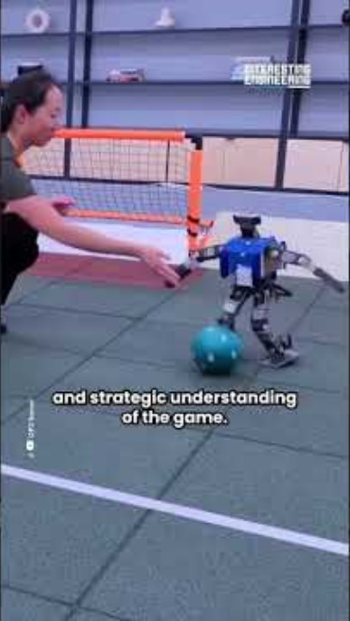
Reinforcement Learning
The algorithm is an “Agent” that
desires rewards
Knows some features about the environment
The algorithm takes an action
The environment
Provides feedback (reinforcement) in the form of rewards/punishment
Updates the agent on its state
…repeat…

Slide 14
When would you use reinforcement learning?
Well defined end-goal
(unlike unsupervised)
No ground truth data in advance
(unlike supervised)
Feedback is available continuously throughout the training process
Example:
Video game AI (Feedback: High Score)
Recommender Systems (Feedback: Stars)

Slide 15
Self-supervised learning
Love-child of supervised and unsupervised learning
Why it’s unsupervised:
As a researcher, you do not provide ground truth data/labels
Why it’s supervised:
It… uses ground truth data/labels
Confused yet?

Slide 16

Demystifying self-supervision
The algorithm generates its own labels/ground truth data!
Example from NLP world: Masked Language Models
Data you provide:
Nobody expects the Spanish Inquisition!
What is the masked word?
Ground truth: “Nobody”
What is the masked word?
Ground truth: “expects”

Slide 17
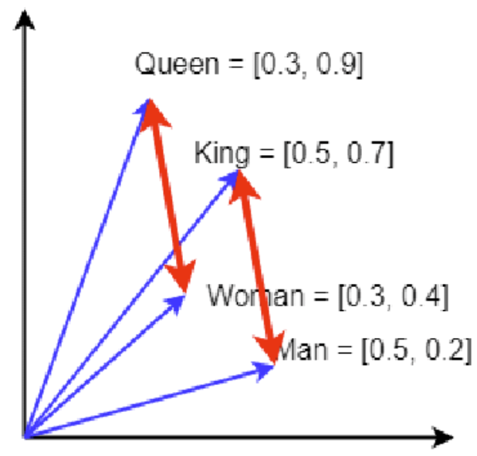
Let’s talk about word embeddings!
Arseniev-Koehler & Foster (2022)
Word embeddings are the result of self-supervised learning
Word2Vec + BERT
What are word embeddings – technically?
Word embeddings & social phenomena?
Valuable in downstream ML tasks?

Slide 18
Unsupervised Machine Learning
Have:
Input features
Want: Computer to yield new insights about data/phenomenon based on these input features
Different algorithms: Different types of insights

Slide 19

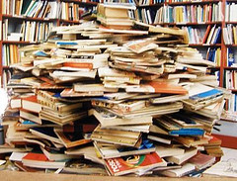
Investigate what is being discussed
Text Summarization
Topic 1: CEO, executive, manage
Topic 2: supply, source, procure, chain
Topic 3: manufacture, create, develop
Topic Modeling

Slide 20
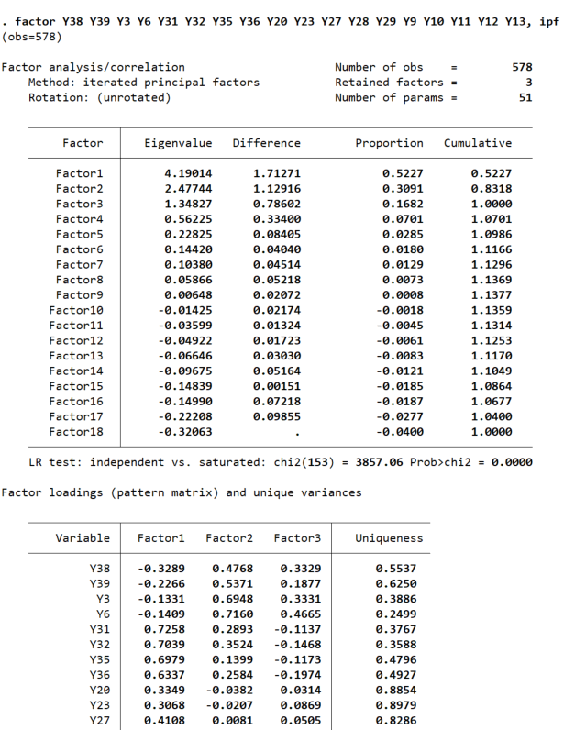
Dimensionality Reduction
K-Nearest Neighbors
Principal Component Analysis
Cluster Analysis
How can we reflect high dimensional data in fewer dimensions
While minimizing loss of information
Should sound very familiar…

Slide 21
Topic Modeling
Corpus of Texts
Topics
Words
each of which contains
which are comprised of
Observed
Latent
Observed
Have: Texts
Want: Topics/Themes
Guiding principle:
Look for words that show up frequently within a text
Discount words that show up in nearly every text
Think: Factor analysis of words

Slide 22
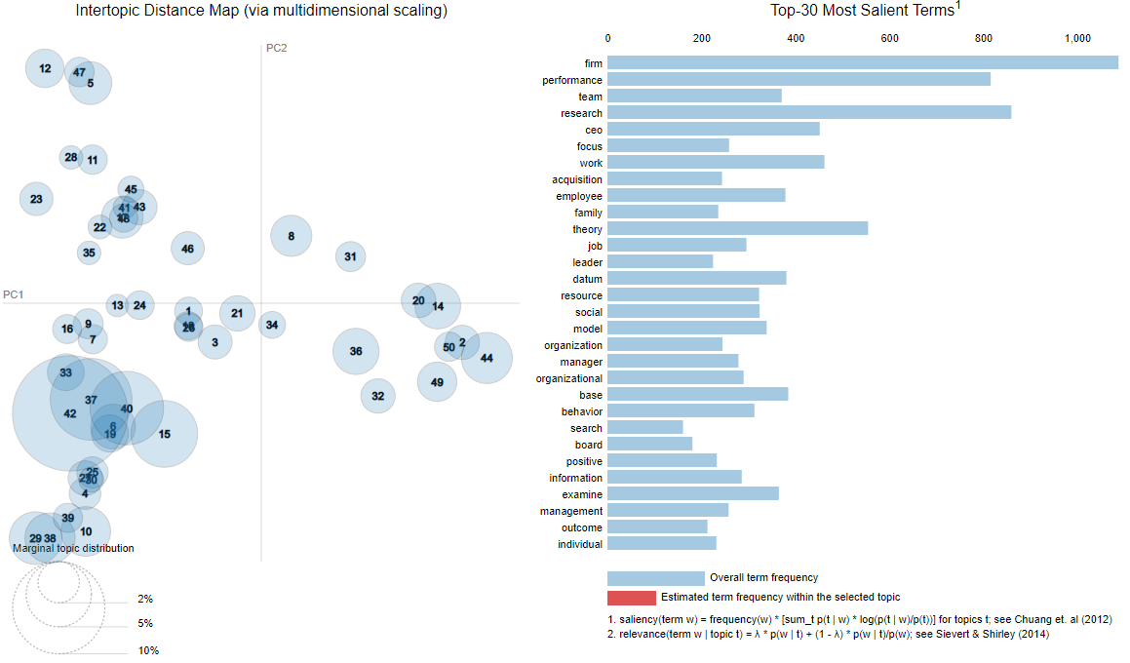
Visualizing topic models
Topic 1: Female, Gender, Manager, Male, Woman, Pay, Gap, Less, Man
Topic 4: Attack, Detection, System, Worm, Scheme, Security, State, Datum
Topic Modeling:
Latent Dirichlet Allocation (LDA)
Topic 14: CEO, Board, Director, Firm, Board_Chair, Shareholder, Corporate, Governance, Independent, Monitoring
Topic 12: Job, Work, Employee, Stress, Turnover, Demand, Factor, Worker, Stressor
Topic 34: Franchising, Franchise, Franchisor, Resource, Theory, Agency, Chain, Scarcity

Slide 23
Think factor analysis… but with words
Factor Analysis
Topic Models
Dimensionality Reduction
Covariance = latent constructs
Items can load on multiple constructs
(barring orthogonal rotation)
Dimensionality Reduction
Covariance = latent topics
Words can be part of multiple topics

Slide 24
Example of topic modeling:
Topics:
Green, Bean, Good
Mother, Gift, Happy
Text 1: “I like green beans, they are good for you. Eating green beans can taste good too. There are several good green bean recipes”
Text 2: “Green beans have multiple good effects on the body. For instance, green beans have been shown to improve good cholesterol.”
Text 3: “Receiving gifts on mother’s day makes most mothers happy. So you should definitely get your mother a gift”
Text 4: “When you give a gift to your mother you not only make your mother happy, but you make the entire family happy.”

Slide 25
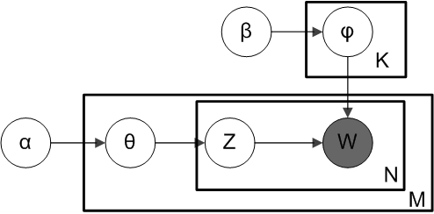
The metaphor is far from perfect
We observe words
Multiple words per document
Topic assignment of words in doc

Slide 26
The metaphor is far from perfect
Dirichlet prior on document-topic distribution (controls topic sparsity).
We observe words
Multiple words per document
Each document comprises a distribution of topics
Topic assignment of words in doc
Multiple documents in the corpus

Slide 27
The metaphor is far from perfect
Dirichlet prior on topic-word distribution
Word distribution of topic
Dirichlet prior on document-topic distribution (sparsity)
Topics
We observe words
Multiple words per document
Each document comprises a distribution of topics
Topic assignment of words in doc
Multiple documents in the corpus

Slide 28

The OLS of Topic Modeling
Well-known and documented
Many packages/ libraries/ modules
Reasonable in a lot of situations
A good benchmark
Not particularly sophisticated

Slide 29
Squint a little harder…
Topic 47: Employee, Exchange, Supervisor, Quality, Work, Subordinate Interaction
Are management research ‘topics’ really expected to be completely uncorrelated?
Topic 5: Work, Daily, Behavior, Help, Employee, Day, Morning, Psychological Affect
Topic 12: Job, Work, Employee, Stress, Turnover, Demand, Factor, Worker, Stressor

Slide 30
Overcoming Limitations of LDA
Correlated topics – Pachinko Allocation Model | Correlated Topic Model
Hierarchical topics – Hierarchical PAM | Hierarchical LDA
Topics that change over time – Dynamic Topic Model
Topic models with metadata – Supervised Topic Model | Dirichlet Multinomial Regression
Short texts – Pseudo-document-based topic model
Unknown number of topics – Hierarchical Dirichlet Process
Global and local topics – Multi-grain LDA
…and so on…

Slide 31
AGENDA
1 Homework review
2 This week’s readings
3 Preprocessing and NLP
4 In class activity
5 For next week

Slide 32

SUPERCOMPUTER

Slide 33
Commands to run
cp /groups/course.man7916/cluster_analysis.py ~
module load python
python3 -m pip install -U matplotlib scikit-learn scipy nltk numpy
srun -p normal -t 10:00 --pty bash
python3 cluster_analysis.py

Slide 34
AGENDA
1 Homework review
2 This week’s readings
3 Preprocessing and NLP
4 In class activity
5 For next week

