Slide 1
MAN 7916 Session 1: Introduction to Content Analysis and Tools
Aaron McKenny
1/8/2025

Slide 2
AGENDA
1 Welcome - Introductions
2 About this course
3 This week’s readings
4 Resources
5 Homework discussion

Slide 3

About me
Assistant Professor of Management
Research Focus
Language
Methods
Non-economic influences
Teaching Focus
Entrepreneurship
Methods

Slide 4
About you?

Slide 5
AGENDA
1 Welcome - Introductions
2 About this course
3 This week’s readings
4 Resources
5 Homework discussion

Slide 6
About this course
Content/Text Analysis Methods
Manual
Computer
Methodological rolodex
What they are
How they’re used
Key considerations
Get your feet wet
Limitations

Slide 7
Course Grading

Slide 8
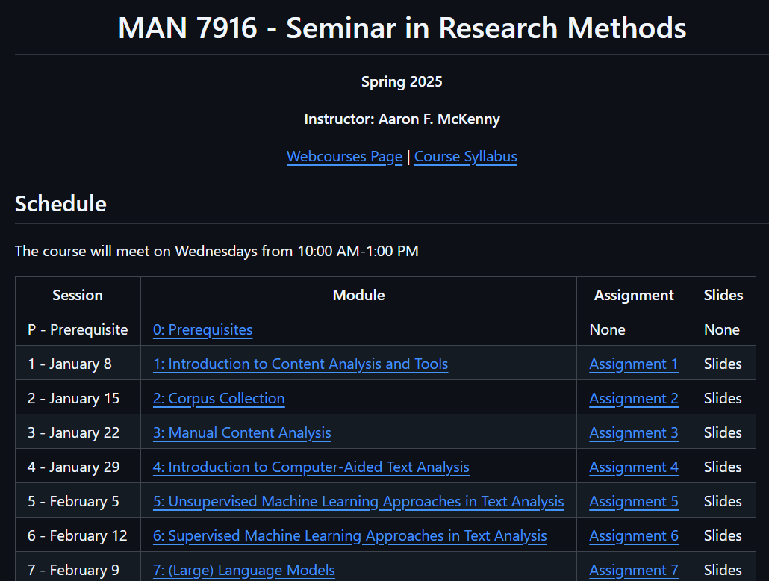
Components: Weekly Assignments
40% Contribution
Individual Work*
Due
On GitHub
Before class
Not accepted late
Grades
Posted to Webcourses

Slide 9
Components: Participation and Discussion Leadership
20% Contribution
How to make this course really boring:
100% Instructor Lecture
Uneven involvement/preparedness
Keep everything at a conceptual level
Participation
Assessed:
Routine, active, verbal participation in class discussion
Content of participation indicates adequate preparation and reflection
Having an “off-day” is okay on occasion

Slide 10
Components: Participation and Discussion Leadership
Most classes will have a student “discussion leader”
2 times per semester
Co-leads the class with me
Co-lead discussion of method/readings
Prepare discussion questions
Stepped-up preparedness/participation
Let’s Select Weeks!

Slide 11
Components: Research Paper
Syllabus is being updated!
Research Paper Excerpt
Hypotheses/Research Questions
Extended Methods Section
Extended Analysis+Results Section

Slide 12
Components: Research Paper
Guidelines:
Encouraged to work with a faculty coauthor*
May work with other students*
May double-count existing papers/papers from other courses
May use someone else’s texts
‘Methods’ papers are inappropriate for this course

Slide 13
Preparing for class
Weekly Readings
Required Readings
Choose Your Own Adventure
Assignments
We will go through in class
Ideally, bring your laptop

Slide 14



Technology

Slide 15
Generative AI
Generally OK (even encouraged)…
As a content analysis tool
Sanity checking your work
Writing improvement
Coding assistance*
Not OK…
Substitute for reading
Writing for you
Assist with analysis/interpretation

Slide 16
AGENDA
1 Welcome - Introductions
2 About this course
3 This week’s readings
4 Resources
5 Homework discussion

Slide 17
Neuendorf Chapters 1 & 2

Slide 18
What is Content Analysis?
“…a research technique for the objective, systematic, and quantitative description of the manifest content of communication” (Berelson, 1952)
“…any research technique for making inferences by systematically and objectively identifying specified characteristics within text” (Stone et al., 1966)
“…a research technique for making replicable and valid inferences from texts [broadly conceived] to the contexts of their use.” (Krippendorff, 2004)
“…a research method that uses a set of procedures to make valid inferences from text” (Weber, 1990)
“…the systematic, objective, quantitative analysis of message characteristics.” (Neuendorf, 2016)

Slide 19
Common Threads?
Systematic
Not ad hoc/purely subjective
Same reliability and validity concerns as other techniques
Based in text (though text here is broader than just the written word)
Organizational communication generates our data
Context (medium, communicator, recipient, intent) matters
Role of Inference
Often using text to infer something about reality

Slide 20

Not Everyone Agrees
Qualitative vs Quantitative… both?
Inductive vs Deductive… both?
Manifest vs Latent content.. Both?
What do the readings suggest?
What do you think?

Slide 21
What content is being analyzed and how?
Inductive theory building
Narrative analysis
Discourse analysis
Semantic analysis
Rhetorical analysis
Critical analysis
Quantitative content analysis
How do these differ? How are they similar?

Slide 22

Assumption: Words have meaning…
I love you…
I like you…

Slide 23
Assumption: Words have meaning…
“I love you”
“Dammit Janet”
“We are an innovative company”
“I like you”
“Gosh Janet”
“We are a software company”

Slide 24
Assumption: Words have meaning…
Language is important in…
Human psychology (Sapir, 1944; Whorf, 1956)
Sociological processes (Fishman, 1967)
Economic processes (Rubinstein, 2000)
They tell us something about reality
How we think
What we value
Where our attention is

Slide 25
Integrative Process of Content Analysis
Process flowchart (Pages 40-41)
How is this similar to other deductive research processes?
Survey
Database
Etc.
How is it different?
What are some research ideas using these links in your area?
S→M
M→R

Slide 26
Psychological aspects of natural language use
What do our words tell us about ourselves?
How are our ‘selves’ reflected in the words we use?
What can we glean from the analysis of words?
Manifest content?
Latent content?

Slide 27
A content analysis of the content analysis literature
How is content analysis being applied to organizational research?
What kinds of research questions are being answered?
What are some of the:
Advantages?
Disadvantages?

Slide 28
Curating Research Assets: Git
Why should we care about version control?
Is it just for our own sanity/organization?
How might this help with collaboration with coauthors?
How does this fit with:
The open science movement?
The replication crisis?
What are some strengths limitations of Git/version control tools?

Slide 29
Let’s explore Git/GitHub!
https://www.github.com/amckenny
https://github.com/stanfordnlp/stanza
https://github.com/arsena-k/Word2Vec-bias-extraction

Slide 30
AGENDA
1 Welcome - Introductions
2 About this course
3 This week’s readings
4 Resources
5 Homework discussion

Slide 31
Other Resources
ARCC – https://arcc.ist.ucf.edu/
Google Colaboratory – https://colab.research.google.com/

Slide 32
AGENDA
1 Welcome - Introductions
2 About this course
3 This week’s readings
4 Resources
5 Homework discussion

