Slide 1
MAN 7916 Session 4: Introduction to Computer-Aided Text Analysis
Aaron McKenny
1/29/2025

Slide 2
AGENDA
1 Homework review
2 This week’s readings
3 Preprocessing and NLP
4 In class activity
5 For next week

Slide 3
Text Preprocessing and Dictionary-based Analysis
Questions?
Points of Confusion?
Let’s go through it!

Slide 4
AGENDA
1 Homework review
2 This week’s readings
3 Preprocessing and NLP
4 In class activity
5 For next week

Slide 5
Hickman et al 2022 – Text Preprocessing
What is text preprocessing and why do we need to do it?
What are some of the major steps in text preprocessing?
What are their purposes?
What are their implications for downstream text analysis such as dictionary coding?
Are there some situations where you might not want to do text preprocessing?
Such as…?

Slide 6
Jurafsky and Martin 2024 Chapters 2 and 3
Before preprocessing, how do computers interpret text?
What are regular expressions?
Why do we need to worry about these?
How do these feed into preprocessing
What is a language model? An n-gram? What is perplexity?
This is going to feed into our next three weeks’ materials

Slide 7
Reid et al 2023 – Dictionary-based Analysis
How does DBCTA work?
What are the key steps in dictionary development
How does this relate to our previous discussion on manual coding?
How does this relate to our previous discussion on validity and reliability?
What are some of the strengths and weaknesses of DBCTA?

Slide 8
Choose Your Own Adventure
What article did you read?
What was the main premise/RQs/Hypotheses?
How did they use content analysis to examine this?
What was your assessment of their analysis?
Clear/rigorous/well-documented? Why (not)?
What was made explicit vs left implicit?

Slide 9
AGENDA
1 Homework review
2 This week’s readings
3 Preprocessing and NLP
4 In class activity
5 For next week

Slide 10
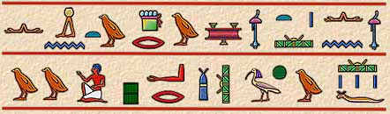
Be the computer…
What is the meaning of this passage?
…or at least tell me how many words are presented here?

Slide 11
What You See vs What the Computer Sees
“I am happier. I have had 3 good days in a row.”
Words
Sentences
Person References
Indicators of Sentiment

Slide 12
What You See vs What the Computer Sees
“I am happier. I have had 3 good days in a row.”
Characters (44)
Words
Sentences
Person References
Indicators of Sentiment
…but is most of the meaning from understanding the individual characters?

Slide 13
Where is the meaning?
Sentences
Words/Tokens
And some words convey more meaning than others
“I am happier. I have had 3 good days in a row.”
Transformed: [ [happier], [3, good, days, row] ]
Sentence Segmentation
Tokenization
Stopword/Non-word Character Removal

Slide 14
Bigger Vocabulary, Greater Complexity
Happy: Happy, happier, happiest, happily, happiness
Be: Be, is, am, are, was, were, been
Same meaning, but different conjugations/inflections/words
Stemming – Happier→Happi, Were→Were
Lemmatization – Happiness→Happy, Were→Be
Transformed: [ [happy], [3, good, day, row] ]

Slide 15
Challenges with Processing Language
Are these words different? “Have” “have”
The computer thinks so by default (“H” vs “h”)
Often normalize the casing of words
Are these ‘words’? “☺”, “:)”, “3”
Decide how to treat emoji/emoticons/numerals
Transformed: [ [happy], [three, good, day, row] ]

Slide 16
A Final Catch
Most NLP applications don’t work with words
[ [happy], [three, good, day, row] ] ← simpler, but still uninterpretable
Solution: Use numeric vectors based on the words used (“vector space model”)
Document-Term Matrix →
One-Hot Vectors
Word Embeddings
 | day | good | happy | row | three
S1. | 0 | 0 | 1 | 0 | 0
S2. | 1 | 1 | 0 | 1 | 1

Slide 17
What are word embeddings?
Whiskey
Beer
Wine
United States
Germany
France
Entrepreneur
Capitalist
CEO

Slide 18
Interesting tendencies of word embeddings
Wine
Vector Algebra: Beer – Germany + France = ????
Beer
Wine
Germany
France
The word embeddings capture elements of ‘meaning’ of the word
as reflected in the corpus in which the embeddings were trained

Slide 19
Embedding Nuances
Static vs Dynamic
Static – 1 word, 1 embedding
Dynamic – 1 word, many embeddings based on context of the word
Do you see any potential issues?
BANK

Slide 20
Merriam-Webster: Bank
Noun:
a mound, pile, or ridge raised above the surrounding level – Fog bank
the rising ground bordering a lake, river, or sea or forming the edge of a cut or hollow – River bank
a steep slope (as of a hill) – Bank of the hill
a protective or cushioning rim or piece – Road bank
an establishment for the custody, loan, exchange, or issue of money, for the extension of credit, and for facilitating the transmission of funds – Bank One
a person conducting a gambling house or game – Break the bank
a supply of something held in reserve – Domino bank
a place where something is held available – Memory bank

Slide 21
Merriam-Webster: Bank (continued)
Noun:
a group or series of objects arranged together in a row or a tier – Bank of vending machines
one of the horizontal and usually secondary or lower divisions of a headline – Bank of the headline
Verb:
to build a raised border of earth around – Bank a fishpond
to heap or pile in a bank – Bank sand along the river
to drive (a ball) into a cushion – Bank shot
to form or group in a tier – Bank bottles on a shelf

Slide 22
Merriam-Webster: Bank (continued)
Verb:
to rise in or form a bank – Clouds would bank up
to incline laterally – The road banks
to follow a curve or incline – To bank around the corner
to manage a bank – I am a banker
to deposit money or have an account in a bank – I bank at Bank One
to deposit or store in a bank – I bank blood at the blood bank
to depend or rely on – To bank on someone

Slide 23
Embedding Nuances (continued)
Level:
Subword (em | ##bed | ##ding)
Word (embedding)
Sentence (This is an example embedding.)
Paragraph (This is […] are important for text analysis)
Document (This is […] and so concludes my dissertation)
Why subword embeddings?
Are vocabularies static?

Slide 24
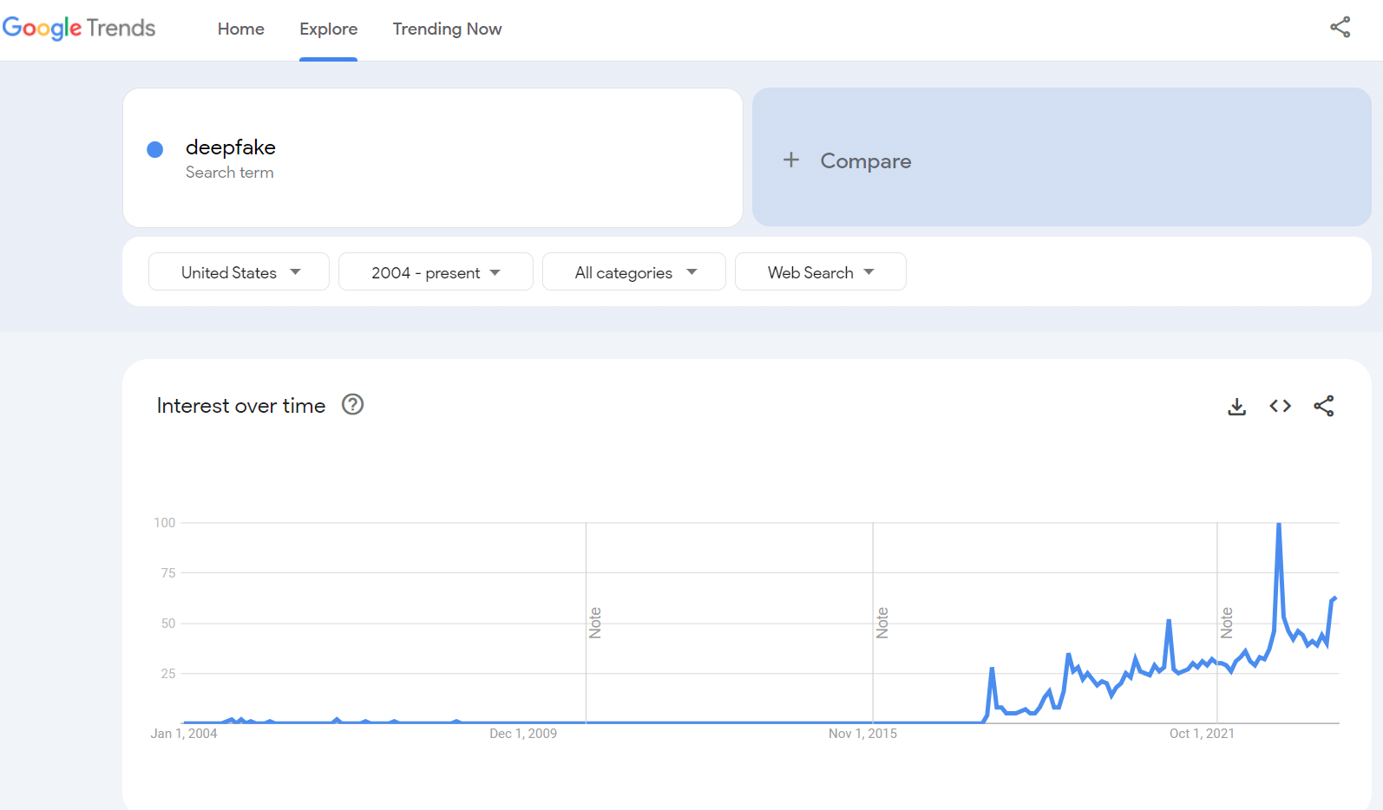
“Deepfake”
What if we had trained our model in 2017?

Slide 25
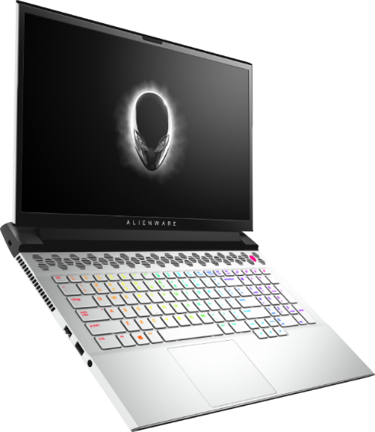
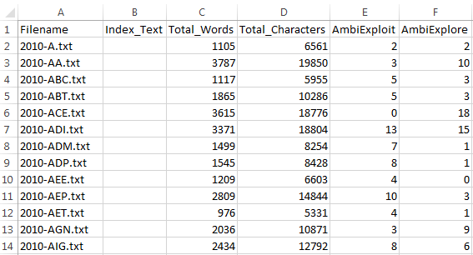
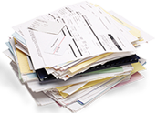
Dictionary-Based CATA
Organizational Ambidexterity

Slide 26
Dictionary-Based CATA
Have:
Texts
“Dictionaries” associated with constructs
Want: Scores for constructs
Premise: Work frequency → Salience
Who cares more about innovation?
The person who won’t stop talking about it…
The person who mentions it once in passing…

Slide 27
How it works
Sample Dictionary: Innovativeness
“Innovative” “Innovation” “Innovate” “Research” “Inventions” “Inventive” “Creative” “Creativity”
Sample narrative to analyze:
“The creativity of our research and development team make this organization one of the most innovative in the industry, with patents on over 2,300 inventions.”
Innovativeness: 4

Slide 28
Dictionary considerations…
Word stems:
Innov*: innovative, innovating, innovation, innovations, innovatively
Hop*: hopeful, hopeless, hoplite, hopping
Words vs phrases
New: new product, new endeavor, New York, New Jersey
But if you use phrases, will you catch them all?
What about context?

Slide 29
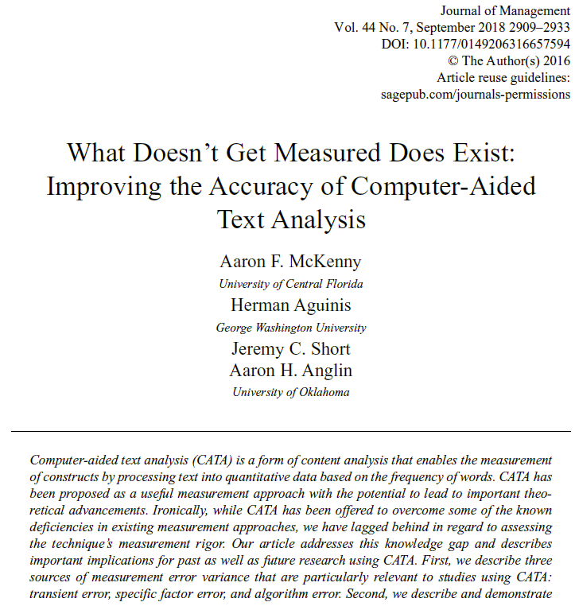
Measurement Error
Transient Error
Changes over time
Specific Factor Error
Inconsistent usage of words
Algorithm Error
Algorithm differences

Slide 30
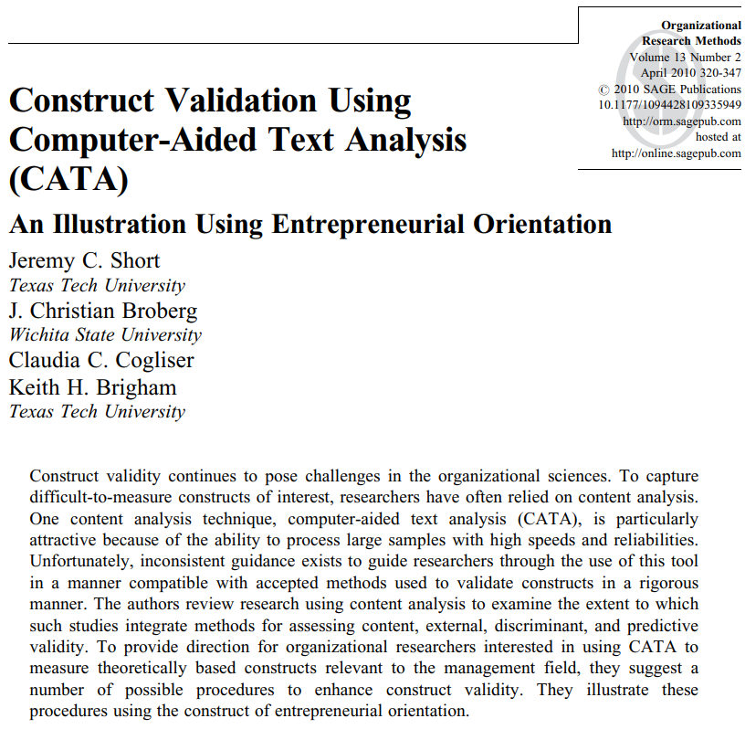
Validation
Dimensionality
Content Validity
External Validity
Predictive Validity
Discriminant/Convergent Validity

Slide 31
Data Post-Processing
Document length normalization
Which is more innovative?
25 innovation words out of 1,000 total?
25 innovation words out of 10,000 total?
Positive skew
Square root
Logarithm
Inverse hyperbolic sine

Slide 32
Analysis Options
Raw word counts as a DV?
Violates normality
Violates homoscedasticity
Things you can do
Poisson
Zero-inflated poisson
Negative binomial
Raw word counts as an IV?
Cornucopia of options

Slide 33
Writing tips
Justify Everything!
Why content analysis
Why computer-aided text analysis
Why these texts
Be forthright about limitations
Some things often highlighted
Non-response/demand characteristics are less of an issue
Link between psychological processes and language
Link between text content and organizational action

Slide 34
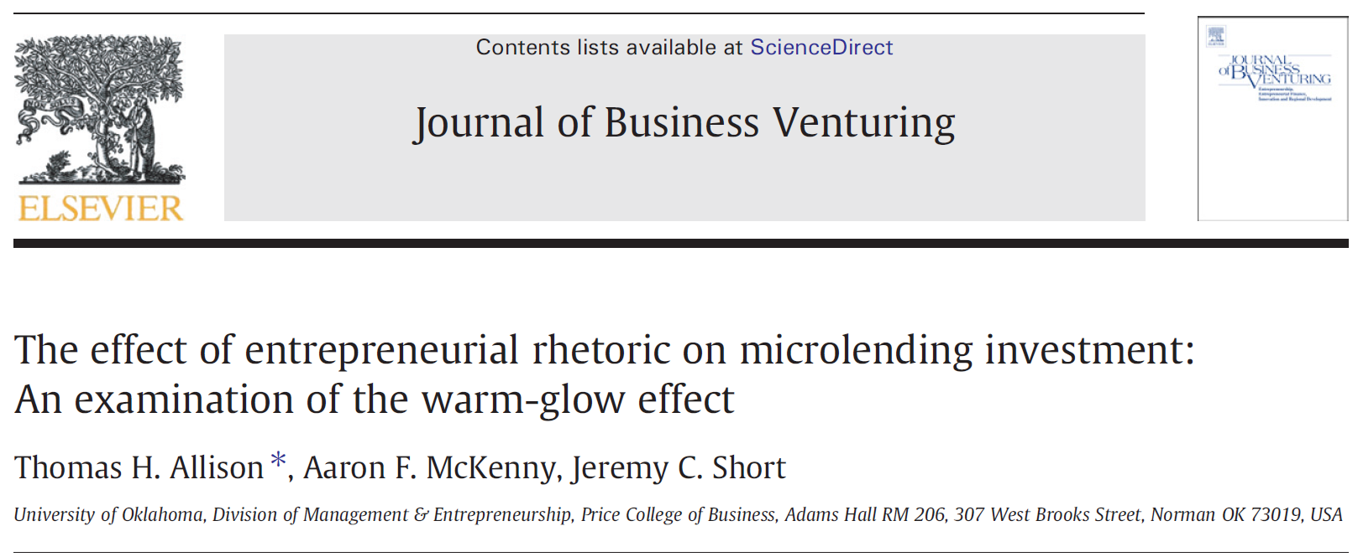
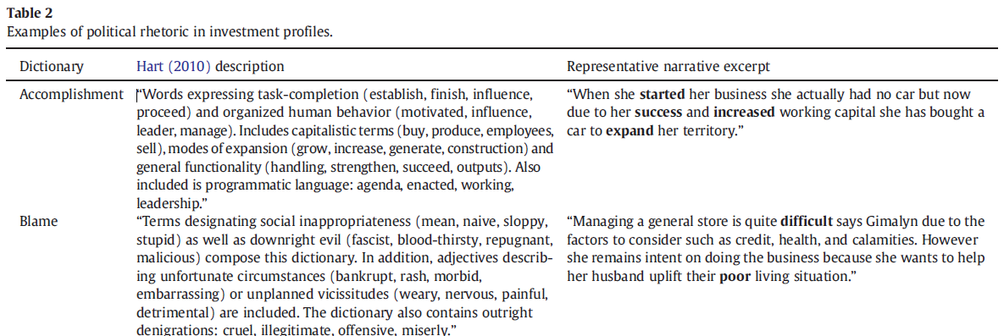
Writing tip: Show them the text!

Slide 35
AGENDA
1 Homework review
2 This week’s readings
3 Preprocessing and NLP
4 In class activity
5 For next week

Slide 36

You will need to…
Resync your local MAN7916 environment with mine (if you haven’t recently)
“Sync fork” on GitHub.com
git pull
Or… if there are conflicts
git remote add upstream https://github.com/amckenny/MAN7916.git
git fetch upstream
Two options
git merge upstream/main
git rebase upstream/main

Slide 37
Resolving Git conflicts
Activate your virtual environment
source ./.venv/bin/activate (Mac/Linux/WSL)
.\.venv\Scripts/activate (Windows)
Download new packages
pip install -r requirements.txt

Slide 38
Basic NLP Demo
Demonstrate the power of GPUs
Demonstrate CAT Scanner
Demonstration of Stanza/spaCy out-of-the-box capabilities

Slide 39
AGENDA
1 Homework review
2 This week’s readings
3 Preprocessing and NLP
4 In class activity
5 For next week

Slide 40
Unsupervised Machine Learning
Jurafsky & Martin readings
Don’t worry about technical/mathematical aspects/algorithms
Worry more about conceptual understanding and application
You’ll need your OpenAI API Key from Paula

