Slide 1
Generative Models
Sampling
Latent variable
Autoencoder
Variational Autoencoder
Bayesian ML+ Deep Learning
GAN (Generative Adversarial Network)
2 neural network competing against eachother

Slide 2
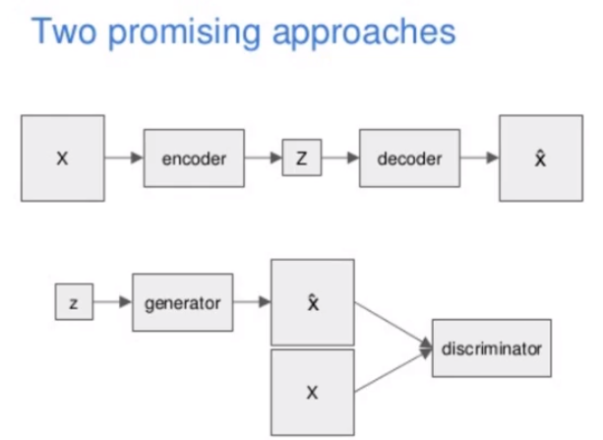

Slide 3
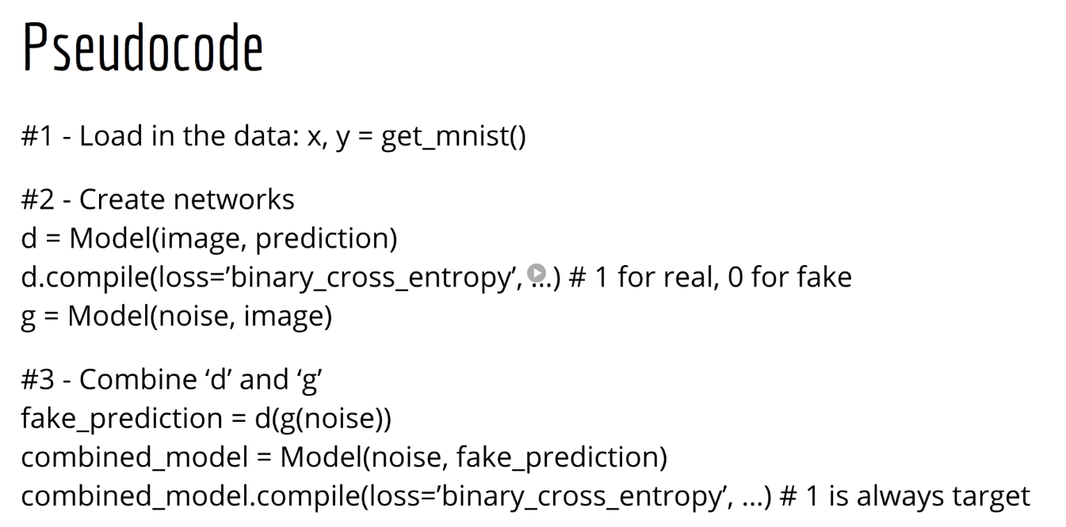










How to develop GAN

Slide 4
