Slide 1
Online Marketing
By Mahtab Siddiqui
Office-15
Roll: 09

Slide 2
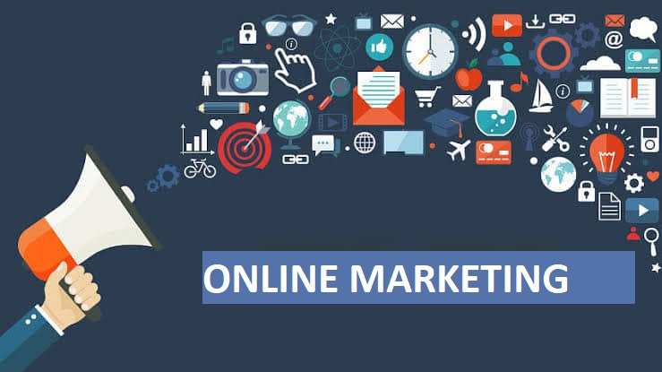
Definition
Online marketing, also called digital marketing, is the promotion of brands to connect with potential customers using the internet and other forms of digital communication. This includes not only e-mail, social media, and web-based advertising, but also text and multimedia messages as a marketing channel.

Slide 3
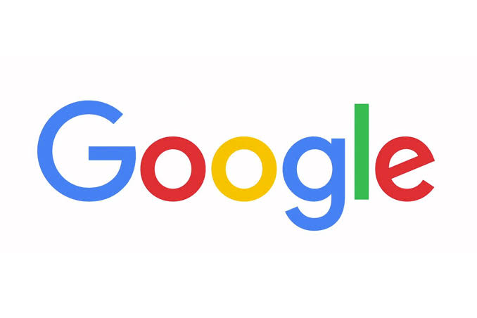
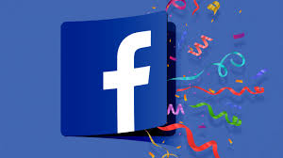
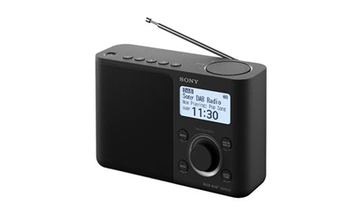
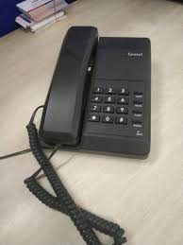

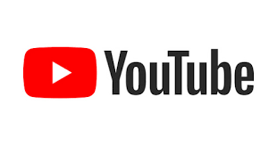
Comparison
Classic Marketing
Online Marketing

Slide 4

Components of Online Marketing
Social Media Marketing
E- mail Marketing
SEO: Search Engine Optimization

Slide 5
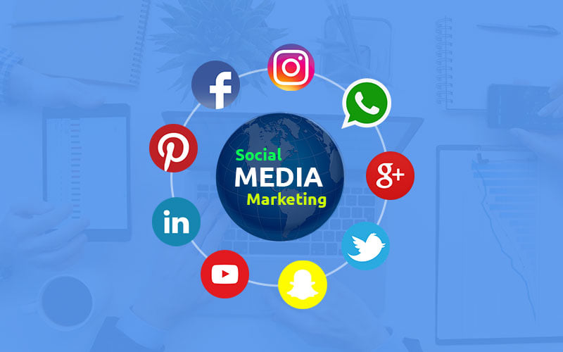
Social Media Marketing

Slide 6
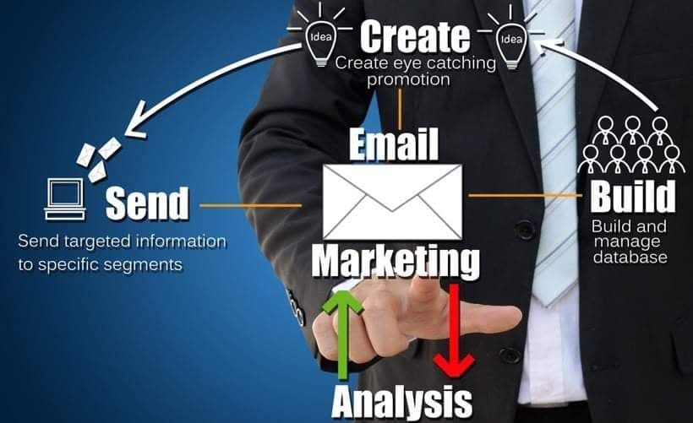
E-mail Marketing

Slide 7
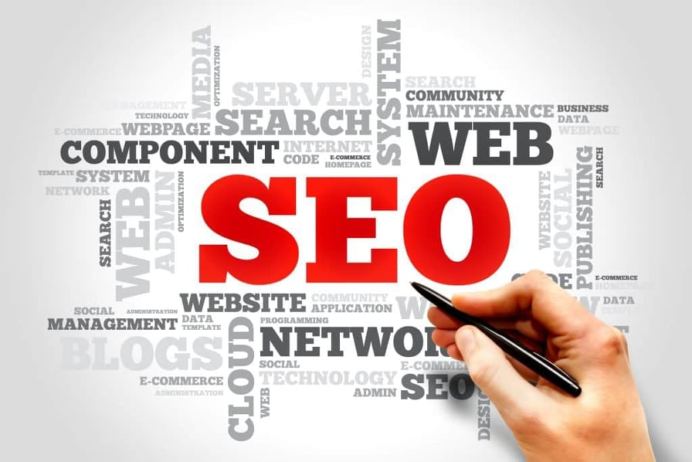
SEO: Search Engine Optimization

Slide 8
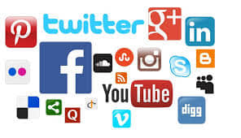
Best Site of Online Marketing
Google
YouTube
Facebook
Twitter

Slide 9
Thank You

