Slide 1
Reflex Security

Slide 2
Security Overview
Authentication
Who Am I?
Authorization
What can I do?
Auditing
What did I do ?
Data Protection
Is my data encrypted at rest and over the wire ?
Kerberos, JWT
Perimeter Security through apache Knox
Integration with IAMs
Knox Single Sign On
Fine grained access control (RBAC)
Centralized Administration through Apache Ranger.
Audit logs capture for all Components and Services
Centralized collection
Data-in-transit encryption
Data-at-rest Encryption
Key Management

Slide 3
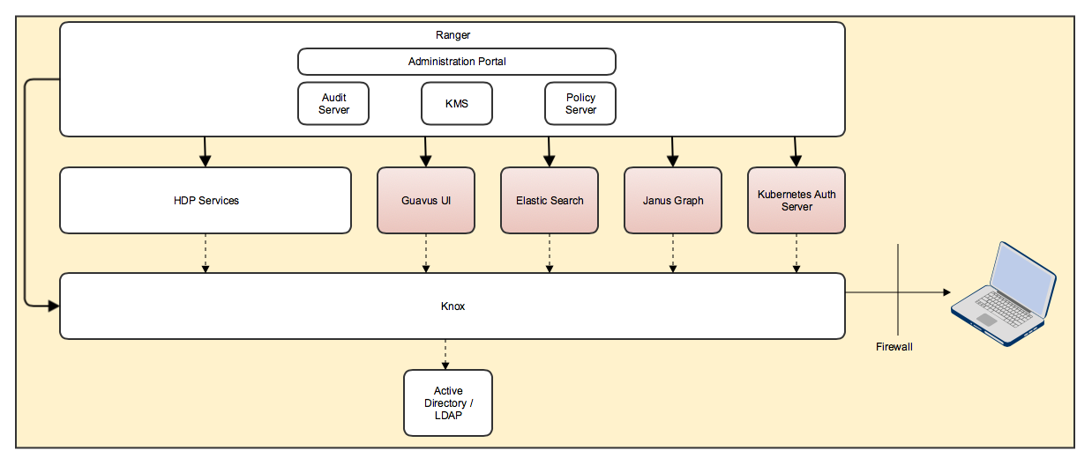
Security Architecture
Reflex Security to be designed around HDP security frameworks
Providing missing security integration for all the additional BPL and RAF components

Slide 4
Security - Authentication
Authentication support for RAF Frameworks
OAuth Authentication, LDAP Authentication
Enable authentication for HDP + HDF stack
Enable Kerberos Authentication for the following components
HDFS
YARN
Hive
HBase
Kafka
Kafka Connect
Oozie
HDF Schema Registry
Zookeeper
Sqoop2
Zeppelin - OAuth Authentication
Authentication support for additional BPL stack components
Gremlin Server – Kerberos Authentication
Postgres – Kerberos Authentication
Elasticsearch – OAuth Authentication

Slide 5
Security – Perimeter Security and Single Sign On
Perimeter security(Knox) and Single Sign On(KnoxSSO) for RAF services and application UI
Perimeter security for HDP+HDF components
Enable Perimeter Security(Knox) as well as Single sign On (KnoxSSO) for following components
NiFi
Ambari
Ranger
Atlas
Zeppelin
Enable Perimeter Security(Knox) for following components
WebHDFS
Hive (JDBC/ODBC)
Kafka (REST)
Gremlin Server (REST)
Perimeter security(Knox) for additional BPL stack components
Kibana
Grafana
Kubernetes Dashboard

Slide 6
Security – Authorization
Enable Authorization support for RAF Frameworks
Ranger based policy management
Enable Authorization for HDP + HDF stack
Enable Ranger based policy management with Tag Based policy support for following components
HDFS
Hive
HBase
Kafka
Enable Ranger based policy management
YARN
Knox
NiFi
Atlas
Enable Authorization support for additional BPL stack components
Elasticsearch - Ranger based policy management with Tag Based policy support
Gremlin Server - Ranger based policy management

Slide 7
Security – Data-in-motion Encryption
Enable data-in-motion encryption
HDFS
YARN
Spark
Hive
HBase
Kafka
Gremlin Server
NiFi
CDAP
Atlas
Ranger
Ambari
Knox
Zeppelin
HDF Schema Registry
Elasticsearch

Slide 8
Security – Data-at-rest Encryption
Enable data-at-rest encryption
HDFS
Encryption Key Management
Using Ranger KMS

Slide 9
Quiz

