Slide 1
Flume
Notes:
The problem with HDFS and streaming data/logs

Slide 2
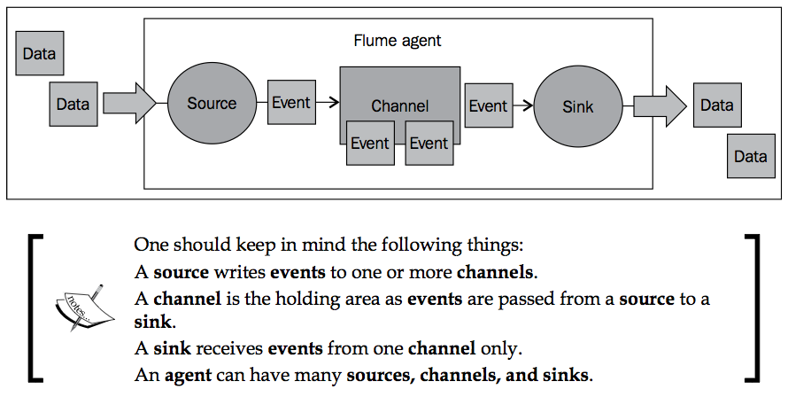

Slide 3
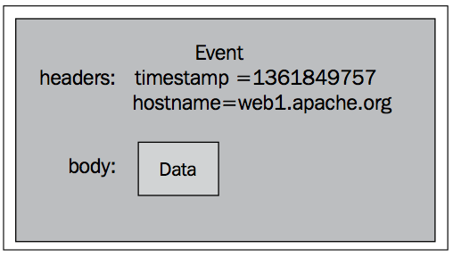
Flume Event
Notes:
Additional header may be added

Slide 4
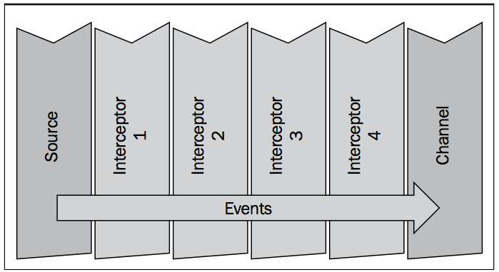
Interceptors
Notes:
An interceptor is a point in your data flow where you can inspect and alter Flume events. You can chain zero or more interceptors after a source creates an event or before a sink sends the event wherever it is destined. If you are familiar with the AOP Spring Framework, it is similar to a MethodInterceptor.

Slide 5
Channel Selectors and Sink Processors
Channel selectors are responsible for how data moves from a source to one or more channels.
replicating channel selector (the default)
simply puts a copy of the event into each channel assuming you have configured more than one.
multiplexing channel selector
can write to different channels depending on certain header information
A Sink Processor is the mechanism by which you can create failover paths for your sinks or load balance events across multiple sinks from a channel

Slide 6
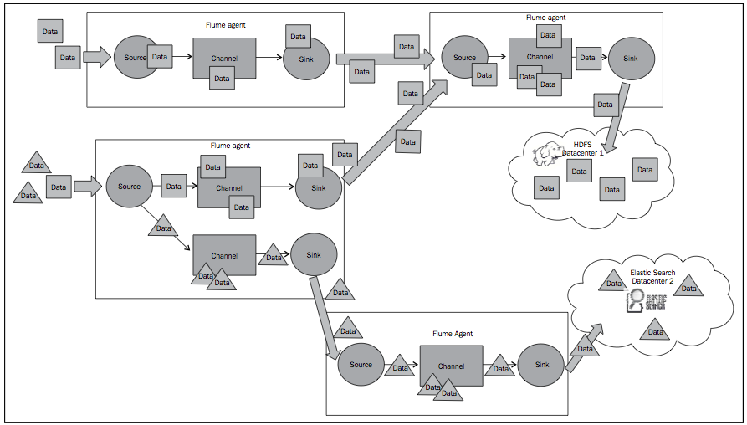

Slide 7
Quick Start
vi conf/hw.conf
agent.sources=s1
agent.channels=c1
agent.sinks=k1
agent.sources.s1.type=netcat agent.sources.s1.channels=c1 agent.sources.s1.bind=0.0.0.0 agent.sources.s1.port=12345 agent.channels.c1.type=memory agent.sinks.k1.type=logger agent.sinks.k1.channel=c1

Slide 8
Start the Agent
./bin/flume-ng agent -n agent -c conf -f conf/hw.conf -Dflume.root.logger=INFO,console
Notice the flume logs
Lets stream some logs
nc localhost 12345

Slide 9
Channels
Memory Channel
Disk Channel

Slide 10
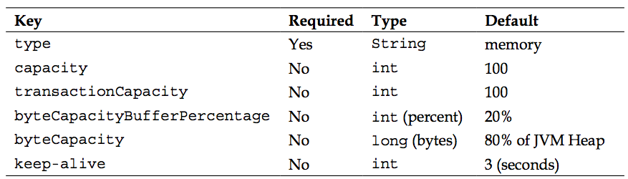
Memory Channel
Notes:
The default capacity of this channel is 100 Events. This can be adjusted by setting the capacity property as follows:
agent.channels.c1.capacity=200 Remember if you increase this value you may also have to increase your Java heap space using the -Xmx and optionally the -Xms parameters.
Another capacity related setting you can set is transactionCapacity. This is the maximum number of events that can be written, also called a put, by a source's ChannelProcessor, the component responsible for moving data from the source to the channel in a single transaction. This is also the number of events that can be read, also called a take, in a single transaction by SinkProcessor, the component responsible for moving data from the channel to the sink. You may want to set this higher to decrease the overhead of the transaction wrapper, which may speed things up. The downside to increasing this, in the event of a failure, is that a source would have to roll back more data.
The default capacity of this channel is 100 Events. This can be adjusted by setting the capacity property as follows:
agent.channels.c1.capacity=200 Remember if you increase this value you may also have to increase your Java heap space using the -Xmx and optionally the -Xms parameters.
Another capacity related setting you can set is transactionCapacity. This is the maximum number of events that can be written, also called a put, by a source's ChannelProcessor, the component responsible for moving data from the source to the channel in a single transaction. This is also the number of events that can be read, also called a take, in a single transaction by SinkProcessor, the component responsible for moving data from the channel to the sink. You may want to set this higher to decrease the overhead of the transaction wrapper, which may speed things up. The downside to increasing this, in the event of a failure, is that a source would have to roll back more data.

Slide 11
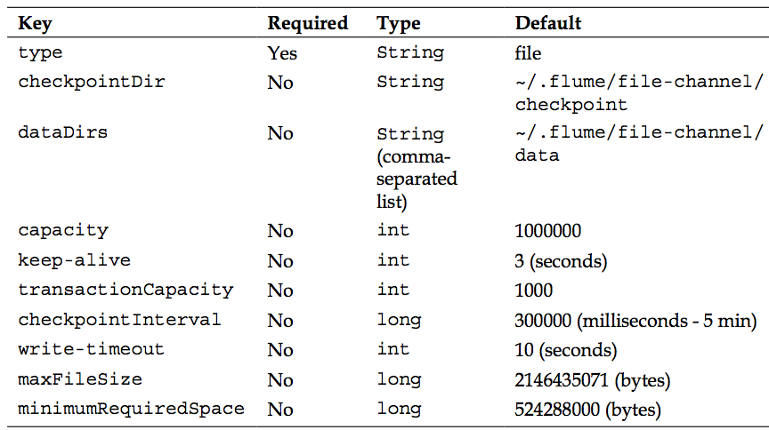
File channel

Slide 12
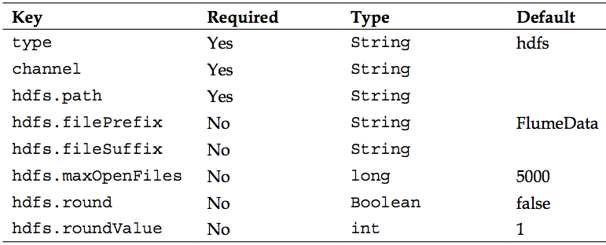
HDFS Sink

Slide 13
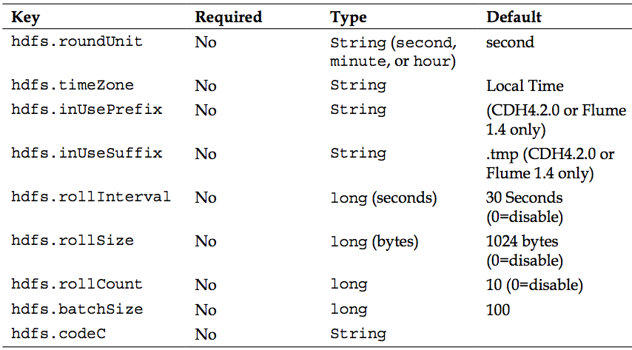
HDFS Sink

